Slide 1
CALCULATOR GAME
BY OLGA MAKAROVA

Slide 2
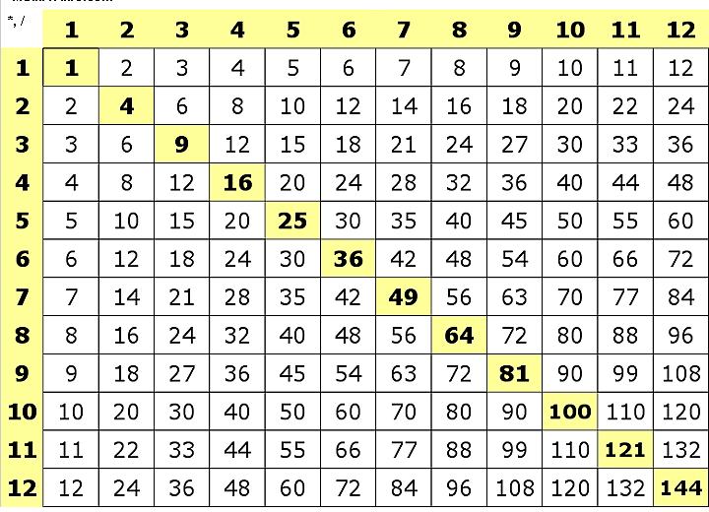
DESCRIPTION
THIS IS A SIMPLE GAME CHECKING USER’S KNOWLEDGE OF THE MULTIPLICATION TABLE.

Slide 3
NOTABLE FEATURES
This game is written in the bash scripting language.
Program name: calculator_game.sh
The program borrowed some logic from the scripts used in class.
The key feature is the timer. Every time the user gives an answer the program displays the time remaining. When the user is out of time the program stops the game.
The user is allowed to give only a limited number of incorrect answers.

Slide 4
OPTIONS
Game duration
Total number of correct attempts
Total number of incorrect attempts
Multiplication range

