Slide 1
THEORY OF CORPORATE FINANCE (FIN 412)
CAPITAL STRUCTURE & FIRM VALUE
BY
Dr. Peter N Amah
Department of Finance
University of Lagos

Slide 2
INTRODUCTION
LEARNING OBJECTIVE:
  To enable participants know how to determine a firm’s optimal long term financing trade-off strategy
WHERE DO WE START? - The balance sheet of a firm is typically composed of Assets (use of funds) on the left hand side and capital and liabilities (sources of funds) by the right hand side
  For simplicity, we are in this topic interested in long term component of the right hand side, and examining whether it is possible to alter its composition to produce the best possible value for the firm.
  Welcome to the exciting world of capital structure decisions

Slide 3
CONCEPTS, DEFINITIONS
Capital Structure may be defined as the composition of the different forms of long term capital used to finance a firm.
  Basically Equity, Debt and Preference capital.
  Capital structure decisions accordingly refer to decisions as to type and amount of a given form of permanent capital to use relative to other forms.
Is Financial Structure the same as Capital Structure?
  Financial structure examines the types and composition of all forms of capital used to fund a business ranging from short to long term. So apart from equity, debt and preference capital, others like overdrafts, short term loan, accounts payable, and accruals are active variables in financial structure decision
At the end, optimal capital structure (if it exists) is the target capital structure at which WACC is minimized and value maximized

Slide 4
THEORIES OF CAPITAL STRUCTURE
Key Questions for Theory:
  Does the way the firm chooses to finance its operations affect value?
  Does leverage matter?
Historically, these questions had stoked controversies which gave rise to two extreme views, namely:
  Net Income Theory
  Net Operating Income Theory

Slide 5
NET INCOME THEORY
This School Thought holds the extreme view that ‘leverage matters’ in the sense that decisions regarding sources of finance affects market value of the firm. It is founded on the following pillars:
1) Cost of debt is not affected by leverage
- Moreover, given its attributes, it is relatively lower
than cost of equity
2) Cost of equity is also not affected by leverage
- Shareholders do not see increase in leverage as a
factor to demand higher return from the firm
3) Accordingly, increased use of low cost debt will drive
weighted average cost of capital down.
Hence, WACC (kw) is a declining function while MV is an increasing function of leverage suggesting that it pays to increasingly use debt to finance the business. Infact it suggests that value is maximized at 100% leverage

Slide 6
NIT: GRAPHICAL REPRESENTAION

Slide 7
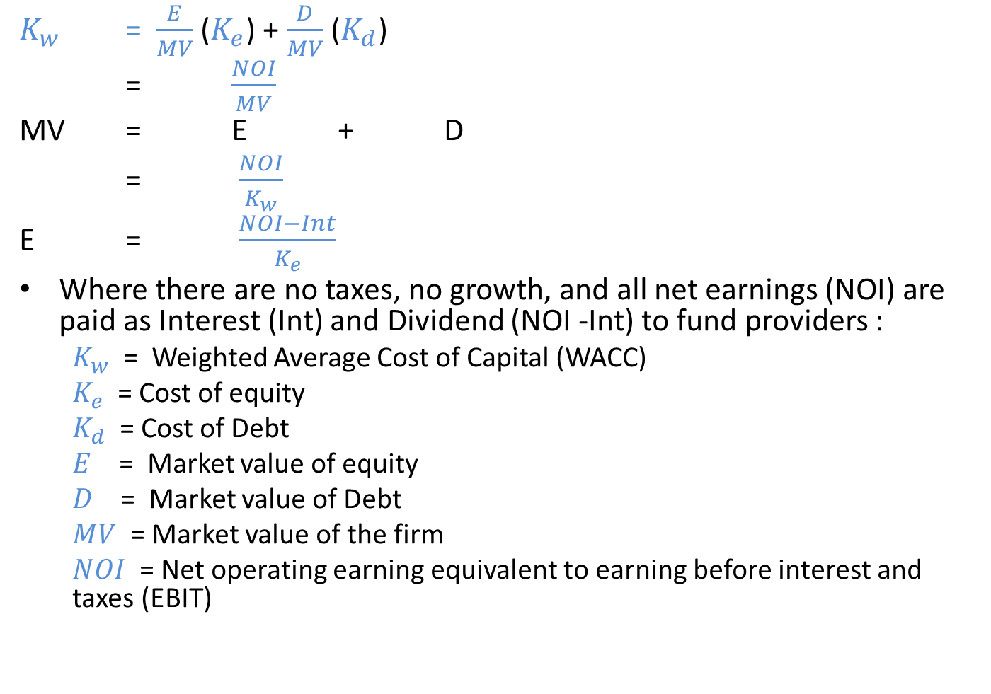
FORMULAE TO REMEMBER
$K_{w}$ = $\frac{E}{MV}$ ($K_{e}$) + $\frac{D}{MV}$ ($K_{d}$)
= $\frac{NOI}{MV}$
MV = E + D
= $\frac{NOI}{K_{w}}$
E = $\frac{NOI−Int}{K_{e}}$
Where there are no taxes, no growth, and all net earnings (NOI) are paid as Interest (Int) and Dividend (NOI -Int) to fund providers :
  $K_{w}$ = Weighted Average Cost of Capital (WACC)
  $K_{e}$ = Cost of equity
  $K_{d}$ = Cost of Debt
  $E$ = Market value of equity
  $D$ = Market value of Debt
  $MV$ = Market value of the firm
  $NOI$ = Net operating earning equivalent to earning before interest and taxes (EBIT)

Slide 8
NIT: ILLUSTRATION
Consider a firm, Net Income (Nig) Ltd with Net Operating Earning of N1.0billion, Cost of Equity of 16% and Interest Rate on Debt of 8%. The company takes capital structure decisions within the framework of Net Income Approach. The financial manager is considering three different levels of debt, N0.00. N1.00billion and N3.25billion respectively.
  What are the estimates of market values of the firm at the different levels of leverage?
  Determine WACC at each leverage level

Slide 9
NIT: SOLUTION
 | Leverage 1 | Leverage 2 | Leverage 3
NOI | 1,000,000,000 | 1,000,000,000 | 1,000,000,000
Interest on debt (8%) | (0) | (80,000,000) | (260,000,000)
Net Earning to shareholders (NE) | 1,000,000,000 | 920,000,000 | 740,000,000
Market value of equity, (E = NE/Ke) | 6,250,000,000 | 5,750,000,000 | 4,625,000,000
Market Value of Debt | 0 | 1,000,000,000 | 3,250,000,000
Market Value of the firm , MV = E+D | 6,250,000,000 | 6,750,000,000 | 7,875,000,000
KW (WACC) = (NOI/MV) | 16% | 14.81% | 12.70%
Note ke = NI/E | 16% | 16% | 16%
Kd | 8% | 8% | 8%
Note: Cost of Debt, cost of equity remained constant, WACCC declined just as market value of the firm increased

Slide 10
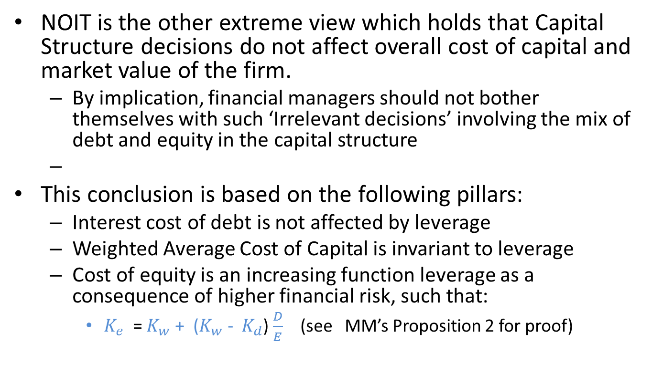
NET OPERATING INCOME THEORY
NOIT is the other extreme view which holds that Capital Structure decisions do not affect overall cost of capital and market value of the firm.
  By implication, financial managers should not bother themselves with such ‘Irrelevant decisions’ involving the mix of debt and equity in the capital structure
This conclusion is based on the following pillars:
  Interest cost of debt is not affected by leverage
  Weighted Average Cost of Capital is invariant to leverage
  Cost of equity is an increasing function leverage as a consequence of higher financial risk, such that:
    $K_{e}$ = $K_{w}$ + ($K_{w}$ - $K_{d}$) $\frac{D}{E}$ (see MM’s Proposition 2 for proof)

Slide 11
NOIT: GRAPHICAL REPRESENTATION

Slide 12
ILLUSTRATION
A firm, Net Operating Income (Nig) Plc Earnings Before Interest & Taxes of N1.0billion and this is expected to continue indefinitely. Meanwhile the firm is considering 3 capital structure options as follows
Debt Equity (Market)
Option 1 0 6,250,000,000
Option 2 1,000,000,000 5,250,000,000
Option 3 3,250,000,000 3,000,000,000
If interest cost of debt capital is 8%, determine the cost of equity, overall cost of capital and corresponding market values if the firm assumes net operating income framework as guiding principle. Assume no taxes and 100% dividend payout.

Slide 13
NOIT : SOLUTION
 | Option 1 | Option 2 | Option 3
EBIT | 1,000,000,000 | 1,000,000,000 | 1,000,000,000
Int (8%) | 0 | (80,000,000) | (260,000,000)
Net Income (NI) | 1,000,000,000 | 920,000,000 | 740,000,000
Ke = NI/E | 16% | 17.52% | 24.67%
Equity (E) | 6,250,000,000 | 5,250,000,000 | 3,000,000,000
Debt (D) | 0 | 1,000,000,000 | 3,250,000,000
Market Value (MV) | 6,250,000,000 | 6,250,000,000 | 6,250,000,000
WACC = NOI/MV | 16% | 16% | 16%
Kd | 8% | 8% | 8%
Observe that cost of debt, overall cost of capital and market value remained constant even as cost of equity increased

Slide 14
CAPITAL STRUCTURE: REFINEMENT OF THEORY
The Net Income and Net Operating Income Theories represent two extreme, albeit unrealistic, views on the relations between capital structure and market value of the firm. From these have arisen the more behavioural models that have shaped the thinking and decisions of financial managers across time. The two particularly popular but contradictory ones for review here are:
  TRADITIONAL OR TRADE-OFF THEORY
  MILLER & MODIGLIANI HYPOTHESIS
Other Theories of interest are:
  PECKING ORDER THEORY
  GROWTH OPPORTUNITIES

Slide 15
TRADE-OFF THEORY (TOT)
The central theses of TRADE-OFF THEORY is that ‘leverage matters’, and infact there is an optimal capital structure at which point weighted average cost of capital is minimized and market value of the firm maximized.
  This is the target capital structure every value-maximizing financial manager should aim to operate
Trade-off Theory is the mainstream view in corporate finance variously known with such names or descriptions as:
  Traditional theory
  Balancing theory
  U – Shaped theory
  Static Theory

Slide 16
TRADE-OFF THEORY

Slide 17
TRADE-OFF THEORY
It holds that as leverage is increased, initially, current holders of debt and equity would not have any reason to fear for their claims on the firm’s cashflow and hence costs of debt and equity remains constant.
  At this segment, which accords with Net Income Theory, use of debt to finance the business decreases WACC and increases market value.
  But then, use of debt cannot go on indefinitely.
OPTIMAL LEVERAGE: This point (L*) beyond which increased use of debt begins to cause reversal in WACC is the optimal point and is the point at which market value is maximized.
A further increase in debt beyond L* would lead to concerns on the ability of firm to meet obligations to providers of capital from expected cashflows.
  This financial risk will begin to drive up costs of debt and equity leading WACC to also go up. As a result, market value will begin to decline.

Slide 18
PRACTICE QUESTIONS
Explain three circumstances that lead WACC to maintain a declining trend prior to point of optimal leverage
Why would WACC increase after the point of optimal leverage?
What do you advise a value-maximizing firm to do between points zero and L*, and beyond L* in the TOT graph?
What happens at the point of optimal capital structure?
From what you now know, why do you think that Net Income and Net Operating Income Theories may not be true representations of capital structure behaviours of firms?

Slide 19
MILLER & MODIGLIANI IRRELEVANCE HYPOTHESES
Background:
  Sometime in the late 50’s, Merton Miller and Franco Modigliani (hereafter known as M&M) worked on the relationship between capital structure, cost of capital and value. This was a time when the mainstream view in finance held that there is added value in increasing the use of leverage to finance a firm due to obvious lower cost of debt and added tax benefits.
  M&M startled the world of finance with a conclusion that ‘Leverage does not matter’ – meaning that capital structure decisions do not have effect on value of the firm. They were able to do this with the aid of certain propositions and some restrictive capital market assumptions for which they were widely criticized

Slide 20
MM PROPOSITION 1
PROPOSITION 1
  “Market value of any firm is independent of its capital structure and is given by capitalizing its expected return at the rate appropriate to its risk class”.
    Accordingly, two firms, unlevered firm (u) and levered firm (L). which are identical in every sense of operating assets and cashflows except for mix of funding would have the same value.
    It is follows, by implication, that investment and financing decisions can be taken independently
However this proposition is built on a number of restrictive perfect market-like assumptions

Slide 21
M&M ASSUMPTIONS
Individuals can borrow on the same terms as the corporation (at riskless rate)
There is absence of transaction costs
There are no taxes
There are no agency and bankruptcy costs
Information is freely and generally available (no information asymmetry)
All cashflow streams are perpetuities

Slide 22
THREE KEY EXPLANATIONS OF M&M HYPOTHESIS:
(Pie model, Home made leverage & Arbitrage)
PIE MODEL: The values created by levered or unlevered firm is likened to a pie, which irrespective of how it is sliced between providers of finance remains the same.

Slide 23
HOME-MADE LEVERAGE (HML)
There is nothing special about corporate leverage. Using borrowing and lending, the individual shareholder can replicate the same so-called advantages of leverage using home made leverage. The mechanics can go as follows for a shareholder in an unlevered firm:
  He sells a portion of his holding, say 50%
  He borrows to buy equivalent amount of shares in the firm at same interest cost the firm borrows
  With this he is able to achieve the same earning performance as the equivalent levered firm. This can be shown by way of illustration

Slide 24
HML: ILLUSTRATION
Unlevered Coy Ltd has no debt with a total asset base of N8.0billion. It has 1.0billion ordinary shares outstanding each priced at N8.00 by the market. Following expert advice, the company proposes to re-leverage its balance sheet by borrowing N4.0billion at interest cost of 10% with intention to engage in share buyback of equivalent amount. Meanwhile Net Operating earning is expected to be N1.0billion and perfect market conditions exist. Required:
Show by way of Return on Equity and Earning per share whether the proposed re-leveraging exercise will be beneficial to the firm
Show by way of home-made leverage whether this balance sheet re-structuring is an important consideration in creating value for the shareholder who currently holds 10% of the company’s shares.

Slide 25
SOLUTION A - HML
 | With Current capital structure | With Proposed Capital Structure
Debt | - | 4,000,000,000
Equity (E) | 8,000,000,000 | 4,000,000,000
Total Asset/Liability | 8,000,000,000 | 8,000,000,000
No of ordinary shares (n) | 1,000,000,000 | 500,000,000
NOI | N1,000,000,000 | N1,000,000,000
Less Int (10%) | - | (N400,000,000)
Net Income (NI) | N1,000,000,000 | (N600,000,000)
ROE = NI/E | 12.5% | 15%
EPS = NI/n | N1.00 per share | N1.20 per share
Computation shows potential increase in earning ‘performance’ measures used here

Slide 26
HML: SOLUTION B
 | Current Personal Capital Structure | Proposed Personal Capital Structure
Debt | - | N400,000,000
Equity (E) | N800,000,000 | N400,000,000
Total Asset/Liability | N800,000,000 | N800,000,000
No of shares (n) | 100,000,000 | 50,000,000
Share of Net Income (10%) | N100,000,000 | N100,000,000
Less Int (10% on debt) | - | (N40,000,000)
Net Income (NI) | N100,000,000 | N60,000,000
ROE = NI/E | 12.5% | 15%
EPS = NI/n | N1.00 per share | N1.20 per share
The simple ROE and EPS Computation shows that the individual shareholder is able to achieve same performance as the firm. Hence no special value is created by corporate leverage

Slide 27
ARBITRAGE
Arbitrage means simultaneous purchase and sale of asset to take advantage of price differential in same or different markets
According to MM, if two firms. Levered (L) and Unlevered (U) in the same risk class with identical operating results but for differences in funding mix, have different market values, the forces of arbitrage will simultaneously and instantaneously generate buy and sell orders on them to ensure they have same equilibrium market value
  Arbitrageurs will continue to sell ‘overvalued levered firm and buy ‘undervalued' unlevered firm until equilibrium price is achieved between the two.

Slide 28
ILLUSTRATION - ARBITRAGE
Consider two firms, Levered Plc and Un-Levered Plc with following financial Information; Levered Plc has 8% debt of N840million and shareholders fund of N5.41billion. Unlevered Plc has equity value of N6.25billion. Assuming the two firms has an estimate of N1.0billion Net Operating Earning earning before interest and taxes and constant cost of equity of 16% as argued by the Relevance School;
Required:
Show that market values of the two firms would differ
Using the case of Mr Arbitrage who owns 10% equity in the levered firm, demonstrate that this differential in value cannot subsist in the MM’s world.

Slide 29
SOLUTION A - ARBITRAGE
 | Unlevered Plc | Levered Plc
NOI | N1,000,000,000 | N1,000,000,000
Less Int (8%) | -- | (N67,200,000)
Net Earning (NI) | N1,000,000,000 | N932,800,000
Market Value of equity = NI/ke | N6250,000,000 | 5,825,000,000
Market value of debt | - | N840,000,000
Total Firm value | N6,250,000,000 | N6,665,000,000
As a result of leverage, market value of Levered Coy Plc is now higher than that of Unlevered Plc

Slide 30
SOLUTION B - ARBITRAGE
Lets consider if profit opportunity exists for Mr Arbitrage if he sells his shares in Levered Plc, and borrows the difference to buy equivalent 10% of unlevered Plc.
Mr Arbitrage sells his entire 10% holding in levered Plc for N582.5million, borrows N42.5million being balance required to buy 10% of the Unlevered firm being N625million.
 | Current Investment in Levered Plc | Investment in Unlevered Plc
Share of Net Earning (10%) | N93,200,000 | N100,000,000
Less int on borrowed diff (8%) | - | N3,400,000
Net Income | N93,200,000 | N96,600,000

Slide 31
SOLUTION B: ARBITRAGE
With profit opportunity of N3.4million, ie (N96.6m – N93.2m), sales pressures will drive down price of levered firm while buy pressures will drive up price of unlevered firm until equilibrium is reached.
  Given perfect market assumptions, this arbitrage process is an instantaneous process which practically renders leverage irrelevant in determining values of firms

Slide 32
MM Vs RISK
If probability of bankruptcy is considered, does the M&M world still consider value invariant to leverage?
Yes, they believe that risk of ruin will only lead to increase in cost of equity in line with postulations of the Net Income theory. This gave rise to their famed proposition ll

Slide 33
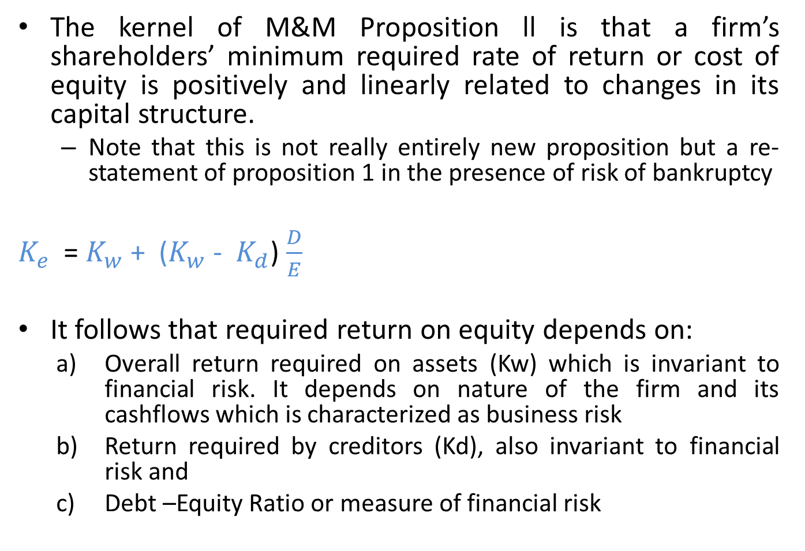
PROPOSITION ll
The kernel of M&M Proposition ll is that a firm’s shareholders’ minimum required rate of return or cost of equity is positively and linearly related to changes in its capital structure.
  Note that this is not really entirely new proposition but a re-statement of proposition 1 in the presence of risk of bankruptcy
$K_{e}$ = $K_{w}$ + ($K_{w}$ - $K_{d}$) $\frac{D}{E}$
It follows that required return on equity depends on:
  Overall return required on assets (Kw) which is invariant to financial risk. It depends on nature of the firm and its cashflows which is characterized as business risk
  Return required by creditors (Kd), also invariant to financial risk and
  Debt –Equity Ratio or measure of financial risk

Slide 34
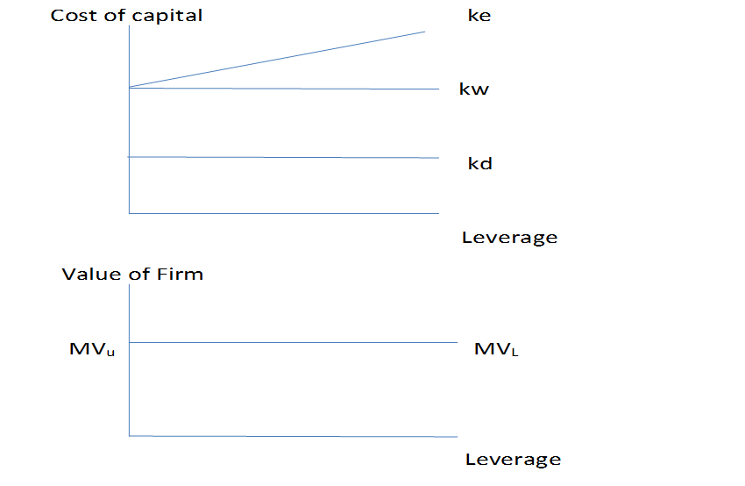

MM, REGRAPHING NOIT

Slide 35
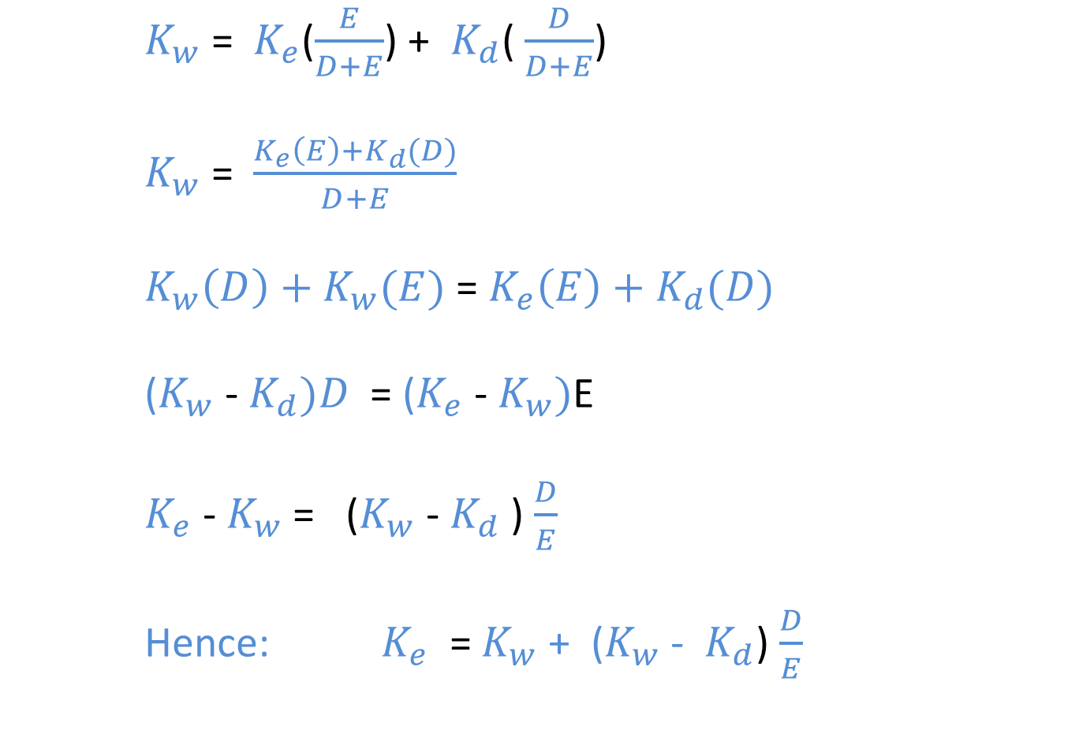
DERIVING PROPOSITION ll
$K_{w}$ = $K_{e}$($\frac{E}{D+E}$) + $K_{d}$( $\frac{D}{D+E}$)
$K_{w}$ = $\frac{K_{e}\left(E\right)+K_{d}(D)}{D+E}$
$K_{w}\left(D\right)+K_{w}(E)$ = $K_{e}\left(E\right)+K_{d}(D)$
($K_{w}$ - $K_{d})D$ = ($K_{e}$ - $K_{w})$E
$K_{e}$ - $K_{w}$ = ($K_{w}$ - $K_{d}$ ) $\frac{D}{E}$
Hence: $K_{e}$ = $K_{w}$ + ($K_{w}$ - $K_{d}$) $\frac{D}{E}$

Slide 36
CRITICISMS OF M&M PROPOSITION 1
UNREALISTIC ASSUMPTIONS regarding perfect market does not have sufficient practical appeal
  Arbitrage is constrained in the presence of transaction costs and information asymmetry
  Initially ignoring risk and bankruptcy costs is unexplainable.. Moreover, Individuals and firms exist in different risk profiles and will hardly borrow and lend at same riskless rate making home made leverage implausible.
  Companies rarely have perpetual cashflow series
  As governments exist, tax is inevitable

Slide 37
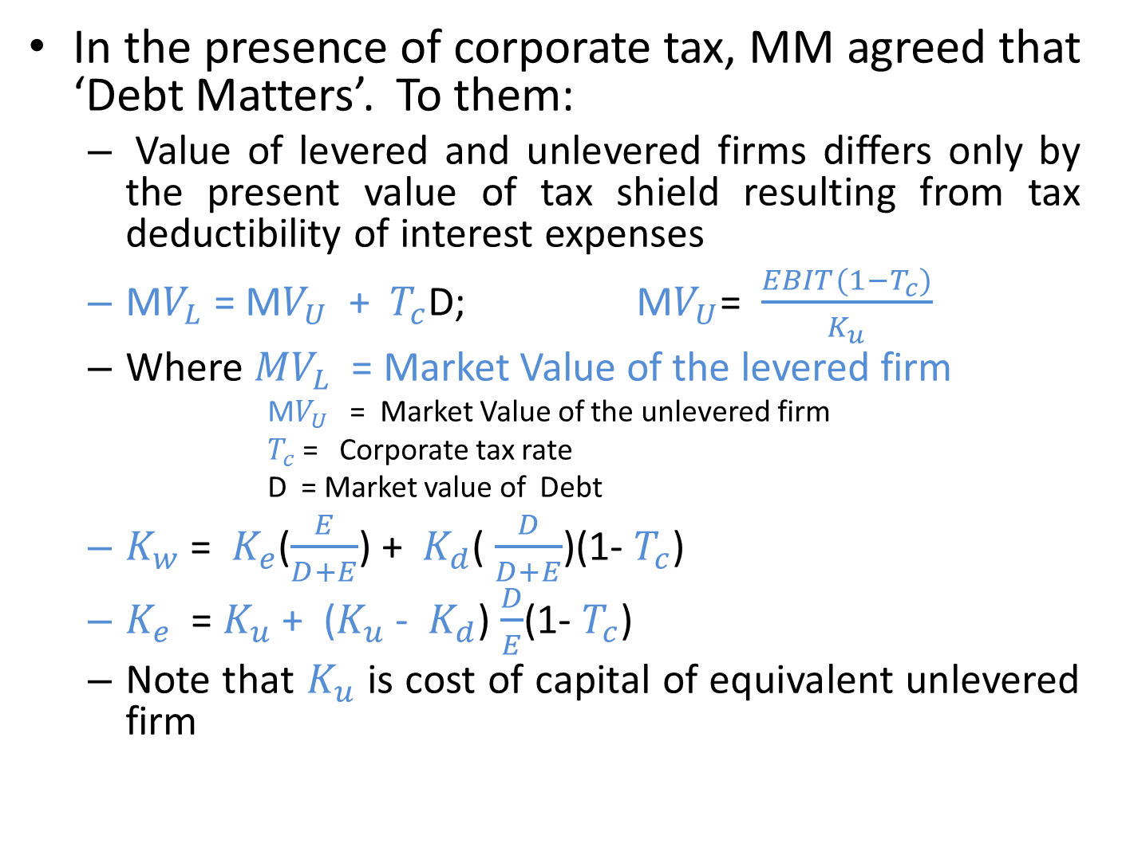
MM & CORPORATE TAXES
In the presence of corporate tax, MM agreed that ‘Debt Matters’. To them:
  Value of levered and unlevered firms differs only by the present value of tax shield resulting from tax deductibility of interest expenses
  M$V_{L}$ = M$V_{U}$ + $T_{c}$D; M$V_{U}$= $\frac{EBIT(1−T_{c})}{K_{u}}$
  Where ${MV}_{L}$ = Market Value of the levered firm
        M$V_{U}$ = Market Value of the unlevered firm
        $T_{c}$ = Corporate tax rate
        D = Market value of Debt
  $K_{w}$ = $K_{e}$($\frac{E}{D+E}$) + $K_{d}$( $\frac{D}{D+E}$)(1- $T_{c}$)
  $K_{e}$ = $K_{u}$ + ($K_{u}$ - $K_{d}$) $\frac{D}{E}$(1- $T_{c}$)
  Note that $K_{u}$ is cost of capital of equivalent unlevered firm

Slide 38
M&M WITH CORPORATE TAX

Slide 39
M&M: ILLUSTRATION
(with tax)
Golden Age Plc has 100m ordinary shares of N1.00 nominal value per share, 15% N100m 10 year debenture maturing in 5 years but trading at par in the market, and current earning before interest & taxes of N25m. Given MM’s proposition ll in the presence of corporate tax rate of 30%, equivalent unlevered cost of capital of 11%,
Required:
Determine minimum required return on equity of the levered firm
Determine the required rate of return to discount the levered firm’s new projects

Slide 40
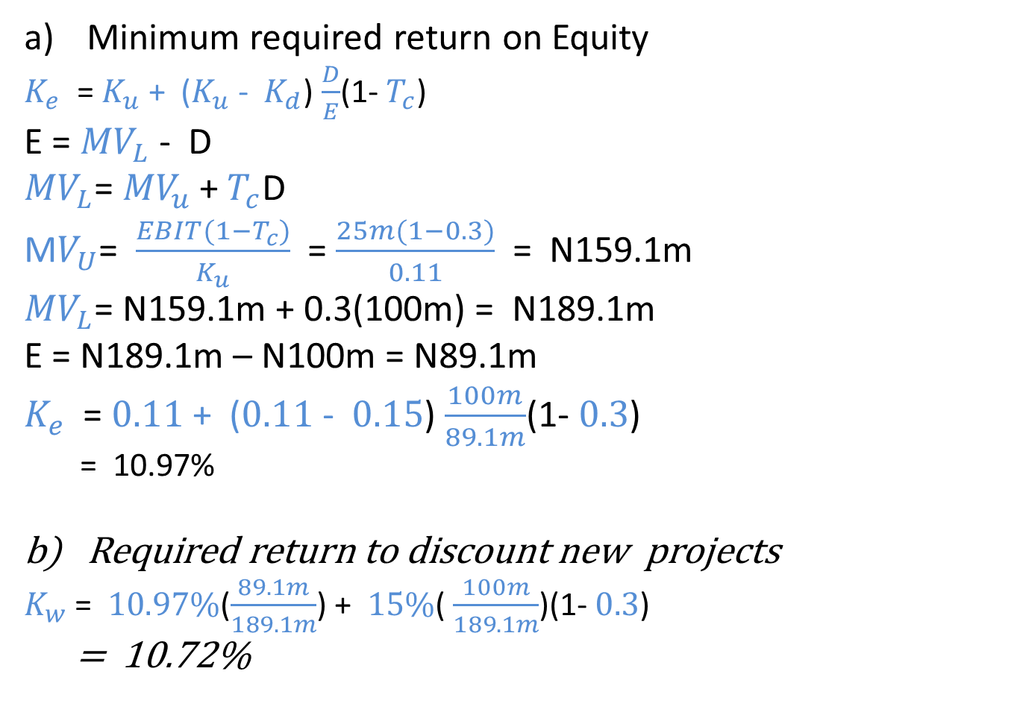
M&M: ILLUSTRATION
(with tax)
Minimum required return on Equity
  $K_{e}$ = $K_{u}$ + ($K_{u}$ - $K_{d}$) $\frac{D}{E}$(1- $T_{c}$)
E = ${MV}_{L}$ - D
${MV}_{L}$= ${MV}_{u}$ +${ T}_{c}$D
M$V_{U}$= $\frac{EBIT(1−T_{c})}{K_{u}}$ = $\frac{25m(1−0.3)}{0.11}$ = N159.1m
${MV}_{L}$= N159.1m + 0.3(100m) = N189.1m
E = N189.1m – N100m = N89.1m
$K_{e}$ = $0.11$ + ($0.11$ - $0.15$) $\frac{100m}{89.1m}$(1- $0.3$)
  = 10.97%
Required return to discount new projects
  $K_{w}$ = $10.97\%$($\frac{89.1m}{189.1m}$) + $15\%$( $\frac{100m}{189.1m}$)(1- $0.3$)
= 10.72%

