Slide 1
DIVIDEND POLICY DECISIONS
By
Dr. Peter N Amah
Department of Finance
University of Lagos

Slide 2
STUDY GUIDE
NOTE:
The contents of this material may be used for study by:
  final year undergraduate students
  Post-Graduate Diploma Students
  MBF, MDF, MBA & M.Sc. students
However, the following topic extensions are exclusively for:
  M.Sc. Students:
    Multi-stage dividend model,
    Mathematical Proof of M&M Dividend Irrelevance Views
    Students are also expected to explore framework of each equation
  MBA, MBF & MDF Students:
    Case Study
    Survey of dividend payments of companies listed in NSE

Slide 3
LECTURE OBJECTIVES
To enable students understand the meaning of dividend, dividend policy and other ways companies return cash to shareholders
To enable students know whether dividend policy decision is a value maximizing exercise
  Appreciate when investors are likely to prefer cash dividend to capital gains, and vice versa
  Appreciate the views of different schools of thought regarding policy and value
To evaluate real life dividend policy case to internalize the above theories, models and concepts

Slide 4
INTRODUCTION:
Definitions, Concepts
Dividend in a general sense refers to payment made to shareholders from earning and capital as a reward for investment made in the shares of the company
  Some authors have defined it within the narrow context of cash payment from earning made by a company
  Cash distribution out of capital may be subject to strict regulation from regulatory authorities
Dividend Policy is a formal guide of a firm’s corporate behaviour in determining the type, amount and timing of dividend payment to shareholders

Slide 5
KEY POINTS, DATES & PROCEDURES TO NOTE
Dividend declaration is down to decision of the Board while shareholders approve
Decision to pay dividend is in practice simultaneously a dividend and financing decision
Declaration Date: The date directors pass a resolution proposing a dividend
Date of Record: The date in which all shareholders whose names appear in the books of the company are entitled to dividend

Slide 6
KEY POINTS, DATES & PROCEDURES TO NOTE
Ex Div. Date: A date at or after which any buyer of shares will not be entitled to dividend. Date of Record is normally set a few days after this date to enable the Registrar update the books. During the period, the books may be closed
Payment Date: This is the date in which dividend warrants are prepared and dispatched to shareholders of Record
In an efficient market, no one is expected to abnormally profit from price movements purely as a result of dividend declaration and payment

Slide 7
TYPES OF DIVIDEND
CASH DIVIDEND
  Regular cash dividend
  Special & extra cash dividend
  Liquidating cash dividend

Slide 8
TYPES OF DIVIDEND
STOCK DIVIDEND
  Scrip or Bonus dividend: In this case, instead of cash, additional shares are ‘paid’ to shareholders on the basis of existing holdings. This may be used to ‘appease’ shareholders when cash can not be paid. Note however that where scrip are issued;
    Total number of shares would increase
    Book value of the firm remains unchanged
    Market value of the firm remains unchanged
    Nominal price per share remains unchanged
    But market price per share is adjusted downwards

Slide 9
TYPES OF DIVIDEND
  Stock Split: This a situation where existing shares are split such that a shareholder receives increased quantity of shares of lower unit value in exchange. When a stock is split;
    Total number of shares increases
    Book value of the firm remains unchanged
    Market value of the firm remains unchanged
    Market price & nominal value per share are reduced proportionately

Slide 10
OTHER TYPES OF DIVIDEND
  Reverse Split: This occurs when “Consolidation” of shares takes place to reduce the number of shares outstanding and increase per-unit value
  Why firms may split shares or do reverse split (logical and illogical)
    When market price is considered too expensive or low
    Regulatory requirement for public listing in some jurisdictions
    Merger & acquisition negotiations
    To reduce cost of printing in the case of reverse splits
  Note that like cash dividends, bonuses and splits, on their own, do not add value to the firm in well functioning markets

Slide 11
OTHER TYPES OF DIVIDENDS
SHARE REPURCHASES: Though not dividend, in the conventional meaning, it is another way firms may choose to return money to shareholders. It involves a buy back of shares held by shareholders for cash.
Effects of corporate action:
  Reduction in number of shares outstanding
  Reduction in asset of cash in the company
  Reduction in equity capital
Why firms may repurchase shares:
  When the firm has excess cash relative to positive NPV opportunities
  When capital gains tax advantage exist for shareholders
  When there exists restrictions on dividend payment
  When the firm targets a certain debt/equity ratio
  Though hardly a valid economic justification, a firm may seek to repurchase shares to manage share glut and improve per share performance data.

Slide 12
ILLUSTRATION 1
Equity Nig. Ltd has the following capital structure before declaring stock dividend of 1 for every 5 previously held in 2020.
  Paid up ordinary shares of N1.00 per share N100m
  5% debenture 2028 20m
  Reserves 50m
  170m
  The shares were selling at N1.20 per share in the market.
  Required:
  a) what is the post stock dividend market price?
  b) How would the capital structure look like after stock dividend payment?

Slide 13
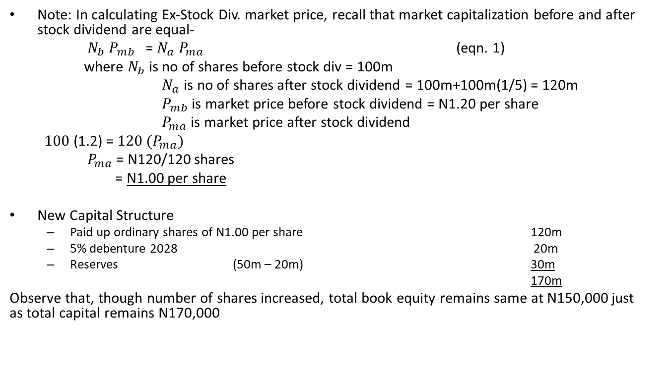
ILLUSTRATION
Solutions on scrip issue
Note: In calculating Ex-Stock Div. market price, recall that market capitalization before and after stock dividend are equal-
$N_{b}$ $P_{mb}$ = $N_{a} P_{ma}$ (eqn. 1)
where $N_{b}$ is no of shares before stock div = 100m
$N_{a}$ is no of shares after stock dividend = 100m+100m(1/5) = 120m
$P_{mb}$ is market price before stock dividend = N1.20 per share
$P_{ma}$ is market price after stock dividend
$100$ (1.2) = $120 {(P}_{ma})$
$P_{ma}$ = N120/120 shares
= N1.00 per share
New Capital Structure
  Paid up ordinary shares of N1.00 per share 120m
  5% debenture 2028 20m
  Reserves (50m – 20m) 30m
  170m
Observe that, though number of shares increased, total book equity remains same at N150,000 just as total capital remains N170,000

Slide 14
ILLUSTRATION 2
Equity Nig. Plc has the following capital structure before undertaking a stock split of 2:1 in 2020:
  Paid up ordinary shares of N1.00 per share N100m
  5% debenture 2028 20m
  Reserves 50m
  170m
  The shares were selling at N1.20 per share in the market. Required:
  Determine market price per share
  Determine nominal price per share
  Determine the new capital structure

Slide 15
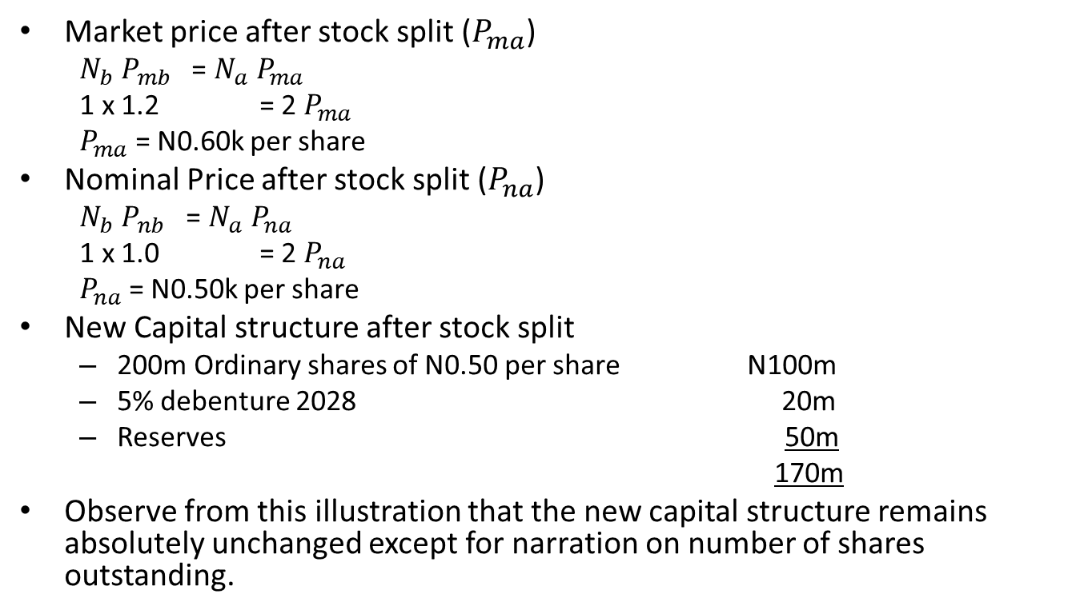
ILLUSTRATION
Solution on stock split
Market price after stock split ($P_{ma}$)
  $N_{b}$ $P_{mb}$ = $N_{a} P_{ma}$
  1 x 1.2 = 2 $P_{ma}$
  $P_{ma}$ = N0.60k per share
Nominal Price after stock split ($P_{na}$)
  $N_{b}$ $P_{nb}$ = $N_{a} P_{na}$
  1 x 1.0 = 2 $P_{na}$
  $P_{na}$ = N0.50k per share
New Capital structure after stock split
  200m Ordinary shares of N0.50 per share N100m
  5% debenture 2028 20m
  Reserves 50m
  170m
Observe from this illustration that the new capital structure remains absolutely unchanged except for narration on number of shares outstanding.

Slide 16
FACTORS AFFECTING DIVIDEND POLICY
AVAILABLE INVESTMENT OPPORTUNITIES & FINANCING OPTIONS
CLIENTELLE CONSIDERATION : Managers should consider shareholder preferences for immediate cash or capital gains. Tax status of shareholders may be important consideration
LEGAL CONSIDERATION: Governments may enact laws or regulations restricting dividend payments to-
  Ensure growth targets of the economy are met
  Limit dividend repatriation
  Strengthen capital base of critical sectors of the economy

Slide 17
FACTORS AFFECTING DIVIDEND POLICY
BOND INDENTURE PROVISIONS: Managers should consider covenants with creditors to avoid unpleasant situations
AGENCY PROBLEMS & MONITORING COSTS: Existence of information asymmetry between managers and external shareholders creates opportunity for expropriation of shareholder’s wealth.
  Dividend may be used as a monitoring mechanism to reduce agency conflict
SIGNALLING EFFECT: Managers can use dividend as information bundle to communicate private information to critical publics of the firm and create the best possible announcement effect. They must however consider-
  Whether dividend is leading indicator of future earning
  What investors decode from reduction or increases in dividends

Slide 18
FACTORS AFFECTING DIVIDEND POLICY
EARNING:
  Past earning
  Current earning
  Future earning
SUSTAINABILITY: Managers always try to adopt policies that stand the test of time. Hence such stable payout forms as-
  Constant dividend amount
  Constant payout ratio
  Steadily incremental payout ratio

Slide 19
DIVIDEND POLICY MODELS
The key questions in modeling dividend policy decisions include:
Do shareholders prefer to be rewarded by way of cash dividend or capital gain
Does dividend policy matter? Does it have any impact on value of the firm or wealth of shareholders?

Slide 20
DIVIDEND POLICY: SCHOOLS OF THOUGHT
TRADITIONAL VIEWS OF DIVIDEND RELEVANCE
  Traditional Right
  Radical Right
DIVIDEND IRRELEVANCE
  Residual theory
  Miller & Modigliani Theorem

Slide 21
TRADITIONAL RIGHT VIEWS
Dividend Policy matters, and infact, the higher the dividend payout ratio, the higher the market value of the firm
This implies that shareholders are prepared to pay higher premium for higher payout ratio
This is based on the legendary bird-in-hand argument since cash dividend is assumed to be less risky than potential capital gain

Slide 22
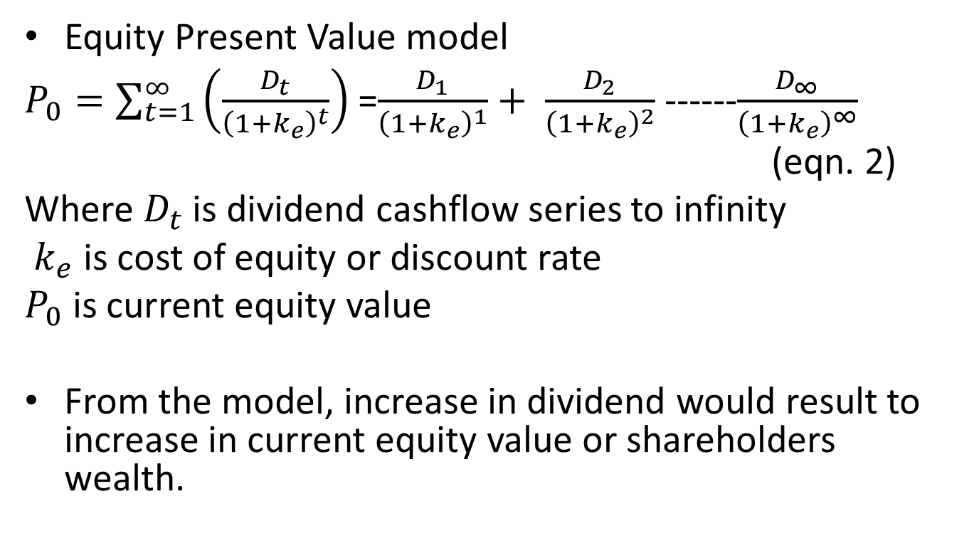
TRADITIONAL RIGHT MODELS
Equity Present Value model
$P_{0}=\sum_{t=1}^{∞}{\left(\frac{D_{t}}{{\left(1+k_{e}\right)}^{t}}\right)}$ =$\frac{D_{1}}{{\left(1+k_{e}\right)}^{1}}+ \frac{D_{2}}{{\left(1+k_{e}\right)}^{2}}$ ------$\frac{D_{∞}}{{\left(1+k_{e}\right)}^{∞}}$
(eqn. 2)
Where $D_{t}$ is dividend cashflow series to infinity
$k_{e}$ is cost of equity or discount rate
$P_{0}$ is current equity value
From the model, increase in dividend would result to increase in current equity value or shareholders wealth.

Slide 23
RADICAL LEFT VIEWS
Dividend policy matters, in the manner that the lower the dividend payout or higher earning retention, the higher the market value of the firm.
This implies that shareholders are prepared to pay higher premium for firms that retain more of their earning in the business
This is typically true for growth firms where rate of return is higher than cost of capital
It is supported within the tax state preference framework where key shareholders would prefer to be rewarded by way of capital gain

Slide 24
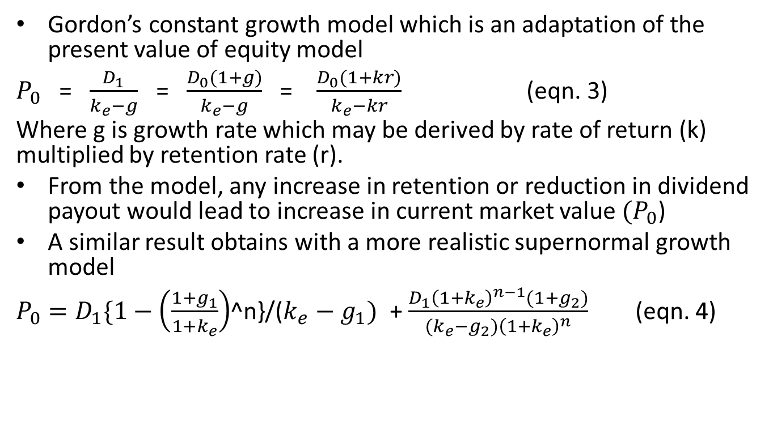
RADICAL LEFT MODELS
Gordon’s constant growth model which is an adaptation of the present value of equity model
$P_{0}$ = $\frac{D_{1}}{k_{e}−g}$ = $\frac{D_{0}(1+g)}{k_{e}−g}$ = $\frac{D_{0}(1+kr)}{k_{e}−kr}$ (eqn. 3)
Where g is growth rate which may be derived by rate of return (k) multiplied by retention rate (r).
From the model, any increase in retention or reduction in dividend payout would lead to increase in current market value ${(P}_{0}$)
A similar result obtains with a more realistic supernormal growth model
$P_{0}=D_{1}\{1−\left(\frac{1+g_{1}}{1+k_{e}}\right)$^n}/($k_{e}−$ $g_{1})$ + $\frac{D_{1}{\left(1+k_{e}\right)}^{n−1}(1+g_{2})}{{(k_{e}−g_{2})\left(1+k_{e}\right)}^{n}}$ (eqn. 4)

Slide 25
MILLER & MODIGLIANI IRRELEVANCE THEOREM (1961)
The core of M&M Thesis is that value of the firm is independent of how a firm decides to distribute its net earning between retained earning for new investments and cash dividend (Proposition 3). This implies that:
  Dividend policy does not matter
  Dividend policy is independent of investment and financing decision decisions
  Two firms in the same risk class having the same operations would have identical value.

Slide 26
M & M ASSUMPTIONS
Information is freely and cost-lesslly available
There are no taxes and transaction costs
There is certainty as to investment decisions and resulting earnings
Investors can borrow and lend at same rate.
Investors are rational and indifferent between capital gains and equivalent cash dividends
Excess cash can only be invested as zero NPV projects
If these assumptions hold , it implies that in equilibrium ,
Rate of return will be equal to cost of capital.
Firms may decide to pay all earning as dividend without affecting ability of the firm to take on new projects, or, retain all the earning without compromising wealth of investors. This further implies that:
  Investors can use borrowing and lending to, in place of retention and cash dividend, sustain their wealth or value

Slide 27
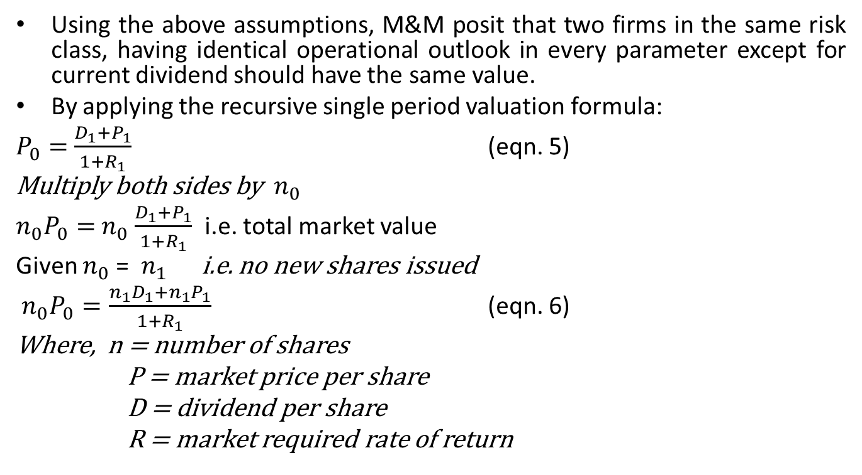
MILLER & MODIGLIANI THEOREM
Using the above assumptions, M&M posit that two firms in the same risk class, having identical operational outlook in every parameter except for current dividend should have the same value.
By applying the recursive single period valuation formula:
$P_{0}=$ $\frac{D_{1}+P_{1}}{1+R_{1}}$ (eqn. 5)
Multiply both sides by $n_{0}$
$n_{0}P_{0}=$ $n_{0}$ $\frac{D_{1}+P_{1}}{1+R_{1}}$ i.e. total market value
Given $n_{0}$ = $n_{1}$ i.e. no new shares issued
$n_{0}P_{0}=\frac{n_{1}D_{1}+{n_{1}P}_{1}}{1+R_{1}}$ (eqn. 6)
Where, n = number of shares
P = market price per share
D = dividend per share
R = market required rate of return

Slide 28
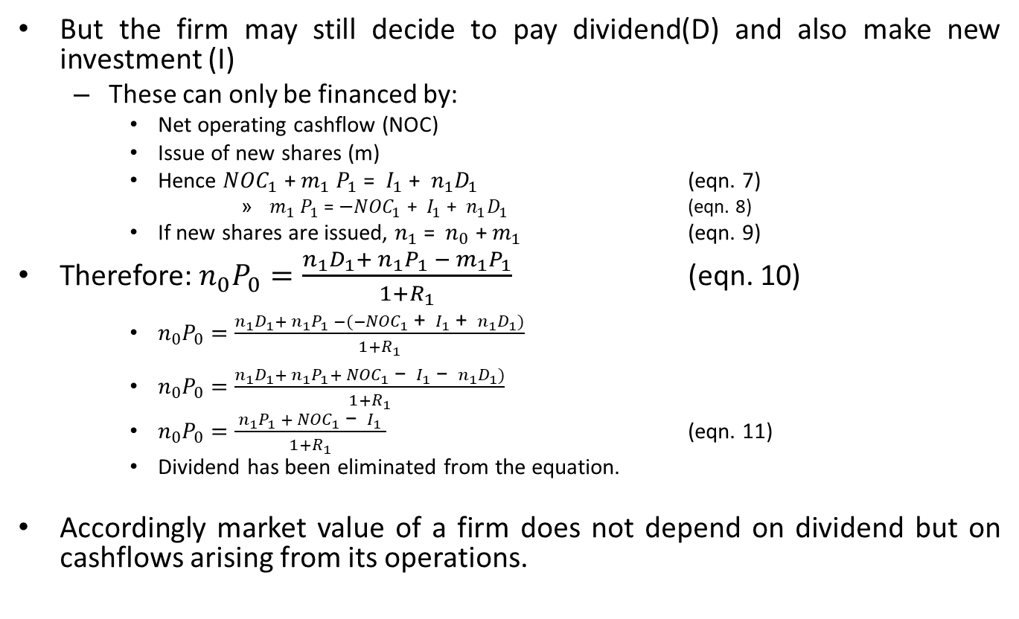
MILLER & MODIGLIANI THEOREM
But the firm may still decide to pay dividend(D) and also make new investment (I)
  These can only be financed by:
    Net operating cashflow (NOC)
    Issue of new shares (m)
    Hence ${NOC}_{1}$ + $m_{1}$ $P_{1}$ = $I_{1}$ + $n_{1}D_{1}$ (eqn. 7)
        $m_{1}$ $P_{1}$ = $−{NOC}_{1}$ + $I_{1}$ + $n_{1}D_{1}$ (eqn. 8)
    If new shares are issued, $n_{1}$ = $n_{0}$ + $m_{1}$ (eqn. 9)
Therefore: $n_{0}P_{0}=\frac{n_{1}D_{1}+ {n_{1}P}_{1} − m_{1}P_{1}}{1+R_{1}}$ (eqn. 10)
    $n_{0}P_{0}=\frac{n_{1}D_{1}+ {n_{1}P}_{1} −(−{NOC}_{1}\text{ + }I_{1}\text{ + }n_{1}D_{1})}{1+R_{1}}$
    $n_{0}P_{0}=\frac{n_{1}D_{1}+ {n_{1}P}_{1}+ {NOC}_{1} \text{−} I_{1} \text{−} n_{1}D_{1})}{1+R_{1}}$
    $n_{0}P_{0}=\frac{ {n_{1}P}_{1} + {NOC}_{1} \text{−} I_{1} }{1+R_{1}}$ (eqn. 11)
    Dividend has been eliminated from the equation.
Accordingly market value of a firm does not depend on dividend but on cashflows arising from its operations.

Slide 29
ILLUSTRATION 3
Durella Ltd’s financial statement shows share capital of N100,000 nominal value of N1.00 per share. Net operating income is estimated to be N300,000. Meanwhile the company has an investment opportunity of N500,000 for which new shares can be issued at par to finance it. Given the assumptions of Miller & Modigliani and company’s cost of capital of 10%, prove that dividend policy is irrelevant to the firm’s financial management decisions.

Slide 30
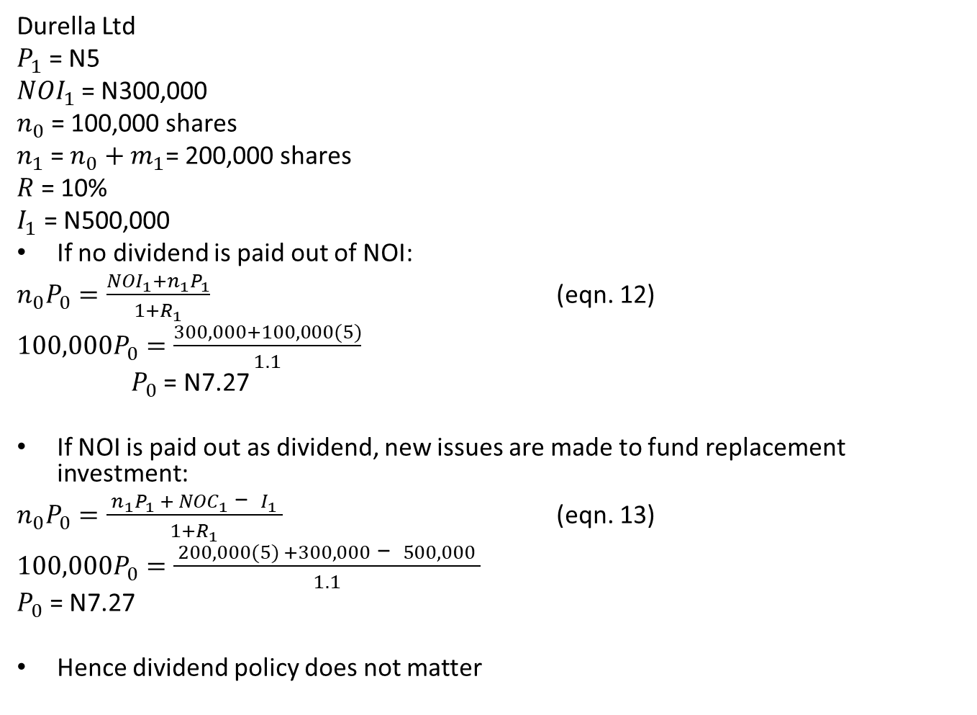
ILLUSTRATION
Durella Ltd
$P_{1}$ = N5
${NOI}_{1}$ = N300,000
$n_{0}$ = 100,000 shares
$n_{1}$ = $n_{0}$ ${+ m}_{1}$= 200,000 shares
$R$ = 10%
$I_{1}$ = N500,000
If no dividend is paid out of NOI:
$n_{0}P_{0}=\frac{{NOI}_{1}+{n_{1}P}_{1}}{1+R_{1}}$ (eqn. 12)
$100,000P_{0}=\frac{300,000+100,000(5)}{1.1}$
$P_{0}$ = N7.27
If NOI is paid out as dividend, new issues are made to fund replacement investment:
$n_{0}P_{0}=\frac{ {n_{1}P}_{1} + {NOC}_{1} \text{−} I_{1} }{1+R_{1}}$ (eqn. 13)
$100,000P_{0}=\frac{ 200,000(5) +300,000 \text{−} 500,000 }{1.1}$
$P_{0}$ = N7.27
Hence dividend policy does not matter

Slide 31
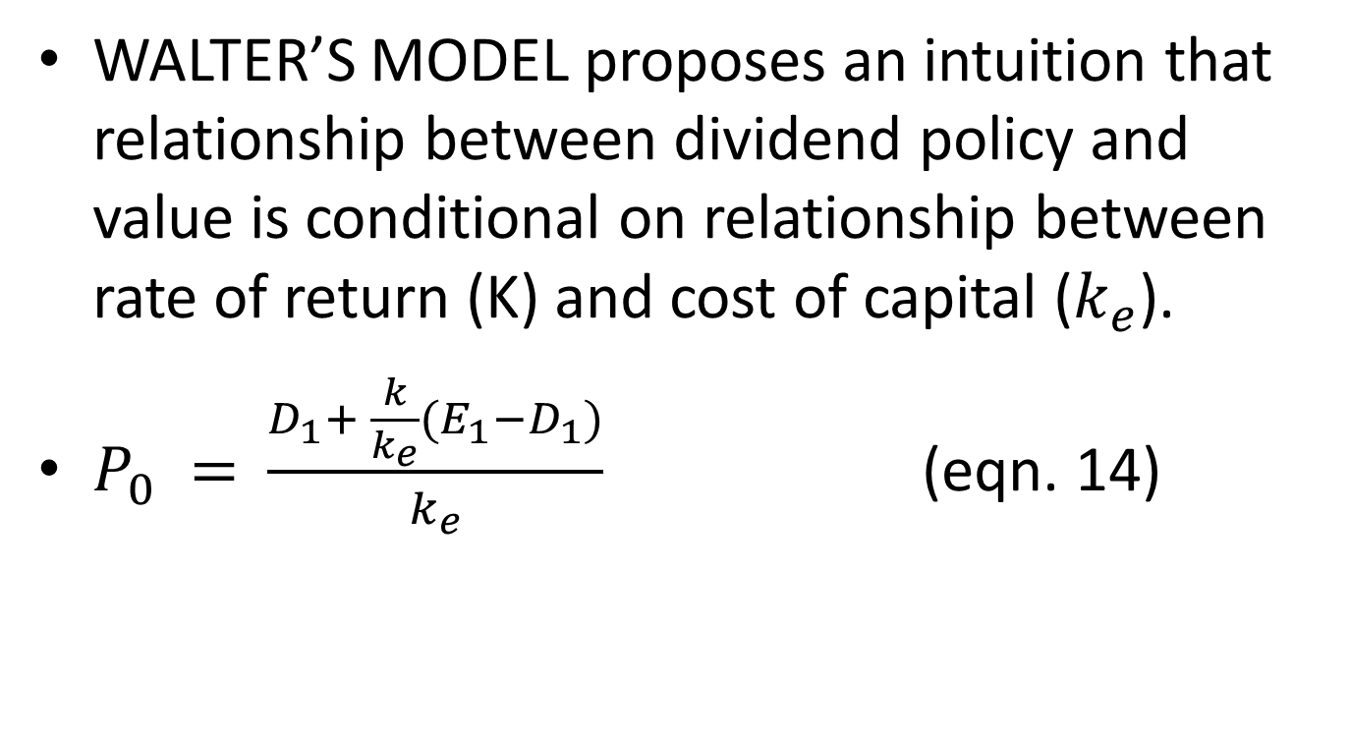
HYBRID MODEL
WALTER’S MODEL proposes an intuition that relationship between dividend policy and value is conditional on relationship between rate of return (K) and cost of capital ($k_{e}$).
$P_{0} =$ $\frac{D_{1}+ \frac{k}{k_{e}}(E_{1}−D_{1})}{k_{e}}$ (eqn. 14)

Slide 32
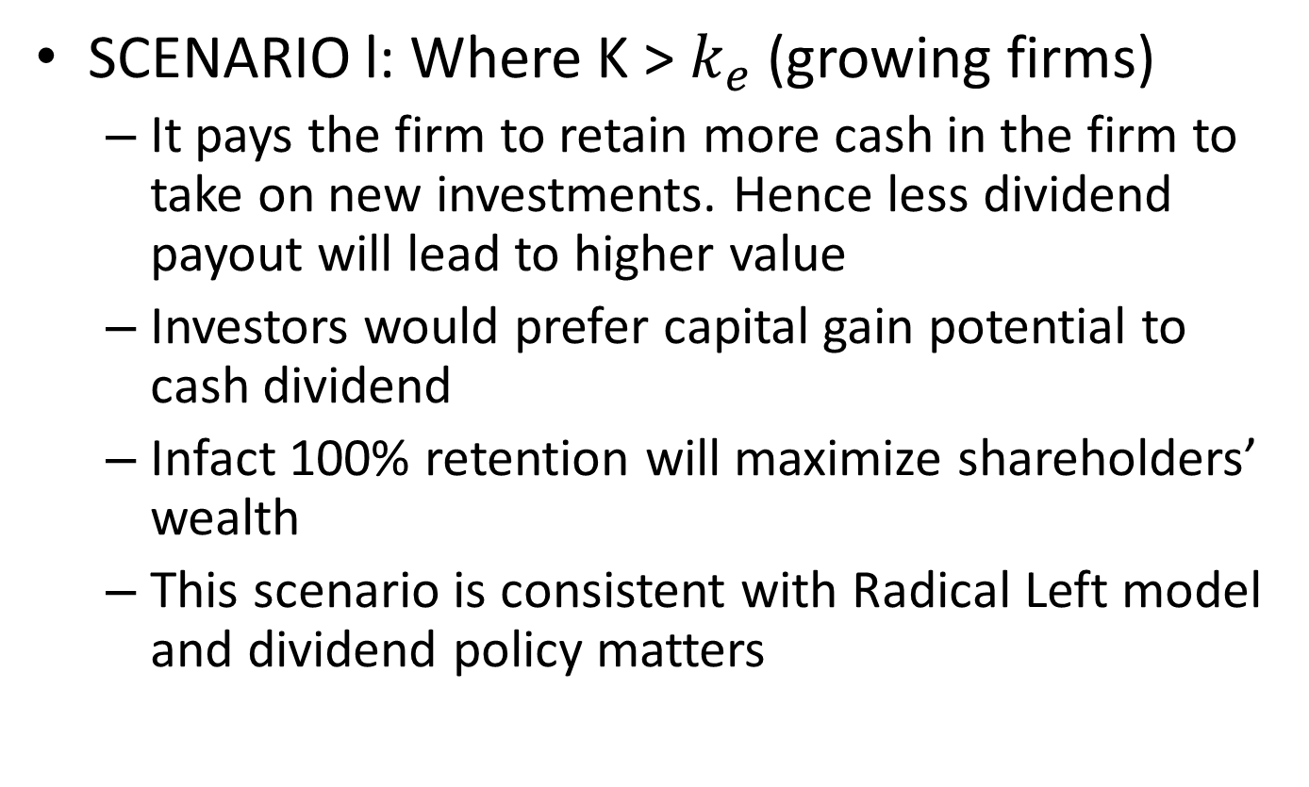
WALTER’s MODEL
SCENARIO l: Where K ˃ $k_{e}$ (growing firms)
  It pays the firm to retain more cash in the firm to take on new investments. Hence less dividend payout will lead to higher value
  Investors would prefer capital gain potential to cash dividend
  Infact 100% retention will maximize shareholders’ wealth
  This scenario is consistent with Radical Left model and dividend policy matters

Slide 33
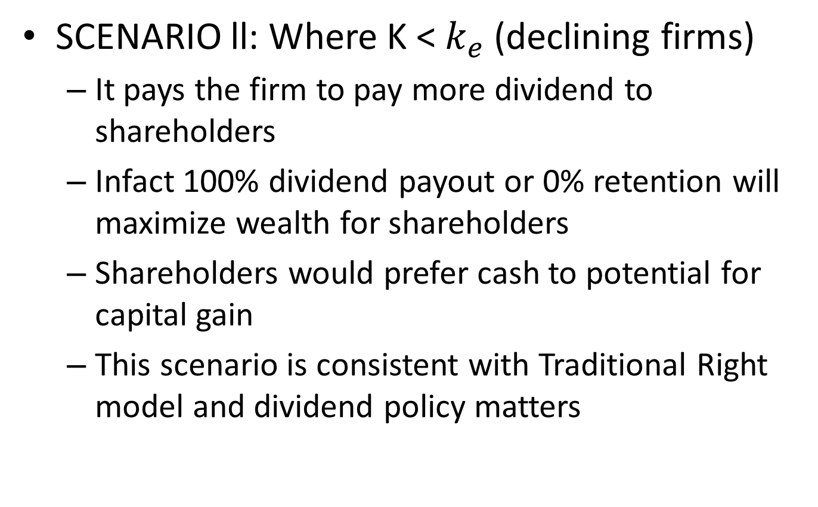
WALTER’s MODEL
SCENARIO ll: Where K ˂ $k_{e}$ (declining firms)
  It pays the firm to pay more dividend to shareholders
  Infact 100% dividend payout or 0% retention will maximize wealth for shareholders
  Shareholders would prefer cash to potential for capital gain
  This scenario is consistent with Traditional Right model and dividend policy matters

Slide 34
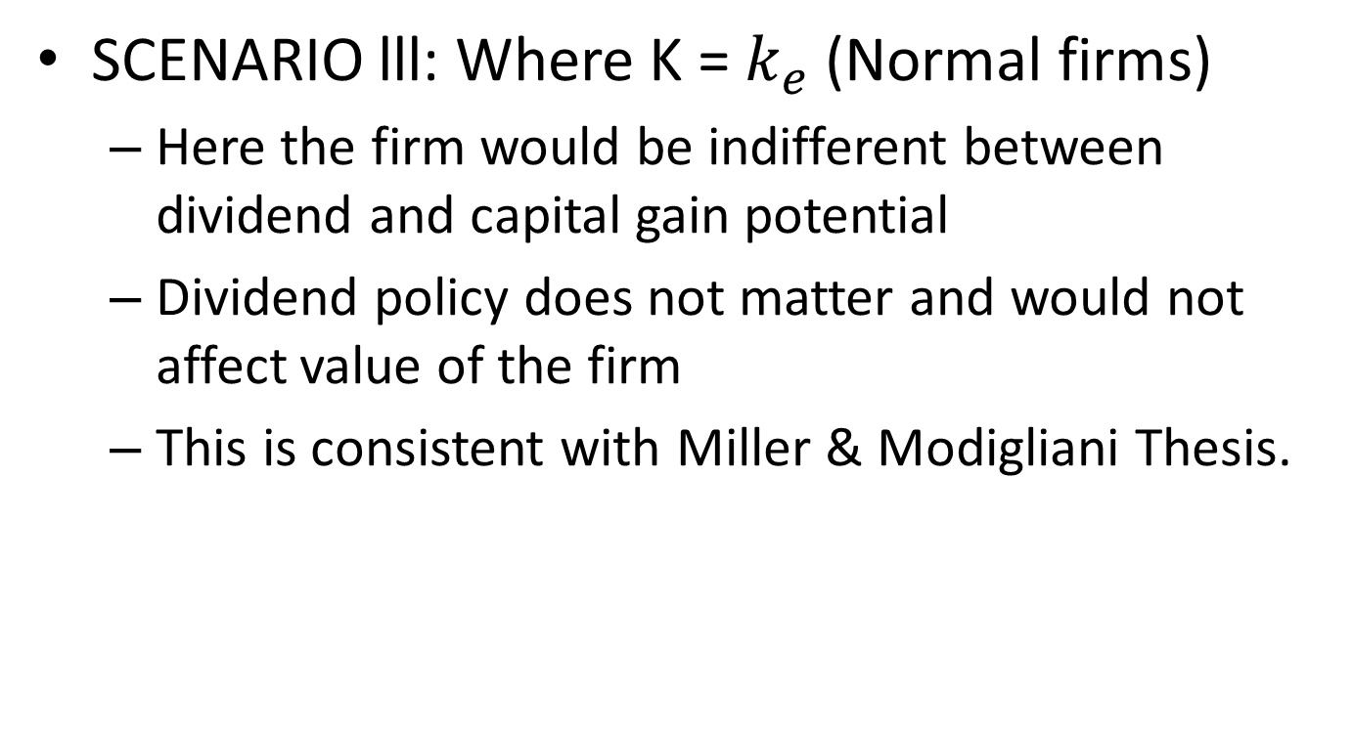
WALTER’s MODEL
SCENARIO lll: Where K = $k_{e}$ (Normal firms)
  Here the firm would be indifferent between dividend and capital gain potential
  Dividend policy does not matter and would not affect value of the firm
  This is consistent with Miller & Modigliani Thesis.

Slide 35
ILLUSTRATION 4
Unilag Dividend Ltd has over the past 5 years recorded average annual earning of N500m on the back of total investment worth N2.5b. The company maintains constant dividend payout ratio of 60%. If the firm’s cost of capital for firms in the same risk class is 15%:
  a) Determine the current market price of the firm.
  b) Consider a sister company, Unilag Growth Ltd, with identical operating statistics but for payout rate of 40%. Would the market price be different from (a) above?
  c) Use results in (a) and (b) above to discuss relevance of dividend policy decisions

Slide 36
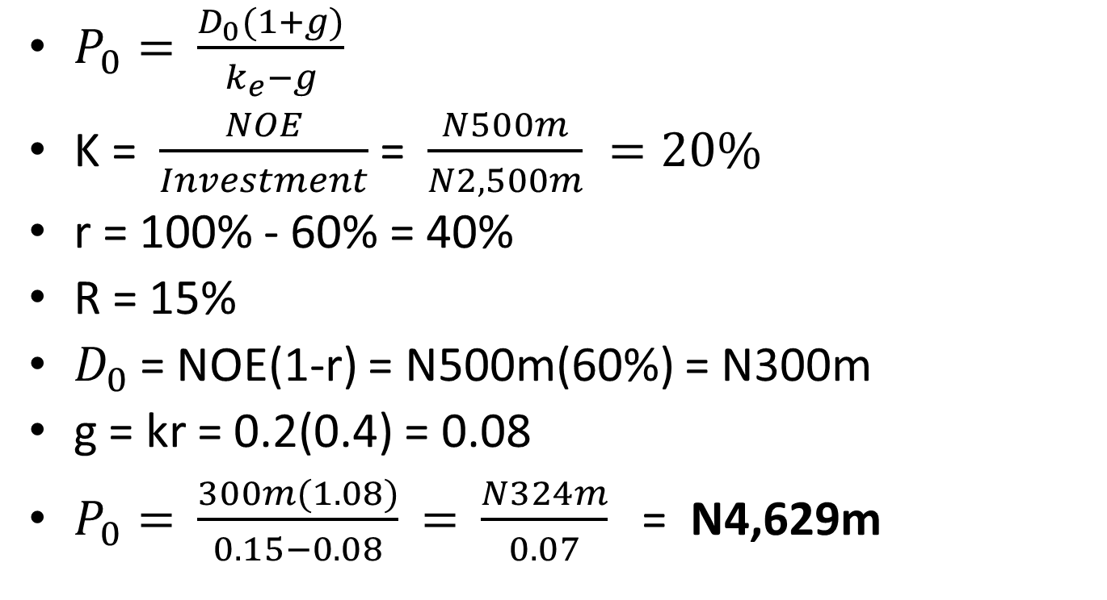
ILLUSTRATION
(Unilag Dividend Ltd)
$P_{0}=$ $\frac{D_{0}(1+g)}{k_{e}−g}$
K = $\frac{NOE}{Investment}$ = $\frac{N500m}{N2,500m} =20\%$
r = 100% - 60% = 40%
R = 15%
$D_{0}$ = NOE(1-r) = N500m(60%) = N300m
g = kr = 0.2(0.4) = 0.08
$P_{0}=$ $\frac{300m(1.08)}{0.15−0.08}$ $=$ $\frac{N324m}{0.07}$ = N4,629m

Slide 37
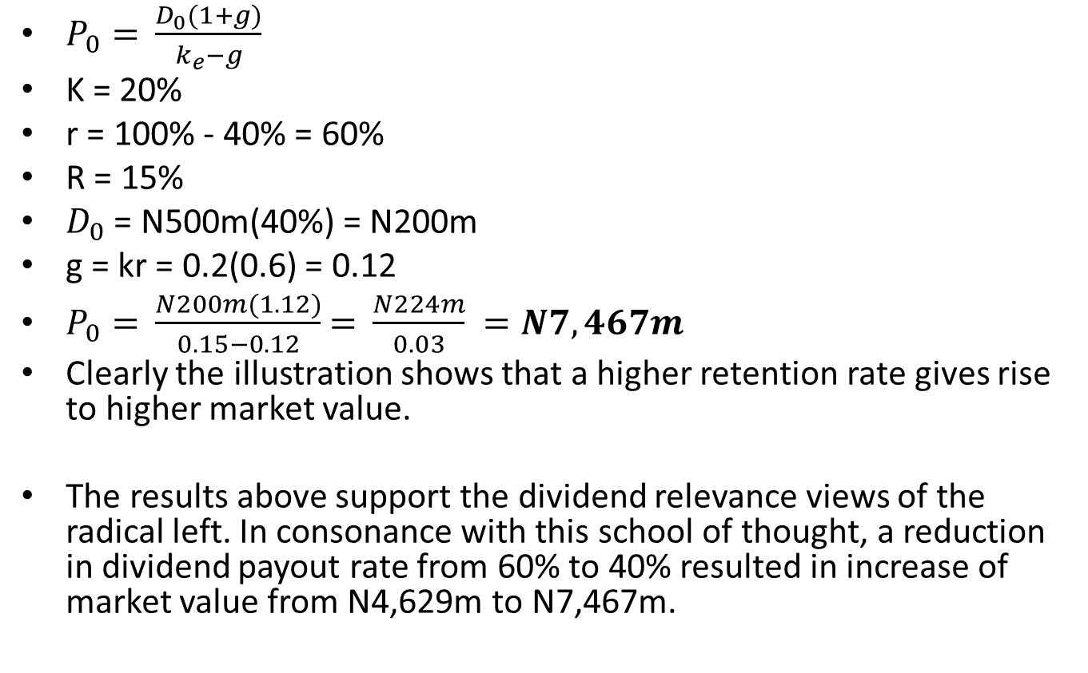
ILLUSTRATION
(Unilag Growth Ltd)
$P_{0}=$ $\frac{D_{0}(1+g)}{k_{e}−g}$
K = 20%
r = 100% - 40% = 60%
R = 15%
$D_{0}$ = N500m(40%) = N200m
g = kr = 0.2(0.6) = 0.12
$P_{0}=$ $\frac{N200m(1.12)}{0.15−0.12}$ $=$ $\frac{N224m}{0.03} =N7,467m$
Clearly the illustration shows that a higher retention rate gives rise to higher market value.
The results above support the dividend relevance views of the radical left. In consonance with this school of thought, a reduction in dividend payout rate from 60% to 40% resulted in increase of market value from N4,629m to N7,467m.

Slide 38
ASSIGNMENT 5
A) Given that all operational statistics remain the same and rate of return on investment was 10%, would solutions to questions a, b and c in illustration above be different?
  Unilag Dividend Ltd N1,418m
  Unilag Growth Ltd N1,178m

Slide 39
ASSIGNMENT 6
Given that average annual earning for Unilag Dividend Ltd and Unilag Growth Ltd reduced to N250m, while other financial data remain the same, use Walter’s Model to compare with results of:
  a) Unilag Dividend Ltd at N500m annual earning
  b) Unilag Growth Ltd at N500m annual earning

Slide 40
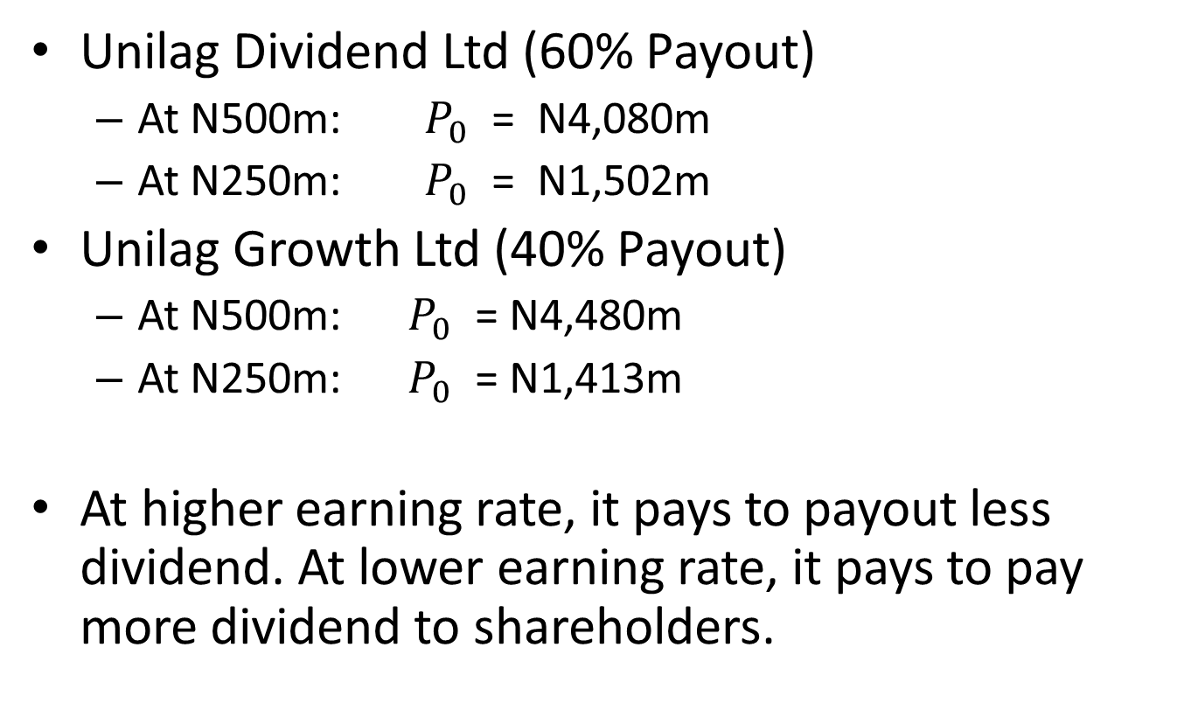
SOLUTION
Unilag Dividend Ltd (60% Payout)
  At N500m: $P_{0}$ = N4,080m
  At N250m: $P_{0}$ = N1,502m
Unilag Growth Ltd (40% Payout)
  At N500m: $P_{0}$ = N4,480m
  At N250m: $P_{0}$ = N1,413m
At higher earning rate, it pays to payout less dividend. At lower earning rate, it pays to pay more dividend to shareholders.

