Slide 1




Git & GitHub
→
→
Module 0: Foundations
local folder
commit
GitHub
Git & GitHub | Module 0: Foundations
Notes:
[SCRIPT] Callback to the environment-setup lecture explicitly: the terminal setup everyone confirmed working then is exactly what runs every command today — this isn't new infrastructure, just a new thing to type into it. Nobody in this room is expected to already know git. Say that out loud. Today is fully guided — every command gets typed together, live, before it's ever asked of them alone.

Slide 2


By the End of Today, You’ll Be Able To…
01
02
03
Start a local git repository
Make a well-messaged commit
Push your first commit to GitHub
Git & GitHub | Module 0: Foundations
Notes:
[SCRIPT] This exact sequence is what the actual project's rubric checks for — not abstractly, literally these three things.

Slide 3
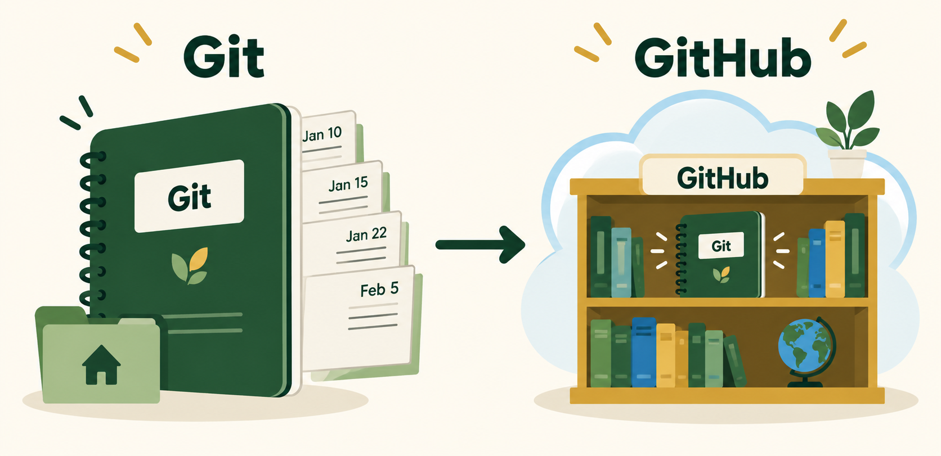
Git Is a Notebook; GitHub Is the Shared Shelf
GIT = LOCAL HISTORY
GIT = LOCAL HISTORY
GITHUB = SHARED HOME
GITHUB = SHARED HOME
Git & GitHub | Module 0: Foundations
Notes:
[SCRIPT] Common early confusion: thinking git and GitHub are the same thing. They aren't — git works with zero internet connection; GitHub is one (very common) place to host what git is already tracking.

Slide 4


Key Terms
Repository
Commit
Remote
A project folder git is tracking
A saved snapshot at one point in time
A hosted copy, like GitHub
Git & GitHub | Module 0: Foundations
Notes:
[SCRIPT] "You'll know these by the end of today." Point out "commit" specifically — it's a noun (a saved snapshot) and a verb (the act of saving one), and both uses come up constantly.

Slide 5

TERMS NAMED
Code Along: Start Tracking a Project
A repository is just a folder git is watching — let’s actually make one.
Git & GitHub | Module 0: Foundations
Notes:
[SCRIPT] Everyone follows along on their own machine from here — hands-on, not a demo to watch.

Slide 6
Start Tracking a Project
bash
$ mkdir my-first-repo
$ cd my-first-repo
$ git init
Run this together. Then use ls -a to see the hidden .git folder.
Git & GitHub | Module 0: Foundations
Notes:
[SCRIPT] Run this together, live. Afterward, run `ls -a` so they can actually see the new hidden `.git` folder — it stops being abstract once they've seen it exist.

Slide 7

A Repo Needs a README
Why it matters
README.md
README.md explains what this project is
It’s the first thing anyone else reads
Write it before you forget why
# My First Repo
This project is a place to practice Git and GitHub.
Git & GitHub | Module 0: Foundations
Notes:
[SCRIPT] Have them create README.md right now, in VS Code, with one sentence describing the (placeholder) project. This becomes real on the actual project — a README with nothing in it is a common lower-scoring pattern.

Slide 8
README WRITTEN
Code Along: Stage and Check Status
Writing the file is one thing — git doesn’t know it exists until you tell it to.
Git & GitHub | Module 0: Foundations
Notes:
[SCRIPT] Back to typing together, now with a real file to actually stage.

Slide 9
Stage and Check Status
bash
$ git add README.md
$ git status
git status is safe to run any time. Build the habit before and after each command.
Git & GitHub | Module 0: Foundations
Notes:
[SCRIPT] Emphasize git status is completely safe to run any time, as often as they want — it's read-only. Build the habit of running it before and after every git command today.

Slide 10
Make Your First Commit
bash
$ git commit -m "Add initial README"
A specific commit message tells future-you what changed.
Not this: “update”
Do this: “Add initial README”
Git & GitHub | Module 0: Foundations
Notes:
[SCRIPT] This is where the project's #2 flagged mistake (one giant final commit) gets prevented — model a SPECIFIC, descriptive message now, while it's cheap, so it's already a habit by project time.

Slide 11

See Exactly What Changed
bash
$ echo "More notes coming soon." >> README.md
$ git diff
git diff shows the actual line-level changes before the next commit.
Git & GitHub | Module 0: Foundations
Notes:
[SCRIPT] Run this live, right after editing README.md a second time — git diff only shows something for a file git already knows about, so this only works cleanly *after* the first commit, not before it. Seeing the actual +/- line diff makes "git tracks changes" concrete instead of abstract.

Slide 12
YOUR LOCAL REPO
Connecting to GitHub
Everything so far has lived only on your machine — nothing’s been shared with anyone yet.
Git & GitHub | Module 0: Foundations
Notes:
[SCRIPT] [~25 min mark] Everything so far has been entirely local — nothing's been shared yet. That changes now.

Slide 13
Making It Public: GitHub
Create
Copy
Skip
a new, empty repository on github.com
the remote URL it gives you
“Add a README” — yours exists
Git & GitHub | Module 0: Foundations
Notes:
[SCRIPT] Walk through the actual github.com UI live, screen-shared. The "don't add a README" point matters — it avoids an immediate merge conflict for a brand-new repo, a confusing first-day surprise.

Slide 14

REMOTE CREATED
Code Along: Link and Push
An empty GitHub repo and your local commits still don’t know about each other yet — this connects them.
Git & GitHub | Module 0: Foundations
Notes:
[SCRIPT] Back to the terminal — this is the moment their local work actually becomes visible on GitHub.

Slide 15
Link and Push
bash
$ git remote add origin <your-repo-url>
$ git push -u origin main
This is the moment your local work becomes visible on GitHub.
Git & GitHub | Module 0: Foundations
Notes:
[SCRIPT] The most common live hiccup here is a typo'd URL or an auth prompt — narrate what a real error looks like so it's not alarming when it happens to someone.

Slide 16
See Your Own History
bash
$ git log --oneline
The payoff: a readable history you built yourself.
A good log is a project timeline, not a mystery.
Git & GitHub | Module 0: Foundations
Notes:
[SCRIPT] Run this after the push. This is the actual payoff of today's whole lesson: a real, readable history they built themselves, not an abstract promise.

Slide 17

Common First-Day Errors
"not a git repository"
"nothing to commit"
Password prompt
You’re in the wrong folder
You probably forgot git add
GitHub wants a token
Git & GitHub | Module 0: Foundations
Notes:
[SCRIPT] Name all three explicitly before anyone hits them — normalizing this up front (per this Fellowship's stereotype-threat research) matters more than any individual fix.
Tokens: Need to generate an ssh token at times which in Github click on profile picture > settings > ssh and gpg keys

Slide 18

CHECK FOR UNDERSTANDING
Which command tells you what’s actually going on?
You just ran a command and nothing seemed to happen.
A
B
C
git init
git status
git push
Git & GitHub | Module 0: Foundations
Notes:
[SCRIPT] Cold-call after individual think time. This is a genuinely common real moment — reinforcing "when unsure, run git status" pays off well beyond today.

Slide 19
ANSWER KEY
When Stuck, Check Status
git status
It’s safe to run and tells you the current state: staged files, unstaged changes, and what branch you’re on.
Git & GitHub | Module 0: Foundations
Notes:
Correct answer: git status
Why: git status is always safe to run and always tells you the real current state — staged files, unstaged changes, what branch you're on.
Source: This module's own objective-3 definition, not an external citation

Slide 20
ADD TO THE BOARD
Put the Git Steps in Order
A
B
C
D
git push
git commit
git add
git init
Post them in the order you’d actually run them.
Git & GitHub | Module 0: Foundations
Notes:
[ACTIVITY] Padlet/Jamboard, or a physical whiteboard if in person; online, drop the order into chat and unmute 1-2 Fellows to explain why. Correct order: git init, git add, git commit, git push. The real teaching point isn't just the order — it's WHY: nothing else works until init starts tracking the folder, and you can't commit what was never added.

Slide 21
CHECK FOR UNDERSTANDING
Rewrite this commit message: "update"
A
B
C
"stuff"
"final update 2"
"Fix typo in README installation steps"
Git & GitHub | Module 0: Foundations
Notes:
[SCRIPT] This is the actual applied skill, not just the concept — have a few Fellows share their real rewritten message out loud before revealing the example.

Slide 22
ANSWER KEY
Rewrite a Bad Commit Message
"Fix typo in README installation steps"
A good message names the specific what. Someone reading the log later should understand the change without opening the diff.
Git & GitHub | Module 0: Foundations
Notes:
Correct answer: "Fix typo in README installation steps"
Why: A good message names the specific WHAT — someone reading the log later (including future-you) should know what changed without opening the diff.
Source: This module's own objective-3 definition, not an external citation

Slide 23
Key Terms — Recap
Repository
A project folder git is tracking the history of
Commit
A saved snapshot of your project at one point in time
Remote
A copy of your repository hosted somewhere else, like GitHub
Git & GitHub | Module 0: Foundations
Notes:
[SCRIPT] Last reinforcement pass — tie each term back to the exact command that just used it live today.

Slide 24

What You Have Now
A real local repo
That repo
The habit
pushed to GitHub
of checking git status often
with real commits
Git & GitHub | Module 0: Foundations
Notes:
[SCRIPT] Today was fully guided — next class's lab is the same sequence again, on your own, with support circulating. The project later this module asks for this completely unguided. Resolve today's opening explicitly: the same terminal confirmed working in the environment-setup lecture is exactly what just ran every command today.

Slide 25
Before Next Class
Keep
Next class
Lab
your practice repo around
Same sequence, on your own
Git & Terminal Practice
Git & GitHub | Module 0: Foundations
Notes:
[SCRIPT] Close by naming the lab specifically as the next rep at this exact sequence, not new content.

Slide 26
KEEP LEARNING
Where to Go From Here
Git Basics
GitHub Docs: Hello World
Pro Git book, Ch. 2
DOCS · 15–20 min
Free canonical git reference.
PRACTICE · 15 min
GitHub’s short guided first-repo walkthrough.
Git & GitHub | Module 0: Foundations
Notes:
[SCRIPT] Mention these exist for review, don't assign as homework — the lab is today's real practice.

