Slide 1
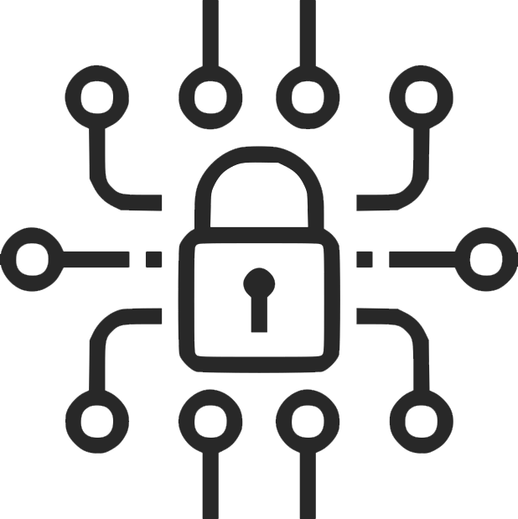
Digital
Lineup
By Olav Sharma – Tier 4

Slide 2
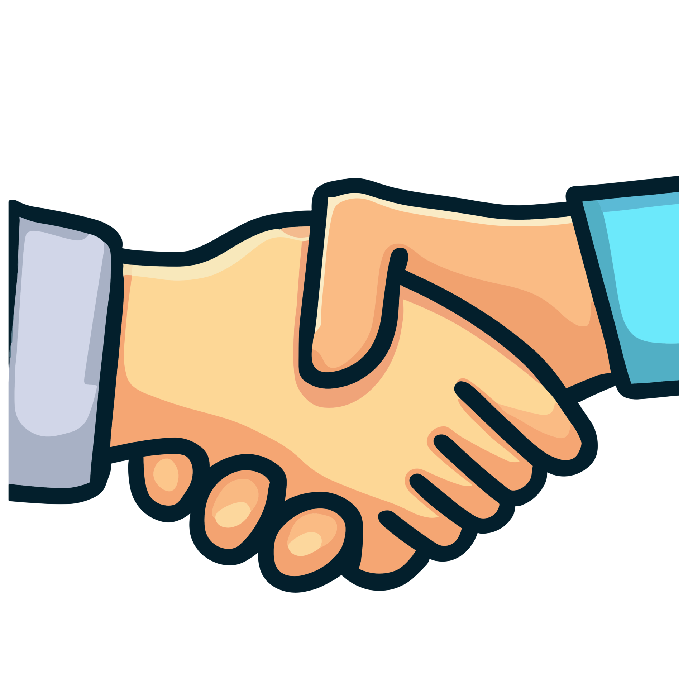
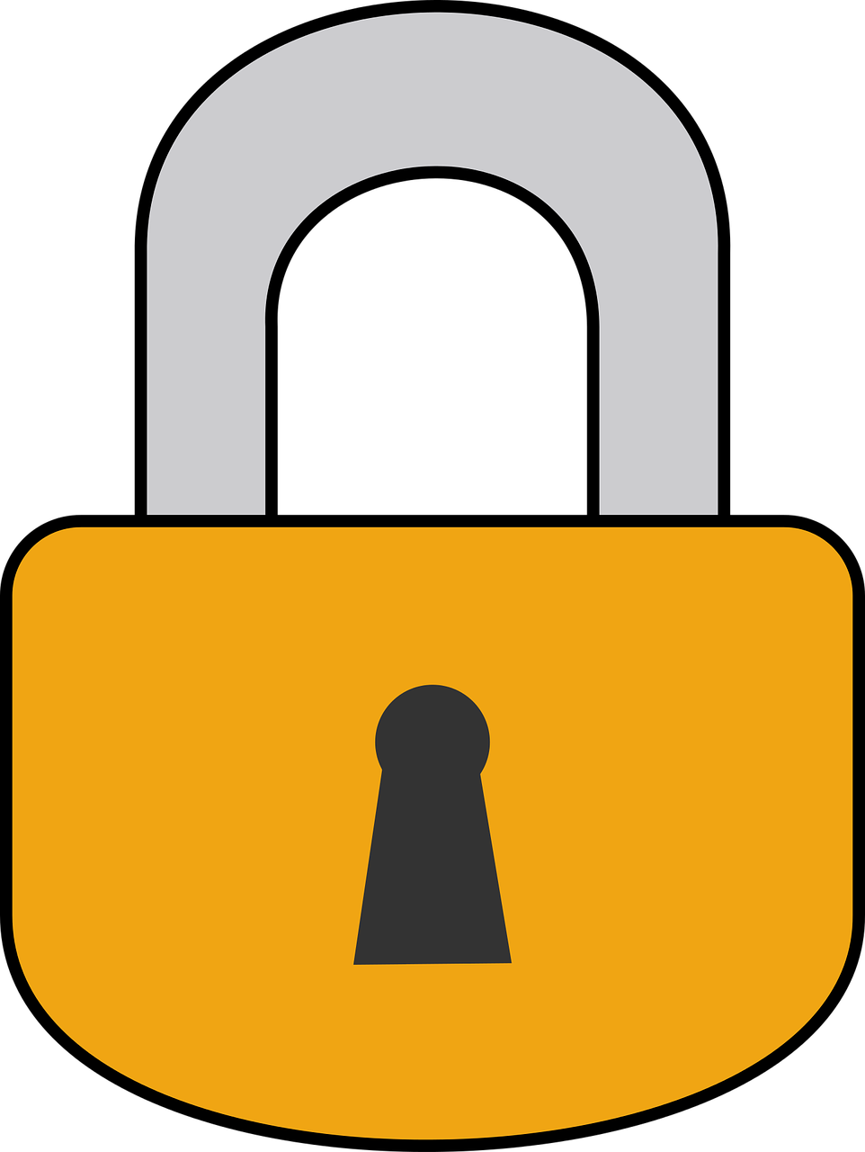
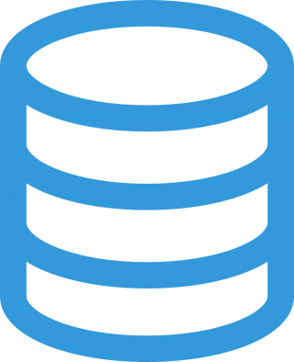
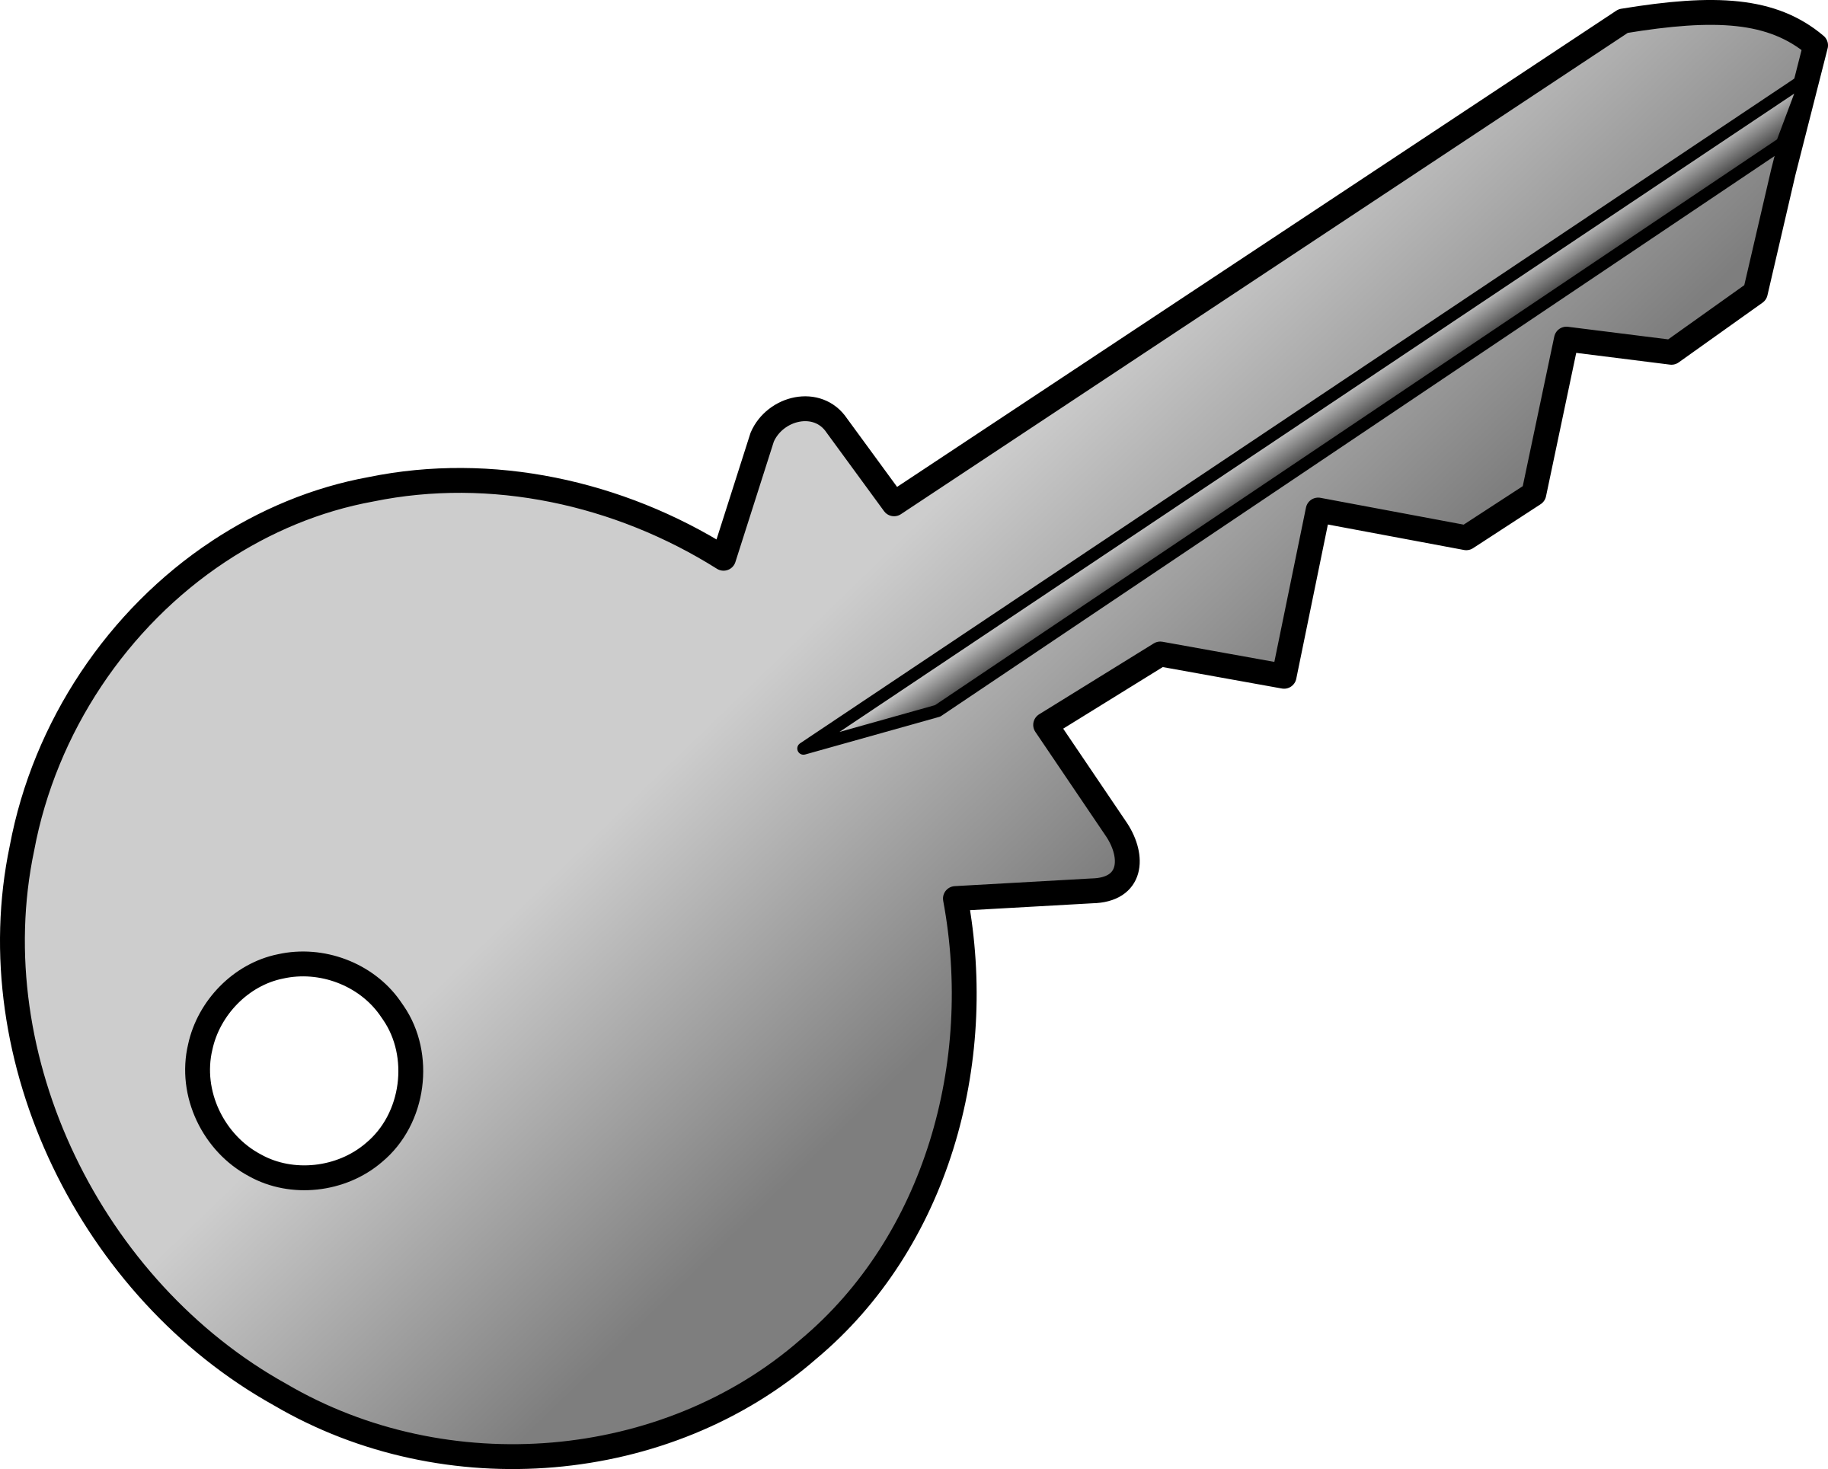
Intro
This Presentation covers the four parts of Digital Lineup,
These four parts of the Digital Lineup are key in keeping you safe, private, secure, and responsible. The next two slides cover security, the two after cover footprint, and so on.
Security,
Footprint,
Citizenship,
and Safety.
Notes:
This presentation covers the four following parts of digitallineup. Security. Digital Footprint. Digital Citizenship. And Safety.

Slide 3
Ch. 1
Security is really important online. Keeping your online accounts secure is extremely important now-a-days with hacked accounts databases, or really most other things being really common nowadays. Two things that are really important for staying secure when online are keeping accounts secure with 2FA, stronger passwords, etc. And understanding how these breaches work and how to protect yourself from them.
Security
The following slides cover securing your accounts, and the importance of security online.
Notes:
Security. Security is really important when online. Keeping your account secure is only gonna get harder. The following slides talk about securing your accounts and why securing them is important.

Slide 4
Why is Security so important?
Security is really important for a number of reason. Three really important reasons are below.
Secure accounts keep your personal info private. Lots of companies store your full name, date of birth, phone number, and sometimes more information. When people log into your accounts, they can usually see some of this information.
Having secure accounts is also important for bank accounts or similar. Nowadays, lots of services such as Google, Samsung, or similar keep your payment methods saved on your account. This makes it really easy for people to use your own money. Lots of these services save virtual cards used for real-life payments using NFC. This means people can use your money in real life too!
Access to a Google, Microsoft, Samsung account or similar grants other account passwords. Many services such as Google, Microsoft, and Samsung. Store passwords for other services in the cloud. Some examples are Google’s password manager, Samsung Wallet Pay, and Microsoft’s password service. This is usually only vulnerable if they use these services though.

Slide 5


Secure your accounts
Securing your accounts is really important, due to how common and easy it is to hack accounts nowadays. To secure your accounts, some general steps are to make a strong password, numbers, letters, symbols, anything! Just make sure you remember it. Next, if the service offers 2FA, enable it. Use your phone for authenticator codes, or use an email code for 2FA. Some great authenticator apps include Microsoft’s authenticator and Google’s authenticator. These are really helpful because they back up your codes between devices through the cloud, just be sure that you’ve enabled it if you were using the app before they started backing them up.

Slide 6
Ch. 2
Digital Footprint

Slide 7
How is your data stored?
balbasdiJASioufjsedifu ahsdiofay uhgsdfiuayshjdfiaysed
Notes:
How data is stored
For all you visual learners, I’ve created a diagram. Here’s a lock from the second slide. Here’s the hand. We put the key in the hand. The hand and the key work together to open the lock. And under those things is the database.

Slide 8
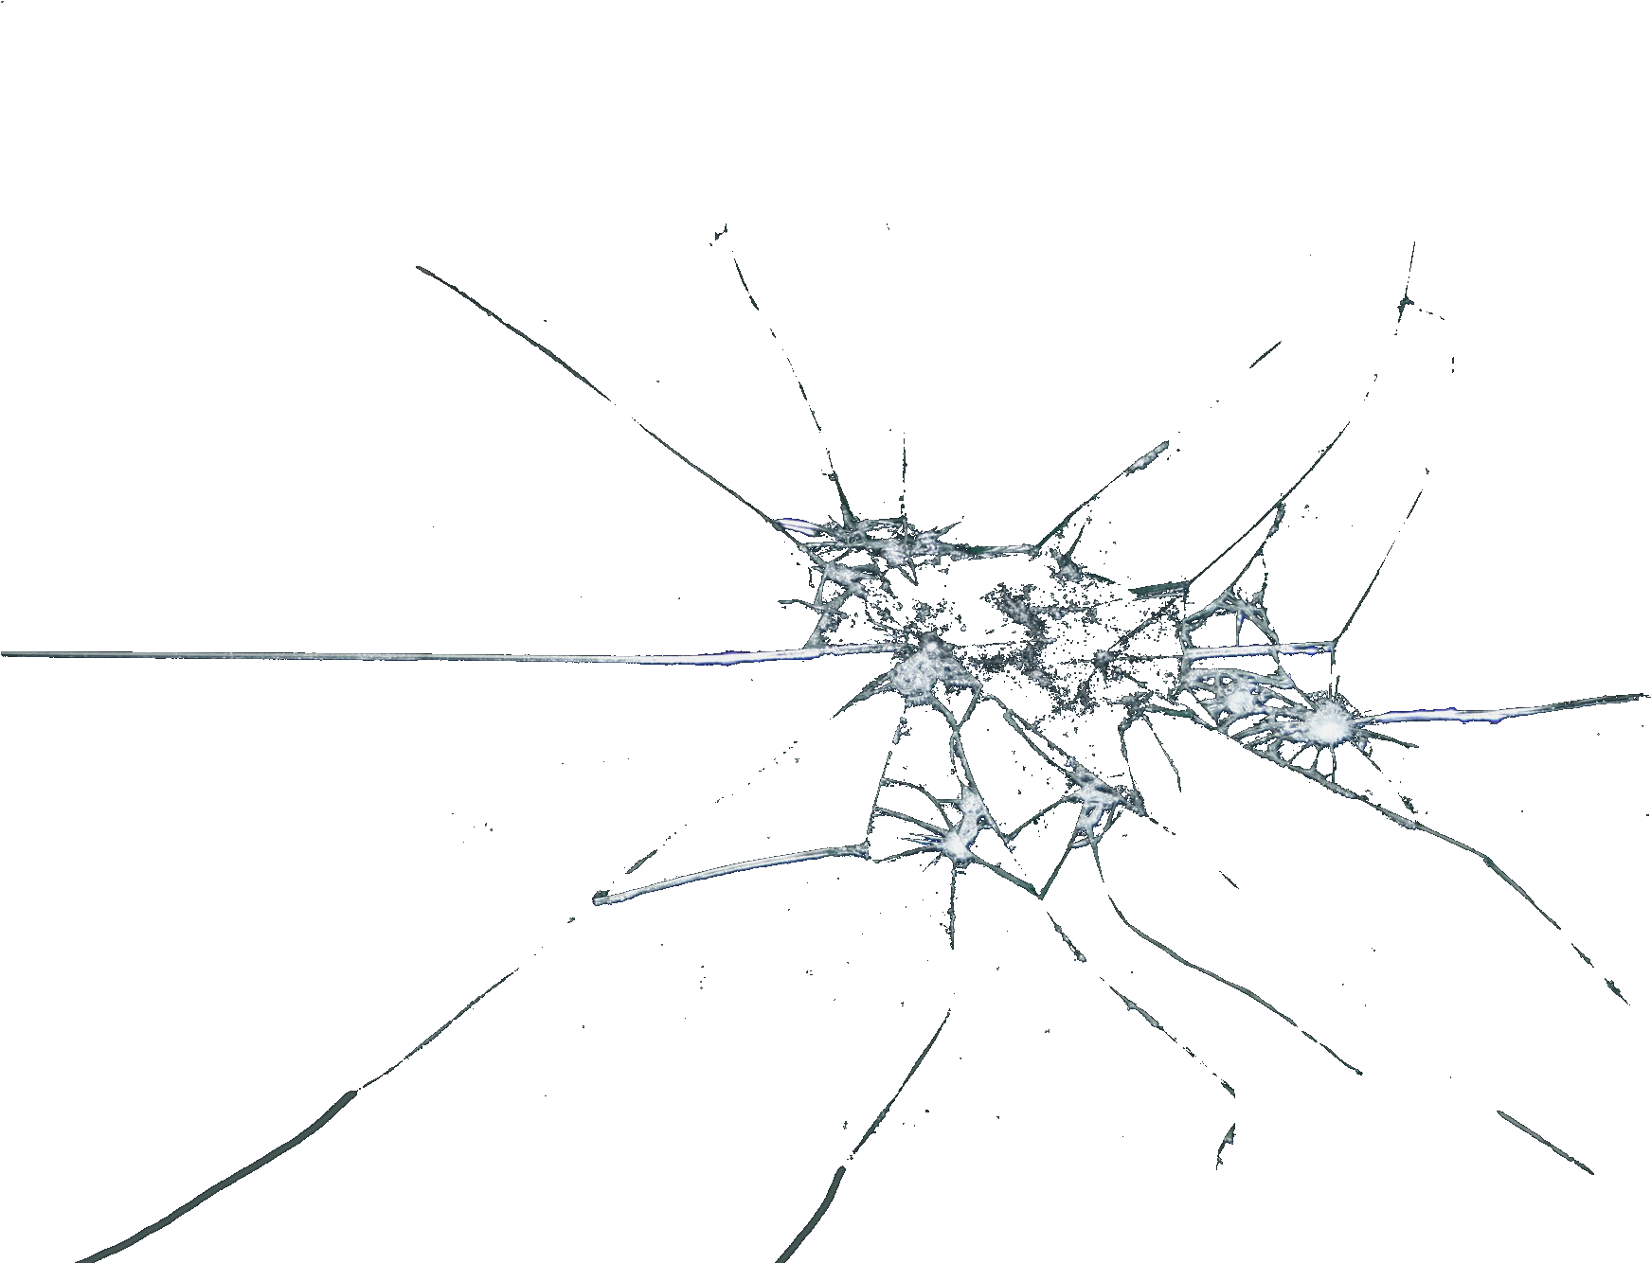
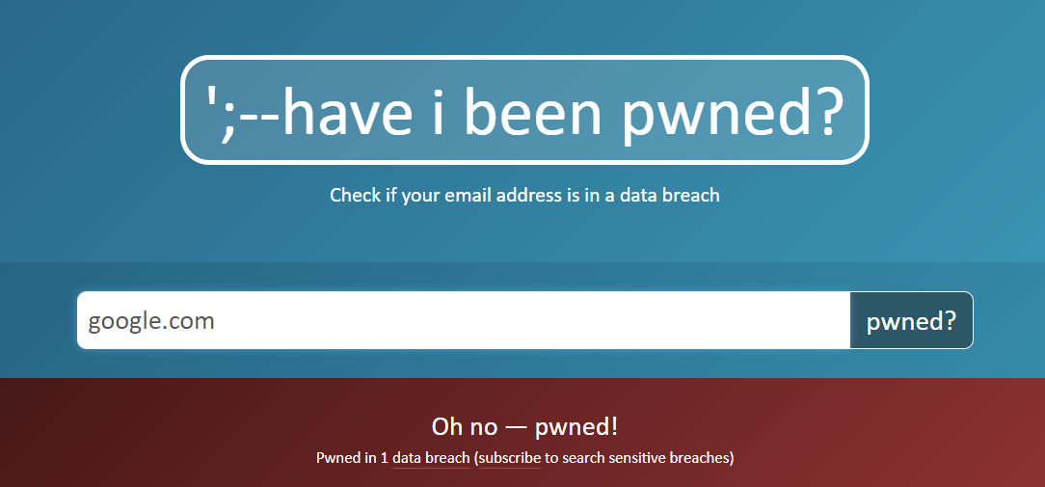
Data Breaches
However, there is something you can do to lessen the effect. Most of the time, the most vulnerable information other than personal information, your account password. This is really vulnerable because most people use very similar passwords or even the same password for different sites. Hackers can use the passwords they find in data breaches, match them to the username, and use them to decode passwords to other site logins. So, the best thing you can do to protect yourself is to use very different passwords. You can also check if you’ve been in a breach using haveibeenpwned.com You can also learn more about this there.
Data breaches are when companies’ databases get breached and leaked to the hacker. Data breaches are really dangerous because these database hold everything that these companies know about you, including sensitive information. This is less dangerous if companies have multiple databases with different tokens to store different information. This way, a hacker would need to breach all of these databases to find your information. But for smaller businesses, a giant data solution like this could be pretty expensive, and they may store all of your data on one server. This is how data breaches work.
Notes:
1.
2. This graph represents the rise in data breaches from 2019 to 2022. You can see how it goes up during the pandemic, and keeps rising and oh, shoot. I broke the ceiling. Oh… There it goes

Slide 9

Ch. 3
Safety

Slide 10
Ch. 4
Responsibility

Slide 11
Similarities + Differences

