Slide 1
COVID-19
🦠
Global Impact Dashboard
Jan 2020 - Mar 2023
104M+
1M+
96.5%
Confirmed Cases
Deaths
Recovery Rate
AnalystLab Africa | Week 4 Internship | Data Visualization & Dashboarding

Slide 2
Dataset Overview
02
🗃️
Data Source
🗺️
Coverage
Johns Hopkins University CSSE
289 Countries & Regions
GitHub Repository (Public)
49 US States breakdown
Updated daily until Mar 2023
Jan 22 2020 – Mar 9 2023

Slide 3
Business Problem & Objectives
03
Core Challenge
Decision-makers need to understand the scale, spread and trajectory of COVID-19 globally, identifying which countries were most affected, how the pandemic evolved over 3 years, and what the survival outcomes were.
Which countries had the highest confirmed cases and deaths?
How did the pandemic grow and peak over 2020–2023?
01
02
What was the global death rate and recovery rate?
How do confirmed cases compare to deaths by country?
03
04

Slide 4
Key Performance Indicators
04
🦠
💀
💚
📉
104M
1M
31M
1.04%
Total Confirmed
Total Deaths
Total Recovered
Death Rate
Cases worldwide
Global fatalities
Documented recoveries
Deaths / Confirmed
BREAKDOWN
US leads confirmed cases
104M
US leads total deaths
1.12M
India - 2nd most confirmed
44.7M
96.5% of cases recovered
96.5%

Slide 5
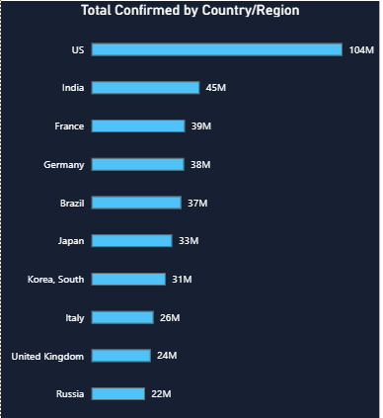
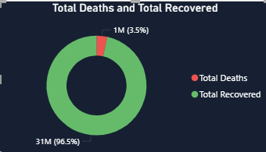
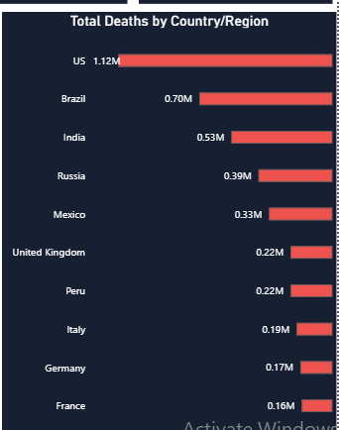
Dashboard Preview
05
COVID-19 Global Impact Dashboard | Jan 2020 – Mar 2023
1M
1.04%
31M
104M
Total Deaths
Death Rate
Total Recovered
Total Confirmed

Slide 6
Key Insights
06
🇺🇸
US Leads All Metrics
📈
Explosive 2021–2022 Growth
With 104M confirmed cases and 1.12M deaths, the US accounts for the highest national burden globally. India follows at 44.7M cases.
Confirmed cases surged from 1M in early 2020 to over 100M by 2022. The Delta and Omicron variants drove the steepest growth curves.
💚
96.5% Recovery Rate
💀
1.04% Global Death Rate
Of all documented cases, 96.5% recovered. Only 3.5% resulted in death — demonstrating effective healthcare response over time.
The global case fatality rate settled at 1.04%. Brazil (1.9%) and Mexico (4.3%) showed significantly higher death rates than the global average.
🌍
Europe Heavily Impacted
📉
Slowdown Post-2022
France, Germany, Italy and the UK all appear in the top 10 for confirmed cases. Europe's dense population contributed to rapid spread.
Daily new cases peaked in early 2022 then declined sharply as vaccination rates increased and immunity built up globally.

Slide 7
Recommendations
07
01
Strengthen High-Burden Countries
02
Invest in Early Detection Systems
03
Address High Death-Rate Nations
Target resources toward US, India and Brazil which consistently showed the highest case and death counts throughout the pandemic.
The 2021–2022 surge shows the need for real-time surveillance dashboards that can identify exponential growth before it overwhelms health systems.
Mexico (4.3%) and Brazil (1.9%) had death rates far above the global average. Targeted healthcare capacity investment is needed in these regions.
04
Leverage Recovery Data
05
Expand Data Collection
06
Build Predictive Dashboards
The 96.5% recovery rate confirms most patients survive. Public health messaging should balance risk communication with recovery outcomes.
Johns Hopkins stopped tracking recoveries for many countries mid-pandemic. Standardised global reporting frameworks would improve future analysis.
Use historical wave patterns to forecast future outbreaks. A 30-day rolling average dashboard would give decision-makers earlier warning signals.

Slide 8
Challenges & How I Overcame Them
08
⚡ Challenges Faced
✅ How I Solved Them
✗
Wide CSV format with 1,143 date columns needing unpivot
✓
Selected 4 fixed columns then used Unpivot Other Columns
✗
Power BI loaded file without headers
✓
Used Home tab > Use First Row as Headers before unpivoting
✗
Map visual disabled due to system security settings
✓
Skipped map visual, I used bar charts for country comparison
✗
Merging 3 tables required matching on 2 keys (Country + Date)
✓
Selected both Country/Region and Date fields during merge
✗
Recovered file had 15 fewer countries than confirmed
✓
Used Left Outer Join to preserve all confirmed case rows
✗
KPI card white borders could not be fully removed
✓
Accepted minor formatting limit and focused on data quality

Slide 9
Tools Used & Key Learnings
09
📊
🔧
📋
🗃️
Power BI Desktop
Power Query
DAX Measures
GitHub / CSV
Dashboard & visualization
Data cleaning & merging
KPI calculations
Raw data source
🎓 Key Learnings
📌 Raw data is never dashboard-ready — cleaning and reshaping is 50% of the work
📌 Unpivoting wide data into tall format is essential for time-series analysis in Power BI
📌 Merging tables on multiple keys prevents incorrect row matches
📌 DAX measures are more flexible than raw column aggregations for KPIs
📌 Data storytelling means connecting visuals to decisions, and not just showing numbers

Slide 10
Conclusion
🦠
This dashboard transforms 3 years of global COVID-19 data into clear, actionable insights, revealing which countries bore the highest burden, how the pandemic evolved, and what the human cost ultimately was.
104M+
Cases Analyzed
✓
Power BI dashboard with 6 interactive visuals
✓
KPI cards, slicers, bar charts, line chart & donut
3 Yrs
✓
Data cleaned, merged and modelled from 3 CSV files
Data Coverage
✓
Insights delivered for 289 countries across 1,143 days
6
Thank you!
Key Insights

