Slide 1
Bank Marketing Campaign Analysis
Business Analytics Case Study

Slide 2
Business Problem Statement
The bank runs telemarketing campaigns to sell term deposits but not all customers subscribe
Every unsuccessful call costs the bank time and money
So;
Why do some customers subscribe while others don't?
Which customer groups are most likely to respond positively?

Slide 3
Dataset Overview
Source: Kaggle - Bank Marketing Dataset
11,162 customers and 17 columns
Data from a Portuguese bank's telemarketing campaigns
No missing values found
Target variable: deposit (yes/no)

Slide 4
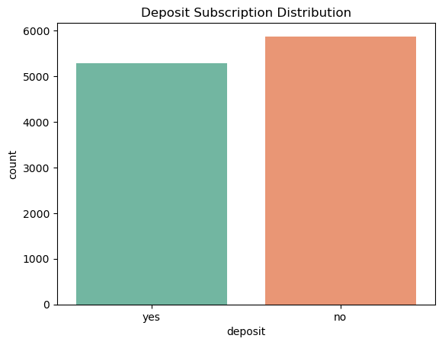
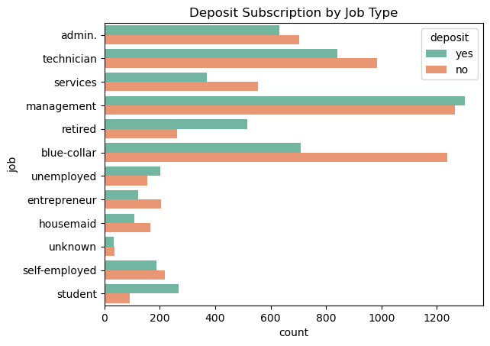
Key Visualizations

Slide 5
Major Findings
Students, retired and tertiary educated customers subscribed the most
Cellular contact method had the highest subscription rate
Longer call duration strongly linked to higher subscription
Customers who subscribed before are very likely to subscribe again
Customers without housing loans are more likely to subscribe

Slide 6
Recommendations
Prioritise targeting students, retired and tertiary educated customers
Use cellular phones as the primary contact method
Train agents to keep customers engaged longer on calls
Re-engage customers who subscribed in previous campaigns first
Use financial profiling to target customers without housing loans

Slide 7
Conclusion
Goal was to identify customer segments most likely to subscribe
Key drivers identified: job type, contact method, call duration and previous campaign outcomes
Implementing these recommendations will improve conversion rates and reduce wasted calls
Data-driven marketing is key to campaign success

