Slide 1

Note: The data and information in this document is reflective of a hypothetical situation and client. This document is to be used for KPMG Virtual Internship purposes only.
Sprocket Central Pty Ltd
Data analytics approach
Olaoluwa J. Taiwo

Slide 2
Note: The data and information in this document is reflective of a hypothetical situation and client. This document is to be used for KPMG Virtual Internship purposes only.
Agenda
Introduction
Data Exploration
Model Development
Interpretation

Slide 3
Note: The data and information in this document is reflective of a hypothetical situation and client. This document is to be used for KPMG Virtual Internship purposes only.
Introduction
Background
Objective
Sprocket Central Pty Ltd, a renowned provider of high-quality bicycles and cycling accessories, seeks to expand its market presence. To achieve this, it's imperative to understand customer behavior and preferences, targeting the most valuable prospects among 1000 new customers.
The primary objective is to develop a data-driven customer segmentation and targeting strategy. This involves analyzing existing customer data, creating meaningful segments, and recommending which of the 1000 new customers should be prioritized to maximize business value.

Slide 4
Note: The data and information in this document is reflective of a hypothetical situation and client. This document is to be used for KPMG Virtual Internship purposes only.
Introduction
Challenges
Data Complexity: The data consists of multiple datasets, requiring integration and thorough cleansing.
Segmentation: Identifying distinct customer segments to tailor marketing efforts effectively.
Modeling: Developing models to predict customer behavior and guide targeting.
Interpretation: Extracting actionable insights from complex data to inform strategic decisions.
The aim of the project is to empower Sprocket Central Pty Ltd to optimize marketing efforts, allocate resources efficiently, and ultimately drive business growth by targeting the most promising customers.

Slide 5
Note: The data and information in this document is reflective of a hypothetical situation and client. This document is to be used for KPMG Virtual Internship purposes only.
Introduction
Techniques
Phase 1: Data Exploration
A meticulous examination of existing datasets is conducted, emphasizing data quality.
Critical feature engineering is performed to prepare the data for subsequent analysis.
Phase 2: Model Development
The RFM (Recency, Frequency, Monetary) analysis is implemented using Python.
Customer segmentation into low, medium, and high-value categories is executed.
Phase 3: Interpretation
Extensive exploratory data analysis (EDA) is undertaken.
Model development results are unveiled and utilized to drive strategic decisions for Sprocket Central Pty Ltd.

Slide 6
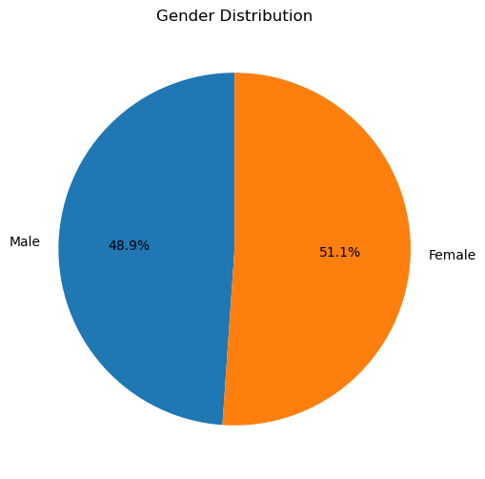
Note: The data and information in this document is reflective of a hypothetical situation and client. This document is to be used for KPMG Virtual Internship purposes only.
Data Exploration
Gender Distribution of the Customers
Female customers are 51.1%
Male customers are 48.9%
This indicate the higher proportion of female customers using the company.

Slide 7
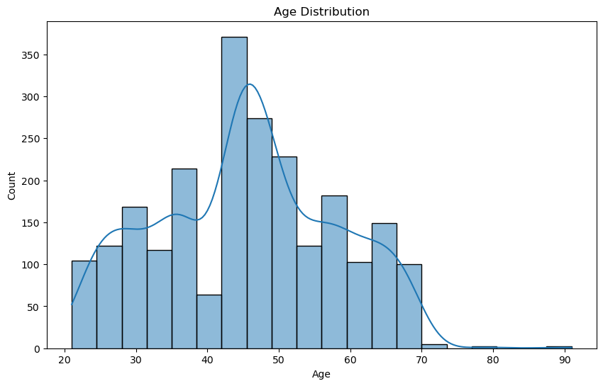
Note: The data and information in this document is reflective of a hypothetical situation and client. This document is to be used for KPMG Virtual Internship purposes only.
Data Exploration
Age Distribution of The Customers
The data shows there is highest number of customers between 40 to 50 years of age.
There is a need for considering age grouping for further analysis

Slide 8
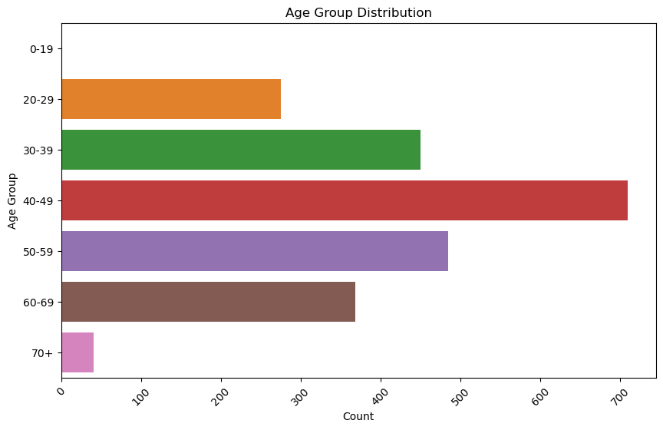
Note: The data and information in this document is reflective of a hypothetical situation and client. This document is to be used for KPMG Virtual Internship purposes only.
Model Development
Age Grouping Distribution of The Customers
The data shows further shows that there is highest proportion of customers between 40 to 50 years of age.
Customers of 30s and 50s also show a great proportions.

Slide 9
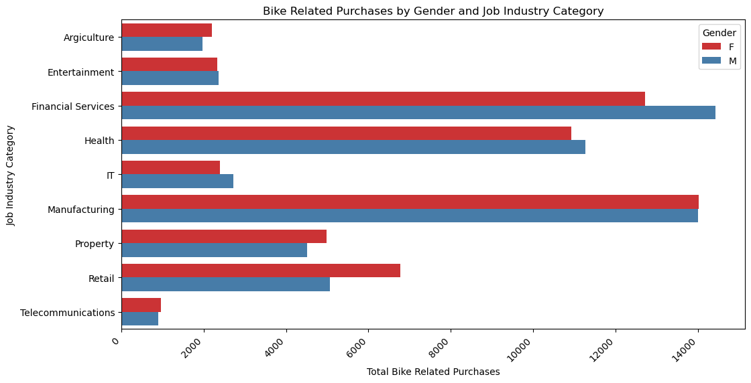
Note: The data and information in this document is reflective of a hypothetical situation and client. This document is to be used for KPMG Virtual Internship purposes only.
Data Exploration
The Proportion Of Customers Purchase Bike For The Past 3 Years By Their Gender
The Financial and Manufacturing industries show a highest proportion of customer that purchase bike for the past 3 years.
Male and Female Share the same proportion in the Manufacturing industries
Male purchase more bike in the Financial industries

Slide 10
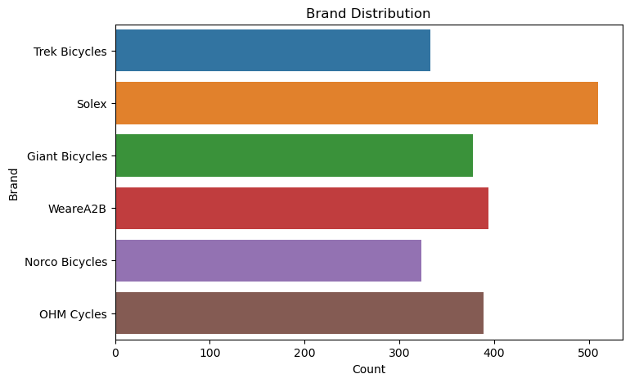
Note: The data and information in this document is reflective of a hypothetical situation and client. This document is to be used for KPMG Virtual Internship purposes only.
Data Exploration
Brand Distribution
Solex has the highest proportion compared to other brands

Slide 11
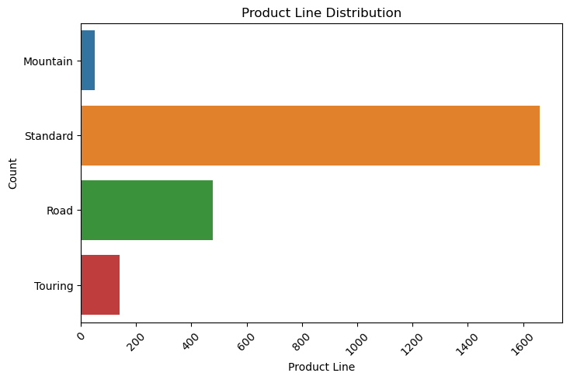
Note: The data and information in this document is reflective of a hypothetical situation and client. This document is to be used for KPMG Virtual Internship purposes only.
Data Exploration
Product Line Distribution
Standard product line has the significance number, and this could be the most popular options, affordability or there is much focus on standard product line than other options by the company.

Slide 12
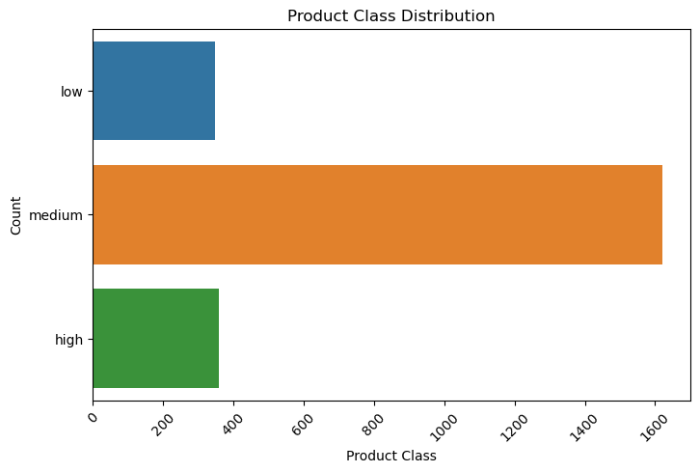
Note: The data and information in this document is reflective of a hypothetical situation and client. This document is to be used for KPMG Virtual Internship purposes only.
Data Exploration
Product Line Distribution
Customers appear to prefer purchasing medium-class bicycles compared to other classes. This could be because of price balance and features which make medium-class bikes more appealing to a broader range of customers.

Slide 13
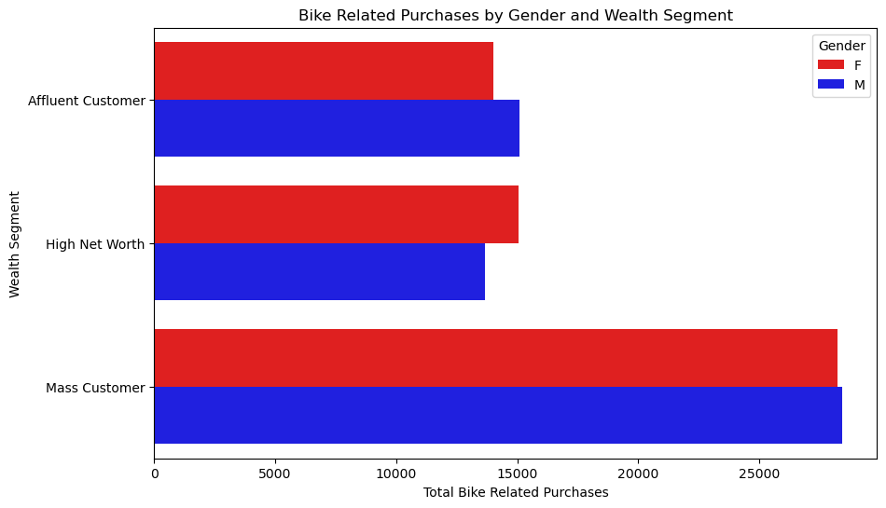
Note: The data and information in this document is reflective of a hypothetical situation and client. This document is to be used for KPMG Virtual Internship purposes only.
Data Exploration
Wealth Segment
The data indicates that most customers fall into the "Mass Customer" category, with similar proportions for both "Affluent" and "High Net Worth" segments.

Slide 14
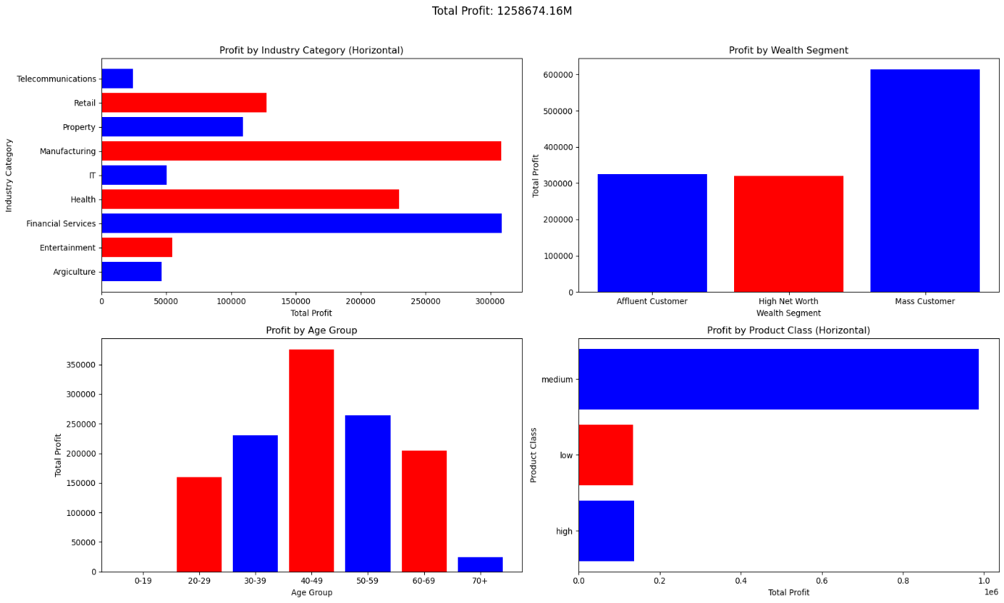
Note: The data and information in this document is reflective of a hypothetical situation and client. This document is to be used for KPMG Virtual Internship purposes only.
Data Exploration
Profits Distribution
Manufacturing and financial industry generated more profits
The customers between the age of 30 to 60 most especially 40s, have the highest revenue for the company.
Customer generate more revenue from medium class bicycles.
Mass customer should be target for more revenue's generation.
Health industry also need more attention.

Slide 15
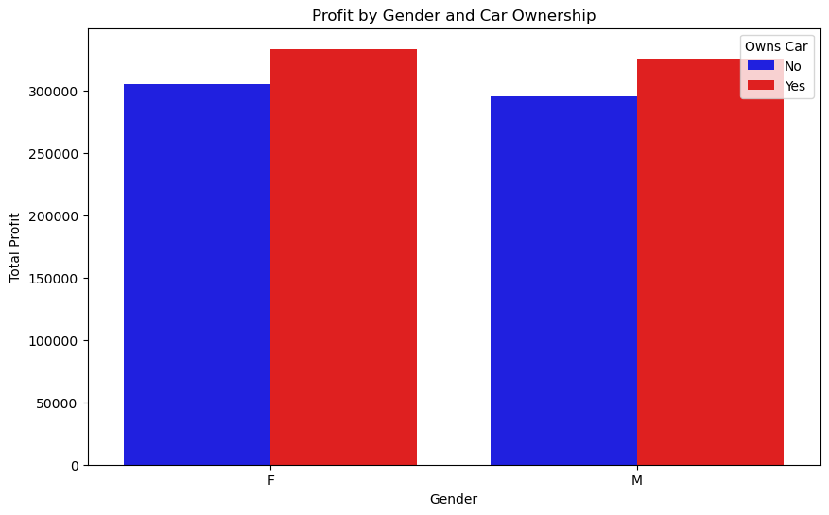
Note: The data and information in this document is reflective of a hypothetical situation and client. This document is to be used for KPMG Virtual Internship purposes only.
Data Exploration
Car Owner ships
The customers that own generated more revenue compared to those without a car for both male and Female.

Slide 16
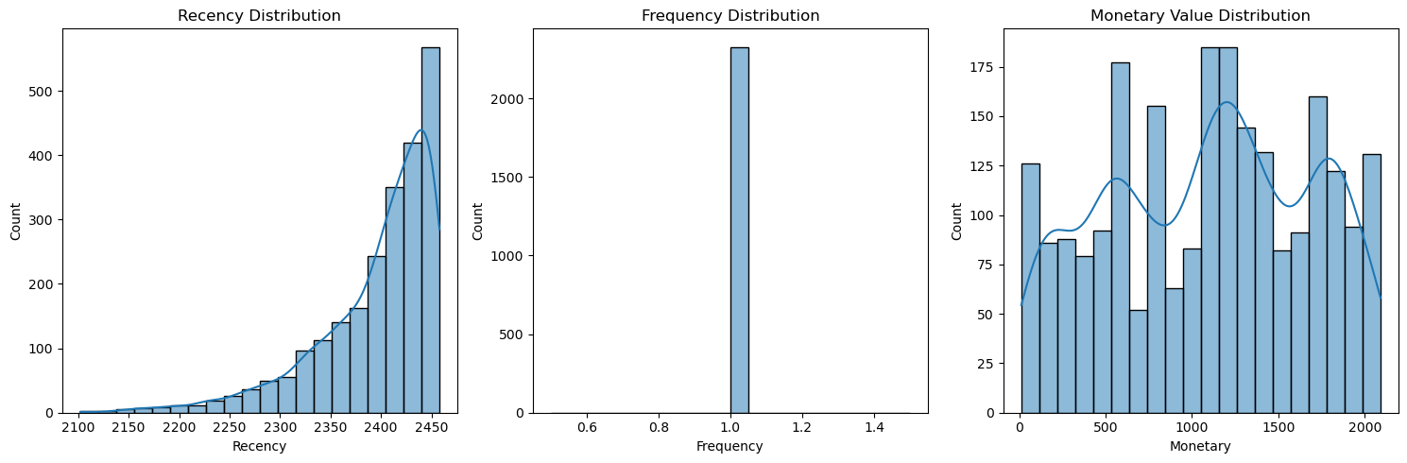
Note: The data and information in this document is reflective of a hypothetical situation and client. This document is to be used for KPMG Virtual Internship purposes only.
Model Development
RFM Analysis for Recency, Frequency and Monetary
The RFM analysis suggest low recency customer
Constant frequency indicate there are only one-off customers
Customers share different monetary values

Slide 17
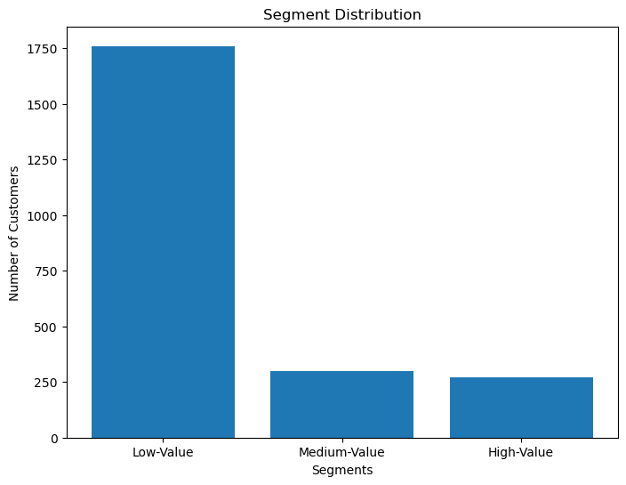
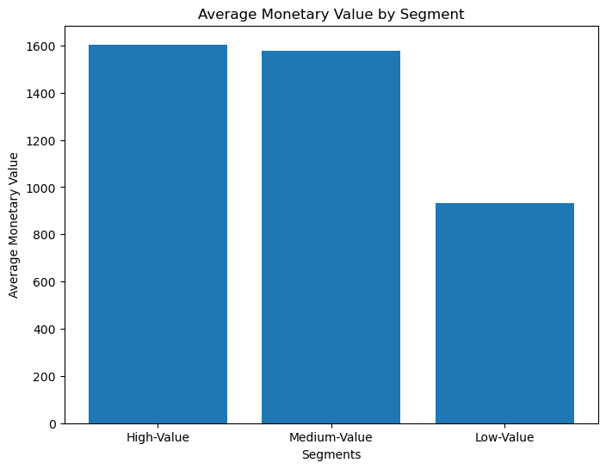
Note: The data and information in this document is reflective of a hypothetical situation and client. This document is to be used for KPMG Virtual Internship purposes only.
Model Development
RFM Analysis of Low, Medium and High Values Customers Based on their numbers and Monetary
The analysis shows a high number of low value customers.
Based on the customers monetary values, there is high proportion of high and medium values customers.
This indicates that while there may be a large number of low-value customers, the revenue generated by those in the high and medium categories significantly contributes to the company's overall financial performance.

Slide 18
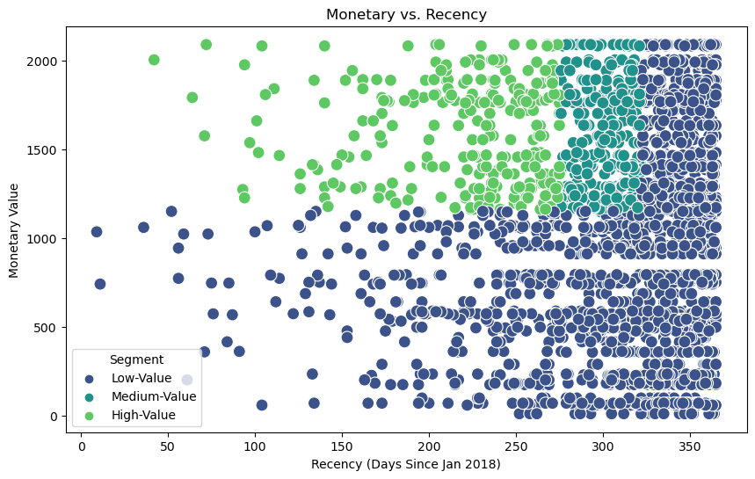
Note: The data and information in this document is reflective of a hypothetical situation and client. This document is to be used for KPMG Virtual Internship purposes only.
Model Development
Monetary VS Recency Based on the RFM Analysis
The results suggest;
High recency and low-value customers.
Loyal, high-value customers.
High recency, high-value customers.
Inactive, low-value customers.
Balanced customer segment.

Slide 19
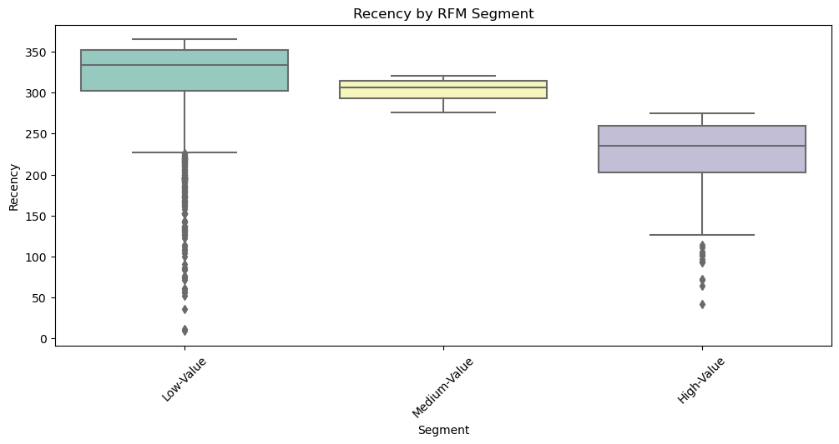
Note: The data and information in this document is reflective of a hypothetical situation and client. This document is to be used for KPMG Virtual Internship purposes only.
Model Development
Recency VS Segment Based on the RFM Analysis
Assessing the recency by segments shows high and low values customers still shows some engagement with the business.

Slide 20
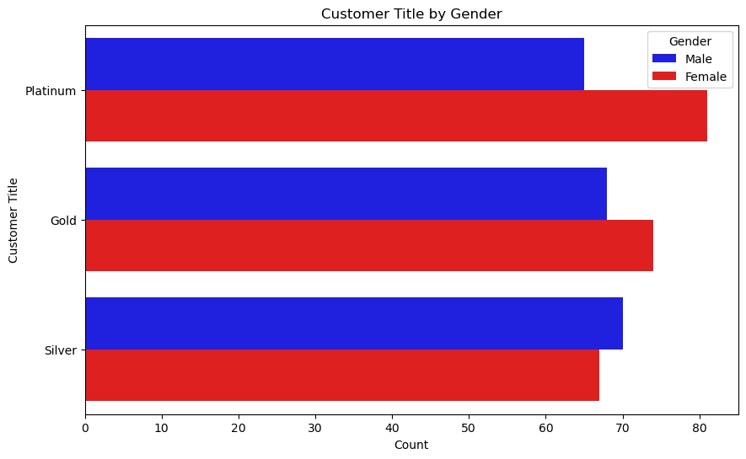
Note: The data and information in this document is reflective of a hypothetical situation and client. This document is to be used for KPMG Virtual Internship purposes only.
Model Development
Customer Segmentation by Gender Based on the RFM Analysis
It shows that female has the highest proportion.

Slide 21
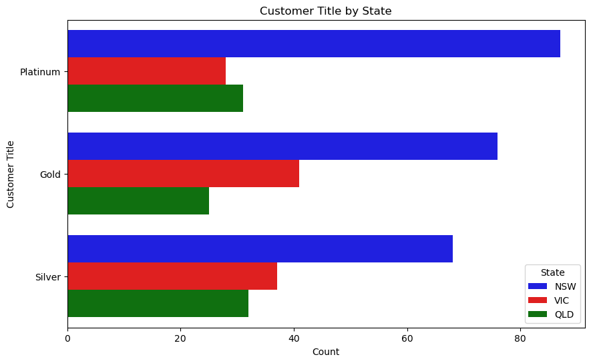
Note: The data and information in this document is reflective of a hypothetical situation and client. This document is to be used for KPMG Virtual Internship purposes only.
Model Development
Customer Segmentation by state Based on the RFM Analysis
Majority of high value customer comes from the New South Wales.

Slide 22
Note: The data and information in this document is reflective of a hypothetical situation and client. This document is to be used for KPMG Virtual Internship purposes only.
Interpretation
Strategic goals: Targeting High Values Customers
The company should target Male and females' customers
Between 35 to 55 years of age
Living in New South Wales
Manufacturing and financial industry
Focusing on medium and high-class bicycles
Marketing standard product line more often
Implementing customer retention strategies because of too much one-off customers

Slide 23
Note: The data and information in this document is reflective of a hypothetical situation and client. This document is to be used for KPMG Virtual Internship purposes only.
Appendix

Slide 24
Note: The data and information in this document is reflective of a hypothetical situation and client. This document is to be used for KPMG Virtual Internship purposes only.
Appendix

