Slide 1


Application of machine learning algorithms for sms spam detection
…
Olatunbosun k. abari-alabi
MSC DATA SCIENCE
MAY 20, 2024

Slide 2


AGENDA
Introduction
Objectives of the study
Research Questions
Methodology
Results
Discussion
Conclusion
References

Slide 3
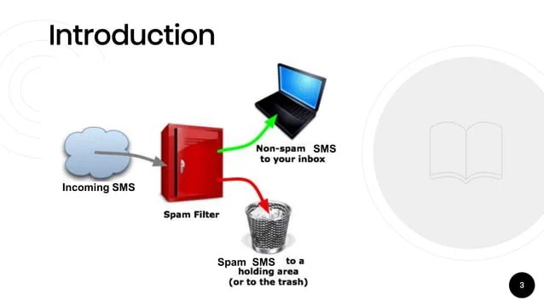
Introduction
In recent years, the proliferation of mobile communication technology, particularly cell phones, has revolutionized interpersonal communication. However, this advancement has been accompanied by an alarming increase in interruptions in the form of spam text messages, also known as Short Message Service (SMS) spam. These unsolicited messages not only disrupt the user experience but also pose significant security risks, including identity theft, data breaches, and financial scams. Murynets and Jover research in 2012 reported that the volume of spam has been on the rise by more than 500% annually leading to dissatisfaction among customers and negatively impacting millions of users globally. To address this pressing challenge, researchers have turned to machine learning (ML) methods and natural language processing (NLP) techniques to develop robust systems capable of effectively identifying and filtering spam SMS messages.

Slide 4
Objective of the Study:
The primary objective of this study is to leverage machine learning algorithms and NLP methods to design a comprehensive system for the detection and mitigation of spam SMS messages. Specifically, the study aims to achieve the following objectives:
1. Design a model capable of accurately recognizing spam SMS messages while minimizing false positives and false negatives.
2. Enhance the accuracy and reliability of the detection system by incorporating advanced natural language processing techniques.
3. Evaluate the performance of various machine learning algorithms in classifying SMS messages as spam or legitimate (ham) in the context of imbalanced datasets.
4. Compare the effectiveness of different ML algorithms and select the model with the highest performance for spam detection.

Slide 5
Research Questions:
To guide the investigation, the study will address the following research questions:
1. How effective are machine learning techniques in identifying and classifying spam text messages (SMS)?
2. Which machine learning algorithms are best suited for detecting spam SMS messages in imbalanced datasets, where spam messages are a minority?

Slide 6
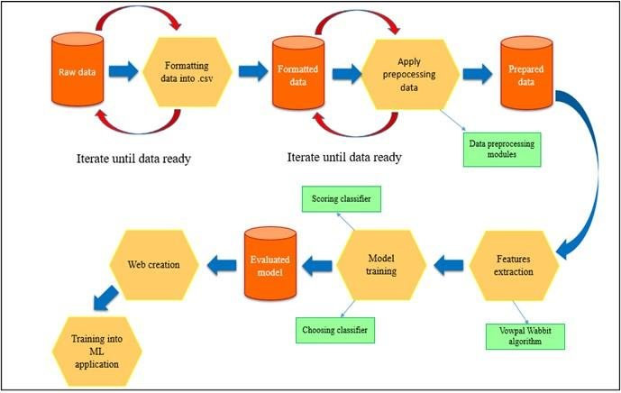
Methodology
Data Collection and Preparation
The SMS Spam Collection Dataset from Kaggle was used for this project, containing both 'spam' and 'ham' messages.
The dataset consists of 5,572 English SMS messages, representative of real-life communication patterns.
Data preparation involved standardization, removal of non-textual elements, dealing with missing values, lowercase conversion, and tokenization.

Slide 7
Methodology contd..
Model Development
Machine learning algorithms, including Naive Bayes, Logistic Regression, and Random Forest, were selected and tested for text classification.
Algorithms were chosen based on their ability to handle textual input and manage imbalanced classes effectively.
Model training involved preprocessing, feature extraction, fair representation of classes, hyperparameter tuning, and selection of evaluation metrics.
Model Assessment
Model assessment was conducted using metrics such as accuracy, precision, recall, and F1 score.
These metrics provide a comprehensive evaluation of the model's performance in distinguishing between spam and ham SMS messages.
The assessment methodology ensures the selected model aligns with the specific requirements of spam detection while minimizing false positives and negatives.

Slide 8
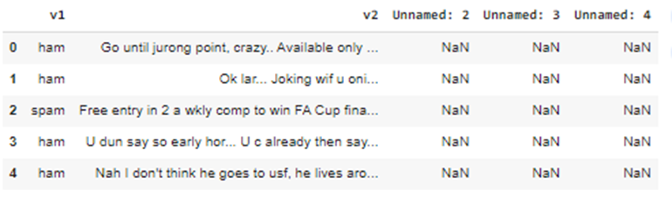
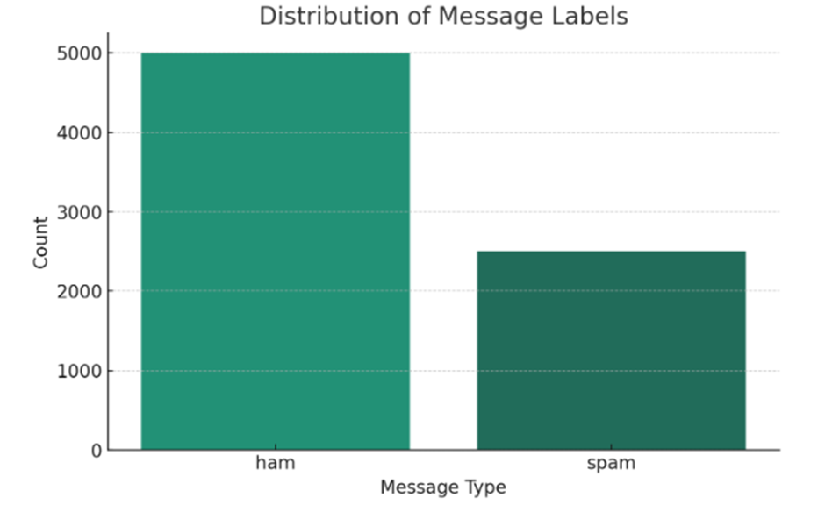
RESULTs
Data Pre-processing and Exploratory Data Analysis
Firstly, we explored our dataset, which comprises both "ham" (non-spam) and "spam" messages. Our dataset consists of around 86.6% ham communications and approximately 13.4% spam messages from a total 5572 messages. To address potential bias, we resampled the dataset to equalize the proportion of spam and ham messages, resulting in a total of 7,500 messages having 33.3% spam and 66.7% ham.

Slide 9
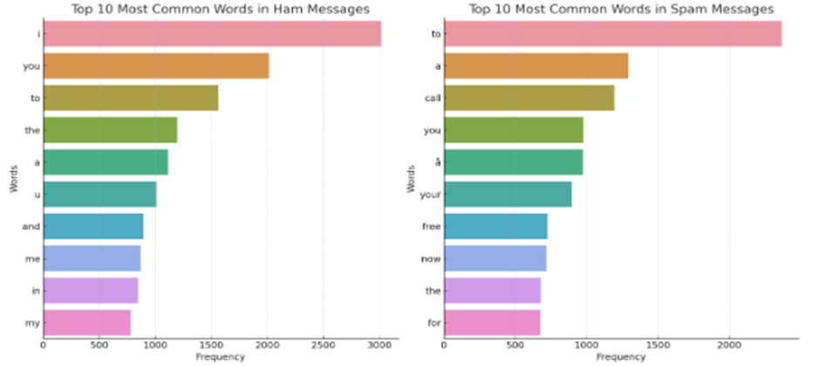
RESULTs contd…
During our analysis, we observed notable differences in the lengths and word usage between ham and spam messages.
The average length of non-spam messages is 71.13 characters.
The average length of spam messages is 138.71 characters.
Spam messages tend to be longer and contain promotional or urgent keywords like "call," "free," and "now," while ham messages focus more on personal interactions.
Sentiment Analysis
In a deeper analysis, ham messages have a mean sentiment polarity of 0.125 and a standard deviation of 0.291, indicating a slight positive sentiment with a wide sentiment range. Spam communications have a greater mean emotion polarity of 0.193 and a lower standard deviation of 0.270. Overall, spam messages exhibit a consistently more positive tone compared to ham messages. This analysis provided insights into the emotional nuances of SMS communications.

Slide 10
RESULTS CONTD…
Machine Learning Classification
We trained our models using TF-IDF vectorization, a technique that transforms text input into numerical representations.
Our evaluation metrics, encompassing accuracy, precision, recall, and F1 score, offered nuanced insights into the performance of each model. Naive Bayes exhibited commendable accuracy (98.07%) and precision (98.09%), albeit with room for improvement in recall. Logistic Regression showcased remarkable precision (99.34%) and accuracy (97.93%), albeit at the expense of slightly lower recall. Notably, Random Forest emerged as the frontrunner, boasting near-perfect precision (100%) and recall (99.38%), culminating in an impressive accuracy of 99.8%.
This illustrates its superior ability to precisely classify spam and non-spam messages while reducing the occurrence of both incorrect spam identifications and incorrect non-spam identifications.
Algorithm | Accuracy | Precision | Recall | F1 Score
Naive Bayes | 0.981 | 0.981 | 0.958 | 0.970
Logistic Regression | 0.979 | 0.993 | 0.942 | 0.967
Random Forest | 0.998 | 1.000 | 0.994 | 0.997

Slide 11
DISCUSSION
Research Question 1: Machine Learning Techniques for SMS Spam Detection
Random Forest achieved 99.8% accuracy, showcasing the efficacy of ensemble methods.
Naive Bayes and Logistic Regression also performed well, offering simplicity and interpretability.
Data preprocessing techniques like TF-IDF are crucial for enhancing model performance.
Exploration of advanced techniques like CNNs and LSTMs holds promise for future improvements.
Research Question 2: Addressing Class Imbalance in SMS Spam Classification
Random Forest consistently demonstrated strong performance, particularly in managing class imbalances.
Deep learning techniques like LSTMs and BERT-based models outperformed traditional methods.
Advanced evaluation metrics such as precision, recall, and F1 score are essential for assessing model effectiveness.
Further exploration of resampling techniques and advanced learning models could enhance spam detection capabilities.

Slide 12
CONCLUSION
Machine learning algorithms, particularly Random Forest, Naive Bayes, and Logistic Regression, demonstrate high effectiveness in detecting SMS spam, with Random Forest achieving exceptional accuracy of 99.8%.
The study underscores the significance of data preprocessing techniques like TF-IDF vectorization in enhancing model performance, especially in managing imbalanced datasets.
While Random Forest stands out for its robustness in handling complex classification tasks, Naive Bayes and Logistic Regression also show promise, emphasizing the importance of diverse model selection.
Practical implications extend to cybersecurity teams, software engineers, and telecom companies, offering actionable strategies to enhance spam detection systems and improve user experience.
Future research directions include exploring advanced deep learning techniques like CNNs and RNNs, implementing transfer learning, and addressing multilingual spam detection challenges.
The study's limitations, such as dataset representativeness and class imbalance, highlight areas for further research and innovation in the field of SMS spam detection.
Overall, the study underscores the evolving landscape of cybersecurity, emphasizing the need for continuous innovation and adaptation in combating emerging spam tactics.

Slide 13
REFERENCES
https://www.kaggle.com/datasets/uciml/sms-spam-collection-dataset?resource=download.
https://image.slidesharecdn.com/sms-spam-detection-180722164354/85/sms-spamdetection-3-638.jpg?cb=1666105906
https://www.researchgate.net/figure/Data-flow-of-spam-detection-machine-learning_fig3_359688147.
Abdulhamid, S., Abd Latiff, M. S., Chiroma, H., Osho, O., Abdul-Salaam, G., Abubakar, A. I., & Herawan, T. (2017). A Review on Mobile SMS Spam Filtering Techniques. IEEE Access, 5, 15650-15666.
He, H., Watson, T., Maple, C., Mehnen, J. and Tiwari, A. (2017) ‘A new semantic attribute deep learning with a linguistic attribute hierarchy for spam detection’, 2017 International Joint Conference on Neural Networks (IJCNN), pp. 3862-3869.
Liu, J., Zhao, Y., Zhang, Z., Wang, Y., Yuan, X., Hu, L., & Dong, Z. (2012). Spam Short Messages Detection via Mining Social Networks. Journal of Computer Science and Technology, 27, 506-514. https://doi.org/10.1007/s11390-012-1239-7.
Vujović, Ž., 2021. Classification model evaluation metrics. International Journal of Advanced Computer Science and Applications, 12(6), pp.599-606.
Murynets, I., & Jover, R. (2012). Crime scene investigation: SMS spam data analysis. Proceedings of the 2012 Internet Measurement Conference.
Xu, S., 2018. Bayesian Naïve Bayes classifiers to text classification. Journal of Information Science, [online] 44(1), pp.48-59.
Zhao, C., Xin, Y., Li, X., Yang, Y. and Chen, Y., 2020. A heterogeneous ensemble learning framework for spam detection in social networks with imbalanced data. Applied Sciences, 10(3), p.936.

Slide 14

THANK YOU

