Slide 1
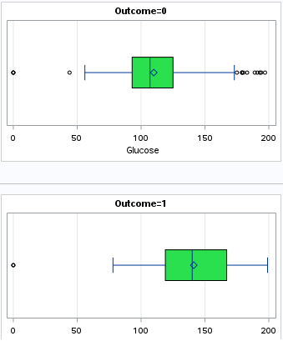
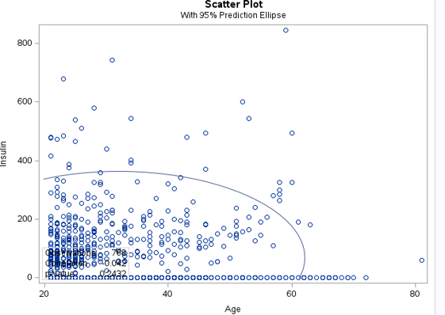

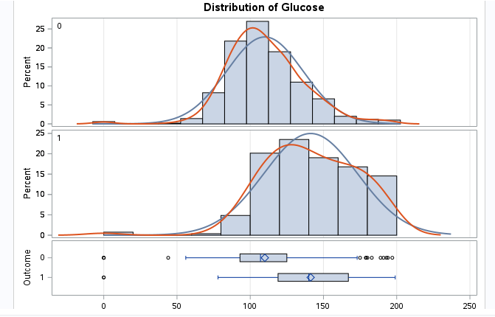
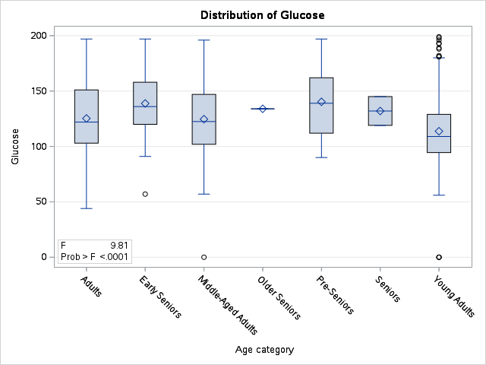
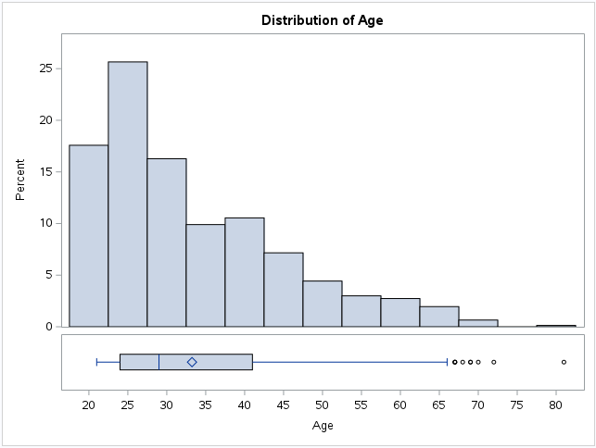
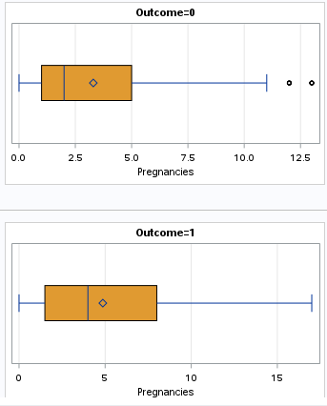


Introduction
Understanding Diabetes: A Statistical View
Non-Diabetic
Glucose Box Plot:
Elevated Levels in Diabetes: The median glucose level is significantly higher in the diabetes group.
Variability: The spread of glucose levels might be larger in the diabetes group, showing varied glucose levels.
Test 2
Correlation Analysis (Age and Insulin):
Hypothesis:
Null Hypothesis (H0): There is no significant correlation between age and insulin in the population studied
Diabetes is a growing health concern worldwide, influencing the lives of millions. Understanding the factors that contribute to its onset is essential in the fight against this condition. This poster distills findings from an in-depth statistical analysis of a dataset capturing key physiological and demographic variables. Our analysis investigates how age, glucose, pregnancies, blood pressure, and insulin levels interact and their collective impact on diabetes risk. The data reveals intricate patterns that not only underscore the complexity of diabetes but also highlight potential avenues for early identification and intervention strategies.
Results
Diabetic
The Spearman Correlation coefficient between Age and Insulin in this dataset is approximately -0.114, and the p-value is approximately 0.0015 less than 0.05, suggesting that this correlation is statistically significant. The negative value of the coefficient indicates a weak inverse relationship.
Statistical Analysis
Test 1
Two Sample T-test (Comparing Glucose Levels):
Research Question: "Is there a significant difference in the average glucose levels between individuals with diabetes and those without diabetes?"
Exploratory Analysis
Test 3
One Way ANOVA Analysis
Hypothesis:
Null Hypothesis (H0): There is no significant difference in average glucose levels between individuals with diabetes and those without diabetes.
Hypothesis:
Null Hypothesis (H0): There is no statistical difference in mean glucose levels among the various age categories.
Results
The low p-value (<.0001) indicates that there are statistically significant differences in glucose levels across age categories. However, the R-squared value of 0.071784 suggests that only a small portion of the variance in glucose levels is explained by the age categories. The analysis results in null hypothesis rejection.
The age distribution suggests a younger population, which might typically have a lower risk for type 2 diabetes.
Non-Diabetic
Diabetic
Results
Non-Diabetic
Pregnancies Box Plot:
Higher Median: Women with diabetes tend to have a higher median number of pregnancies.
Wider Spread: The spread of pregnancies (IQR) might be wider in women with diabetes, indicating more variability.
Non-Diabetic
Diabetic
The analysis of glucose levels between non-diabetic (500 individuals) and diabetic (268 individuals) groups, using the Shapiro-Wilk test, shows the non-normal distribution in both groups (p < 0.0001). So, we can reject the null hypothesis. The T-test indicates a significant difference in mean glucose levels (110.0 for non-diabetic, 141.3 for diabetic) This result is visually supported by skewed distributions and outliers in both groups, as seen in histograms.
Conclusion
Our comprehensive statistical analysis of key physiological and demographic factors provides crucial insights into the complexity of diabetes. The findings indicate a statistically significant difference in glucose levels between diabetic and non-diabetic subjects. There is a significant correlation between age and insulin. There exist notable variations in mean glucose levels across diverse age categories.
Reference: https://www.kaggle.com/datasets/akshaydattatraykhare/diabetes-dataset/data
Diabetic

