Slide 1

Hash
Analytics
Internship
PROOF OF CONCEPT

Slide 2

Employee Attrition Problem
Komolafe Olatunji Samuel

Slide 3

OBJECTIVE:
Presenting an analytical solution to help a company trying
to control attrition by answering the following questions:
What type of employees are leaving ?
Which employees are prone to leave next?
Using data analytics to generate meaningful insights and present these insights inform of
visualizations from the available data provided by the company, the following analytical techniques
were implemented;

Slide 4

STEP 1:
UNDERSTANDING THE VARIOUS FEATURES OF THE DATASET AND WHICH FEATURES ARE OF
IMPORTANCE TO THE OBJECTIVE OF OUR ANALYSIS
STEP 2:
DATA INSIGHTS: Divide the data into two groups(existing and ex employee) and compare their
characteristics

Slide 5

STEP 3:
DATA VISUALIZATION
Check the percentage of employees that left the company vs those remaining. Below is a chart
showing that.

Slide 6
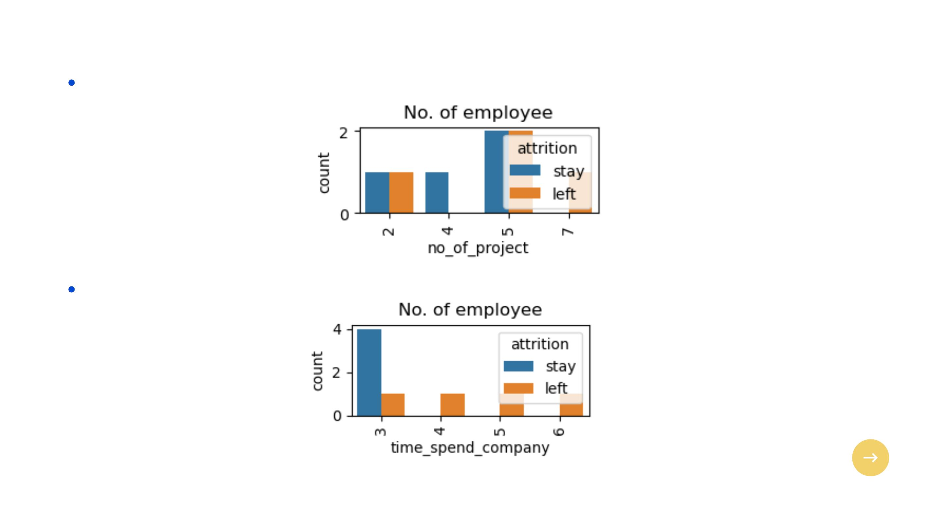
Check the number of projects allocated to each employee(existing and ex).
Check the number of years employees(existing and ex) spent in company.

Slide 7
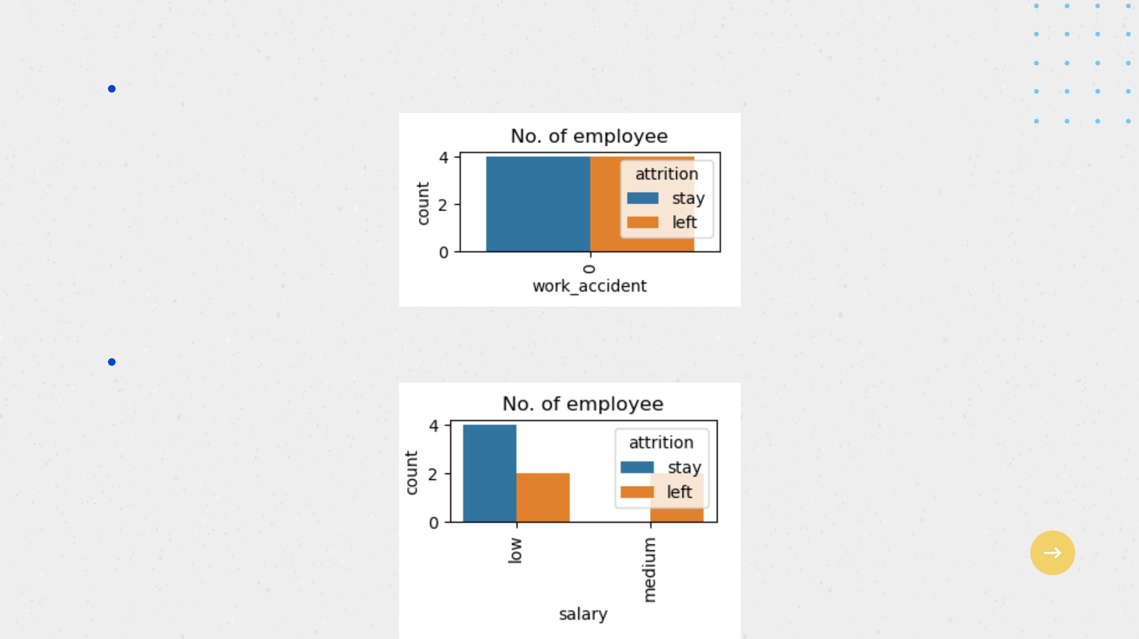
Check for the number of work accidents of employees(existing and ex).
Check for the salary of employees(existing and ex).

Slide 8
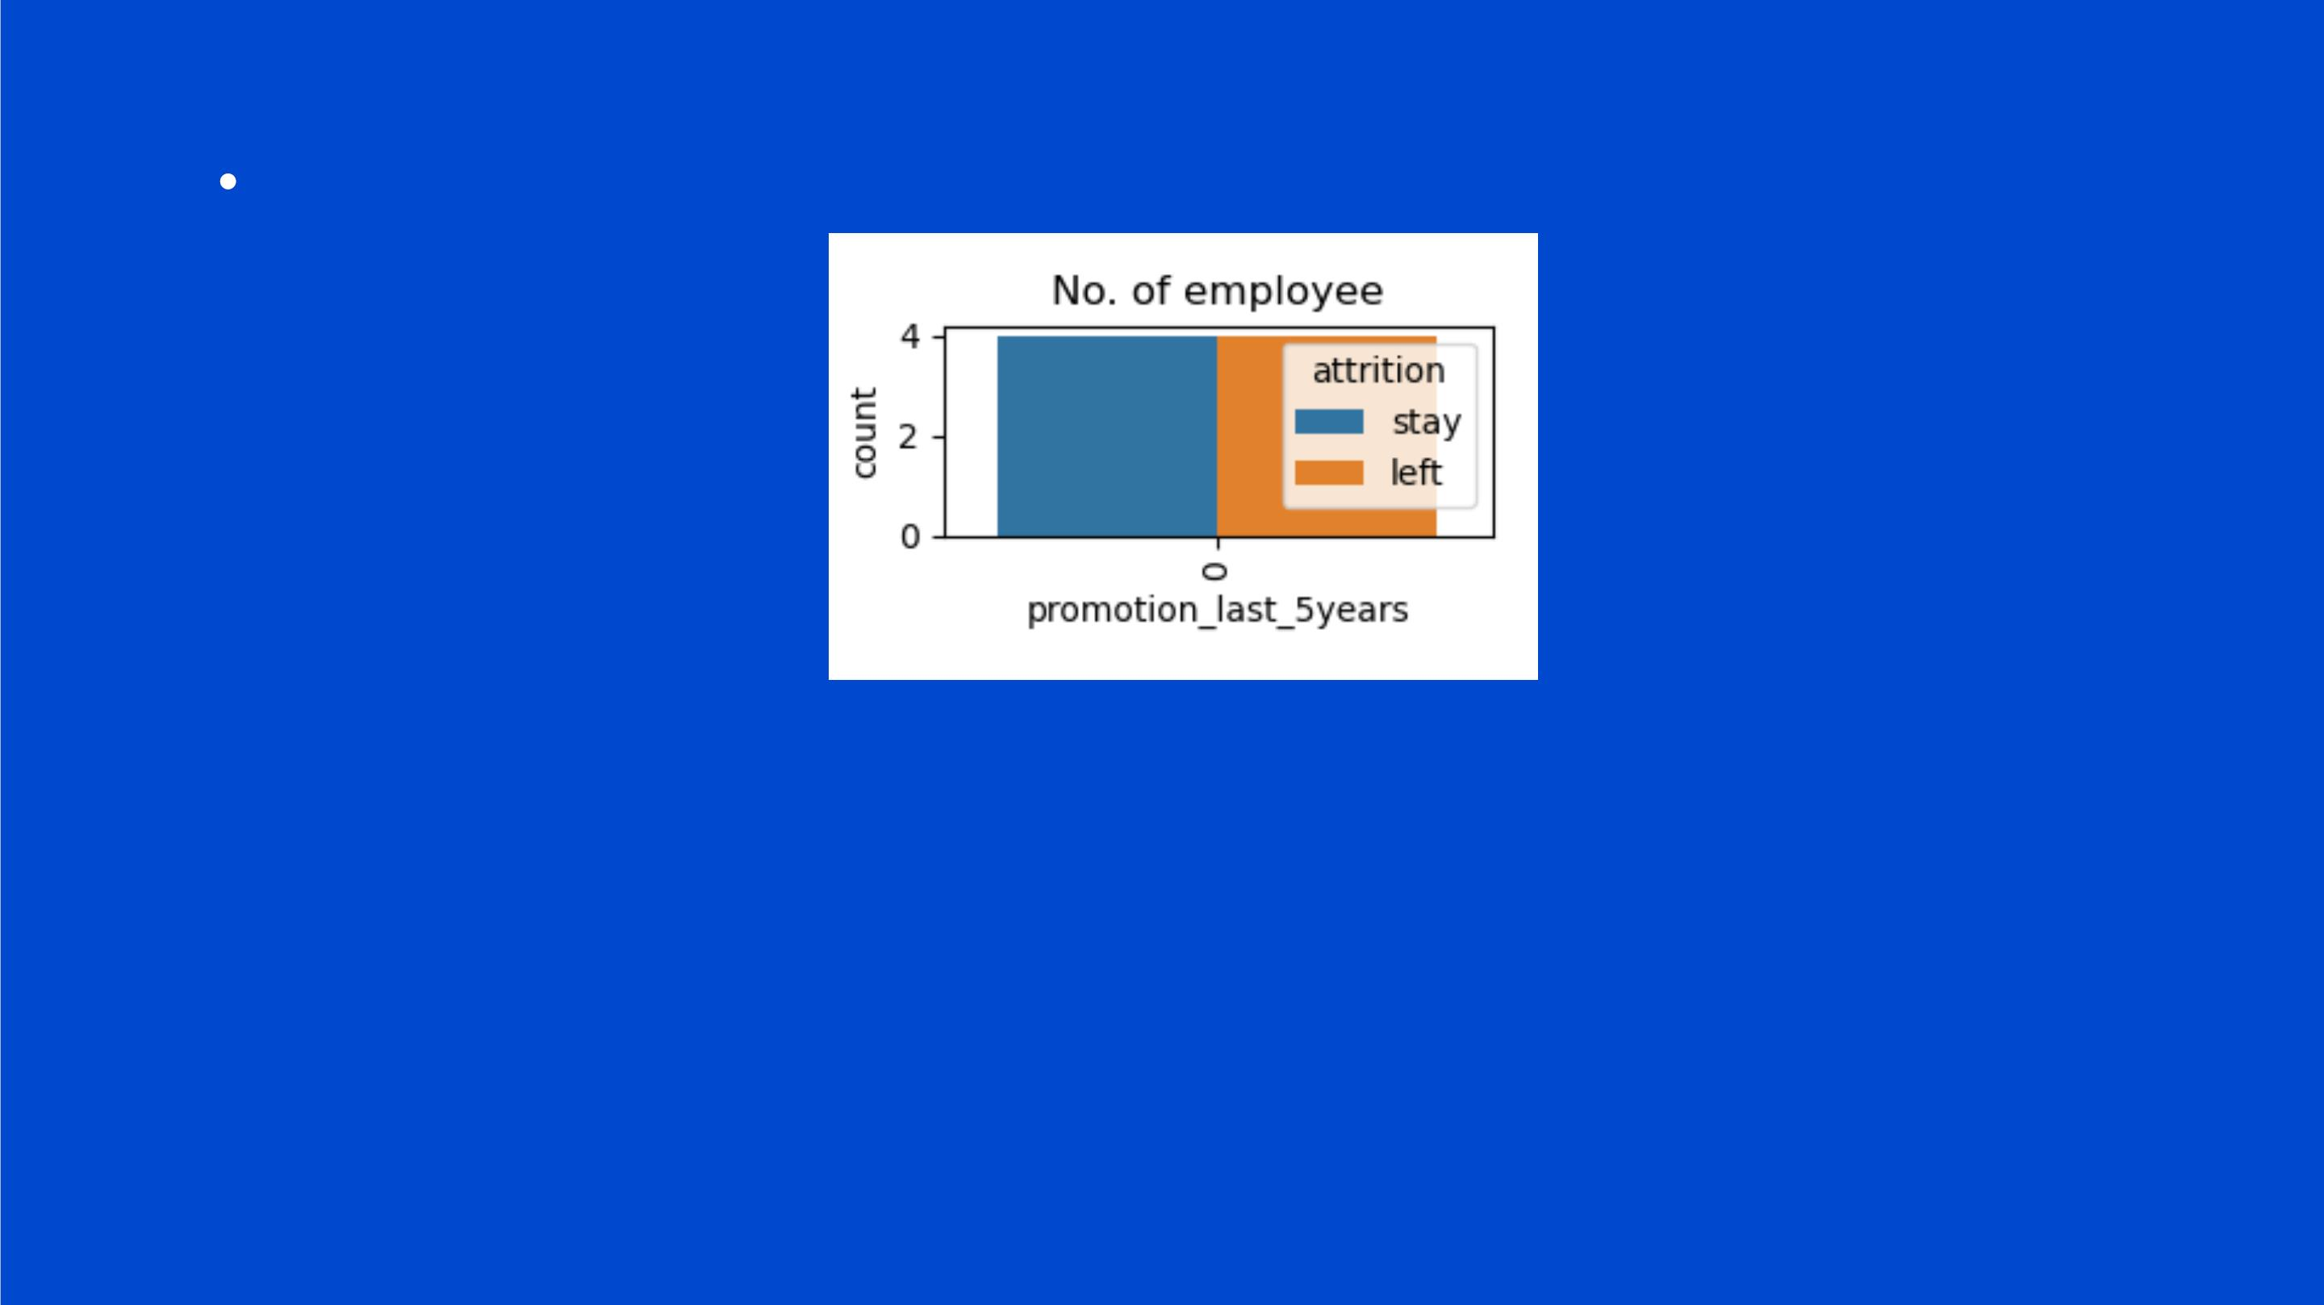
Check for the number of promotions of employees(existing and ex).
You can observe the following points in the above visualization:
Employees with more than 5 projects left the company.
Most of the employees left after 3 years because there was no promotions.
The no of employee that left is 50% of the total employment.
No employee got promoted in the last 5 year.
Most of the employees are getting salary either medium or low.

Slide 9
DATA ANALYSIS AND VISUALIZATION SUMMARY
Following features are most influencing a person to leave the company:
Promotions: Employees are far more likely to quit their job if they haven't received a promotion in
the last 5 years. So, the company should look into promoting its staff to make them want to continue working with them.
Time with Company: Here, The three-year mark looks like a time to be a crucial point in an
employee's career. Most of them quit their job around the three-year mark. If the company ꢀcreate a package for its employees, most of them could get to stay longer with them.

Slide 10
Number Of Projects: Employee engagement is another critical factor to influence the employee to leave the company. Employees with 3-5 projects are less likely to leave the company. The employee with less and more number of projects are likely to leave. Therefore, the company should consider moderating the projects it assigns to employees.
Salary: Most of the employees that quit among the mid or low salary groups. If the company could increase the salaries of its employees, it should be able to reduce the attrition rate.

Slide 11

THANKS

