Slide 1


Academy
CLI 101
Anthony McKale
Principal Software Engineer

Slide 2
Agenda
- Software 101
- Windows CLI
- Shell Paths and Variables - Window Common CLIs

Slide 3
Types of Software

Slide 4
Software Types
Background services – no user input, runs in background
CLI software – simple text input, can run in background
UI software – has pretty user UI, can not run in background (often just pretty frontend to Background service or CLI)
Terminal Software – simple text input, but nothing happens locally, all I/O sent to remote server (comes in two parts Server / Client)
Web Software – special terminal software, html UI application sent from Server, ran on HTML client (lots of implementation, but all follow HTML protocol for sending data/app back and forth)

Slide 5
Software Types
 | User Interface | Processing
Background service | None | Local
CLI software | Text CLI | Local
UI Software | Windowed Application | Local
Terminal Software | Text CLI | Remote
Web Software | HTML Application | Local / Remote
Desktop users tend to only explicitly run UI / Web (client) Software
Servers tend to run only run service / CLI / Web (server) Software
Choose software type based on your customer (Desktop or Service)

Slide 6
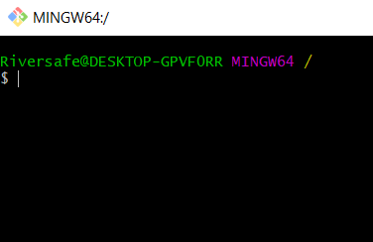
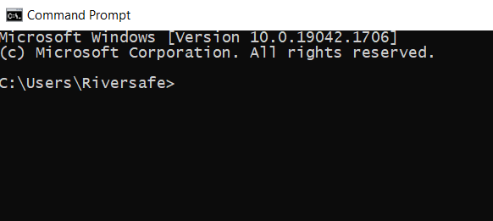
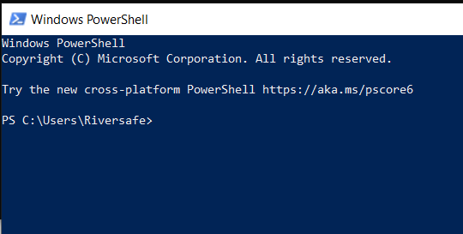
Software Types
CLI software – simple text input, can run in background
These are the tools of Developers CLI Software runs on “Command Line Interfaces” (more on those in a second)
BASH CMD Powershell Linux/Windows* Windows Windows/Linux*

Slide 7
Software Type Questions ?
…

Slide 8
Windows CLI

Slide 9
Windows CLI
“Command Line Interfaces” These allow for:
Programs to be run
File systems to be navigated
Shell Variables
Contain a programming scripting language for automation*
https://en.wikipedia.org/wiki/Command-line_interface

Slide 10
Windows CLI
“Command Line Interfaces” These allow for:
Programs to be run
File systems to be navigated
Shell Variables
Contain a programming scripting language for automation*
* Bad news: all CLIs have different scripting languages**
https://en.wikipedia.org/wiki/Command-line_interface

Slide 11
Windows CLI
Questions? Onto primer of File Path / Shell Variables

Slide 12
Windows CLI
“Command Line Interfaces” These allow for:
Programs to be run
File systems to be navigated
Shell Variables
Contain a programming scripting language for automation*
* Bad news: all CLIs have different scripting languages** ** Good news: they all look and work the same
https://en.wikipedia.org/wiki/Command-line_interface

Slide 13
Primer: Path Paths / Shell Variables
File paths and Shell Programs and Shell Variables

Slide 14
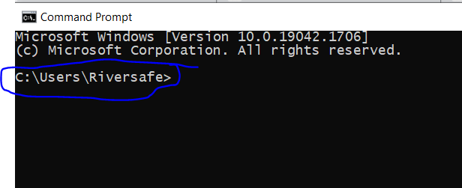
File Path
CLI have a concept of a filepath
CLI have a active directory, where commands will run You can see active directory in CLI window

Slide 15
File Path
Path used by file system commands
Format different depending on CLI back slash (\) is windows style forward slash (/) is unix style CMD/Powershell example C:\dev\docs\
Bash example /C/dev/docs/

Slide 16
File Path
File systems navigation commands take two types of path
Absolute path to file/directory
e.g. DriveLetter:\Dir1\File C:\dev\readme.txt
Relative path from current active directory
Path | Symbol
parent directory | .. ../previous_dir
current directory | . ./../previous_dir
home directory | ~ (Bash Only) ~/Desktop

Slide 17
File Path Example
CMD has a cd (change directory command) cd <new active directory name> CMD move directory absolute example ( note: ..) C:\dev\docs\
cd C:\dev\ C:\dev\ CMD move directory relative example ( note: ..) C:\dev\docs\
cd .. C:\dev\

Slide 18
Shell Programs
Chrome is 100mb, which is 29kb Chrome is a UI program which is a CLI program CLI programs are small

Slide 19
Shell Programs: Rules
Shell programs tend to follow UNIX Philosophy
Unix philosophy as KISS Principle of "Keep it Simple, Stupid”
Build modular programs
Write simple programs
Write small programs
Value developer time over machine time
Write flexible and open programs
https://en.wikipedia.org/wiki/Unix_philosophy

Slide 20
Shell Programs
Unix philosophy in practice Using programs together
cd = change directory ls = list directory modular, simple, small steps to move to dir and read contents:
cd /c/dev
ls

Slide 21
Shell Variables
CLI have a concept of a variables
variables are value containers
Each variable has a name and a value
When Shells are started :
Copy of environment variables taken
CLI specific special variables added* (*Advanced Topic not covered)

Slide 22
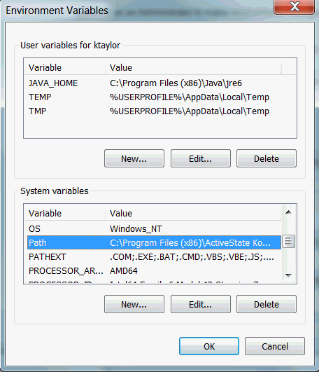
Shell Variables
Environment variables are static system variable, set to store information used for many purposes
From where to find programs, to what version of windows is running
More details:
https://en.wikipedia.org/wiki/Environment_variable Windows Howto: https://docs.oracle.com/en/database/oracle/machine-learning/oml4r/1.5.1/oread/creating-and-modifying-environment-variables-on-windows.html

Slide 23
Shell Variables
Once CLI started shell variables can be create/delete/read at will
Actions on shell variables will not change the Environment variables*
Likewise any changes to Environment variables won’t be seen until you restart your CLI * set = shell, setx = environment, setx is dangerous!

Slide 24
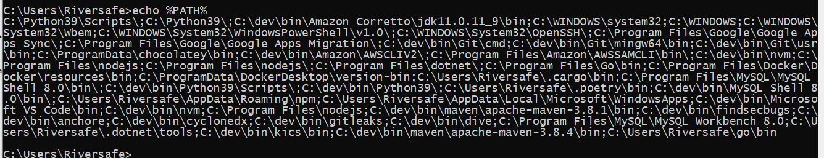
Special Shell Variables
The most important shell variable is PATH
PATH variable controls how programs are found It’s a semi-colon (;) separated list of folders to look for programs in

Slide 25
Shell Example
CMD has a echo (print command) echo <text> CMD has a set (set variable command) set <name>=<value> CMD read shell variable example echo %PATH% CMD write read shell variable example set FOO=BAR
echo %FOO%

Slide 26
Windows CLI
Common Windows “Command Line Interfaces”*
* on Linux you’ll typically use Bash but as Windows others exist (Advanced Topic)
https://en.wikipedia.org/wiki/Command-line_interface
BASH CMD Powershell Linux/Windows* Windows Windows/Linux*

Slide 27
CMD
CMD (Command Prompt)
Grand daddy of them all, made in 1987, basis of Windows precursor called DOS. Superseded on Windows by Powershell, but inbuilt for historical reasons Run with CMD.exe
https://en.wikipedia.org/wiki/Cmd.exe

Slide 28
CMD
Shell variables access:
Action | Command
Read Variable in current shell window | %<VAR_NAME>% e.g. echo %PATH%
Write Variable for current shell window | set <VAR_NAME>=<VALUE> e.g. set FOO=BAR echo %FOO%
Write Environment Variable for all shell windows, and system Use with caution! | setx <VAR_NAME>=<VALUE> e.g. setx FOO=BAR echo %FOO%

Slide 29
CMD
File path: uses windows style back slash (\)
File Commands:
Full list available on window’s cmd/powershell website
https://docs.microsoft.com/en-us/windows-server/administration/windows-commands/windows-commands
Action | Command
Change directory | cd <directory>
List directory | dir
Make directory | mkdir <directory>
Rename file | rename <file/directory>

Slide 30
Powershell
Replacement of CMD for windows administrators.
Main difference is greatly enhanced Script capabilities. Available on Windows and Linux but not commonly used on Linux. Run with powershell.exe
https://en.wikipedia.org/wiki/PowerShell

Slide 31
Powershell
Shell variables access:
Action | Command
Read Variable in current shell window | $env:env_var $shell_var e.g. echo $env.path
Write Variable for current shell window | $<VAR_NAME>=<VALUE> e.g. $FOO=BAR echo $FOO
Write Environment Variable for all shell windows, and system Use with caution! | setx <VAR_NAME>=<VALUE> e.g. setx FOO=BAR echo $env:FOO

Slide 32
Powershell
File path: uses windows style back slash (\)
File Commands:
Full list available on window’s cmd/powershell website
https://docs.microsoft.com/en-us/windows-server/administration/windows-commands/windows-commands
Action | Command
Change directory | cd <directory>
List directory | dir (ls also available, dir in color)
Make directory | mkdir <directory>
Rename file | rename <file/directory>

Slide 33
Bash
Defacto CLI for Linux systems, available via various interpreters on Windows.
Compared to CMD/Powershell has greatly enhanced Script capabilities. But uses L/Unix Slashes for Filepaths. Available on Windows and Linux but not commonly used on Windows. Commonly ran via externally installed program: git-bash https://www.gnu.org/software/bash/

Slide 34
Bash
Shell variables access:
Action | Command
Read Variable in current shell window | $shell_var e.g. echo $path
Write Variable for current shell window | <VAR_NAME>=<VALUE> e.g. FOO=BAR echo $FOO
Write Environment Variable for all shell windows, and system Use with caution! | setx <VAR_NAME>=<VALUE> e.g. setx FOO=BAR echo $env:FOO

Slide 35
Powershell
File path: uses linux style forward slash slash (/)
File Commands:
Full list available on gnu’s bash website
https://www.gnu.org/software/bash/manual/bash.html
Action | Command
Change directory | cd <directory>
List directory | ls
Make directory | mkdir <directory>
Rename file | move <file/directory>

Slide 36

Scripting
Scripting is CMD/Powershell/Bash is a advanced topic
Each CLI has it’s own unique Scripting Language
Next session we’ll cover Bash scripting
The most common, cross platform, powerful of these Scripting Languages

Slide 37
Questions
I’ve been Anthony “Zapper” M^{c}Kale
Hopefully I’ve Educated, Informed, and even Entertained Good Testing is Good Security is Good software

Slide 38
Thank you

