Slide 1
Introduction to stock assessment work
XSAM/SAM workshop 13.-16. January

Slide 2
Assessment methods
An introduction to stock assessment
Input to the assessment process
Results (diagnostics)
Uncertainties
sampling errors
sources of bias
risk analysis to the help?
Multispecies and mixed fisheries considerations

Slide 3
Fish stock assessment
The assessment of a fish stock is the structured approach of analyzing available information to gain insight into the historic and present status both in terms of the abundance and the exploitation of the stock usually including quantitative predictions about the stock's response to different levels of fishing.
What happens if ….?

Slide 4
All models are wrong
Parsimony
Since all models are wrong the scientist cannot obtain a "correct" one by excessive elaboration. On the contrary following William of Occam he should seek an economical description of natural phenomena. Just as the ability to devise simple but evocative models is the signature of the great scientist so overelaboration and overparameterization is often the mark of mediocrity.

Slide 5
All models are wrong (George Box)
Worrying Selectively
Since all models are wrong the scientist must be alert to what is importantly wrong. It is inappropriate to be concerned about mice when there are tigers abroad.
All models are approximations. Assumptions, whether implied or clearly stated, are never exactly true. All models are wrong, but some models are useful. So the question you need to ask is not "Is the model true?" (it never is) but "Is the model good enough for this particular application?"

Slide 6
David Hand
In general, when building statistical models, we must not forget that the aim is to understand something about the real world. Or predict, choose an action, make a decision, summarize evidence, and so on, but always about the real world, not an abstract mathematical world: our models are not the reality—a point well made by George Box in his oft-cited remark that "all models are wrong, but some are useful".

Slide 7
The estimation of:
Historic and current N
Historic and current B
N by age (or length)
N of youngest age = R
B by age (or length)
B mature fish = SSB

Slide 8
Equations used in stock assessment:
Cohort
Baranov
Stock vs survey

Slide 9
Any issues regarding these equations?
Discuss with the guy next to you .......

Slide 10
More equations
General version of cohort eq.:
Z is”total mortality”
e^{-Z} proportion surviving
Can be ”any” time step
Tracking cohorts

Slide 11
More equations:
A differential equation:
Discrete solution:

Slide 12
Fixed time-step:
Z is ”total mortality”
e^{-Z} is the proportion surviving

Slide 13
Logarithms to the rescue
Both sides of the = :

Slide 14
We can also show:
For the catches:
And survey indices:
Ikke helt fritt for ekstra antagelser

Slide 15
Hmmm
This looks easy peasy

Slide 16
The logarithms
This more precise

Slide 17
Rewritten to:
Should catchability not be constant we have:

Slide 18
Mortality and then some ....
Can the catchability term be modelled in any way? Can this be an issue at all? What? How? When?
Depth as an explanatory factor:

Slide 19
Cod in the Barents Sea:

Slide 20
Using changes in average survey catching depth as explanatory variable:

Slide 21
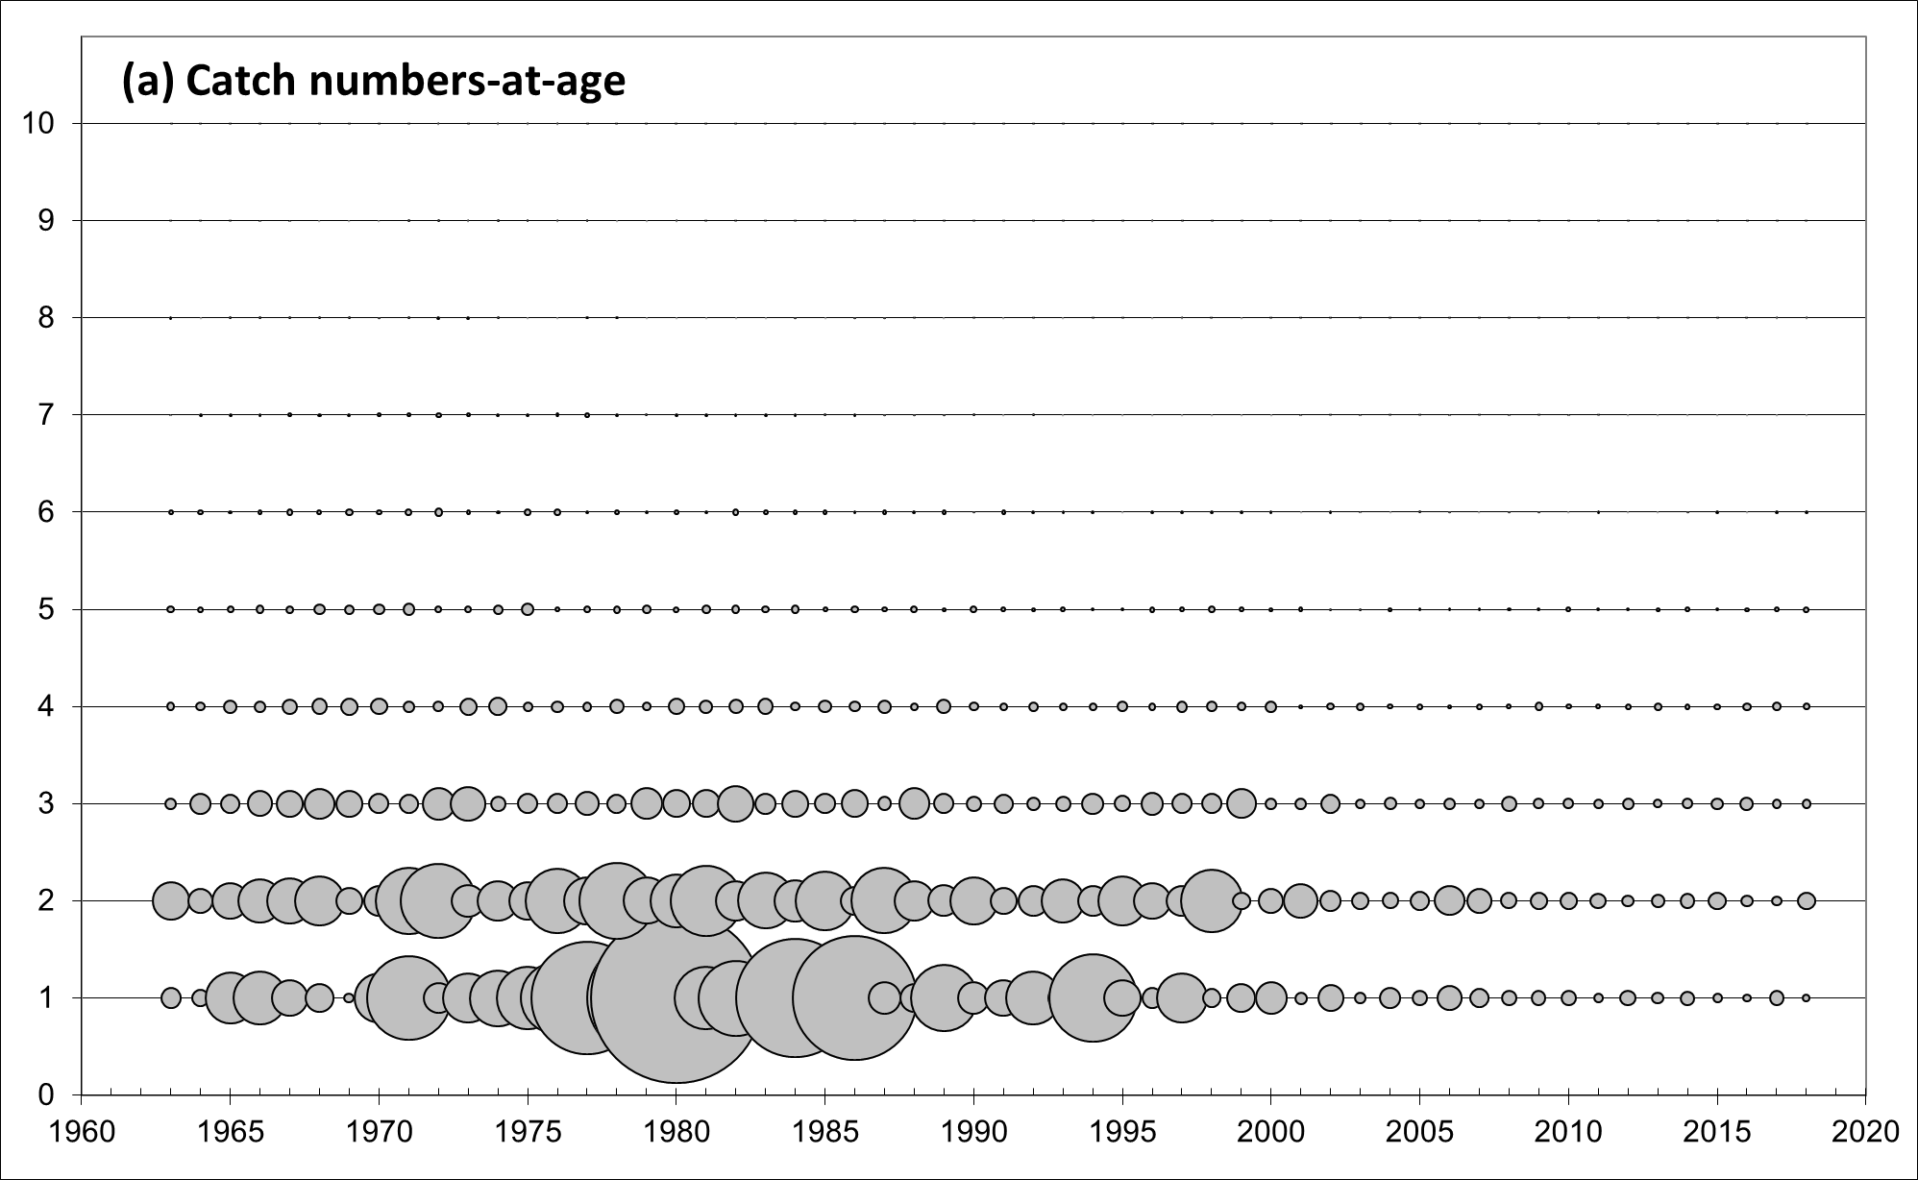
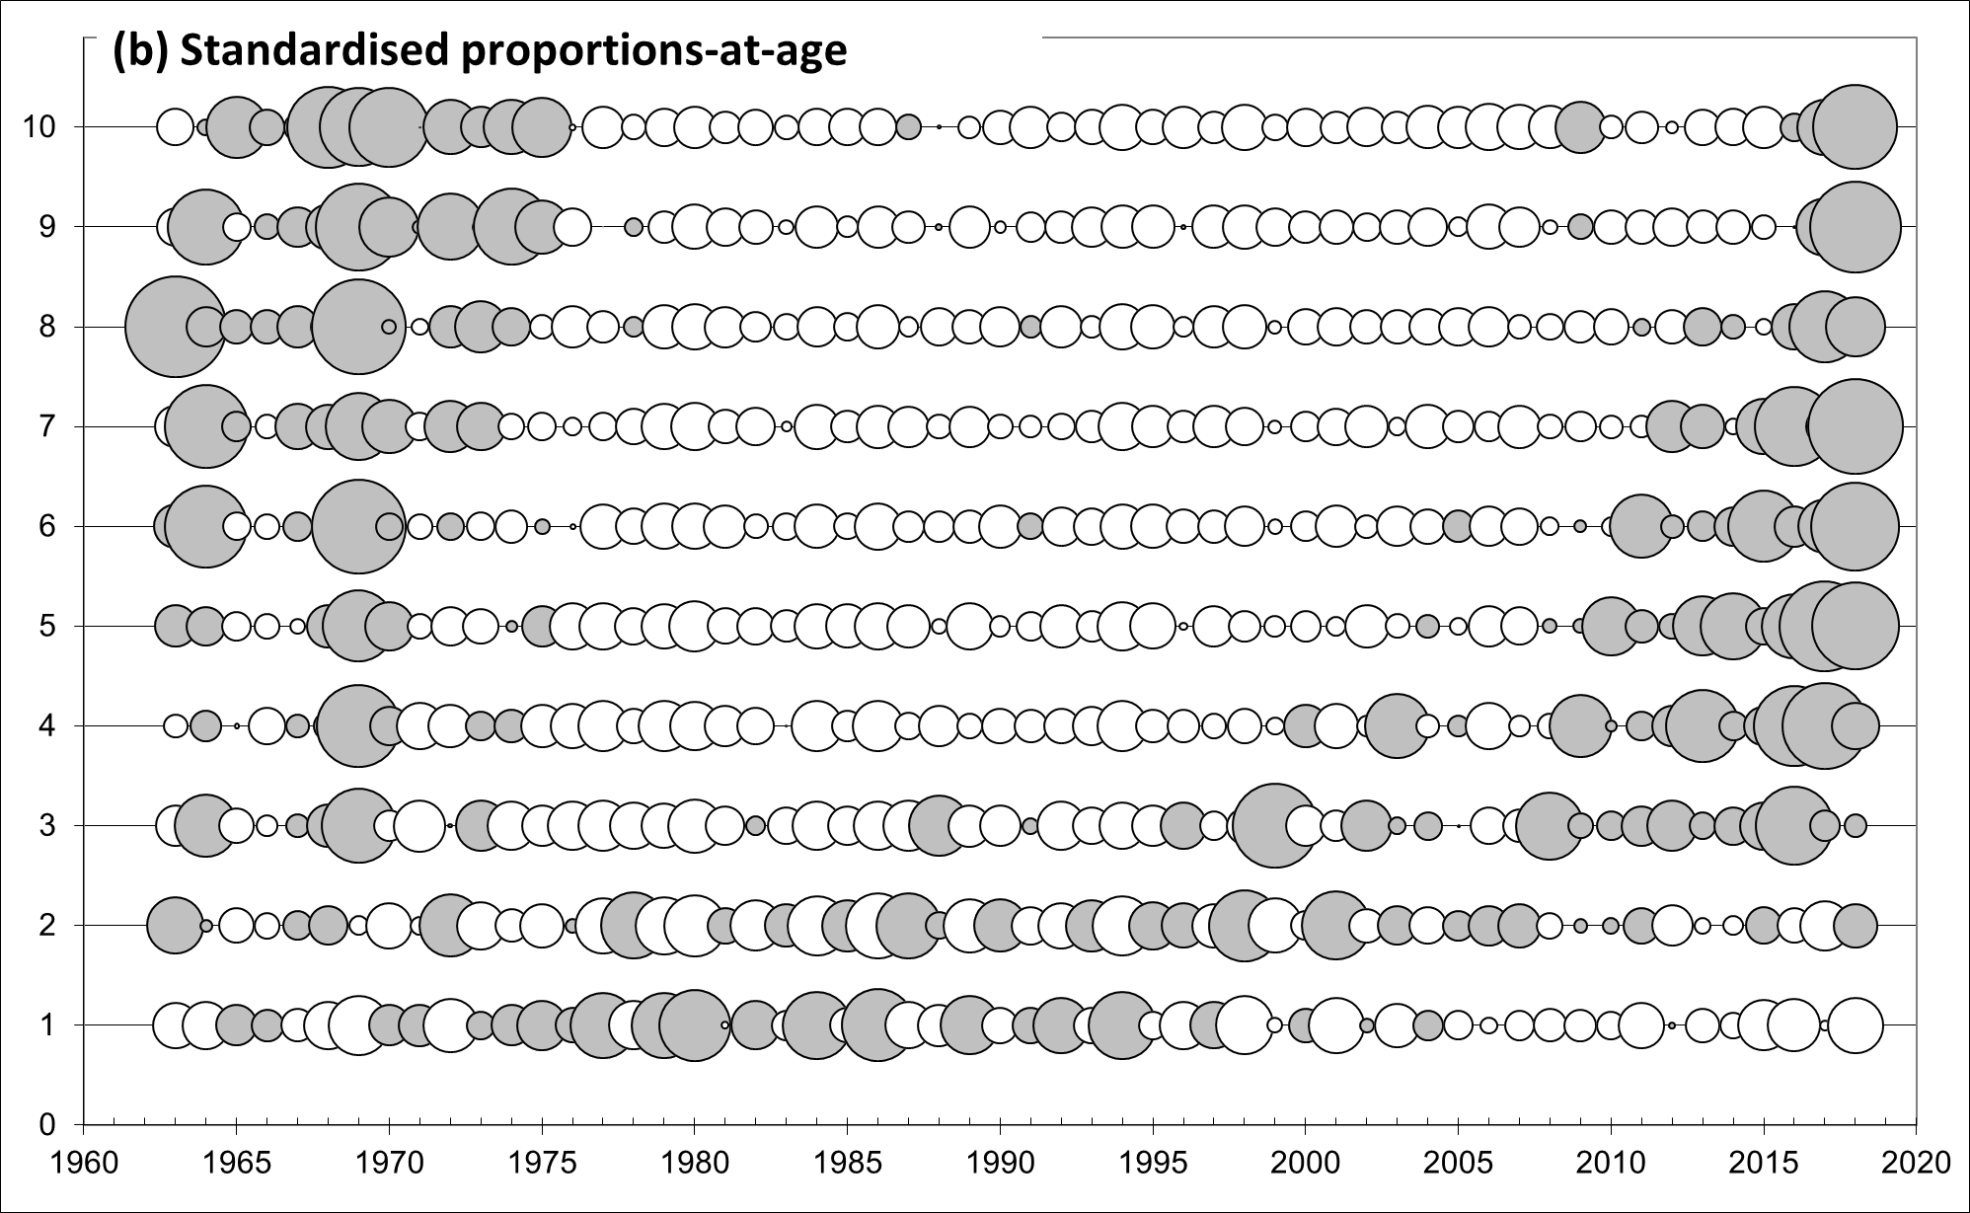
Catch-at-age matrix

Slide 22
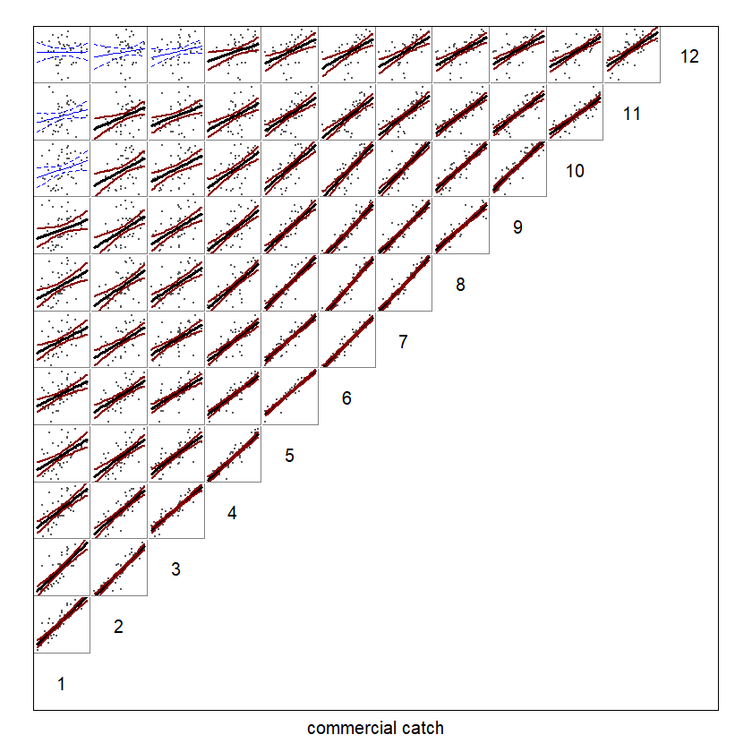
Catch-at-age correlations

Slide 23
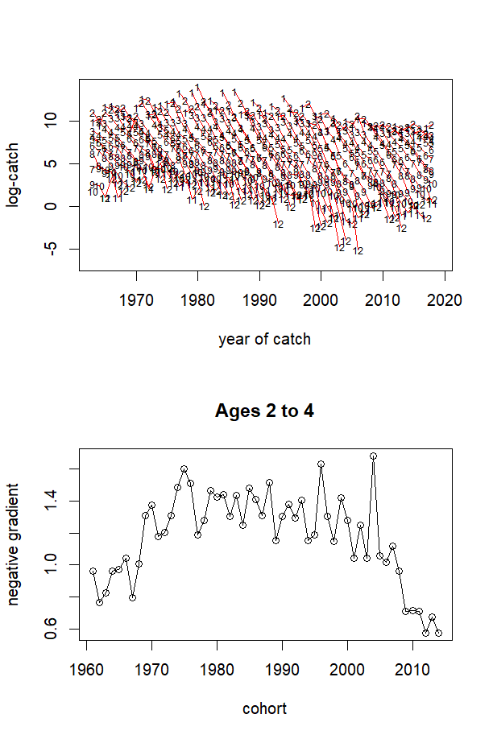
Catch curve analysis

Slide 24
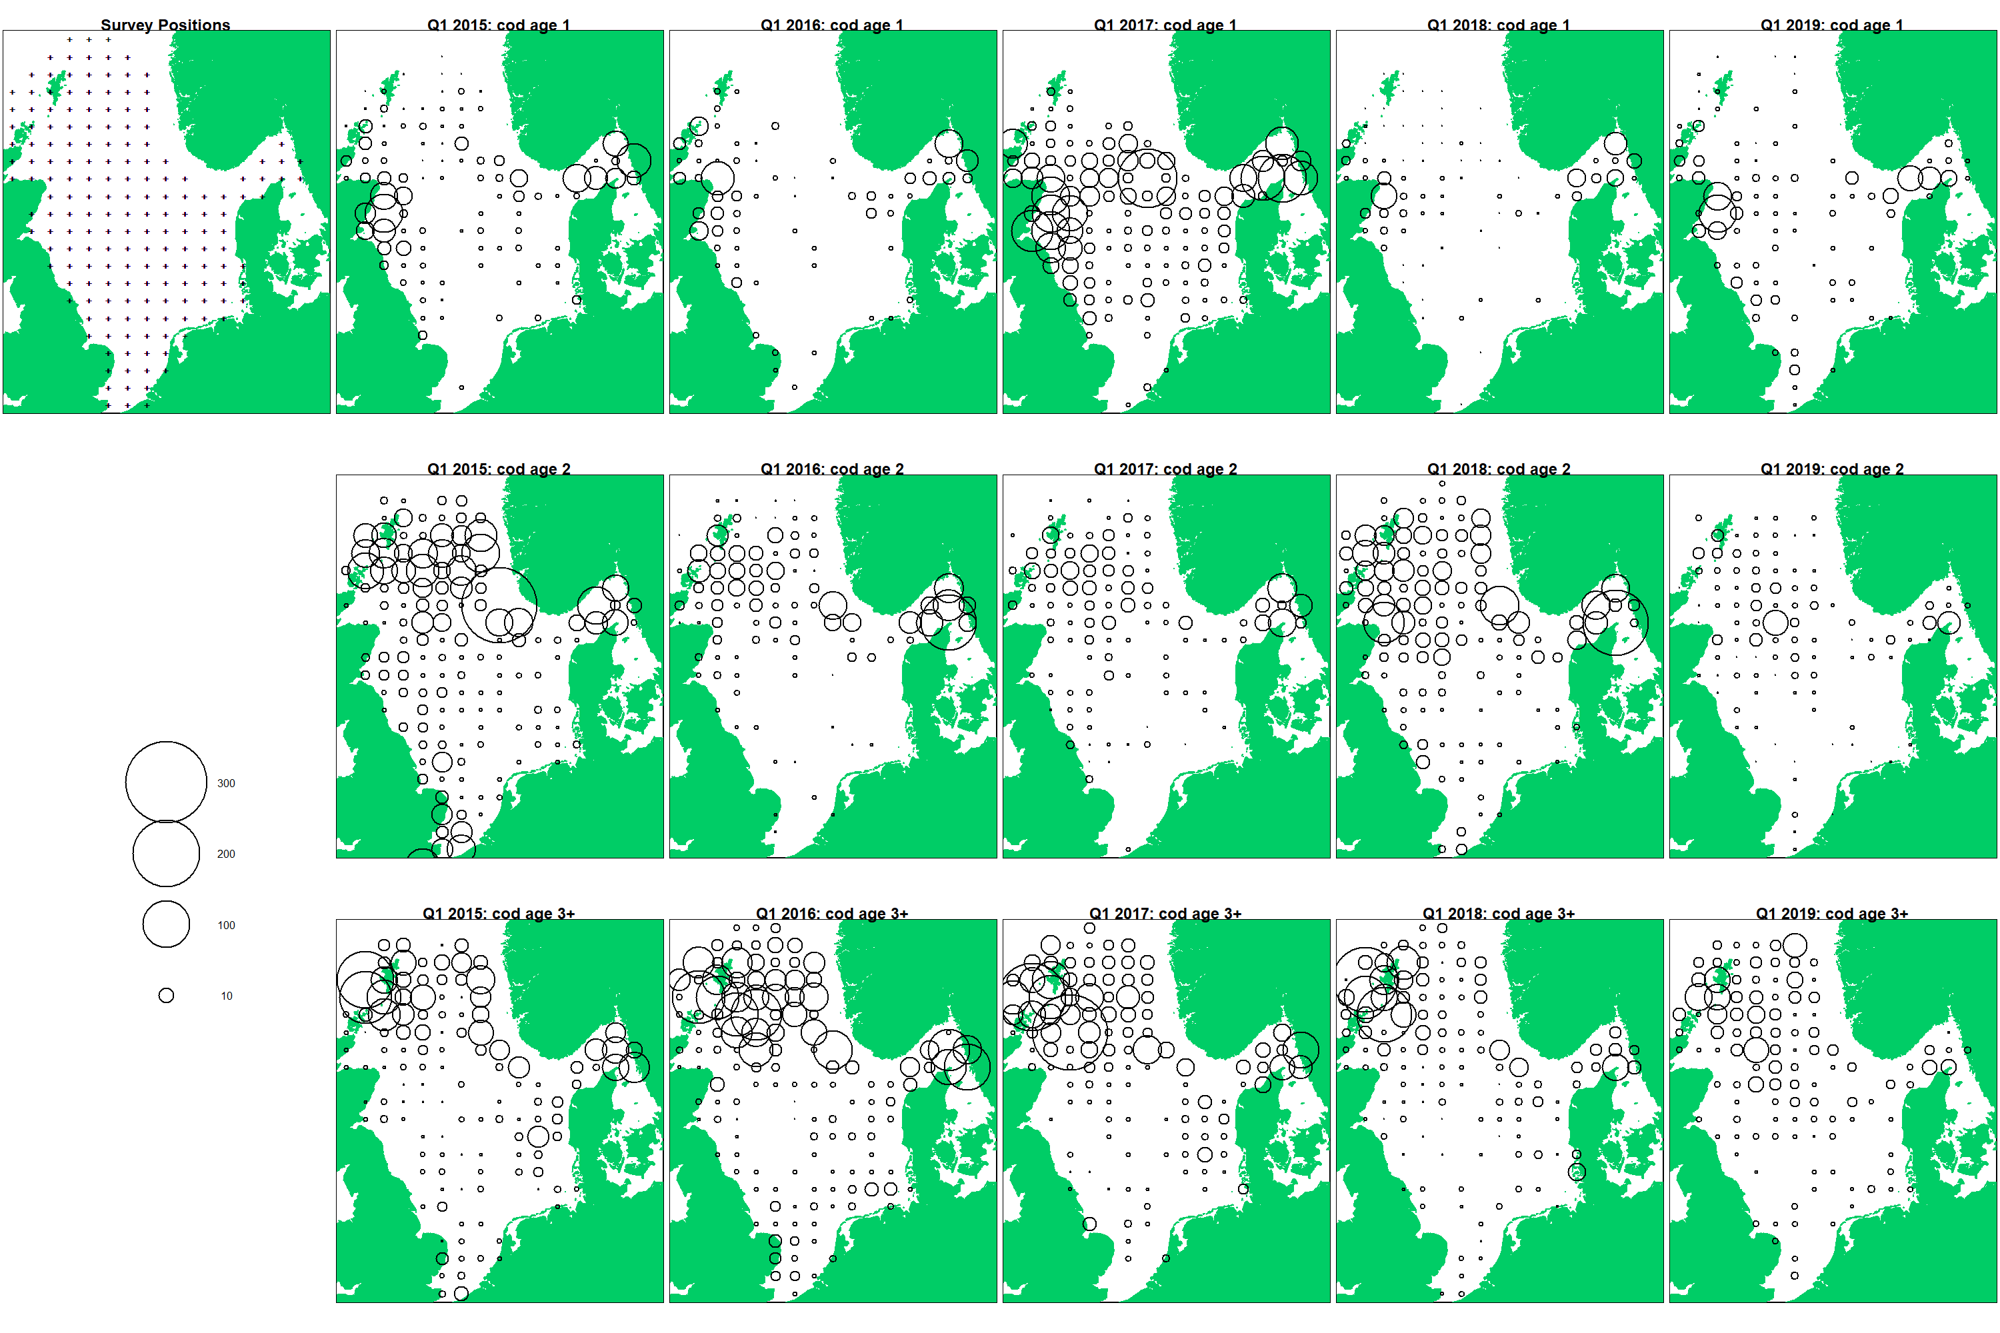
NS-IBTS Q1 CPUE

Slide 25
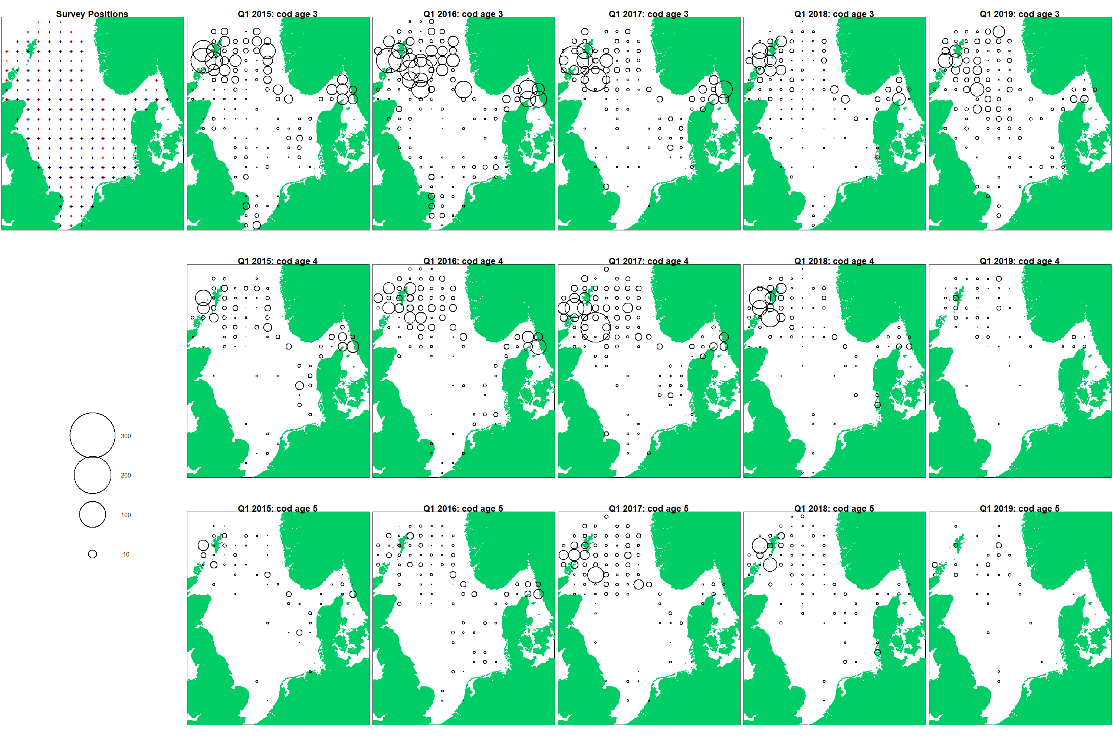
NS-IBTS Q1 CPUE

Slide 26
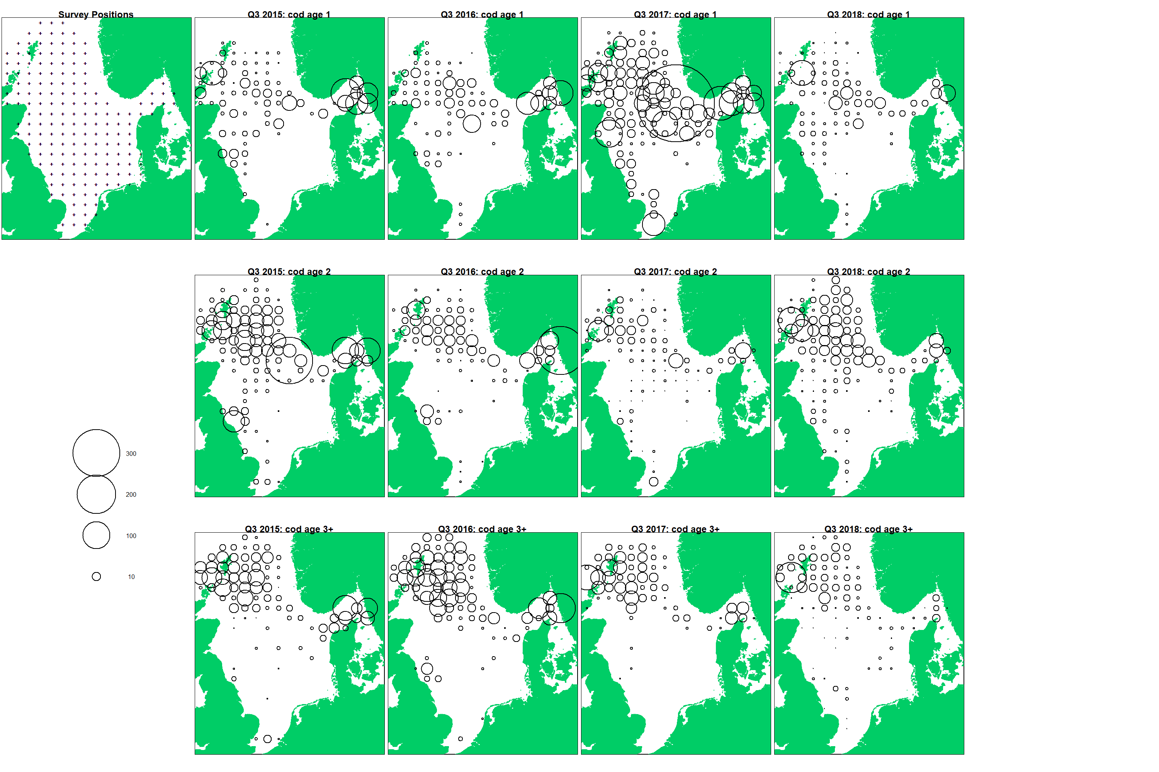
NS-IBTS Q3 CPUE

Slide 27
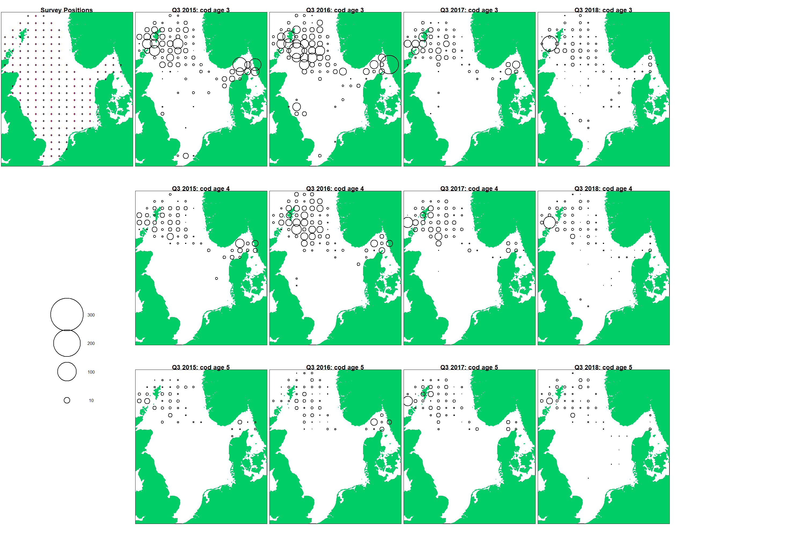
NS-IBTS Q3 CPUE

Slide 28
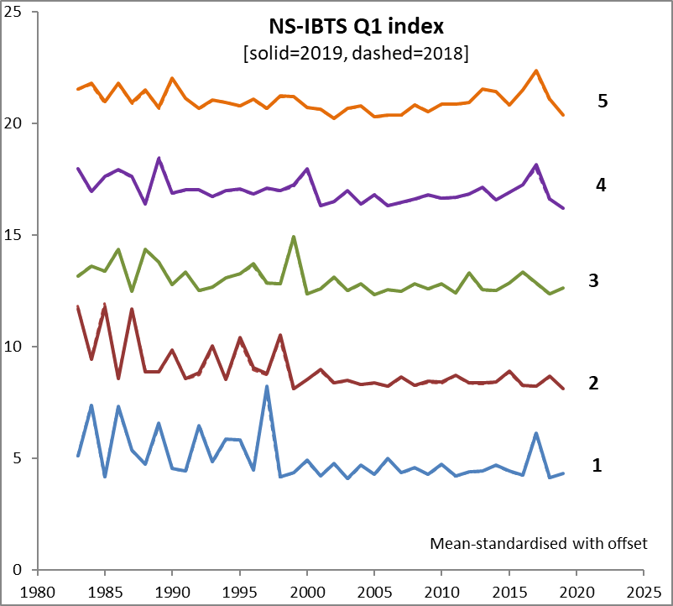
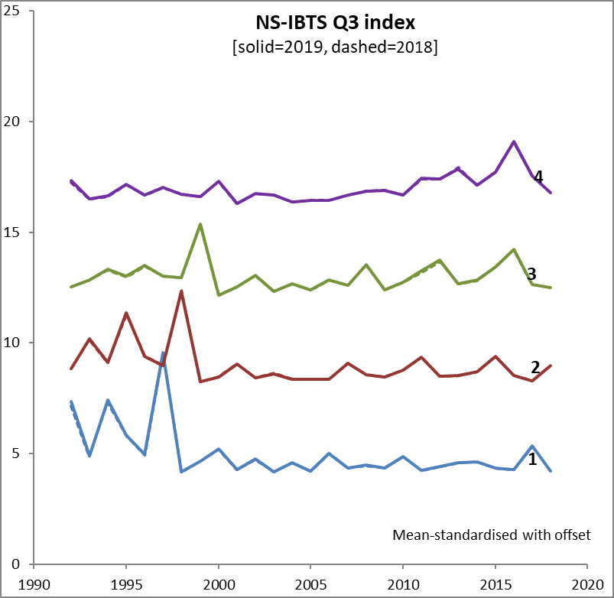
NS-IBTS: Delta-GAM Changes

Slide 29
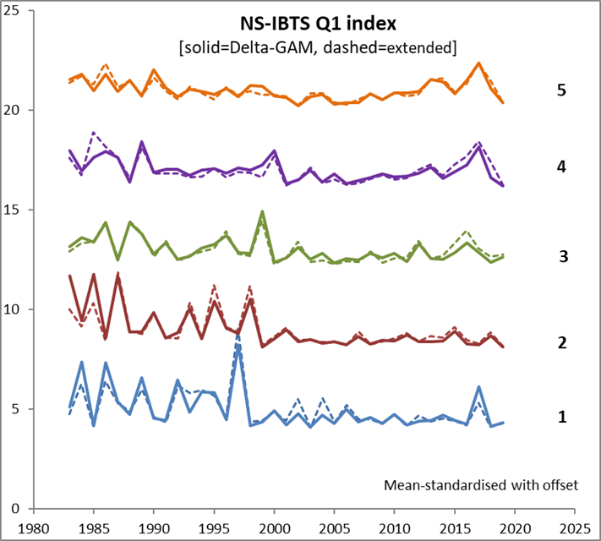
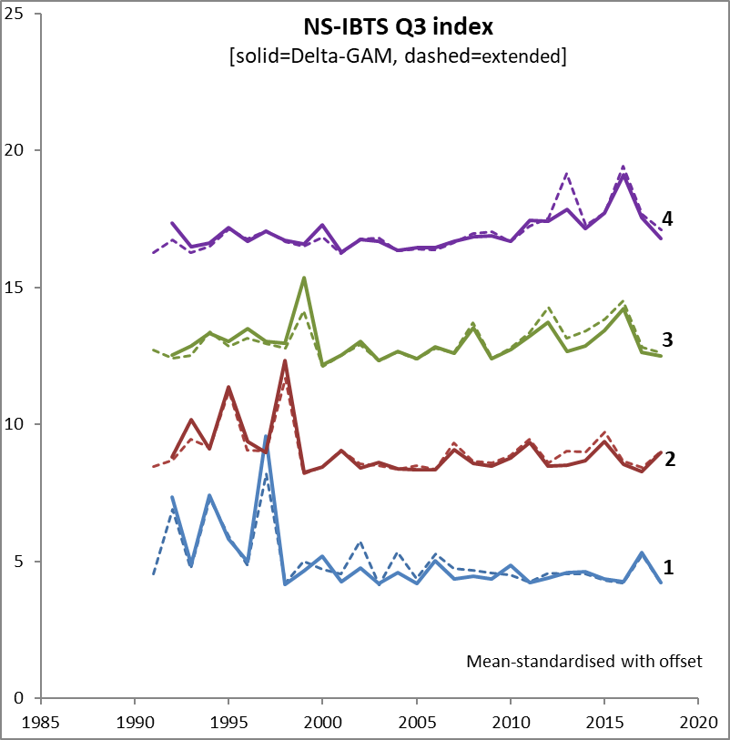
IBTS Delta-GAM vs ICES

Slide 30
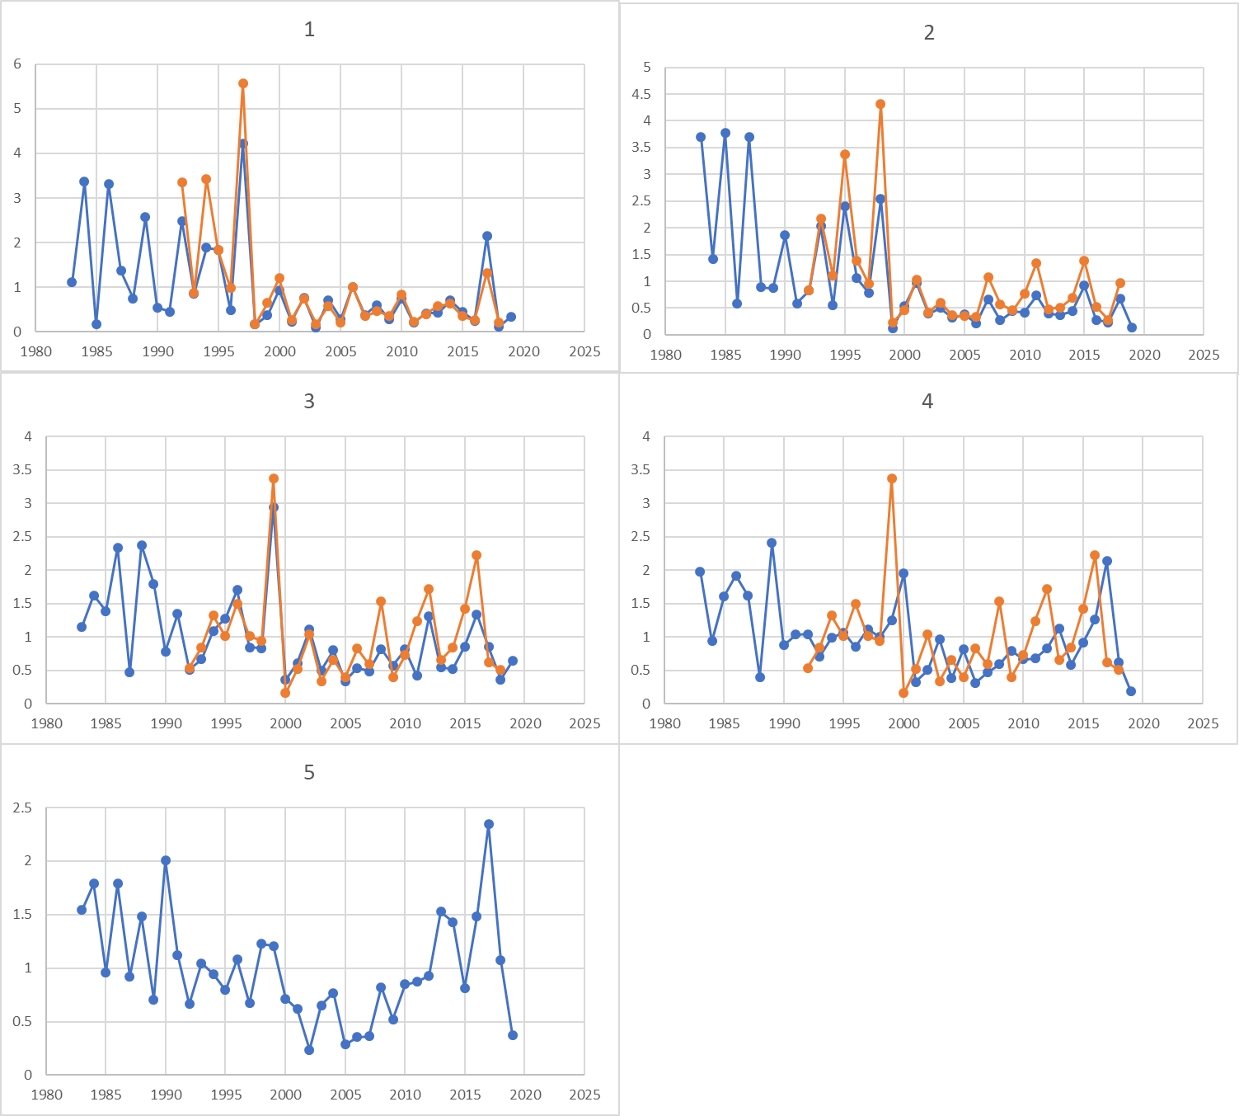
IBTS Delta-GAM Indices

Slide 31
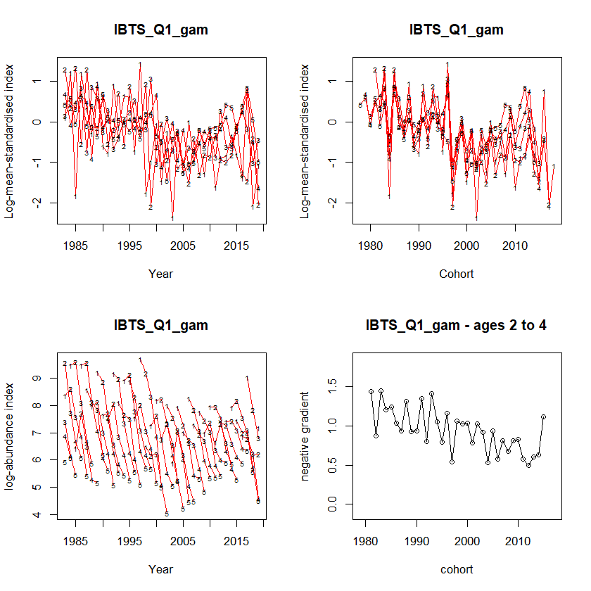
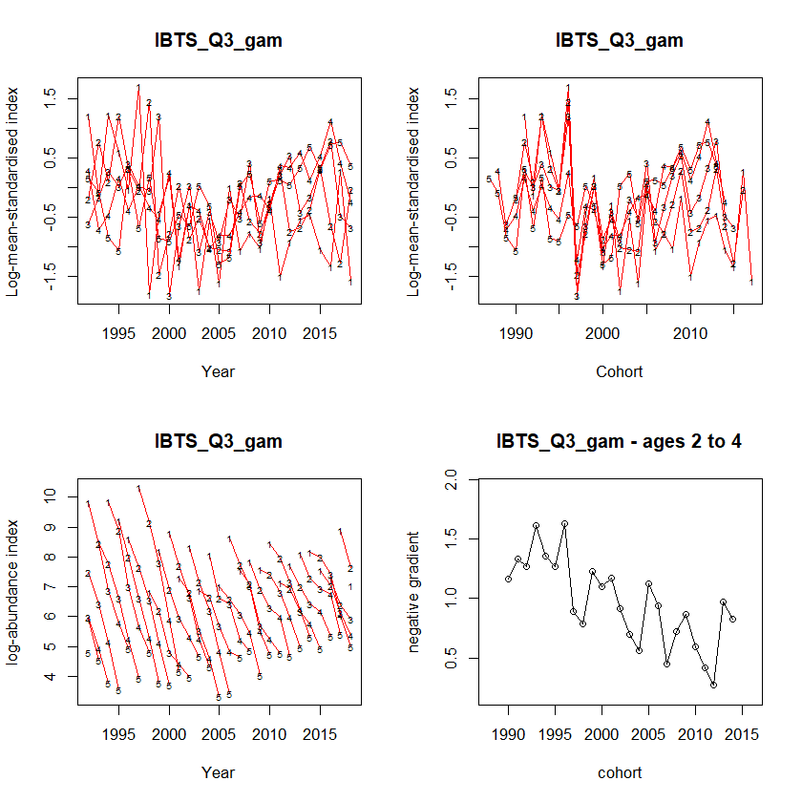
Survey data: Catch curve analysis

Slide 32
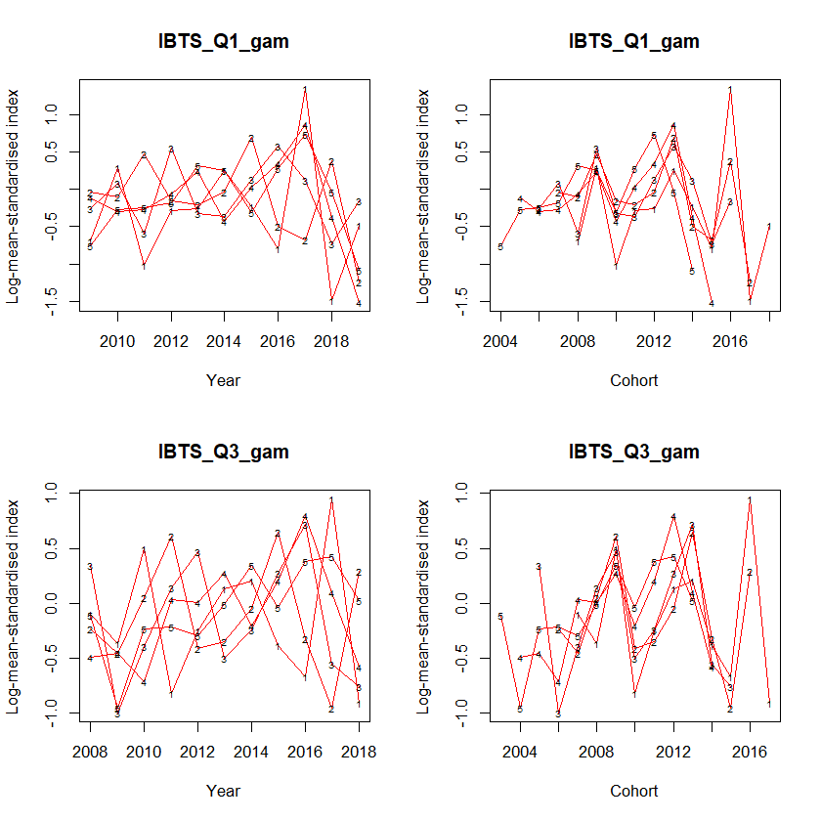
Survey data: Catch curve analysis

Slide 33
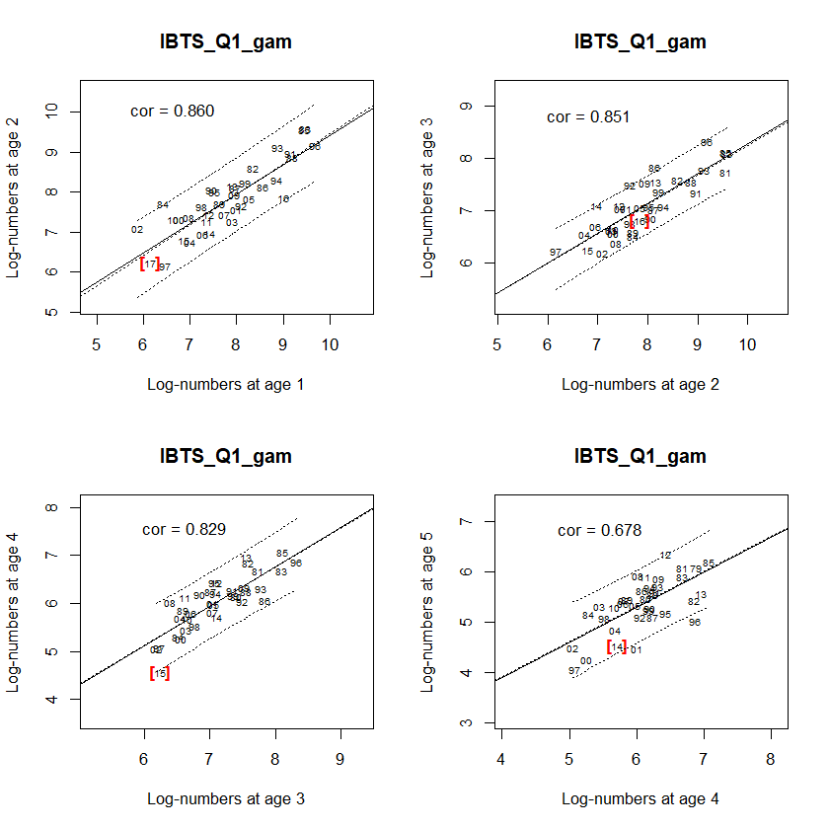
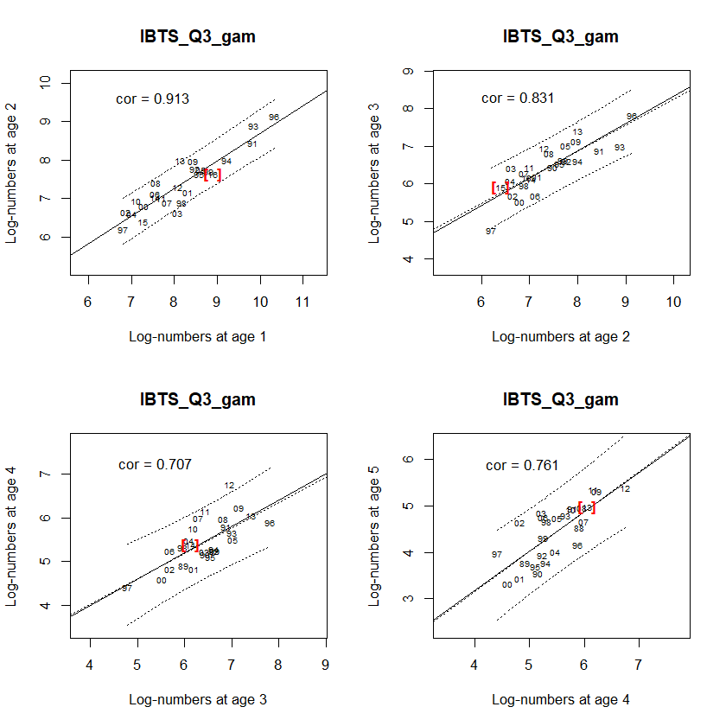
Survey data: Internal Consistency

Slide 34
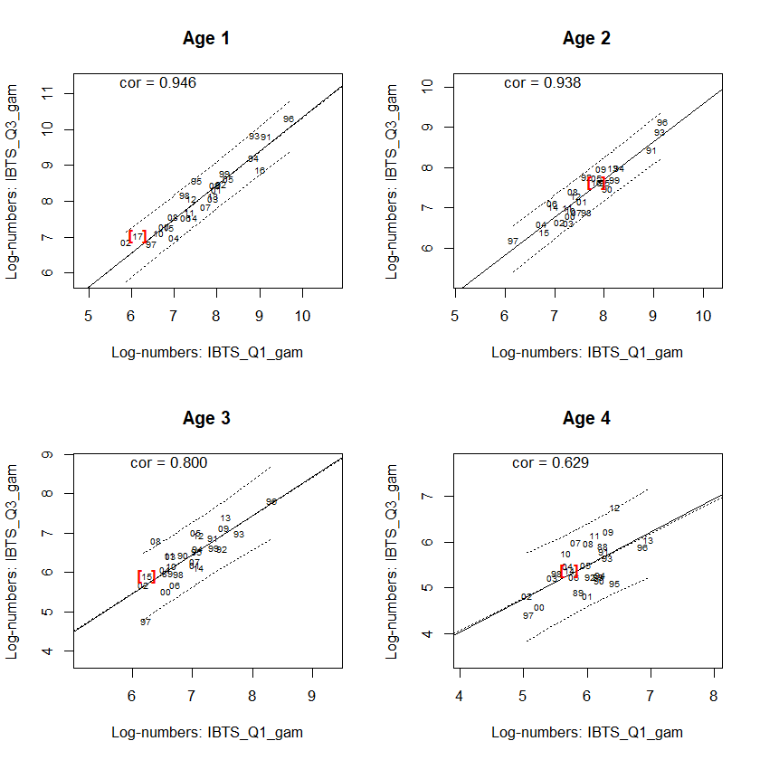
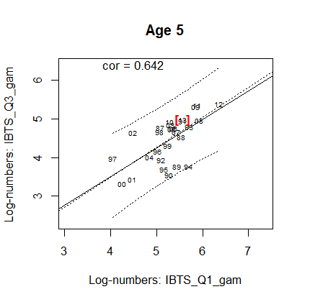
Survey data: Between Survey Consistency

Slide 35
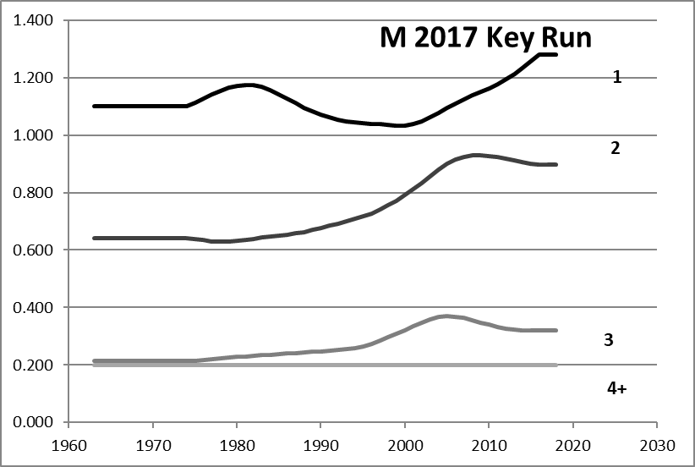
Natural Mortality

Slide 36
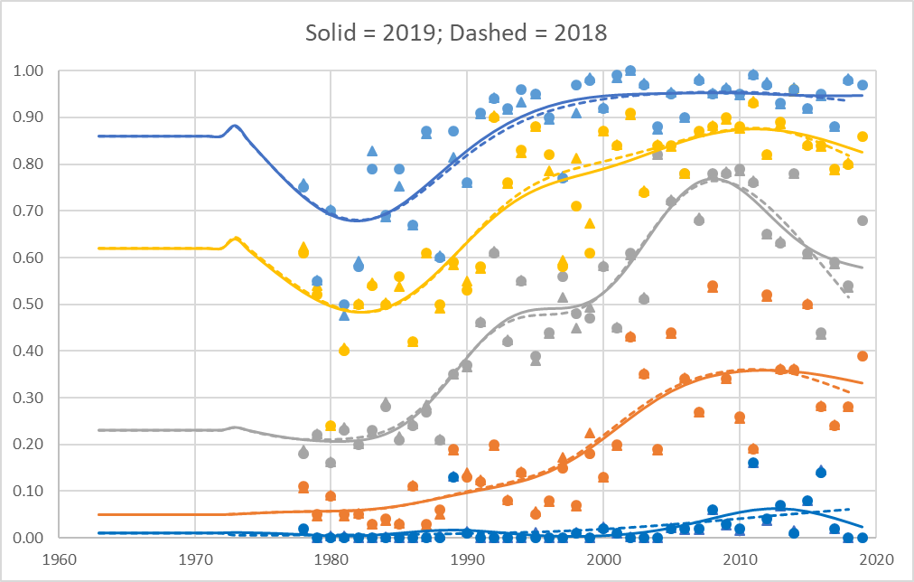
Maturity

Slide 37
«Random» errors
The NEA Cod example with depth is also illustrating what we call year-effects in a trawl survey. The high degree of clustering introduces a correlation.
They can be caused by the sampling itself, but can also be caused by factors effecting our ability to observe. May show up as year effect being large compared to sampling error.
The handling of year effects is far from being trivial.
Assessment results will be conditional on choices we make, our interpretation. Using default settings and smiling when model converges is not necessarily productive.

Slide 38
Acoustic surveys
Is a result of highly subjective processes
The use of trawl information when allocating echo energy to different species/groups may introduce consistency between operators, but may introduce strong bias.
The echo abundance is a scalar and is transformed to numbers of fish by using a size composition. Compositional data: Will introduce a strong negative correlation if you have few age groups.

Slide 39
And for the remainer of the day:
Edit the given R-scripts and run on input for NSS Herring and NEA Cod

