Slide 1
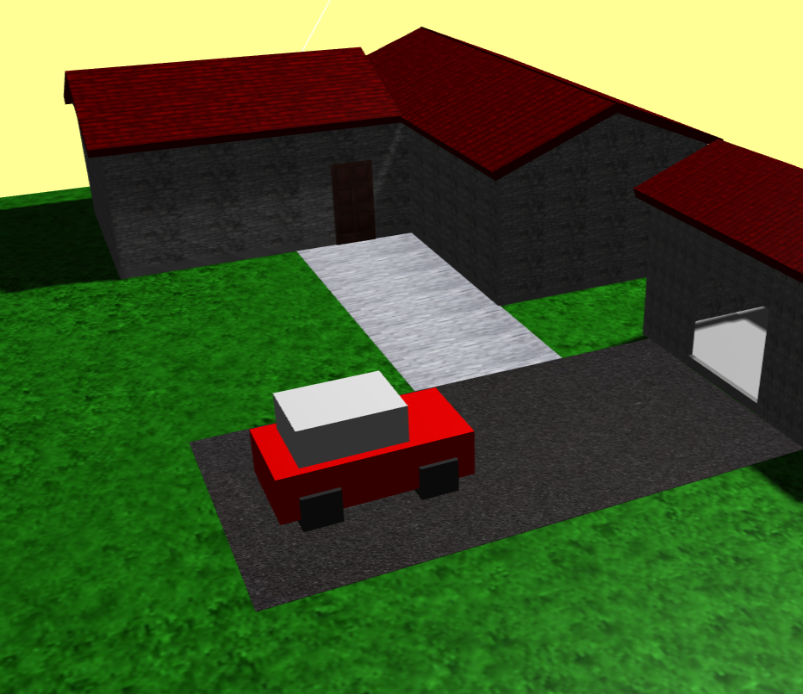
Project 1 – Little House
Olavo Estima, 93249
Introduction to Computer Graphics – 2021/2022 – Project 1

Slide 2
The slides can be done in English or Portuguese; the choice is yours
Do not write full sentences, just topics
It is a Computer Graphics project; images are expected in (almost) every slide
This is just a possible skeleton for your slides; add more slides when needed – but not too many
Total presentation time is 12 minutes, including a demo of your project

Slide 3
Main ideas
What is your project about?
What can the user do?
Are you using just the basic three.js or also additional modules?
URL – where is your project?

Slide 4
Main ideas
House modeling with its divisions and furniture
Illumination
Animation
User Interaction

Slide 5

What can the user do?
Camera Rotation, Panning, and Zoom
Increase or decrease the car speed
Stop the spotlight movement
Reset the sun’s position
Hide Walls

Slide 6
Modules and Project URL
Three.js
Three.min.js
OrbitControls.js
https://Olavo-Estima.github.io

Slide 7
Models
Models (6)
1 House
1 Car
1 Garage
1 Spotlight
2 pavements

Slide 8
Scene Graph
Scene
Plane
Building
Pavement
Light
Car
Camera
Wall
Floor
Roof
Main
Cabin
Wheel

Slide 9
Animation
Car Movement
Spotlight Movement

Slide 10

Illumination
The scene has a single spotlight denominated as “sun” that does the illumination of all scene with a rotation movement around it.

Slide 11
User Interaction
The user can use the mouse to zoom in and zoom out, panning and rotate the scene
The user can use the keyboard to:
Stop the movement of the spotlight;
Reset the spotlight initial position;
Increase/decrease the car’s movement speed;
Hide/show the house/garage walls and roofs;

Slide 12
Development (Code Organization)
This project is divided into:
2 javascript files (helper.js and scene.js)
1 HTML file (index.html)
1 folder with the modules used (lib)

Slide 13
Problems / difficulties
CORS (texturing)
Model creation

Slide 14
Conclusions
This project made me gain some knowledge about other features of three.js we hadn’t used in the practical classes.
There were some mistakes that made me realize that some things would be better made using other

Slide 15
References
Mainly Youtube videos about some themes such as:
Events -> https://www.youtube.com/watch?v=x68rZ_UEQPE&ab_channel=AugustoProano
Textures -> https://www.youtube.com/watch?v=thVl4UOQSEM&ab_channel=Genka
Shapes -> https://www.youtube.com/watch?v=Dyxvo4H24Hs&ab_channel=NikLever
CORS Error -> https://www.youtube.com/watch?v=gPzMRoPDrFk&ab_channel=SoftAuthor
threejs.org

