Slide 1
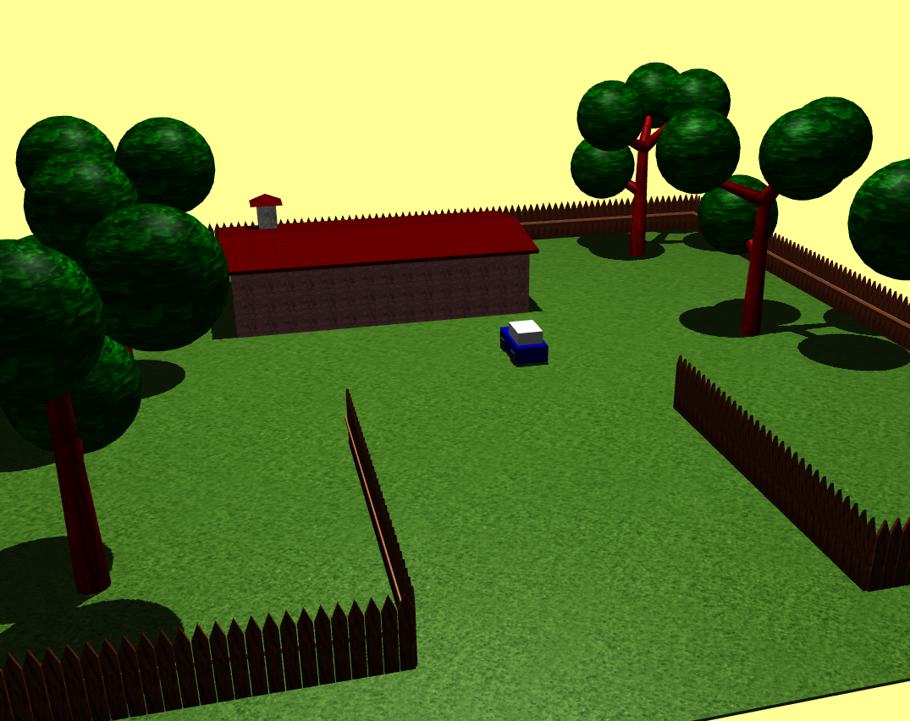
Project 2
Olavo Estima, 93249
Introduction to Computer Graphics – 2021/2022 – Project 2

Slide 2
The slides can be done in English or Portuguese; the choice is yours
Do not write full sentences, just topics
It is a Computer Graphics project; images are expected in (almost) every slide
This is just a possible skeleton for your slides; add more slides when needed – but not too many
Total presentation time is 12 minutes, including a demo of your project

Slide 3
Main ideas
What is your project about?
What can the user do?
Are you using just the basic three.js or also additional modules?
URL – where is your project?

Slide 4
Models (Previous Work)
Models (6)
1 House
1 Car
1 Garage
1 Spotlight
2 pavements

Slide 5
Models
Models (11)
1 House
1 Car
1 Spotlight
5 trees
1 Fence
1 moon
1 sun

Slide 6
Scene Graph (Previous)
Scene
Plane
Building
Pavement
Light
Car
Camera
Wall
Floor
Roof
Main
Cabin
Wheel

Slide 7
Scene Graph
Scene
Plane
House
Pavement
Light
Car
Tree
Fence
Camera
Main
Cabin
Wheel
Wall
Floor
Roof
Chimney

Slide 8
Main Changes
Cleaning of the code;
House from BoxGeometry to Shape;
Creation of the models of the sun, the moon, trees and fences, and a chimney;
It is possible now to move the car using the arrow keys;
Textures added to the scene;

Slide 9
User Interaction
The user can use the mouse to zoom in and zoom out, panning and rotate the scene
The user can use the keyboard to:
Stop/restart the movement of the spotlight(S key);
Reset the spotlight initial position(W key);
Move the car (Arrow keys) and increase/decrease its speed (A and D keys respectively)

Slide 10
Development (Code Organization)
This project is divided into:
2 javascript files (helper.js and scene.js)
1 HTML file (index.html)
1 folder with the modules used (lib)

Slide 11
Problems / difficulties
CORS (texturing)
3D Model Import (GLTFLoader, OBJLoader, …)
Model creation (holes on shapes)
Raycaster (moving the elements of the scene)

Slide 12
Conclusions
This project made me gain some knowledge about other features of three.js we hadn’t used in the practical classes.

Slide 13
References
Mainly Youtube videos about some themes such as:
Shapes -> https://www.youtube.com/watch?v=Dyxvo4H24Hs&ab_channel=NikLever
CORS Error -> https://www.youtube.com/watch?v=gPzMRoPDrFk&ab_channel=SoftAuthor
Raycaster -> https://www.youtube.com/watch?v=a0qSHBnqORU&ab_channel=Genka
GLTFLoader (mainly errors) ->
https://discourse.threejs.org/t/unable-to-load-gltfloader-js/3985
https://discourse.threejs.org/t/three-gltfloader-is-not-a-constructor/25681
https://www.youtube.com/watch?v=yPA2z7fl4J8&ab_channel=RajatKumarGupta
threejs.org (Documentation)

