Slide 1
CYBERBULLYING
Comprehensive analysis on cyberbullying among university students in a University

Slide 2
INTRODUCTION
Cyberbullying is defined as the use of electronic communication to bully someone, usually by sending intimidating or threatening messages. Cyberbullying is a persistent form of harassment that can happen anywhere and at any time, unlike traditional bullying, which is limited to specific places and times. The purpose of this study is to investigate how undergraduates' use of social media, amount of time spent online, and engagement in cyberbullying are related to one another. It also entails the study of cyber bullying in relation to gender. According to the data gotten there were 201 people all together , 113 male ,83 female and 5 nil i.e they didn't input their gender

Slide 3
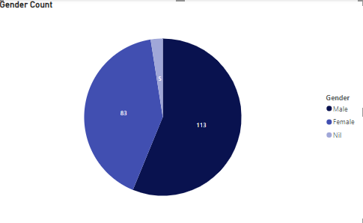
Gender Count
Gender Count of University Students from the data gotten

Slide 4
Questions Asked
Is cyber bullying Gender based in the university?
Which gender was bullied most?
Which gender was least bullied?
2. Is cyberbullying Level based in the university?
Which Level was bullied most?
Which Level was least bullied?
3. Is Cyber bullying Marital Based ?
4. Is Cyberbullying Ethnicity Based?
5. Is Cyberbullying Religion Based?
6. Which age was affected more by cyberbullying?

Slide 5
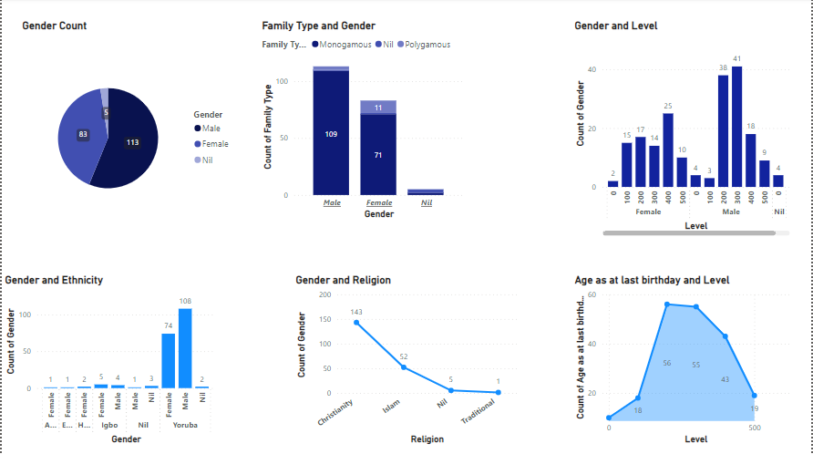
Overview of the data based on questions asked

Slide 6
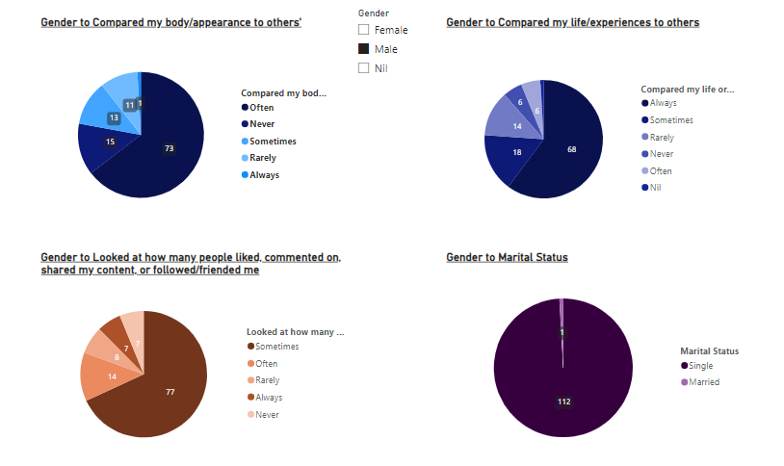
Question 1a
From the data Provided , Gender that was bullied or bullied someone most was the male Gender wit the following chart displayed. The male gender data was compared to the female gender data and also answered the question 3 that marital status does not affect because most of them are single.

Slide 7
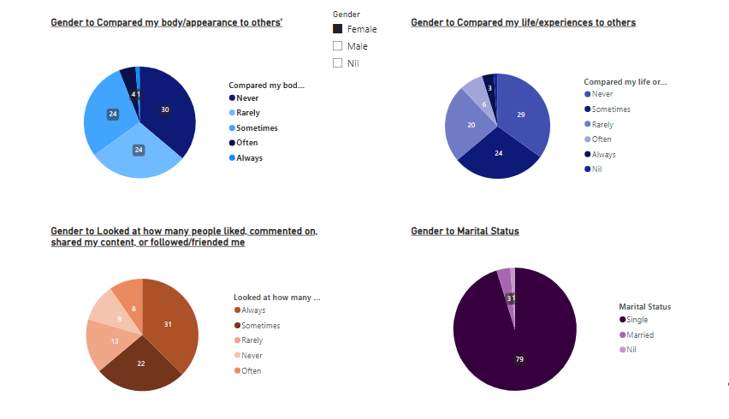
Question 1b
From the data Provided , Gender that was bullied or bullied someone most was the male Gender wit the following chart displayed. The male gender data was compared to the female gender datand also answered the question 3 that marital status does not affect because most of them are single.

Slide 8
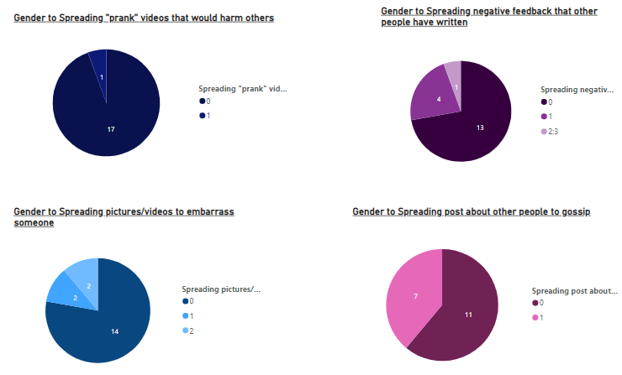
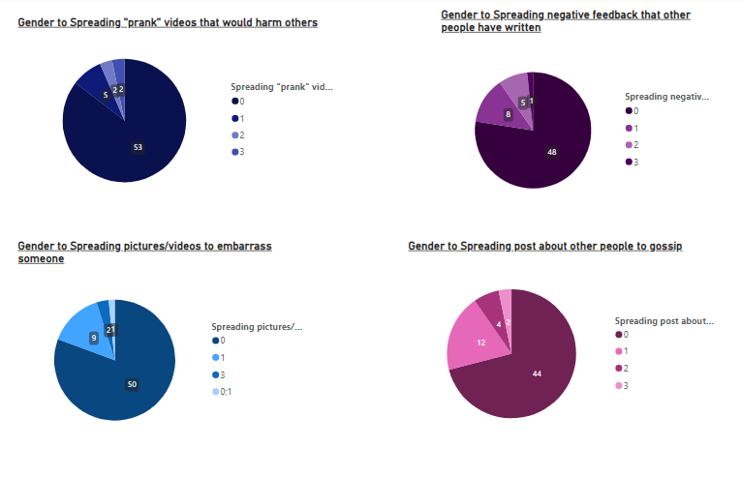
Question 2a
100 Level
400&
500
Level
This data compares the level and it was gotten that mostly the 200 and 300 level students were often bullied or bullied someone. This exact data shows the other levelslike 100,400,500 level and how they engaged in cyberbullying

Slide 9
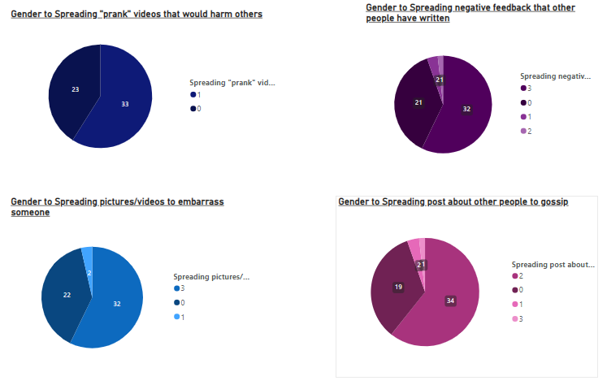
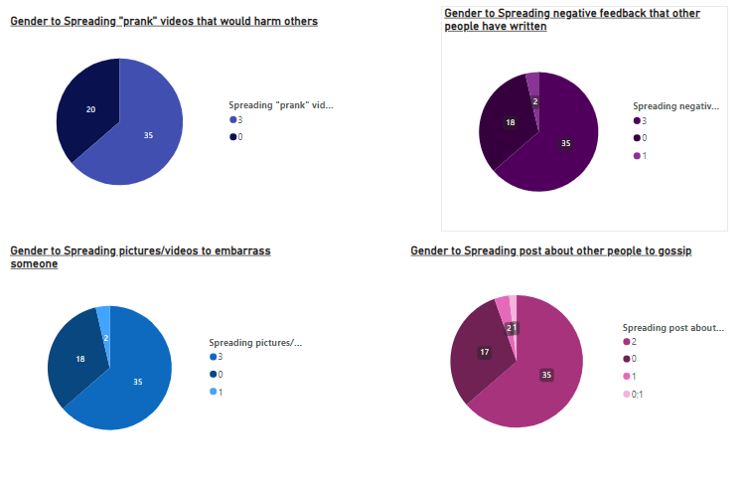
Question 2b
200
Level
300
Level
This data compares the level and it was gotten that mostly the 200 and 300 level students were often bullied or bullied someone.

Slide 10
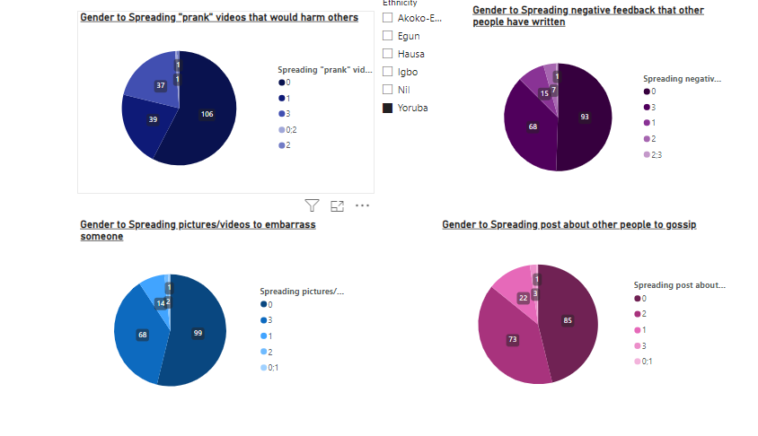
Question 4
Ethnicity has nothing to do with cyberbullying according to the above chart. Because even Yoruba which is the most populated rarely engaged in cyber bullying according to the data

Slide 11
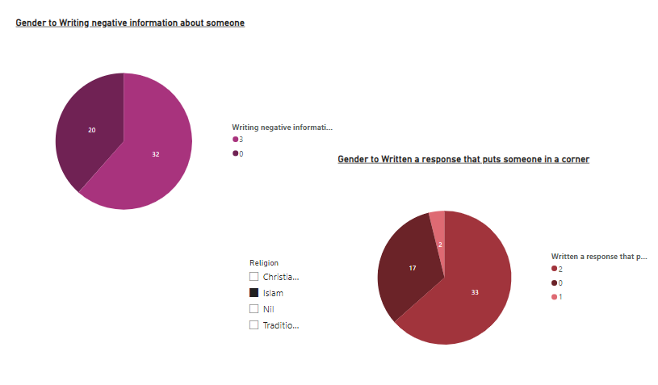
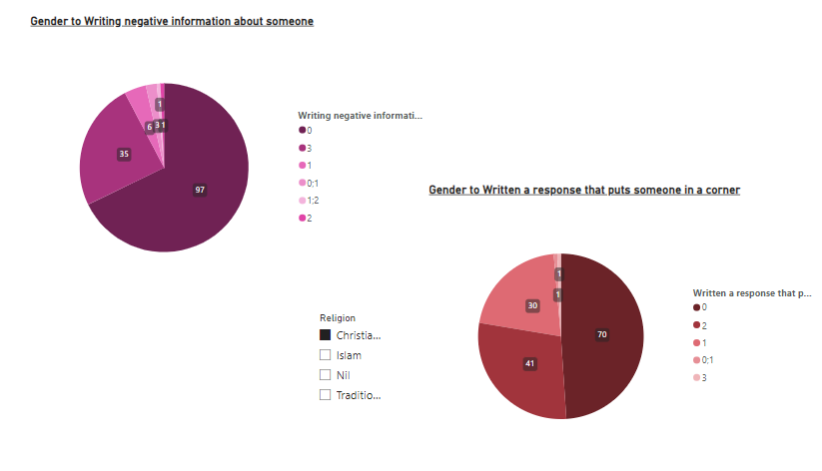
Question 5
Here Religion affects Cyberbullying because Islam had a higher percentage of engaging in Cyberbullying compared to Christianity and Traditional

Slide 12
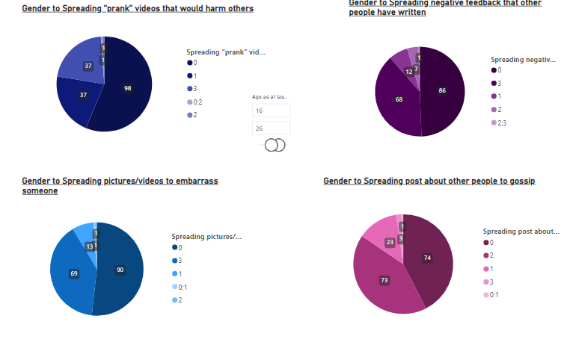
Question 6
Age range was from 16 - 39 and most of the age group that was categorized was 16-26 and alot of them didnt engage in cyberbullying. So age is not a factor relating to cyber bullying

Slide 13
Conclusion
Every Other factors did not affect Cyberbullying except Gender, Level and Religion. So i suggest a lot of awareness should be created and Male Gender should be educated more on why they should not engage in cyberbullying, 200 and 300 level students should be educated on the bad side of cyberbullying and Awareness should be passed out in Religious meetings talking about why it's not good to engage in Cyberbullying and also Counselling and Follow up should be done to those that have experienced Cyberbullying. An example is setting up a Non-Governmental Organization that talks about Cyberbullying .

