Slide 1
DBCLI
A Database Command Line utility
https://github.com/hyee/dbcli

Slide 2
Why use DBCLI(1)
SQL*Plus is powerful, but not user-friendly
Less-intelligent query output
Difficult logic control for coding
Lack of interfaces to develop addons
DBCLI is an aid of database CLI utility such as SQL*Plus and SQLcl
Supports Windows/MacOS/Linux
Portable and contains portable JRE bundle
Auto-ported to SQL*Plus and SQLcl, and similar commands with SQL*Plus
Languages: Java,Lua,PL/SQL,SQL
Many powerful features

Slide 3
Why Use DBCLI(2)
Easy connect (command login/reconn)
Intelligent format of the query output
Rich column value formatter(command col)
Combine queries (command grid)
Client-side VPD(command set dbid/instance/container/schema)
Many common utilities(awrdump/addmdump/dumptrace/grep/tee/unwrap/sql2csv/sql2file/etc)
Powerful scripting engines and documentation
SQL*Plus-style engine: Command ora/sys/show/exa
Snapper engine: command snap
Graphing engine: Command chart/graph
Shell engine: command ssh/sh ( to be enhanced)
Interfaces to programmer
Rich hot keys
Coloring

Slide 4
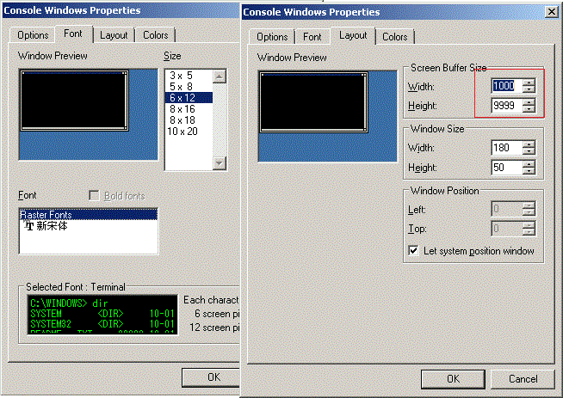
Windows Only: Configure Command Window
Use smaller font size
Open command window => right click the title bar=> default values
When use ConsoleZ as the terminal, try smaller Unicode font by clicking “View=>Console window” to avoid some display issues
Use larger screen buffer
2000 x 9999 is recommended
Use Better color solution
Optional, depends on ColorTool(https://github.com/microsoft/terminal/tree/master/src/tools/ColorTool).
run “colortool -s” under “dbcli\bin” and choose the scheme that you preferred

Slide 5
Easy-Connect (login and reconn)
Login: show stored connections
Login -a <alias> <id> : create an alias for a login
Login <id>|<alias>|<keyword>: connect to db, or list the connections that match the keyword
Login –p <id>|<alias> : print connection string
Reconn: reconnect to the previous login database
The account information is stored as data\password.dat, and never be overridden by the new version
ORCL> login # Alias Name User SSH Link Url --- ----------- ------------------------------------ ---------- -------- ----------------------------------------- 1 cary@scaqaa05adm01/yuisong cary jdbc:oracle:thin:@snaccx5adm01.us.ocsdn 2 clo_normal@scao08adm06/catdb clo_normal jdbc:oracle:thin:@snao08adm06.us.ocsdn.c 3 clo_normal@slcm01adm01vm01/rwp_shard clo_normal jdbc:oracle:thin:@sncm01adm01vm01.us.ocsd ORCL> login 2 Statement completed. Database connected. CATDB> reconn Statement completed. Database connected. CATDB>

Slide 6
Intelligent format of the query output(Set)
The string columns are auto-adjusted to fit the screen, refer to “set grid” for more manual configurations
CATDB> set printsize 10 CATDB> sf dba_objects $ select * from (select * from dba_objects) where rownum<=50 OWNER OBJECT_NAME SUBOBJECT_NAME OBJECT_ID DATA_OBJECT_ID OBJECT_TYPE CREATED LAST_DDL_TIME ----- -------------- -------------- --------- -------------- ----------- ------------------- ------------------- SYS TS$ 16 6 TABLE 2018-02-07 22:51:55 2018-02-07 23:57:54 SYS ICOL$ 20 2 TABLE 2018-02-07 22:51:55 2018-02-07 23:57:54 SYS C_FILE#_BLOCK# 8 8 CLUSTER 2018-02-07 22:51:55 2018-02-07 22:51:55 SYS I_OBJ2 37 37 INDEX 2018-02-07 22:51:56 2018-02-07 22:51:56 SYS USER$ 22 10 TABLE 2018-02-07 22:51:55 2018-02-07 23:05:16 SYS I_TAB1 33 33 INDEX 2018-02-07 22:51:55 2018-02-07 22:51:55 SYS I_OBJ5 40 40 INDEX 2018-02-07 22:51:56 2018-02-07 22:51:56 SYS CDEF$ 31 29 TABLE 2018-02-07 22:51:55 2018-02-07 23:57:54 SYS I_IND1 41 41 INDEX 2018-02-07 22:51:56 2018-02-07 22:51:56 SYS I_OBJ# 3 3 INDEX 2018-02-07 22:51:55 2018-02-07 22:51:55 10 rows returned. CATDB> set printsize 5 colsep | CATDB> sf dba_objects $ select * from (select * from dba_objects) where rownum<=50 +-----+--------------+--------------+---------+--------------+-----------+-------------------+-------------------+ |OWNER| OBJECT_NAME |SUBOBJECT_NAME|OBJECT_ID|DATA_OBJECT_ID|OBJECT_TYPE| CREATED | LAST_DDL_TIME | |-----|--------------|--------------|---------|--------------|-----------|-------------------|-------------------| |SYS |TS$ | | 16| 6|TABLE |2018-02-07 22:51:55|2018-02-07 23:57:54| |SYS |ICOL$ | | 20| 2|TABLE |2018-02-07 22:51:55|2018-02-07 23:57:54| |SYS |C_FILE#_BLOCK#| | 8| 8|CLUSTER |2018-02-07 22:51:55|2018-02-07 22:51:55| |SYS |I_OBJ2 | | 37| 37|INDEX |2018-02-07 22:51:56|2018-02-07 22:51:56| |SYS |USER$ | | 22| 10|TABLE |2018-02-07 22:51:55|2018-02-07 23:05:16| +-----+--------------+--------------+---------+--------------+-----------+-------------------+-------------------+ 5 rows returned. CATDB> set colsep default

Slide 7
Line Wrap
For a output line whose width larger than screen buffer width, the overflow part would be chopped to avoid the messed output
To view the missing information:
Use command “<query>|less” to enter the Linux-style less mode, and press arrow keys to scroll the screen
Use “less last” to view the last output in less mode
Use command “out”, which will launch the editor to view the historical outputs.
In case of the default editor is “vi”, you can use “W/B” to scroll the screen
Use “set editor [<name>]” to define the default editor
Command “out”
out : save the historical outputs into file “cache/<sub-dir>/out.log” and open the file
out <file-name>: save the historical outputs into file “cache/<sub-dir>/<file-name>” and open the file
out clear: clear the historical output

Slide 8
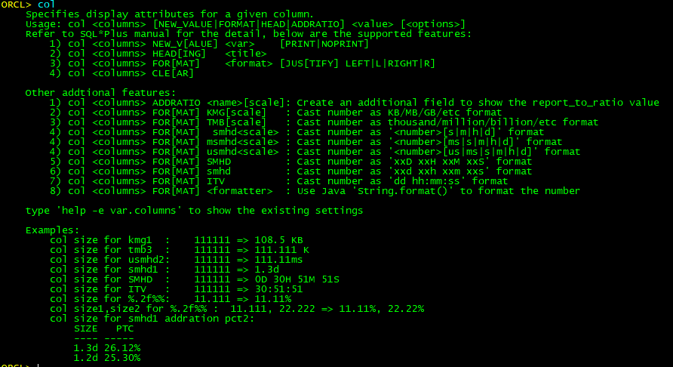
Rich column value formatter(command col)
DBCLI provides additional formatters on the specific columns with the col command
DBCLI also provides set sep4k/scale to globally define the format of the number values

Slide 9
Rich column value formatter(command col)
Those formatters covers most of the Real-World requirements that used on database, including size, amount, time cost, percentage, etc
CATDB> col x format kmg2 CATDB> col b format tmb CATDB> col y,z format smhd1 CATDB> col a format msmhd2 CATDB> set sep4k on CATDB> select 1111111 x, 1111111 b,'|' "|",111111 y, 99999 z, 222.222222 a,9999.99 o from dual; X B | Y Z A O ------- ------|---- ---- -------- -------- 1.06 MB 1.11 M|1.3d 1.2d 222.22ms 9,999.99 CATDB> col y noprint CATDB> col x addratio pct CATDB> col z format %.2f%% CATDB> col c format itv CATDB> select dbms_random.value*1e6 x, 1 y, dbms_random.value*100 z, dbms_random.value*1e4 c from dual connect by rownum<10; X PCT Z C --------- ------- ------ -------- 228.04 KB 6.06% 88.56% 01:00:06 539.46 KB 14.34% 29.53% 01:18:30 971.22 KB 25.81% 82.01% 00:51:38 105.42 KB 2.80% 71.04% 02:38:58 630.58 KB 16.76% 46.73% 02:34:33 327.43 KB 8.70% 21.66% 02:24:43 244.83 KB 6.51% 80.24% 01:10:09 89.45 KB 2.38% 25.60% 02:15:21 625.99 KB 16.64% 78.21% 01:10:37

Slide 10
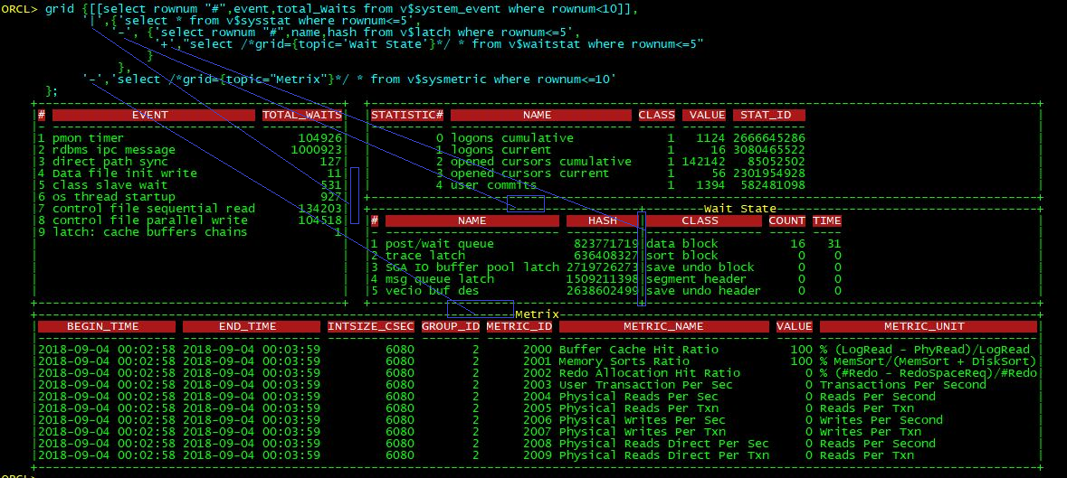
Combine queries (command grid) - 1
The GRID command is designed for developing script, to utilize the screen spaces to show enough information and reduce screen scrolling
Use |,-,+ to combine the output of the queries
| : output A left to output B
+: output A merge to output B
- : output A above to output B
All SQLs must be dynamic SQLs, meaning that they are string texts that enclosed by ‘…’, ”…” or [[…]]
Accepts either JSON or Lua-style object as the parameter, for LUA, {..} is to combine queries, and [[...]] to quote SQL text
More examples: command top/exa cache
Notes:
grid {[[select rownum "#",event,total_Waits from v$system_event where rownum<10]],
'|',{'select * from v$sysstat where rownum<=5',
'-', {'select rownum "#",name,hash from v$latch where rownum<=5',
'+',"select /*grid={topic='Wait State'}*/ * from v$waitstat where rownum<=5"
}
},
'-','select /*grid={topic="Metrix"}*/ * from v$sysmetric where rownum<=10'
};

Slide 11
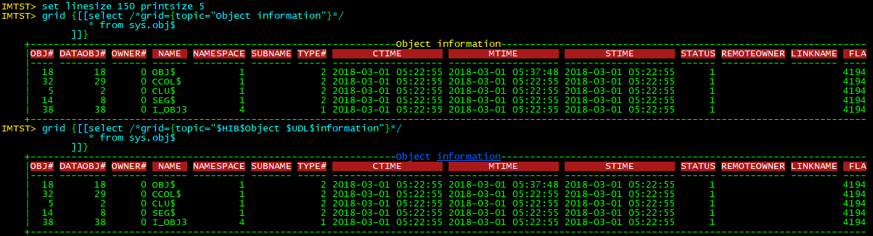
Combine queries (command grid) - 2
The grid command accepts /*grid={…}*/ to define the additional information, including:
topic=“<title>”: the title of the grid
Width=<number>: define block fixed width, if the query output wider than the size, then the outstanding part will be chopped. When -1 then means align to its siblings
height=<number>: define block fixed height, if the output rows longer than the size, then the outstanding rows will be removed. When -1 then means align the height to its siblings.
max_rows=<number>: maximum printed query records
bypassemptyrs=“on/off”: controls whether to display the grid in case of no record to be printed
Other additional configurations that used in “snap” and “chart” commands
JSON format is not a good choice for multi-lines SQL:
JSON uses [….] to define an array, and {…} to define an object. For Lua, they are all {…}
To define an object(map), the JSON syntax is {a: <value>,b: <value>}, for Lua, it is {a=<value>,b=<value>}
To define a string value that has multiple lines, JSON uses “line1 \n ” +“line2”，and Lua is [[line1 \n line2]]
Notes:
grid {[[select /*grid={topic="Object information"}*/
* from sys.obj$
]]};
grid {[[select /*grid={topic="$HIB$Object $UDL$information"}*/
* from sys.obj$
]]}

Slide 12
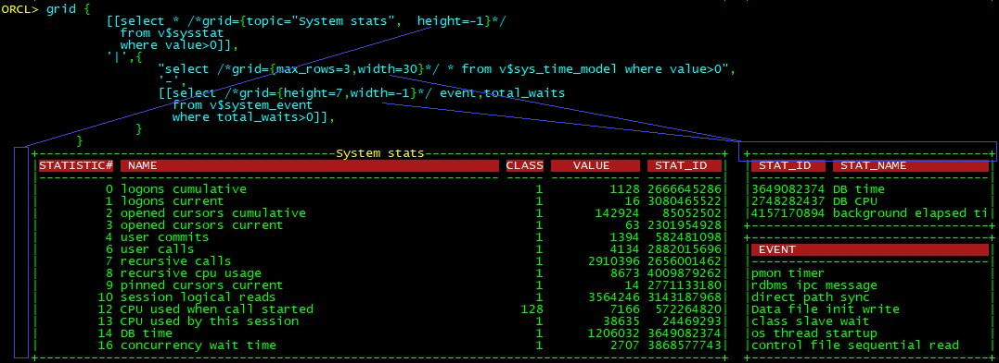
Combine queries (command grid) - 3
Below Example shows how to define the additional information, including topic, height and width
Notes:
grid {
[[select * /*grid={topic="System stats", height=-1}*/
from v$sysstat
where value>0]],
'|',{
"select /*grid={max_rows=3,width=30}*/ * from v$sys_time_model where value>0",
'-',
[[select /*grid={height=7,width=-1}*/ event,total_waits
from v$system_event
where total_waits>0]],
}
}

Slide 13
Client-side VPD
Set instance <inst_id>|0|-1|default : auto rewrite all SQL Texts that refer to the Oracle views which contain field inst_id/instance_number
Set dbid <dbid>/schema <schema>/ container <con_id>/cdbmode cdb|pdb: similar behaviors
IMTST> set printsize 5 feed off IMTST> sf gv$session $ select * from (select * from gv$session) where rownum<=50 INST_ID SADDR SID SERIAL# AUDSID PADDR USER# USERNAME COMMAND OWNERID ------- ---------------- --- ------- ---------- ---------------- ---------- -------- ------- ---------- 2 0000002DD8ACF520 1 33453 0 0000002DE0A234D0 0 0 2147483644 2 0000002DE0AD3B00 2 5920 4294967295 0000002DE8A560B0 2147483620 SYSRAC 0 2147483644 2 0000002DE8AEDAE0 3 7753 0 0000002DF0A33D40 0 0 2147483644 2 0000002DF0AC3D08 4 3085 0 0000002E00BCED50 0 0 2147483644 2 0000002DF0ACFE00 33 61608 0 0000002DD8A30C90 0 0 2147483644 IMTST> set instance 3 IMTST> sf gv$session $ select * from (select * from gv$session) where rownum<=50 INST_ID SADDR SID SERIAL# AUDSID PADDR USER# USERNAME COMMAND OWNERID ------- ---------------- --- ------- ---------- ---------------- ---------- -------- ------- ---------- 3 0000002DD8ACF520 1 7513 0 0000002DE0A234D0 0 0 2147483644 3 0000002DE0AD3B00 2 49004 4294967295 0000002DE8A560B0 2147483620 SYSRAC 0 2147483644 3 0000002DE8AEDAE0 3 65424 0 0000002DF8A44688 0 0 2147483644 3 0000002DF8AD1388 5 26864 0 0000002E00BCED50 0 3 2147483644 3 0000002DF0ACFE00 33 5057 0 0000002DD8A30C90 0 0 2147483644 IMTST> sf dba_hist_system_event $ select * from (select * from dba_hist_system_event) where rownum<=50 SNAP_ID DBID INSTANCE_NUMBER EVENT_ID EVENT_NAME WAIT_CLASS_ID WAIT_CLASS ------- --------- --------------- -------- ------------------------------------ ------------- ---------- 4173 577749011 3 2679325 kksfbc child completion 1893977003 Other 4173 577749011 3 3166130 ASM Staleness File I/O 1740759767 User I/O 4173 577749011 3 6961751 enq: JS - job run lock - synchronize 1893977003 Other 4173 577749011 3 13102552 Disk file Mirror Read 1740759767 User I/O 4173 577749011 3 23293667 remote log force - commit 3386400367 Commit

Slide 14
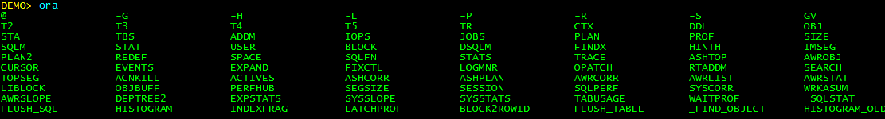
Common Utility – Completers
When typing the ‘tab’ key, the list of candidates will be shown under the command line. And another ‘tab’ will switch into the list to choose a candidate in case of the terminal support the ANSI color feature
DBCLI supports 2 kinds of completers
The command completer: happens when inputting the first word and then typing tab. Its candidates are the commands that DBCLI supports
The keyword completer: happens when inputting the 2nd or other word and typing tab. The keyword completer’s candidates are Oracle maintained objects such as views, packages, etc.
The public offline dictionary is located at oracle/dict.pack
Use “dict init” to customize the offline dictionary that only used in current connected database
Better to executed with SYSDBA/DBA account so that more information can be collected
This kind of dictionary is stored under the “cache” directory, will be automatically loaded when same db is connected

Slide 15
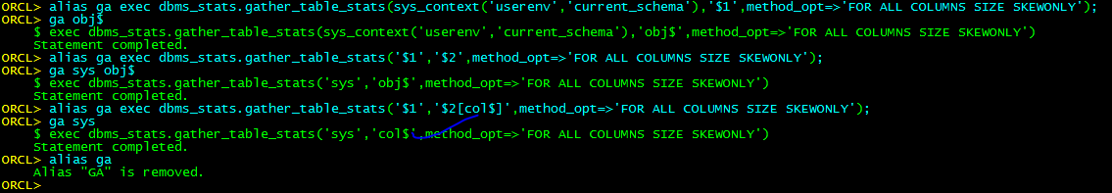
Common Utility - alias
Similar to Linux alias command
The created alias is stored in folder aliases\oracle
Can define default value of the parameter
Notes:
alias ga exec dbms_stats.gather_table_stats(sys_context('userenv','current_schema'),'$1',method_opt=>'for all columns skewonly’);
ga obj$;
alias ga exec dbms_stats.gather_table_stats('$1','$2',method_opt=>'for all columns skewonly’);
ga sys obj$;
alias ga exec dbms_stats.gather_table_stats('$1','$2[col$]',method_opt=>'for all columns skewonly’);
ga sys;
Alias ga

Slide 16
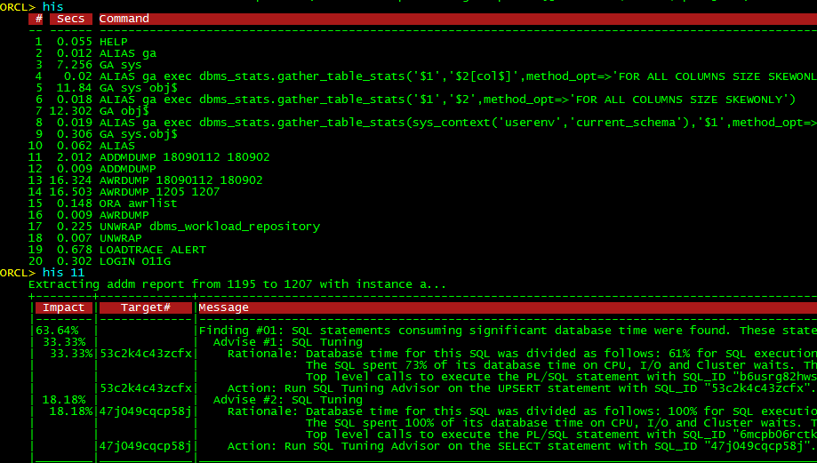
Common Utility – history/his
To list or execute historical command

Slide 17
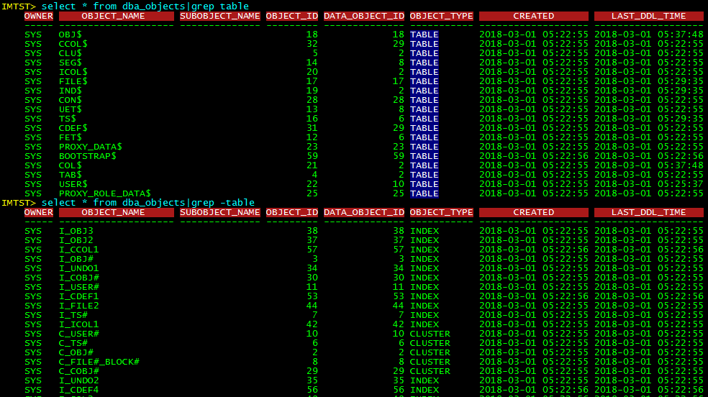
Common Utility - grep
Notes:
Select * from dba_objects|grep table;
Select * from dba_objects|grep -table

Slide 18
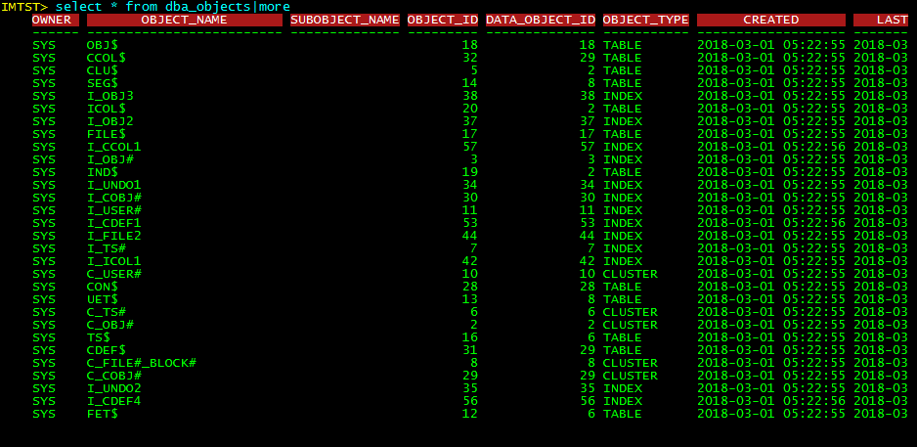
Common Utility - more
Notes:
Select * from dba_objects|more

Slide 19
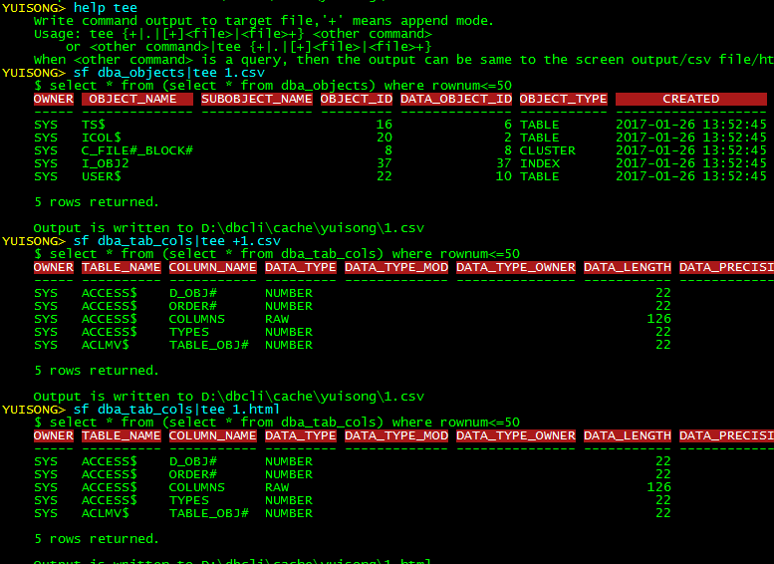
Common Utility - tee
Supports extracting output into text/csv/html file
Supports either override mode or append mode
Notes:
Sf dba_objects|tee 1.csv
Sf dba_tab_cols| tee +1.csv
Sf dba_tab_cols|tee 1.html

Slide 20
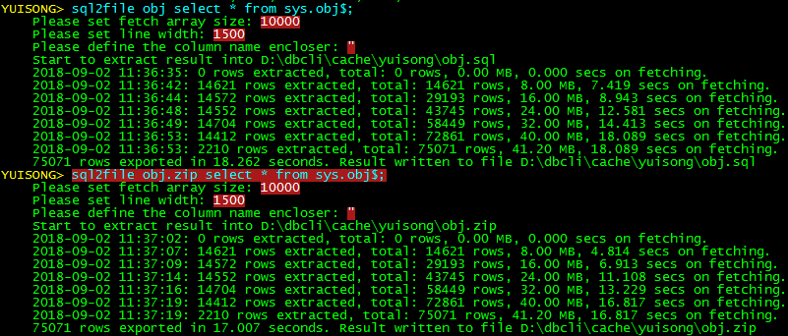
Common Utility – SQL2File
To Extract query result into INSERT statements file
If the target file extension is .zip or .gz, then the result will be auto-compressed
Notes:
Sql2file obj select * from sys.obj$;
Sql2file obj.zip select * from sys.obj$;

Slide 21
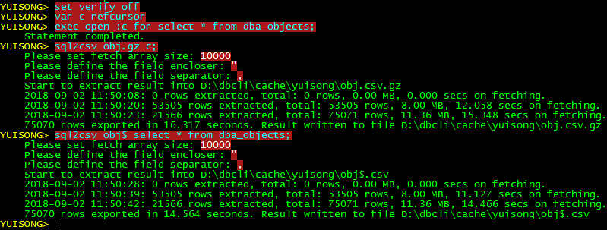
Common Utility – SQL2CSV
To Extract query result into CSV file, as well as generating sqlldr control file
If the target file extension is .zip or .gz, then the result will be auto-compressed
Faster than Oracle exp command
Notes:
Set verify off
Var c refcursor;
exec open :c for select * from dba_objects;
Sql2csv obj.gz c;
Sql2csv obj$ select * from dba_objects;

Slide 22
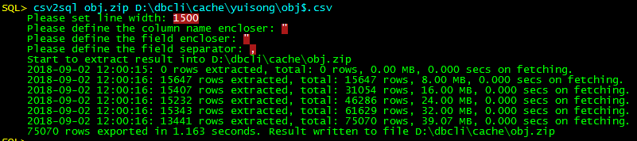
Common Utility – CSV2SQL
To convert CSV file into SQL file, as well as generating sqlldr control file
If the target file extension is .zip or .gz, then the result will be auto-compressed
Notes:
Csv2sql obj.zip d:\dbcli\cache\yuisong\obj$.csv

Slide 23
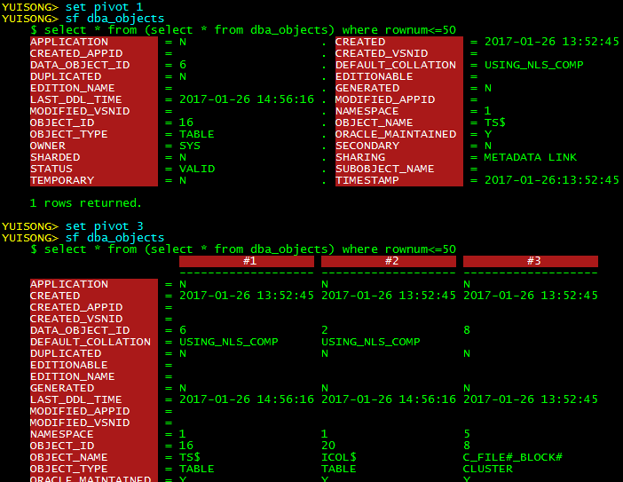
Common Utility – Pivot
Command: set pivot <top-n rows>, or use alias p [<top-n-rows>]
To pivot top N result of the next query
Notes:
Set pivot 1
Sf dba_objects
Set pivot 3
Sf dba_objects

Slide 24
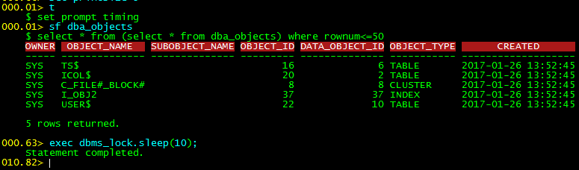
Common Utility – Timing
Command: set prompt timing, or use alias t
To print the elapsed time of each input command as the prompt
Notes:
T
Sf dba_objects
Exec dbms_lock.sleep(10);

Slide 25
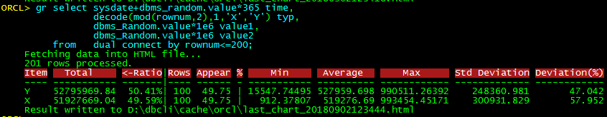
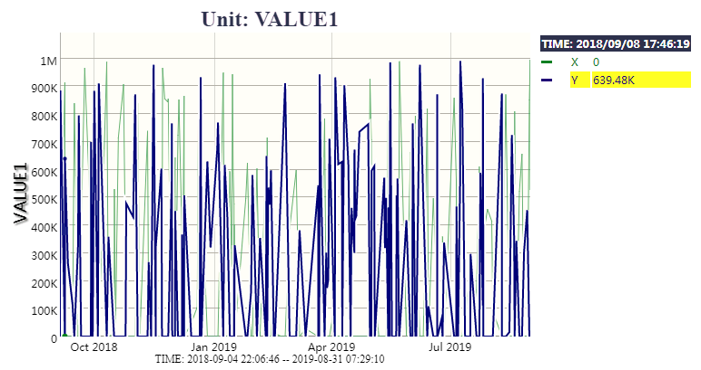
Common Utility – graph/gr
Command: gr[aph] <query>|<csv file>
To convert time-series data as line chart
Notes:
gr select sysdate+dbms_random.value*365 time, decode(mod(rownum,2),1,'X','Y') typ, dbms_Random.value*1e6 value1, dbms_Random.value*1e6 value2 from dual connect by rownum<=200;

Slide 26
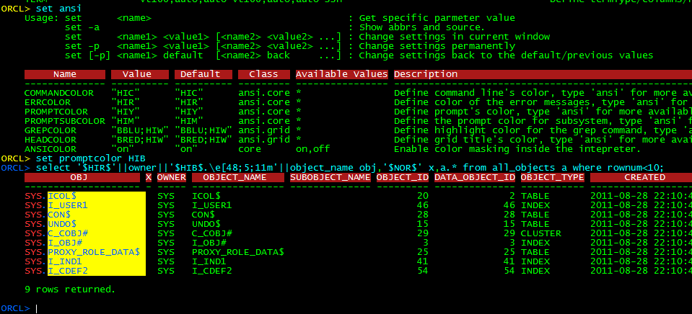
Common Utility – Coloring
Type ansi to see the available ANSI codes and names
Type set ansi to see existing color solution
Type set <ansi_name> <color> to change existing color solution
Support using ANSI colors in SQL
Notes:
ansi
Set ansi
Set promptcolor HIB
select '$HIR$'||owner||'$HIB$.\e[48;5;11m'||object_name obj,'$NOR$' x,a.* from all_objects a where rownum<10;

Slide 27
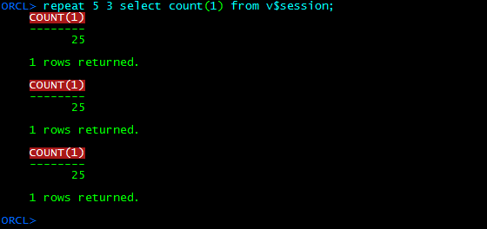
Common Utility – Repeat/itv
Usage: repeat <interval> <times> <other command>
To repeat the execution with specific interval and times
Notes:
Repeat 5 3 select count(1) from v$session;

Slide 28
Common Utility – Read only mode
Normally used in production environment for security purpose
Note: Only supports blocking the DDL/DML from DBCLI or uncommitted transaction from procedures. It will not block calling the procedures or PL/SQL block that performs DDL/DML and then self commit.
YUISONG> set readonly on YUISONG> delete sys.obj$; DBC-00453: Command "DELETE SYS.OBJ$" is disallowed in read-only mode! YUISONG> create table ttt(x int); DBC-00453: Command "CREATE TABLE" is disallowed in read-only mode! YUISONG>

Slide 29
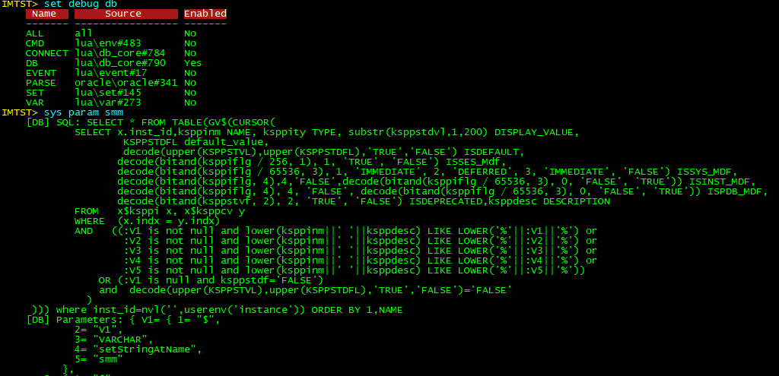
Common Utility – Monitor dbcli activities
Command: set debug db
To monitor every executed SQL from dbcli
Notes:
Set debug db
Sys param smm

Slide 30
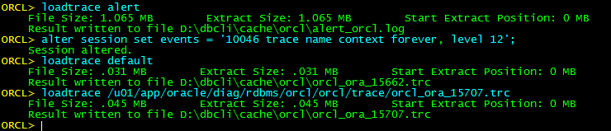
Common Utility – loadtrace/dumptrace
Command: loadtrace alert/default/<file_path>
To download oracle trace file into local PC
Support downloading trace file from remote instance
When readonly mode is off, it could create directories and then drop it
Notes:
Loadtrace alert
Alter session set events=‘10046 trace name context forever, level 12’;
Loadtrace alert;

Slide 31
Common Utility – UnWrap
Command: unwrap [<owner>.]<object_name> [<file_ext>]
To extract the source code of procedure/package/function/trigger/type
If the source code is encrypted, then decrypt it
Notes:
Unwrap dbms_workload_repository

Slide 32
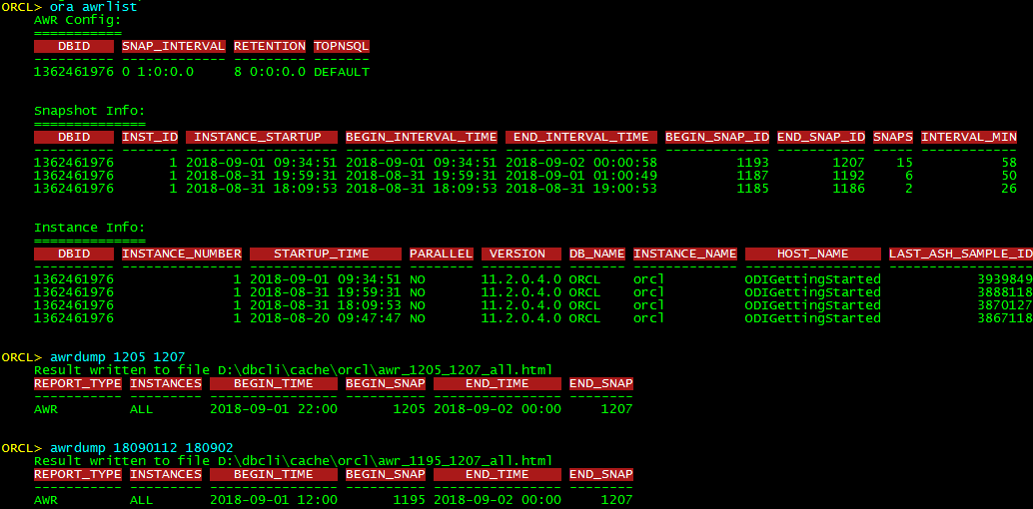
Common Utility – AWRDump
To Extract AWR report and AWR global report
Usage awrdump <start> <end> [<inst1,inst2,...>]
<start> can be either begin_snap_id or YYMMDDHH24MI format
<end> can be either end_snap_id or YYMMDDHH24MI format
The instance parameter is optional, default to the value of “set instance” or extract all instances
<start> and <end> can also be optional of “set starttime/endtime” is configured
Notes:
Ora awrlist

Slide 33
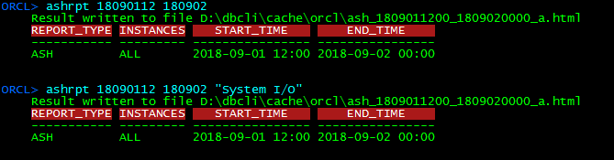
Common Utility – ASHRPT
Grammar is similar to AWRDUMP, to generate ASH report

Slide 34
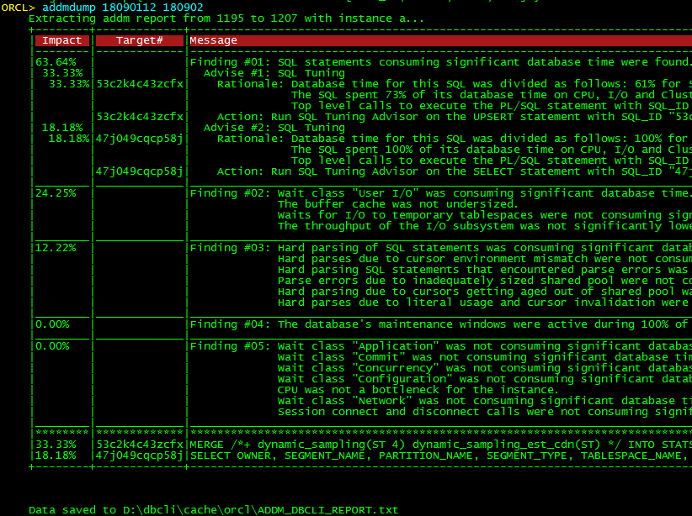
Common Utility – ADDMDump
Grammar is similar to AWRDUMP, to create and extract new ADDM report
Can also use “ora addm <id>” to extract existing ADDM report

Slide 35
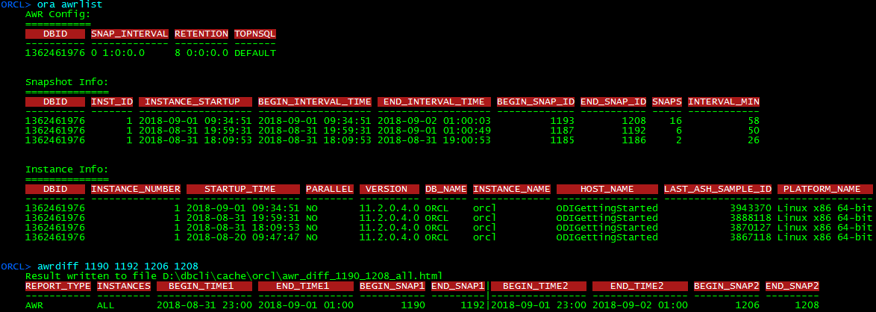
Common Utility – AWRDiff and ADDMDiff
To generate AWR/ADDM difference report
Usages: awrdiff/addmdiff <p1_start> <p1_end> <p2_start> [p2_end] <inst1,inst2,...>

Slide 36
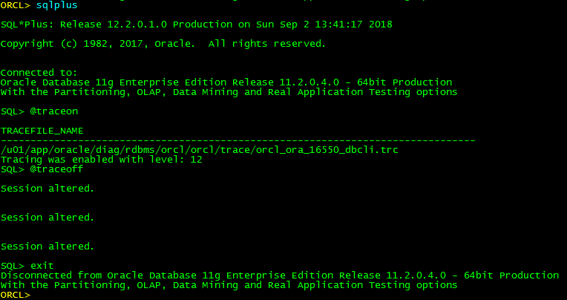
Common Utility – porting to sqlplus and sqlcl
Sqlplus/sqlcl should be found in the default path, or has been defined in the EXT_PATH env variable in file data\int.cfg
When the command is invoked, sqlplus/sqlcl will be called and auto-login with the same account
SQL_PATH and ORACLE_PATH will be defined as the directories under oracle\sqlplus

Slide 37
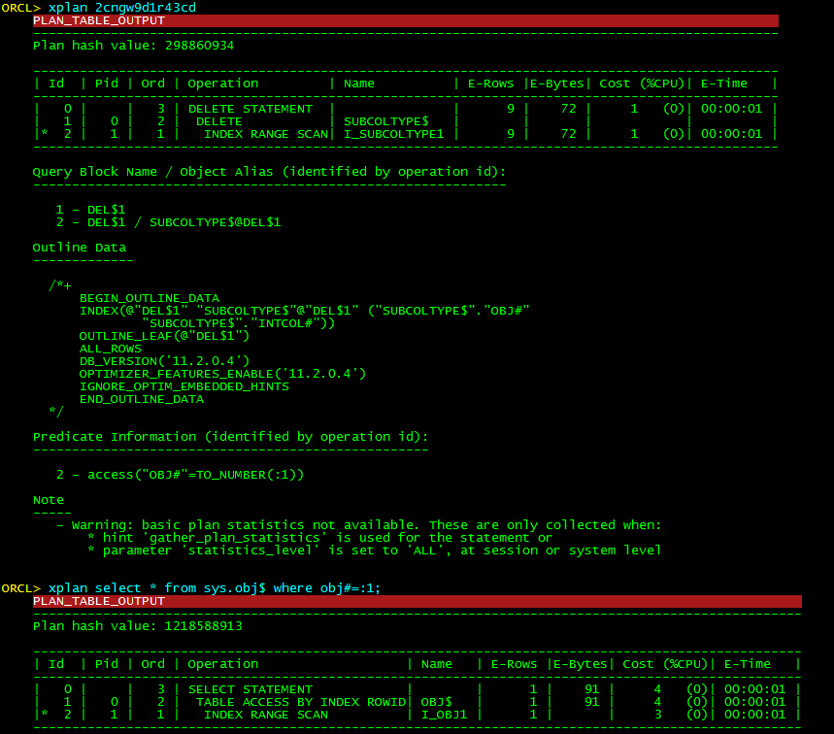
Common Utility – Xplan
Similar to explain plan + select from <dbms_xplan.display(…)>, but provides more additional features
Usage: xplan [-<format>|-10053|-prof] <SQL statement|SQL ID>
-10053: generate 10053 trace file
-prof: generate SQL profile script

Slide 38

Common Utility – SQLProf
To create SQL Profile from many sources and assign to a specific SQL
Will not make any changes onto db, instead, it generates a SQL script file
Usage: sqlprof <sql_id> [<plan_hash_value|new_sql_id|sql_prof_name|spm_plan_name> | plan]
Sql_id: Targt SQL id to be fixed the plan, the tool will search its SQL text as the fixed target
Param#2: The source of the profile, could be plan_hash_value, the plan of other sql_id, existing profile/spm, plan_table

Slide 39
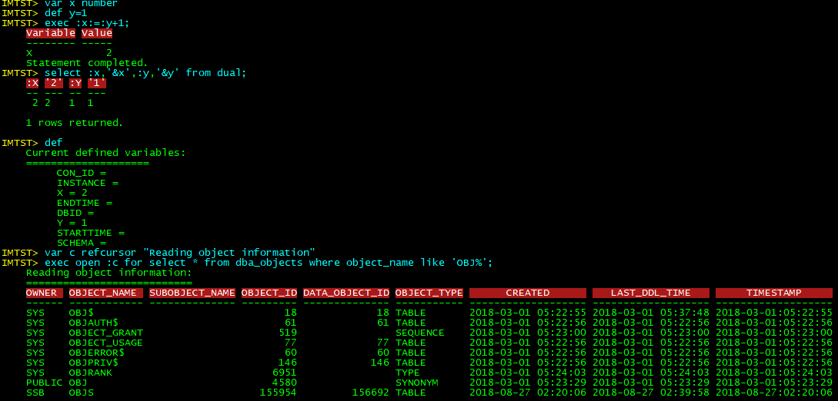
Common Utility – VAR[IABLE] and DEF[INE]
VAR <name> <datatype> [<comment>] : Similar to SQL*Plus, to define a variable binding (:<name>), however can also define a comment that mainly used in REFCURSOR
DEF <name>=<value>: Similar to SQL*Plus, to define a text substitution(&<name>). It can also be used to list all existing variables
Different from SQL*Plus, variable binding and text substitution is sharable, meaning a variable can be referenced as either :var or &var
The settings of set dbid/instance/starttime/endtime/container are globally available to all SQL or PL/SQL statements
Notes:
var x number
Def y=1
exec :x:=:y+1;
select :x,'&x',:y,'&y' from dual;
Def
var c refcursor "Reading object information“
exec open :c for select * from dba_objects where object_name like 'OBJ%';

Slide 40
Common Utility - Others
Command clear: clear screen
Command reload: reset DBCLI into initial state
Command keymap: show or define keymap
Command search: search all source code and print the lines that match the input keyword
Some SQL*Plus commands:
CONNECT or CONN
DISCONNECT or DISC
DESCRIBE or DESC
ACCEPT or ACC
HOST or !
PRINT or PRI
SPOOL or SPO
SAVE
ED or EDIT
/ or r
Type help –a or set for more commands

Slide 41
Configuration files
The Configuration files will not be deleted or overridden when extract newer DBCLI release into the same directory
The configuration files includes:
The files under the “data” directory, including:
password.dat : The account information that used by the “login” command
setting.dat: The permanent settings that created by “set -p <option> <value>”
init.cfg(Windows)/init.conf(Linux/OSX): The MSDOS commands or Shell commands that impacted the startup of DBCLI
jdbc.cfg: The user-defined database connection information
plugin.cfg: The user-defined plugins
The user-defined aliases under the “aliases” directory

Slide 42
Scripting Engines
Input parameter names are from :V1(or &V1) to :V20(or &V20) and case-insensitive, however SQL*Plus is &1…
V1 to V20 are all default to null(empty string) and don’t ask mandatory input, however SQL*Plus will ask for input if not specified in the command line.
A variable value can be used as either substitution(&var) and binding(:var)
Either input parameter or variable can pre-define default value and options(-option) in the script annotation part(sub-part of the documentation)
If an input parameter is dot(.), it means using the default value
3 switches can be defined in the annotation part and can be treated as variables:
Privilege switch(@check_access_xxx): auto-choose the first value that matches the required access right
User switch(@check_user_xxx): auto-choose the first value that login user matches the required user
Version switch (@other): auto-choose the first value that matches the require db version
If the “default” option is not defined in a switch annotation and current login user cannot match any requirement, then the script will exit with an error
2 other annotations:
@ALIAS: defines the nicknames of the script, multiple nicknames should be separated by comma(,)
@ARGS: defines the minimum number of input parameters
The life cycle of the VAR/DEFINE/SET settings are script-locally, and don’t affect the global level settings, however in SQL*Plus those are all global, which can mess the variables of different scripts.
Engines:
SQL*Plus-style engine: does not support all SQL*Plus syntax, but supports all commands that dbcli provides(help -a to list all supported commands)
Show: Executes the pre-defined scripts that don’t require any input parameter
Ora: Executes the pre-defined scripts that accept parameters
SYS: Similar to Ora, but executes the pre-defined scripts that refer to x$ table
EXA: Similar to Ora, but executes the pre-defined scripts that to query Exadata information
Snapper engine(snap): JSON/Lua format, to compute the delta values of the same queries in a specific period, support Linux top-style output
Graphing engine(chart/ch): JSON/Lua format, to generate line/bar chart of the time-series data, mainly used on AWR data

Slide 43
Common Pre-defined Scripts (1)
* Note: […] means optional, | means “OR”
top [interval] [-iostat|-latch] [-filestat]: monitor db stats with specific interval, default is 10 seconds
cellio [interval] [-pred|-cc|-db] [-cell] [-diskio] : monitor Exadata cell stats with specific interval, default is 20 seconds
Exa cell: show Exadata information
Ora/sys param <keyword>: show parameters that match the keyword
Ora tbs [<tablespace_name>]: show tablespace usages
ora actives [-b|-p|-m]: list active SQLs
ora plan <sql_id> <plan_hash_value>: show execution plan
ora sql <sql_id>: show SQL text and stats
Ora sqlm [<sql_id> [sql_exec_id][-l]]: show sql monitor list, or extract SQL Monitor report. Type ‘help ora sqlm’ for more usages.
Ora ashplan <sql_id> [plan_hash_value] [-dash]: show sql plan + aggregated ash cost of all executions of the same phv
Ora ashchain [<sql_id>|<sid>] [-sid|-p] [-flat]: An enhancement of Tanel Poder’s script to see blocking information of ASH
Ora ashtop [<sql_id>] [-snap <seconds>] [-p|-o]: An enhancement of Tanel Poder’s script to see blocking information of ASH
Ora obj <object_id|data_object_id|[owner.]object_name>: Show information of an object
Ora search <keyword>: search object with specific keyword
Ora size [owner.]<object_name>: show space usage of an object
Ora space [owner.]<object_name> [-adv]: show detailed space usage of an object
Ora ddl [owner.]<object_name>: show ddl of an object
Ora stats [owner.]<table_name> [-advise]: show table stats or run statistics advisor
Ora histogram [owner.]<table_name> <column> […]: Show/change histogram of a column
Ora spd [owner.]<table_name>: show SPD information of an object
Ora/sys liblock [[owner.]<object_name>]: show library cache lock
Show lockobj: show DML lock information
Show waiters: show blocking information
Show waitchain: show blocking information
Show trans: show running transactions

Slide 44
Common Pre-defined Scripts (2)
Show sga: show sga information
Show pga: show pga information
Show me: show information of my session
Ora session <sid> [<inst_id>]: show other information
Ora awrlist: summarize the available AWR data
Ora awrtop/awrtop2 [yymmddhh24mi] [yymmddhh24mi]: show AWR top SQLs of the specific period
Ora awrstat <sql_id>: show specific sql stats from AWR
Ora awrevent [yymmddhh24mi] [yymmddhh24mi]: show top awr event
Ora awrobj [owner.]<object_name>: show list of SQLs and stats that refer to the specific object
Ora/sys latchprof [<sid>]: enhancement of Tenor Poder’s script to analyze the real-time latch info
Ora waitprof <sid> >]: enhancement of Tenor Poder’s script to analyze the waits of a specific session
Ora tabusage [owner.]<table_name>: Show table usage stats
Ora hinth <keyword>: search available hints
Ora events <keyword>: search oracle events
Ora fixctl <keyword>: search fix controls
Ora deptree [owner.]<object_name> [-c]: show dependency of an object
Ora deptree2 [owner.]<object_name> : show dependency of an object, requires less privileges
Ora sqld <sql_id> [<plan_hash_value>]: generate SQL report
Ora addm [<task_id>]: list or show available ADDM/other reports
Ora rtaddm [<report_id>]: list or show realtime ADDM report
Ora dsqlm [<sql_id>] [YYYYMMDDHH24MI] [YYYYMMDDHH24MI]: list or generate dictionary SQL Monitor report
Ora perfhub [1|YYMMDDHH24MI] [YYMMDDHH24MI] : generate Performance Hub report
Ora sqlperf <sql_id>: generate SQL Performance Hub report
Ora expstats [owner.]<table_name>: generate script that used to import table stats
Ora redef [owner.]<orig_table_name>[.partition_name] <new_table_name> : generate script for online-redefinition

Slide 45
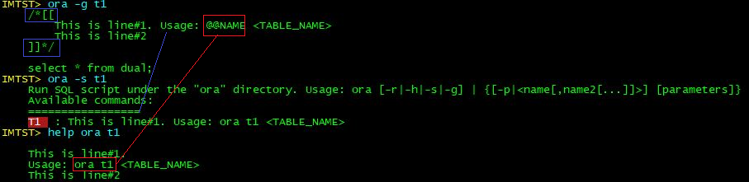
Scripting Engine – documentation(optional)
A script documentation is enclosed by /*[[…]]*/ that does not impact the SQL execution entries
@@NAME will be automatically replaced by the command prefix
The first line is to brief the usage, and other lines to detail the usage
Notes:
t1.sql:
========
/*[[This is usage
--[[
&V1: v={1}
&V2: X={2} P={3}
&V3: X={&V2}
--]]
]]*/
select :V1 p1,'&V4' p4,:V2 p2,'&V3' p3 from dual

Slide 46
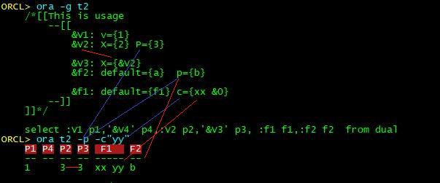
Scripting Engine – default value and options
All input parameters are all defaulted to NULL(empty string) if not specified in the annotation area
Annotation area is the sub-area of documentation area, which is enclosed by --[[…]]-- or --[[…--]]
The option values are chainable
Format:
Single-line annotation: &<name>: <option#1>={<default value>}, <option#2>={value2}, …
Multi-lines annotation: &<name>: { <option#1>={<default value>},
<option#2>={value2
}, …
}
Notes:
t2.sql:
========
/*[[This is usage
--[[
&V1: v={1}
&V2: X={2} P={3}
&V3: X={&V2}
&f2: default={a} p={b}
&f1: default={f1} c={xx &0}
--]]
]]*/
select :V1 p1,'&V4' p4,:V2 p2,'&V3' p3, :f1 f1,:f2 f2 from dual

Slide 47
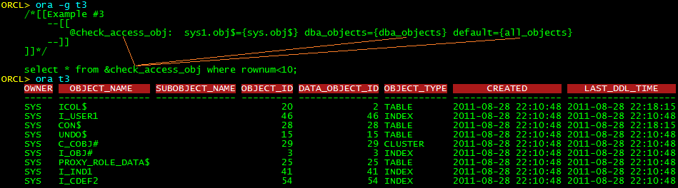
Scripting Engine – privilege switch
A privilege switch is optionally defined in the annotation area, whose variable name starts with “@check_access_”
It’s an order-choice variable that returns the first value that current session has the privilege of the specific object.
If the “default” option is not defined and current session doesn’t match any of the privileges, then the script will exit with error
Syntax: @check_access_<name>: {
object1[/object2[/…]]={<value1>},
object={<valueN>},
default={<value_defaul}
}
Below example will query “dba_objects” if it has the access to dba_objects, otherwise will query “all_objects”. Since “sys1.obj$” doesn’t exist, its value “sys.obj$” will never be accessed
Notes:
t3.sql:
========
/*[[Example #3
--[[
@check_access_obj: sys1.obj$={sys.obj$} dba_objects={dba_objects} default={all_objects}
--]]
]]*/
select * from &check_access_obj where rownum<10;

Slide 48
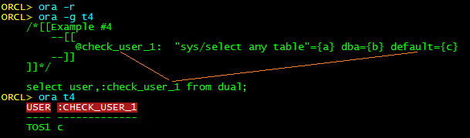
Scripting Engine – User switch
A user switch is an order-choice option that returns the first value that matches the current user’s name or owning roles, whose name starts with “@check_user_”
If the “default” option is not defined and current user doesn’t match any listed users, then the script will exit with error
With below example, since current user “TOS1” neither is SYS nor has the SELECT ANY TABLE access right, so value a is bypassed; and it also hasn’t the DBA role, finally the default value c is returned.
Notes:
t4.sql:
========
/*[[Example #4
--[[
@check_user_1: "sys/select any table"={a} dba={b} default={c}
--]]
]]*/
select user,:check_user_1 from dual;

Slide 49
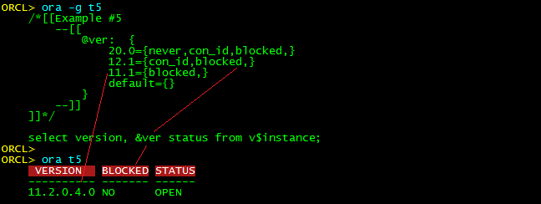
Scripting Engine – DB Version Switch
A version switch is an order-choice variable that returns the first matched database version of current connection
Its name is “@<string>”, where string should not start with either “check_access_” or “check_user_”
If current db version doesn’t match any pre-defines versions, and the “default” option is not defined, then the script will exit with error
With below example, since current db version is less than both 20.0 and 12.1, so the variable returns “blocked,”
Notes:
t5.sql:
========
/*[[Example #5
--[[
@ver: {
20.0={never,con_id,blocked,}
12.1={con_id,blocked,}
11.1={blocked,}
default={}
}
--]]
]]*/
select version, &ver status from v$instance;

Slide 50
Scripting Engine – Snapper usage (1)
The snap command is used to calculate the delta values of the same query at different timestamps, so that no need to create temp tables in database to store the snapshot data.
The snapper script also supports either documentation or annotations that described in previous chapters. But its code part should follow the JSON syntax or Lua syntax.
Command line syntax:
Snap <script…> [args] begin [-sec]=> do something or wait some time => snap <script…> end: manually define the snap period, -sec means dividing the delta values by elapsed seconds
Snap <script…> [args] [-sec] “other command”: calc the delta value between before executing command and after executing command
Snap <script…> [args] [-sec] <<!
<other commands>
! : similar to above syntax except it support cross line commands
Snap <script…> <interval[+]> [args] [-top] [-sec]: calc the delta value between specific interval(in second)
if + is specified then meaning that the scripts will be executed periodically
if -top is specified then meaning the output will be displayed like Linux-top style, usually used together with <seconds>+

Slide 51
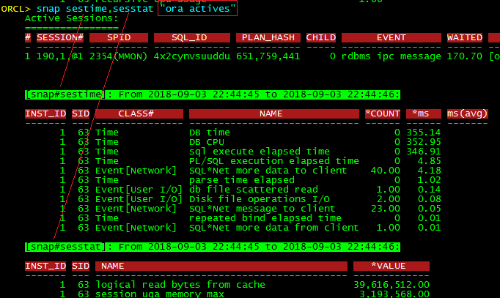
Scripting Engine – Snapper usage (2)
Below example is to snap current session’s time model and session stats of executing “ora actives”:
Notes:
Snap sestime,sesstat "ora actives"

Slide 52
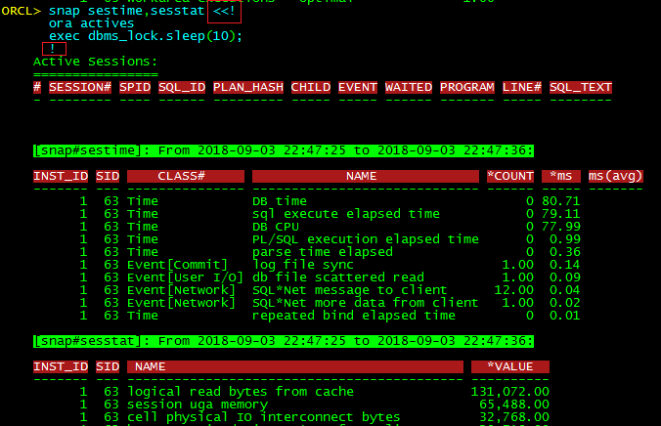
Scripting Engine – Snapper usage(3)
Below example is to compare current session’s time model and session stats of executing multiple commands:
Notes:
Snap sestime,sesstat <<!
ora actives;
exec dbms_lock.sleep(10);
!

Slide 53
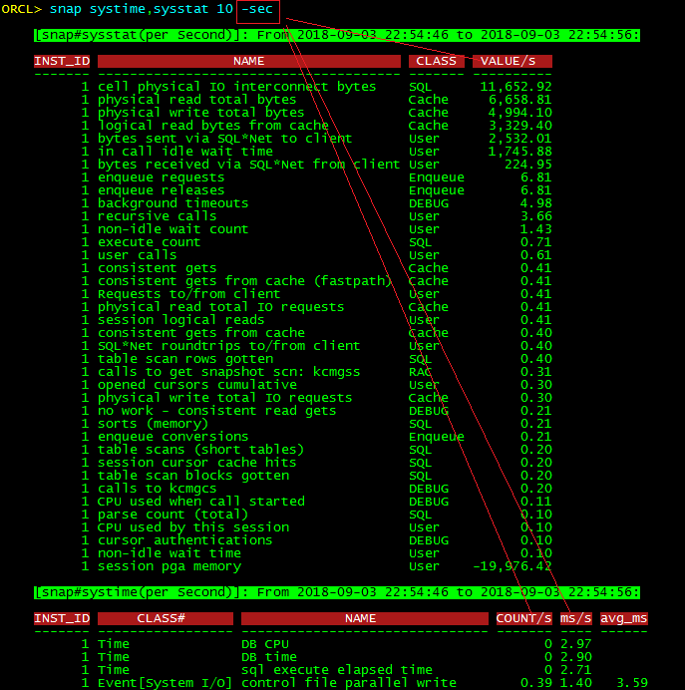
Scripting Engine – Snapper usage (4)
Below example is to compare the system time model and system stats for 10 seconds, and show the delta value based on per second:
Notes:
snap systime,sysstat 10 -sec

Slide 54
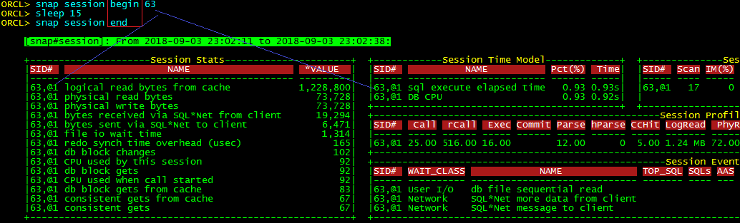
Scripting Engine – Snapper usage (5)
Below example is to compare the session statistics of sid=63 during a period(15 seconds):
Notes:
Snap session begin 63
Sleep 15
Snap session end

Slide 55
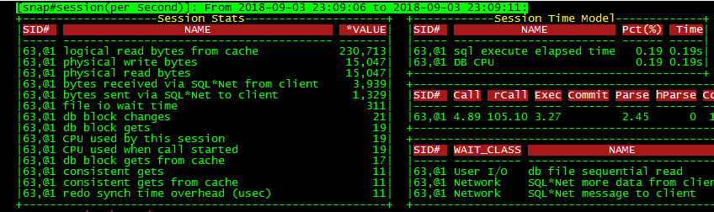
Scripting Engine – Snapper usage(6)
Below example is to keep monitoring the session statistics of sid=63 periodically(every 5 seconds), each time before the output is displayed, the screen will be reset:
Notes:
Snap session 5+ 63 -top -sec

Slide 56
Scripting Engine – Snapper script syntax(1)
As shown below, the only the first element in blue is mandatory, the 2 elements in magenta are commonly used, and the others are optional:
{
sql={<grid SQL array>} or [[<sql text>]],
group_by="<list of grouping fields seperated by comma>“,
delta_by="<list of aggregation fields seperated by comma>",
order_by="<list of sort fields after the calculation, use '-<column>' as desc ordered>",
per_second="on or off", /*controls whether the –sec option is enabled by default*/
top_mode="on or off", /*controls whether the –top option is enabled by default*/
fixed_title="on or off", /*controls whether to add “*” before the each delta field titles*/
include_zero="on or off", /*controls whether to display the row whose delta values are all zero(0)*/
calc_rules={<map of formulas>}, /*additional calc rules apart from calculating the delta values, e.g. fielC=fieldA*100/fieldB */
column_formatter={<map of formulas>}, /* use “col” command to format some specific fields */
before_sql=[[<sql text>]], /*the SQL that used for initiation before snap starts*/
after_sql=[[<sql text>]], /*the SQL that used for data cleanout after snap finishes*/
variables={<map of variables>} /*mainly used in case of sql is a PL/SQL block, to define additional variables*/
}

Slide 57
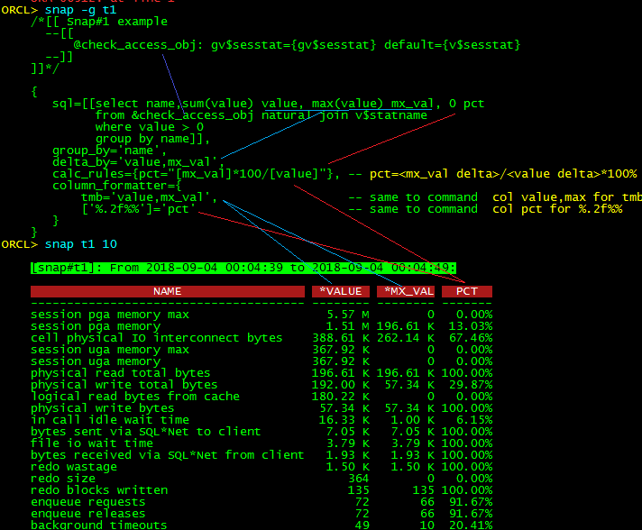
Scripting Engine – Snapper script syntax(2)
Below example describes how to use sql/group_by/delta_by/calc_rules/column_formatter and the relative syntaxes:
Notes:
t1.snap:
========
/*[[ Snap#1 example
--[[
@check_access_obj: gv$sesstat={gv$sesstat} default={v$sesstat}
--]]
]]*/
{
sql=[[select name,sum(value) value, max(value) mx_val, 0 pct
from &check_access_obj natural join v$statname
where value > 0
group by name]],
group_by='name',
delta_by='value,mx_val',
calc_rules={pct="[mx_val]*100/[value]"}, --$HIY$ pct=<mx_val delta>/<value delta>*100% $NOR$
column_formatter={
tmb='value,mx_val', -- same to command $HIY$ col value,max for tmb$NOR$
['%.2f%%']='pct' -- same to command $HIY$ col pct for %.2f%% $NOR$
}
}

Slide 58
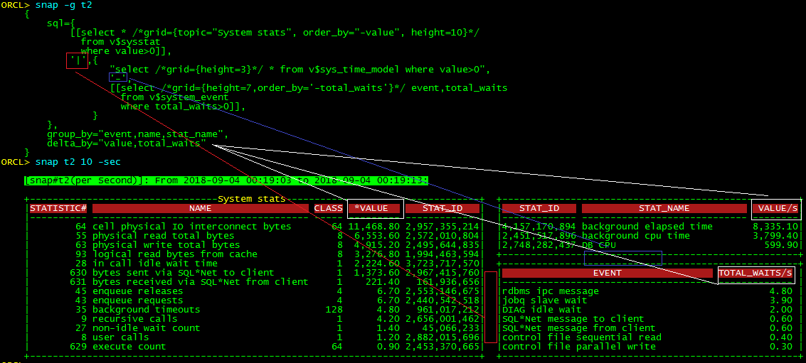
Scripting Engine – Snapper script syntax(3)
Below example describes how the grid command is used in case of multiple SQLs are relative.
Be noted that some fields are not included in either group_by and delta_by, in such case will their last values will be printed
Notes:
t2.snap:
========
{
sql={
[[select * /*grid={topic="System stats", order_by="-value", height=10}*/
from v$sysstat
where value>0]],
'|',{
"select /*grid={height=3}*/ * from v$sys_time_model where value>0",
'-',
[[select /*grid={height=7,order_by='-total_waits'}*/ event,total_waits
from v$system_event
where total_waits>0]],
}
},
group_by="event,name,stat_name",
delta_by="value,total_waits"
}

Slide 59
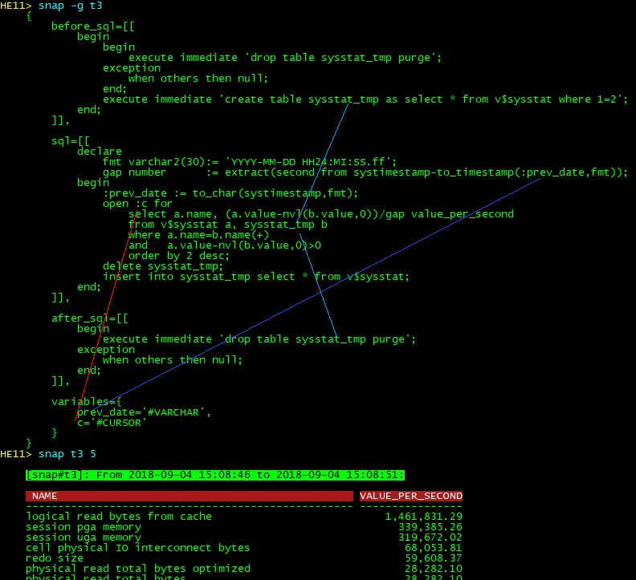
Scripting Engine – Snapper script syntax(4)
Below example describes how to use the before_sql/after_sql/variables options
Notes:
t3.snap:
========
{
before_sql=[[
begin
begin
execute immediate 'drop table sysstat_tmp purge';
exception
when others then null;
end;
execute immediate 'create table sysstat_tmp as select * from v$sysstat where 1=2';
end;
]],
sql=[[
declare
fmt varchar2(30):= 'YYYY-MM-DD HH24:MI:SS.ff';
gap number := extract(second from systimestamp-to_timestamp(:prev_date,fmt));
begin
:prev_date := to_char(systimestamp,fmt);
open :c for
select a.name, (a.value-nvl(b.value,0))/gap value_per_second
from v$sysstat a, sysstat_tmp b
where a.name=b.name(+)
and a.value-nvl(b.value,0)>0
order by 2 desc;
delete sysstat_tmp;
insert into sysstat_tmp select * from v$sysstat;
end;
]],
after_sql=[[
begin
execute immediate 'drop table sysstat_tmp purge';
exception
when others then null;
end;
]],
variables={
prev_date='#VARCHAR',
c='#CURSOR'
}
}

Slide 60
Scripting Engine – Snapper script syntax(5)
Apart from the input parameters, the variables defined in annotation area and the “variables” entry, the global variables such as instance/dbid/etc, the snap engine also provides 2 addition variables:
snap_interval: the elapsed seconds since previous snap
snap_cmd: if not null then means the snap command is executed with snap <script…> “other command” syntax, in such case the “other command” string will be passed as variable snap_cmd
Notes:
t4.snap:
========
{
sql=[[
select round(:snap_interval,2) ela,
nvl(event,'ON CPU') event,
round(count(1)/:snap_interval,2) aas
from v$active_session_history
where sample_time+0>=sysdate-:snap_interval/86400
group by event
]]
}

Slide 61
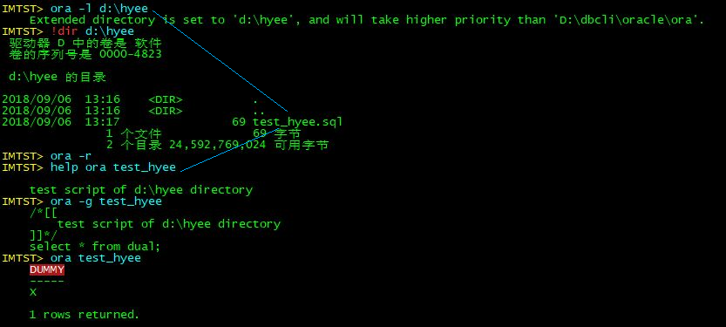
Scripting Engine – Position of the customized script
For Oracle, the default directories of each scripting engine are:
ora: oracle\ora
snap: oracle\snap
sys: oracle\sys
show: oracle\show
exa: oracle\exa
chart: oracle\chart
sp: oracle\sqlplus
Apart from the pre-defined scripts, you are able to develop the script and put it into one of those directories:
The corresponding directory that described above
Create sub-directory under the corresponding directory and put in the script, in this case, the script will be treated as highest priority when duplicate scripts are found
Create an external directory to store the scripts, and use <engine_name> -l <external_dir_path> to link the path, of with <engine_name> is one of the above 6 engines. The linking will affect permanently

