Slide 1
The proto humanoid project
By Les Howell
For RSSC

Slide 2
Overview
Goal??
Progress as of 02/08/2020
How it looks
Design decisions
  Mechanical
  electronics
Issues discovered
  3D printing issues
  Mounting issues
  Design issues
Errors requiring correction
Show the bot and questions

Slide 3
Goal??
Something like a bipedal humanoid
Learn the issues in human movement
Build/learn/modify/build or repair
Ultimately decide if it should be continued

Slide 4
Progress as of 02/08/2020
Movement bits designed
Legs, arms, basic hips, basic shoulders all working, but may need more degrees of freedom.
Body contains Raspberry PI, and shoulder servos
Hip assembly holds the PWM circuits.
Basic structure complete

Slide 5
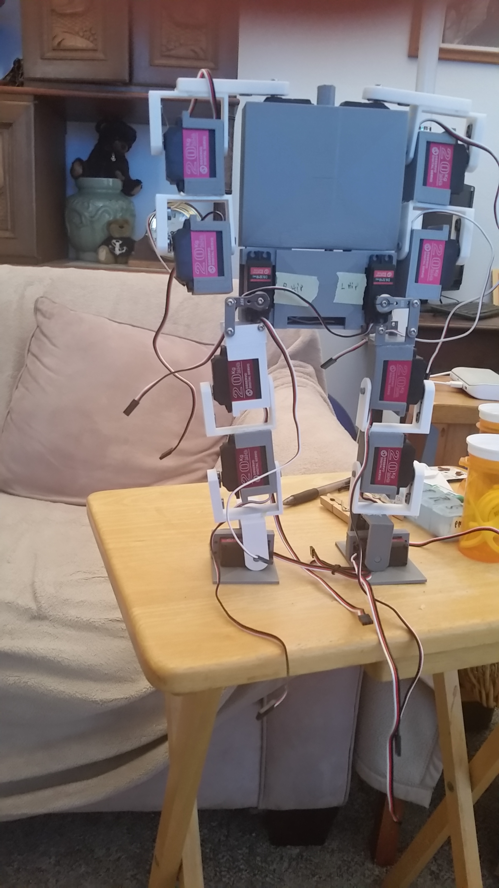
How it looks
Headless but basically together.
It is still too fragile to pass around
No electronics yet

Slide 6
Design decisions
Mechanical
  Avoid modifying servos (it’s a protype and may be scrapped)
  Head yet to be designed
  Grippers yet to be designed
Electrical
  Bury electronics as much as possible
  Lithium Ion battery power 18650 if posssible.
  Raspberry PI 4 8G with 128Gb sd card.
  IMU with integrated filtering and fusion, BNO055.
  Sensors to be determined (prototype, remember.)

Slide 7
Issues discovered
Pins not sufficiently bound. Chris said run a blind hole down the middle. Works!!
My gluing ability is the pits. Add some markers of better mounting positions would help.
Print at high resolution, low layer size. This adds strength and binds the layers more tightly.
3D gloop is the only glue that really binds PLA. It chemically welds the parts together. Parts MUST be sanded prior to gluing.
Measure, Measure, Measure, then glue or design.
Trial fit all mounting bits and create a “plate” to check the mounting of the boards.
Think heavily about how many degrees of freedom and how to achieve the desired mobility.
Screw inserts, and bearings are needed for more robust use. Again, this is a protype.
Animate the parts to check fitting and clearance during the design stage. You can use the difference option to “cut away” some of the assembly to check clearance.
Print, check, print, check… until it works. Final design will be quite different. Remember access holes and cooling.
One design file in OpenSCAD was a bad design choice
Arms do not clear hip pivots Fixed by adding length in shoulder cranks.
Arms did not swing overhead. Fixed by changing servo arm setting and shoulder crank design.
Feet and shoulders may both need another degree of freedom I think, I need to think about these places and how to implement that.
  Feet did need rotation, so added that called ankleroll and ankle pitch now.
Round all pivoting brackets. The angles here make them too stff and subject to breaking.
Printing on glass is possible but requires absolute leveling, especially on the larger format printers.

Slide 8
Errors requiring correction
Arms do not clear hip joints. Added 10mm to shoulder crank
One shoulder doesn’t clear the corner of the body. Needs to be redone completely. My gluing error. Corrected.
Are more degrees of freedom needed at shoulders, hips and feet?
  Yes! Added ankle roll as well as ankle pitch. Still need to think about hips and shoulders.
Screw holes on the early printed pivoting brackets are not properly centered. This has been corrected in the scad file but all the pivoting brackets that are in error need to be reprinted, and thus the bits they are glued to will need to be reprinted, too.
Need to add cooling for the Raspberry PI in the body. Added a 1” fan at 5v.

Slide 9
Questions?
Heres Qubie.

