Slide 1
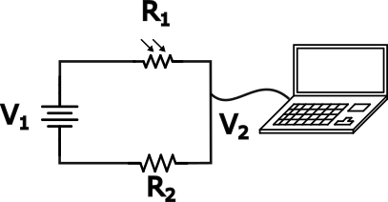
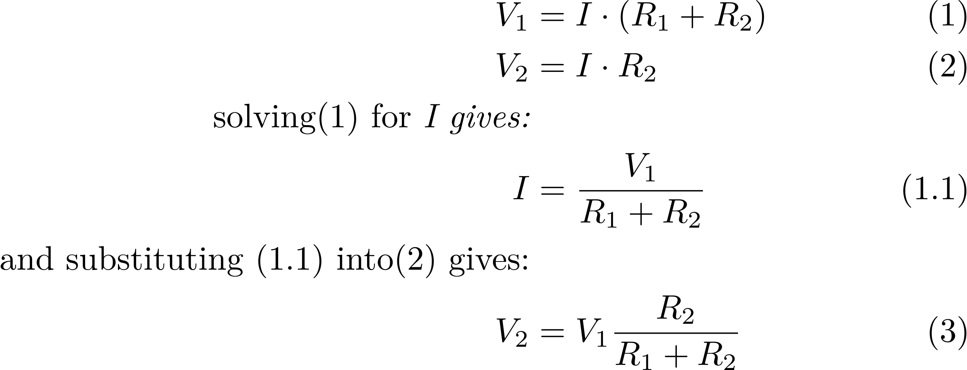

Slide 2
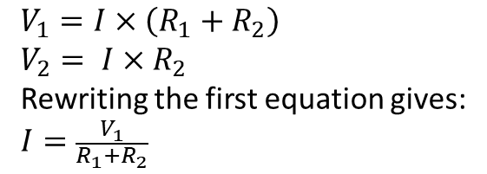
$$V_{1}=I×\left(R_{1}+R_{2}\right)$$
$$V_{2}= I×R_{2}$$
Rewriting the first equation gives:
$$I=\frac{V_{1}}{R_{1}+R_{2}}$$

