Slide 1
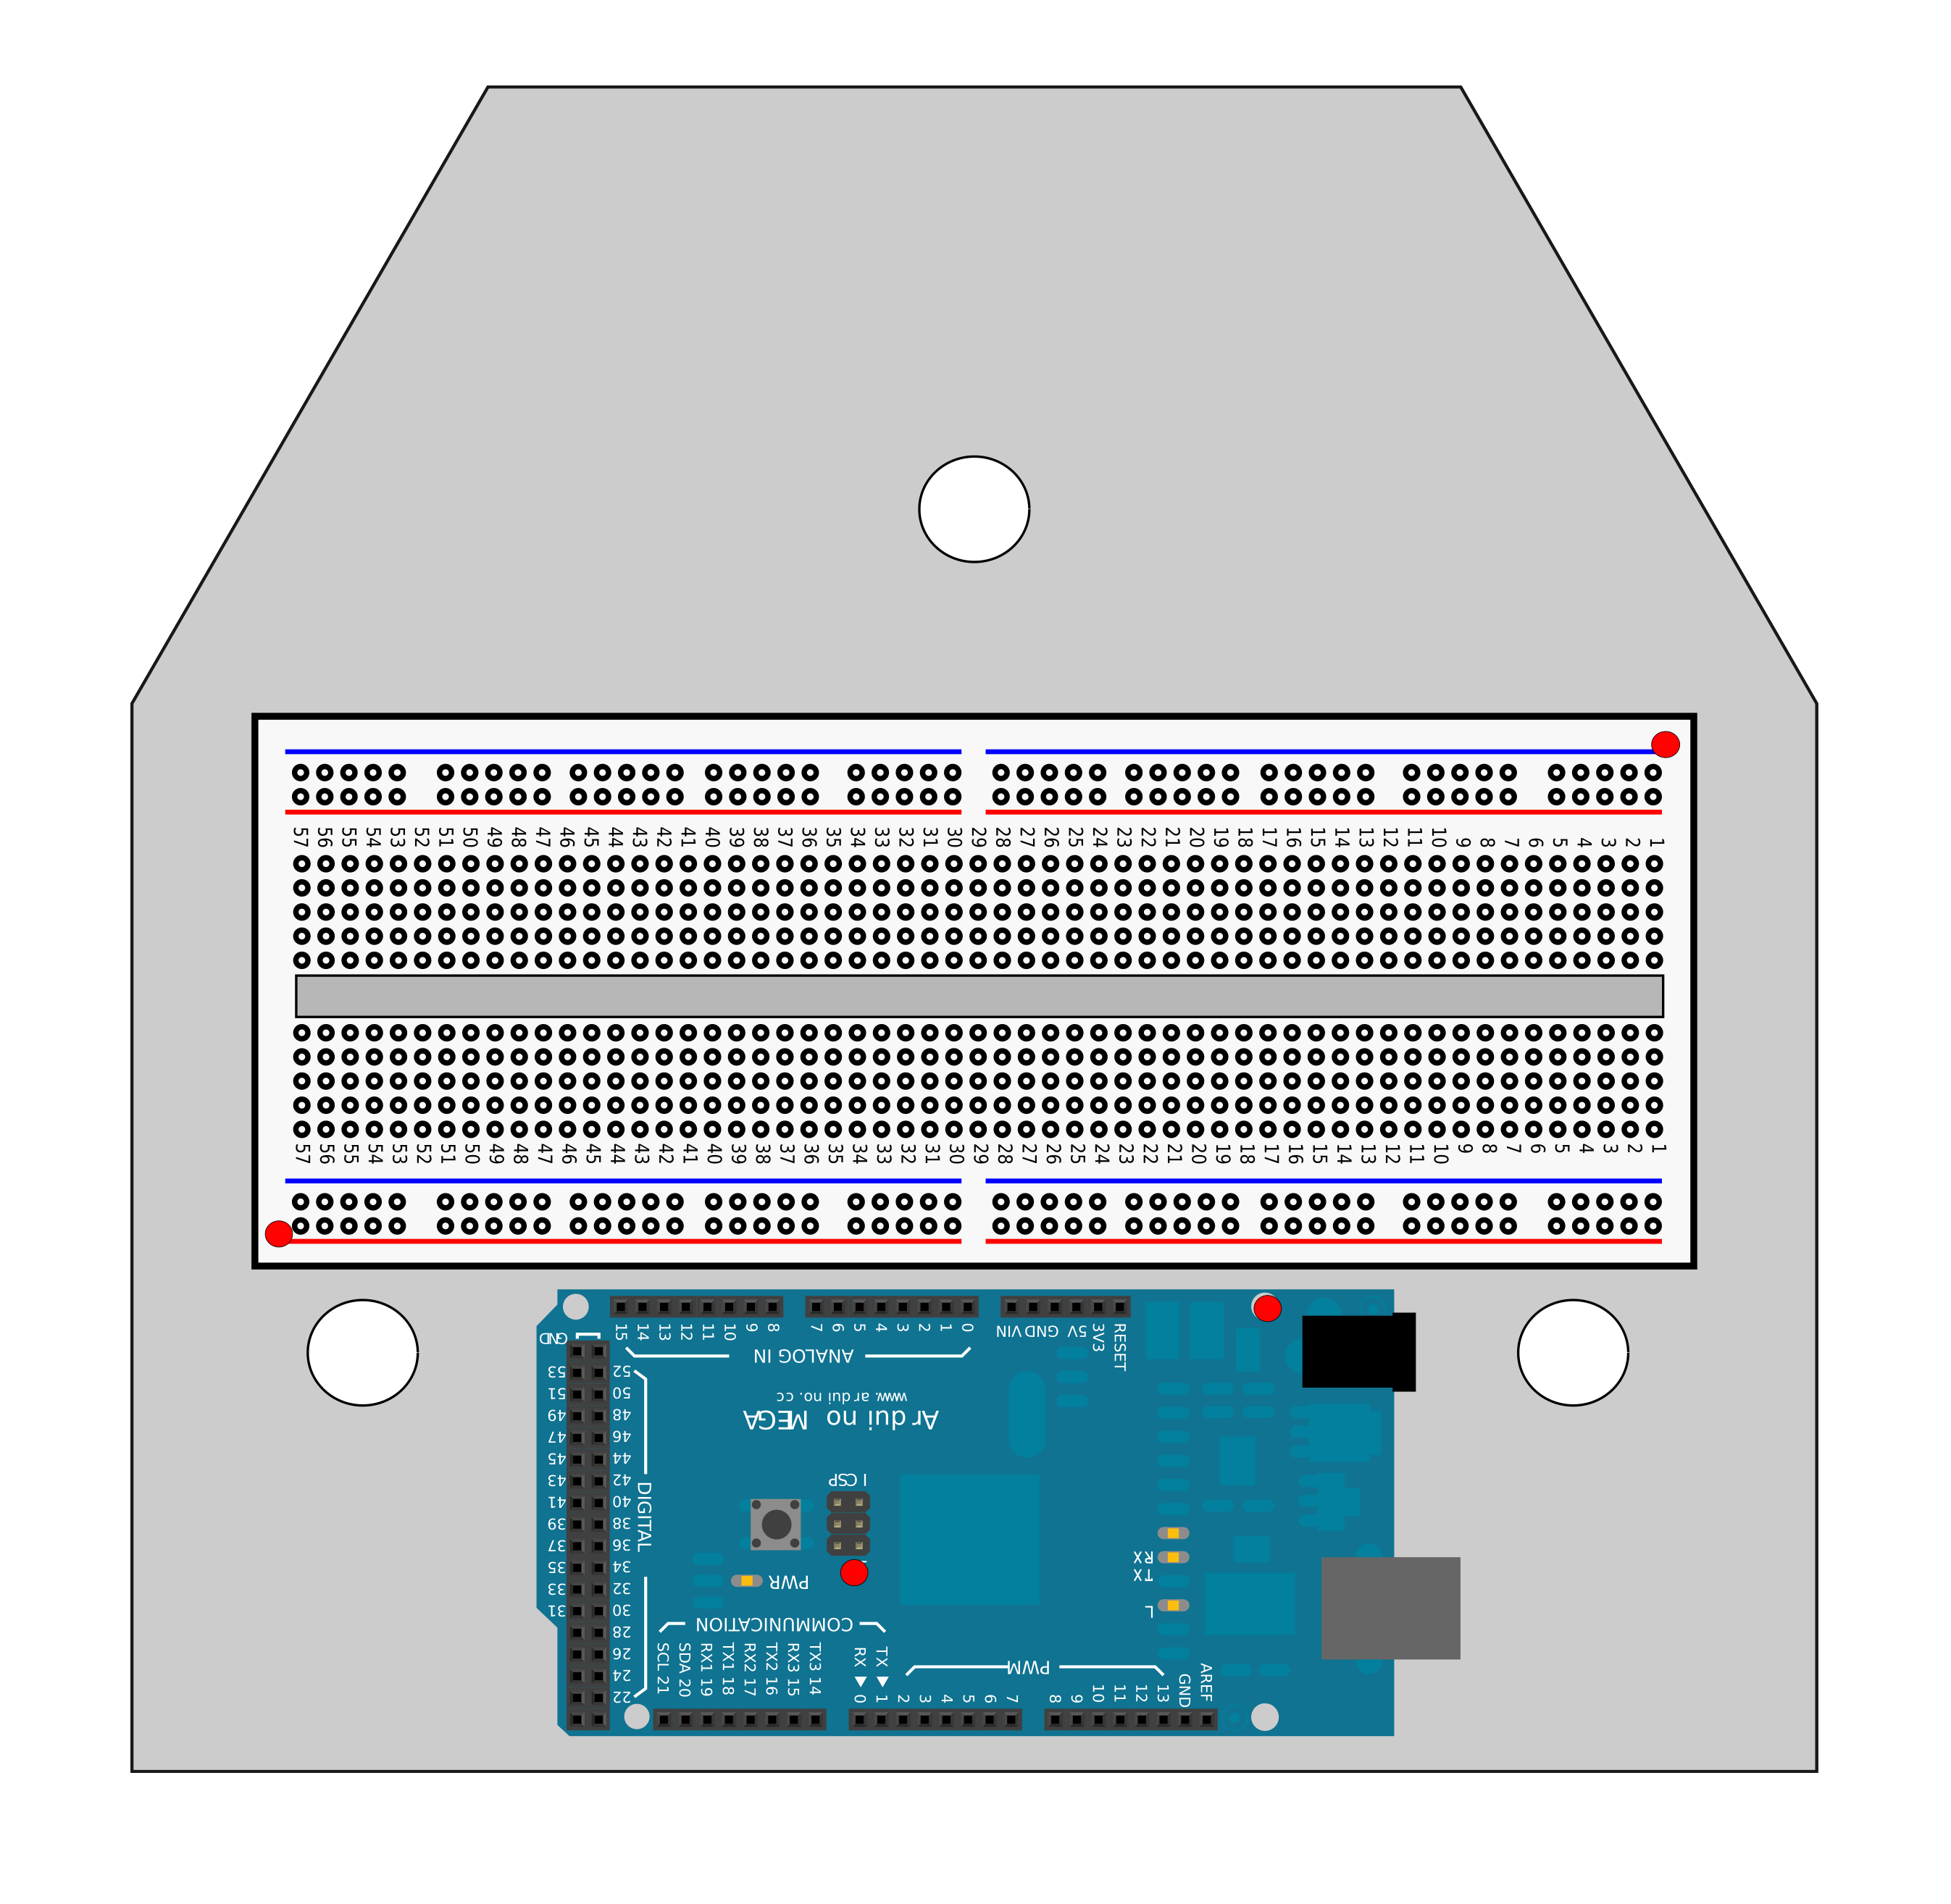
Chassis: TOP View
Mark the red dots on the front of chassis
Mark the middle of these two big circles on the front. Ignore the top circle.

Slide 2
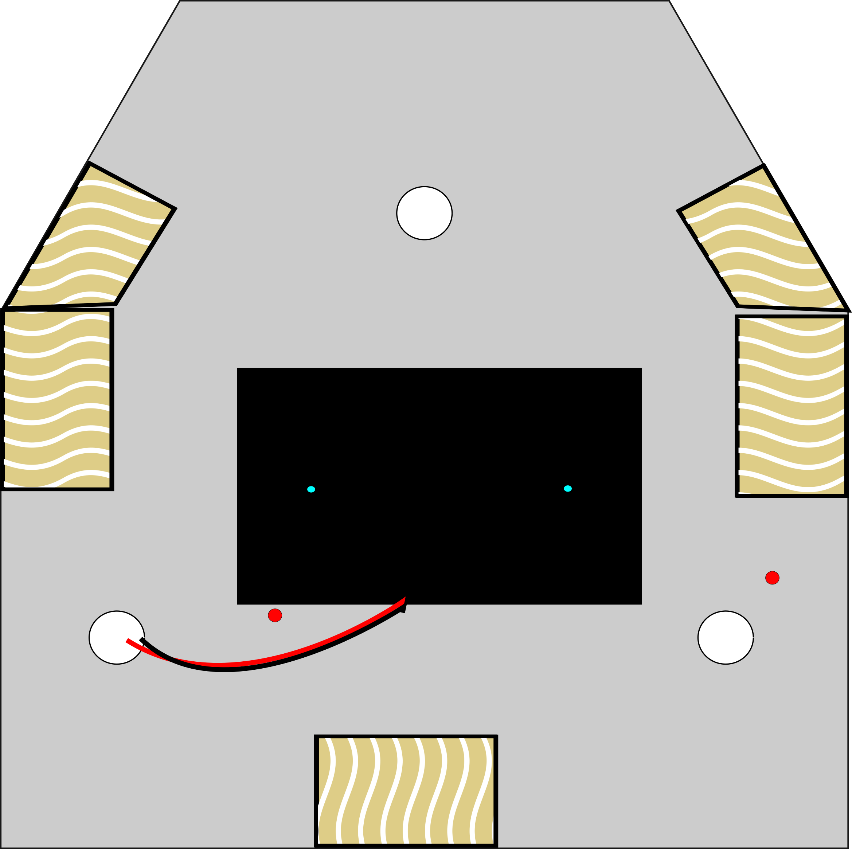
Chassis: Bottom View
Sand the bottom in the tan areas.
Mark blue dots, measuring off of the battery holder.

Slide 3
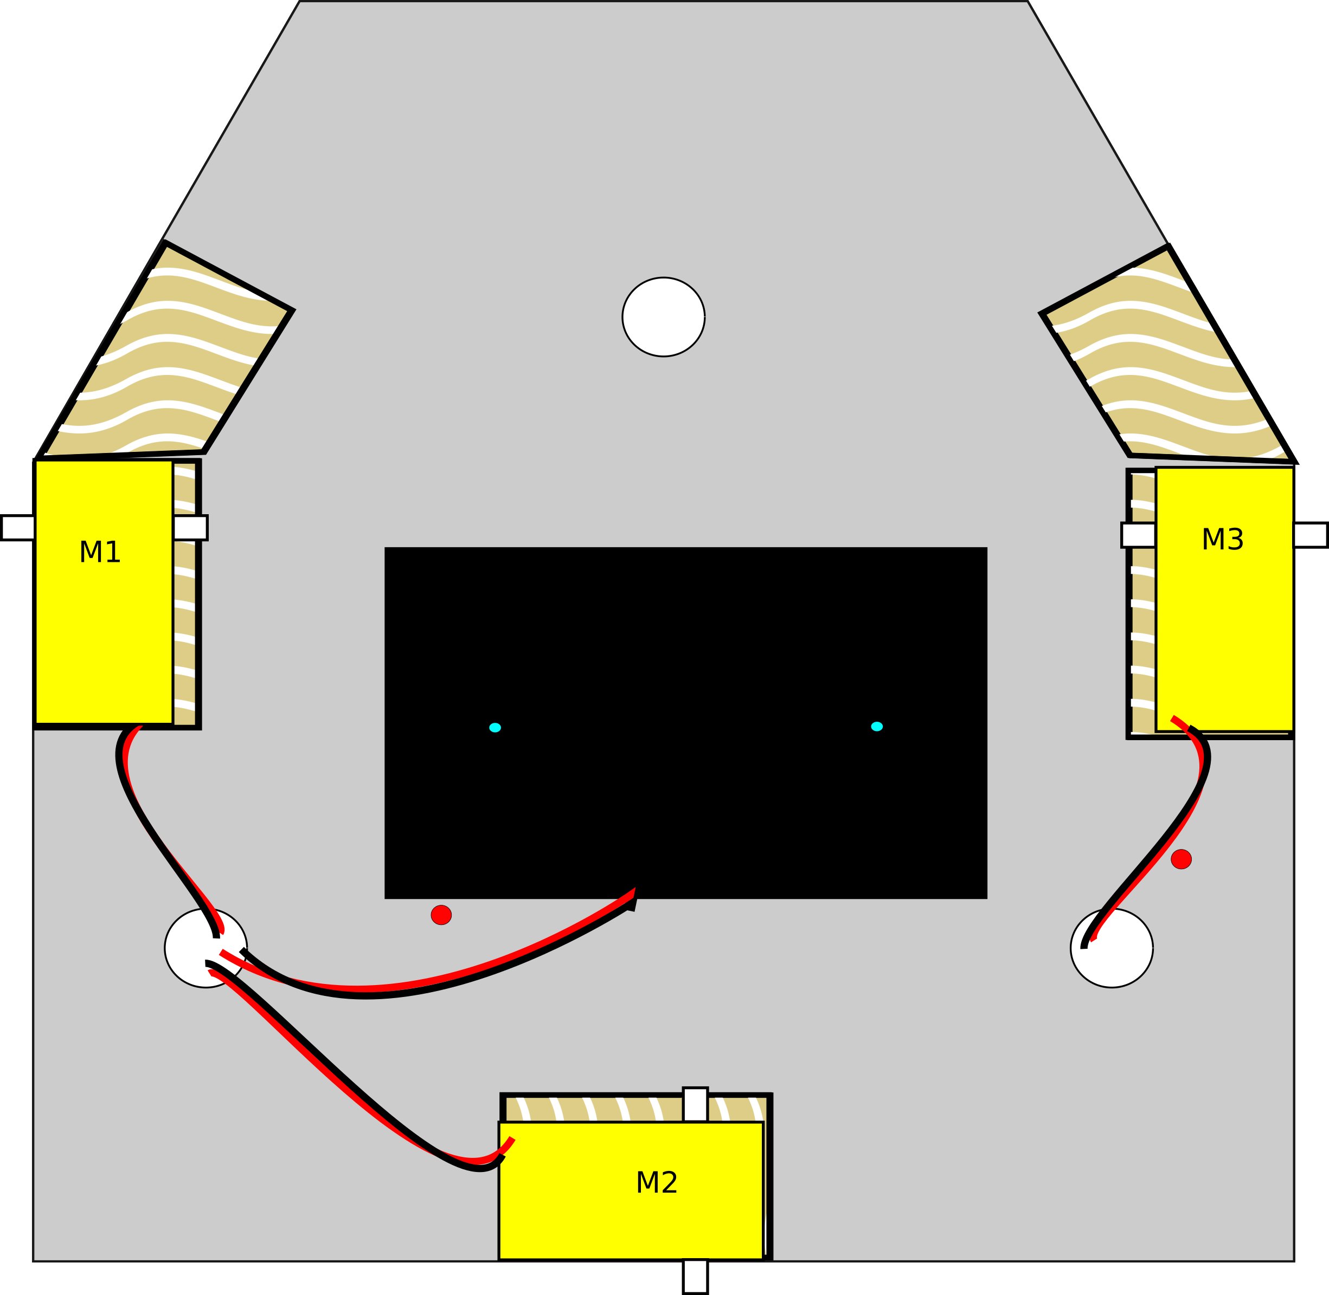
Bottom with Dual Lock and Motors

Slide 4
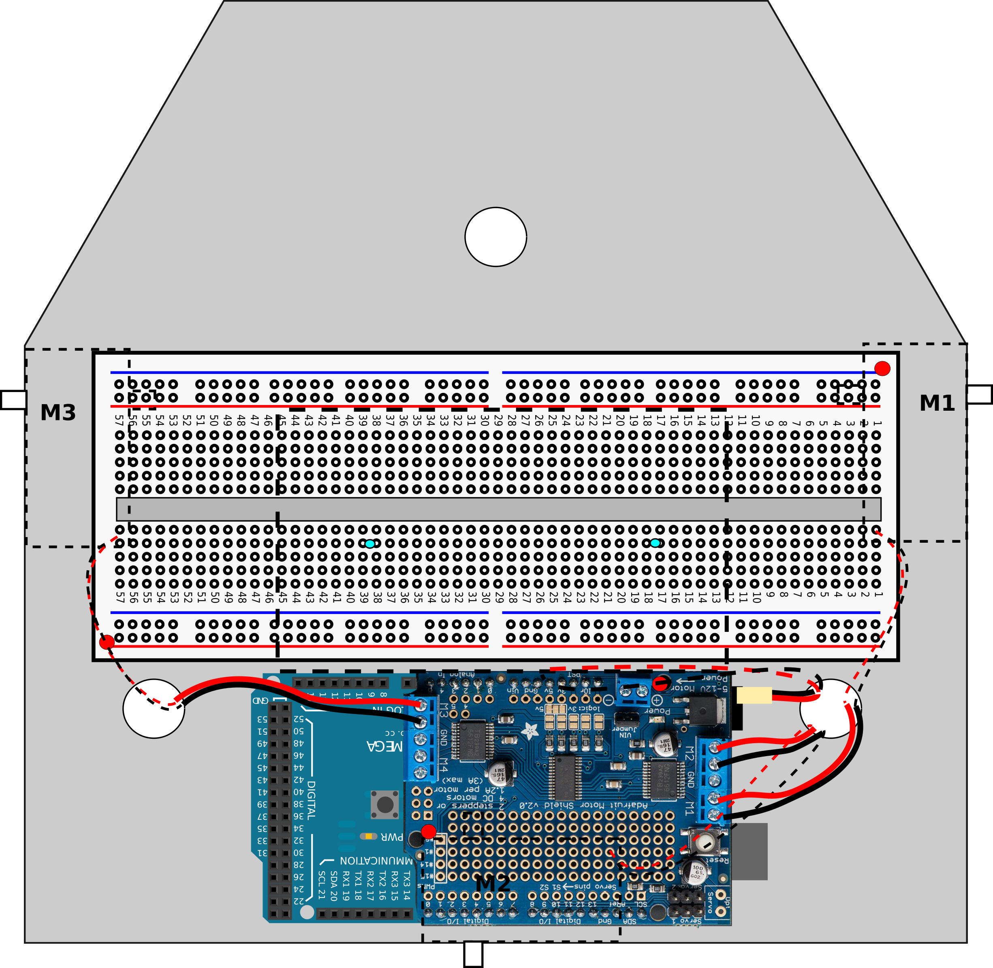
Top with Breadboard and Mega and Motor Shield

Slide 5
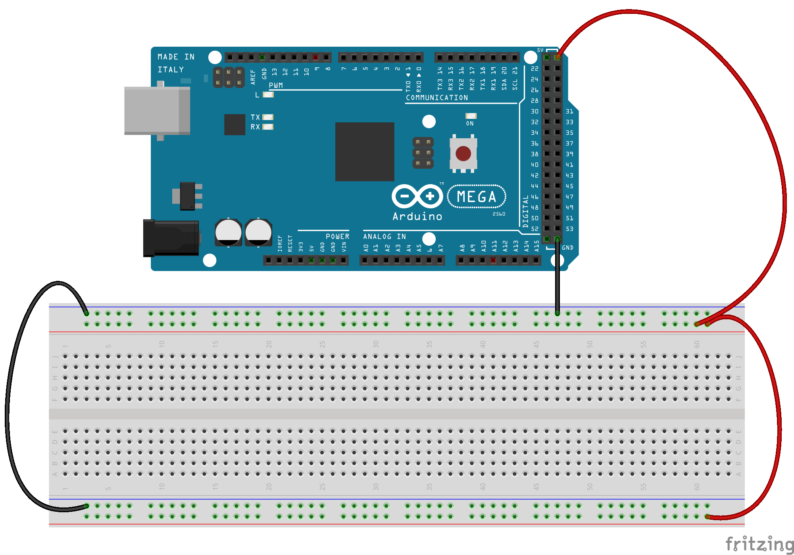
Basic Power Supply

Slide 6
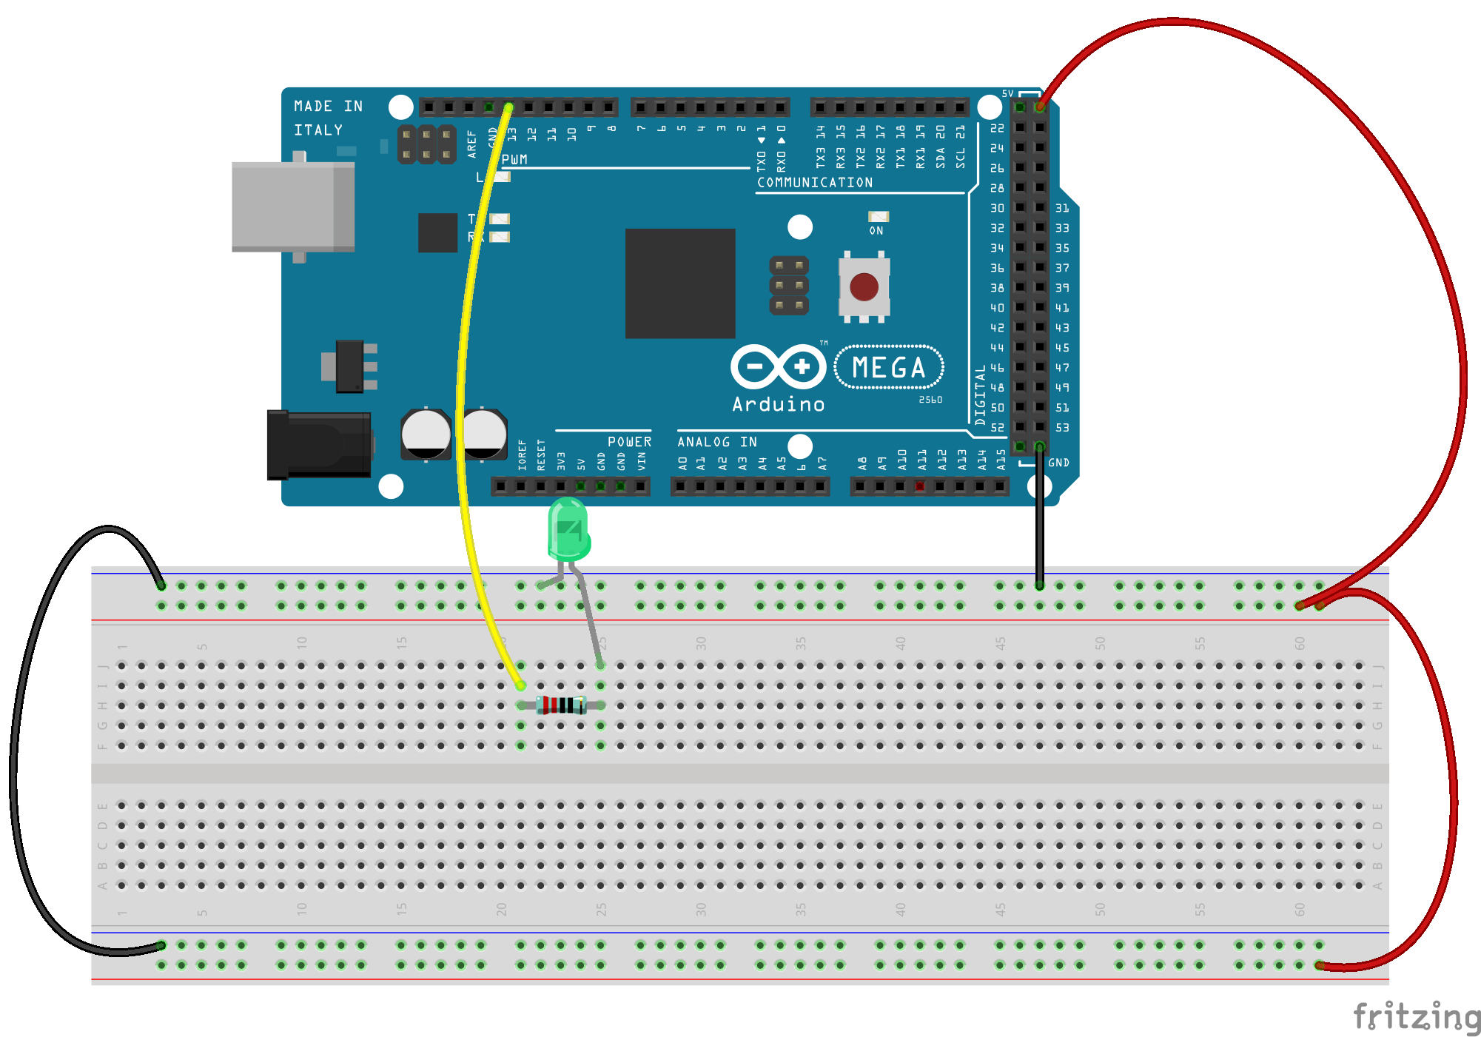
Add Blink Circuit

Slide 7
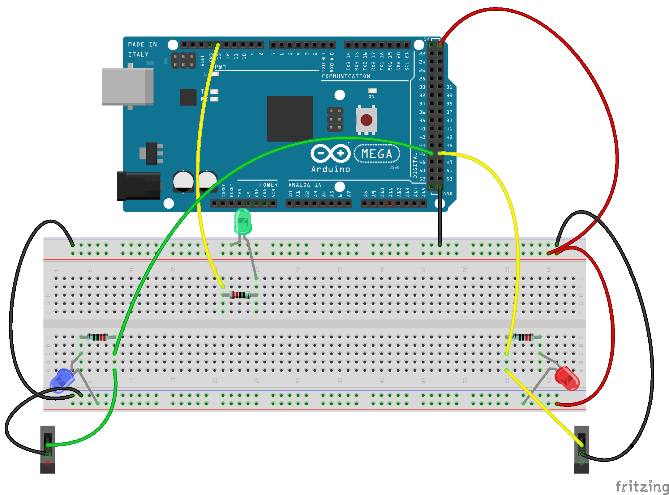
Add Bump Sensors

Slide 8
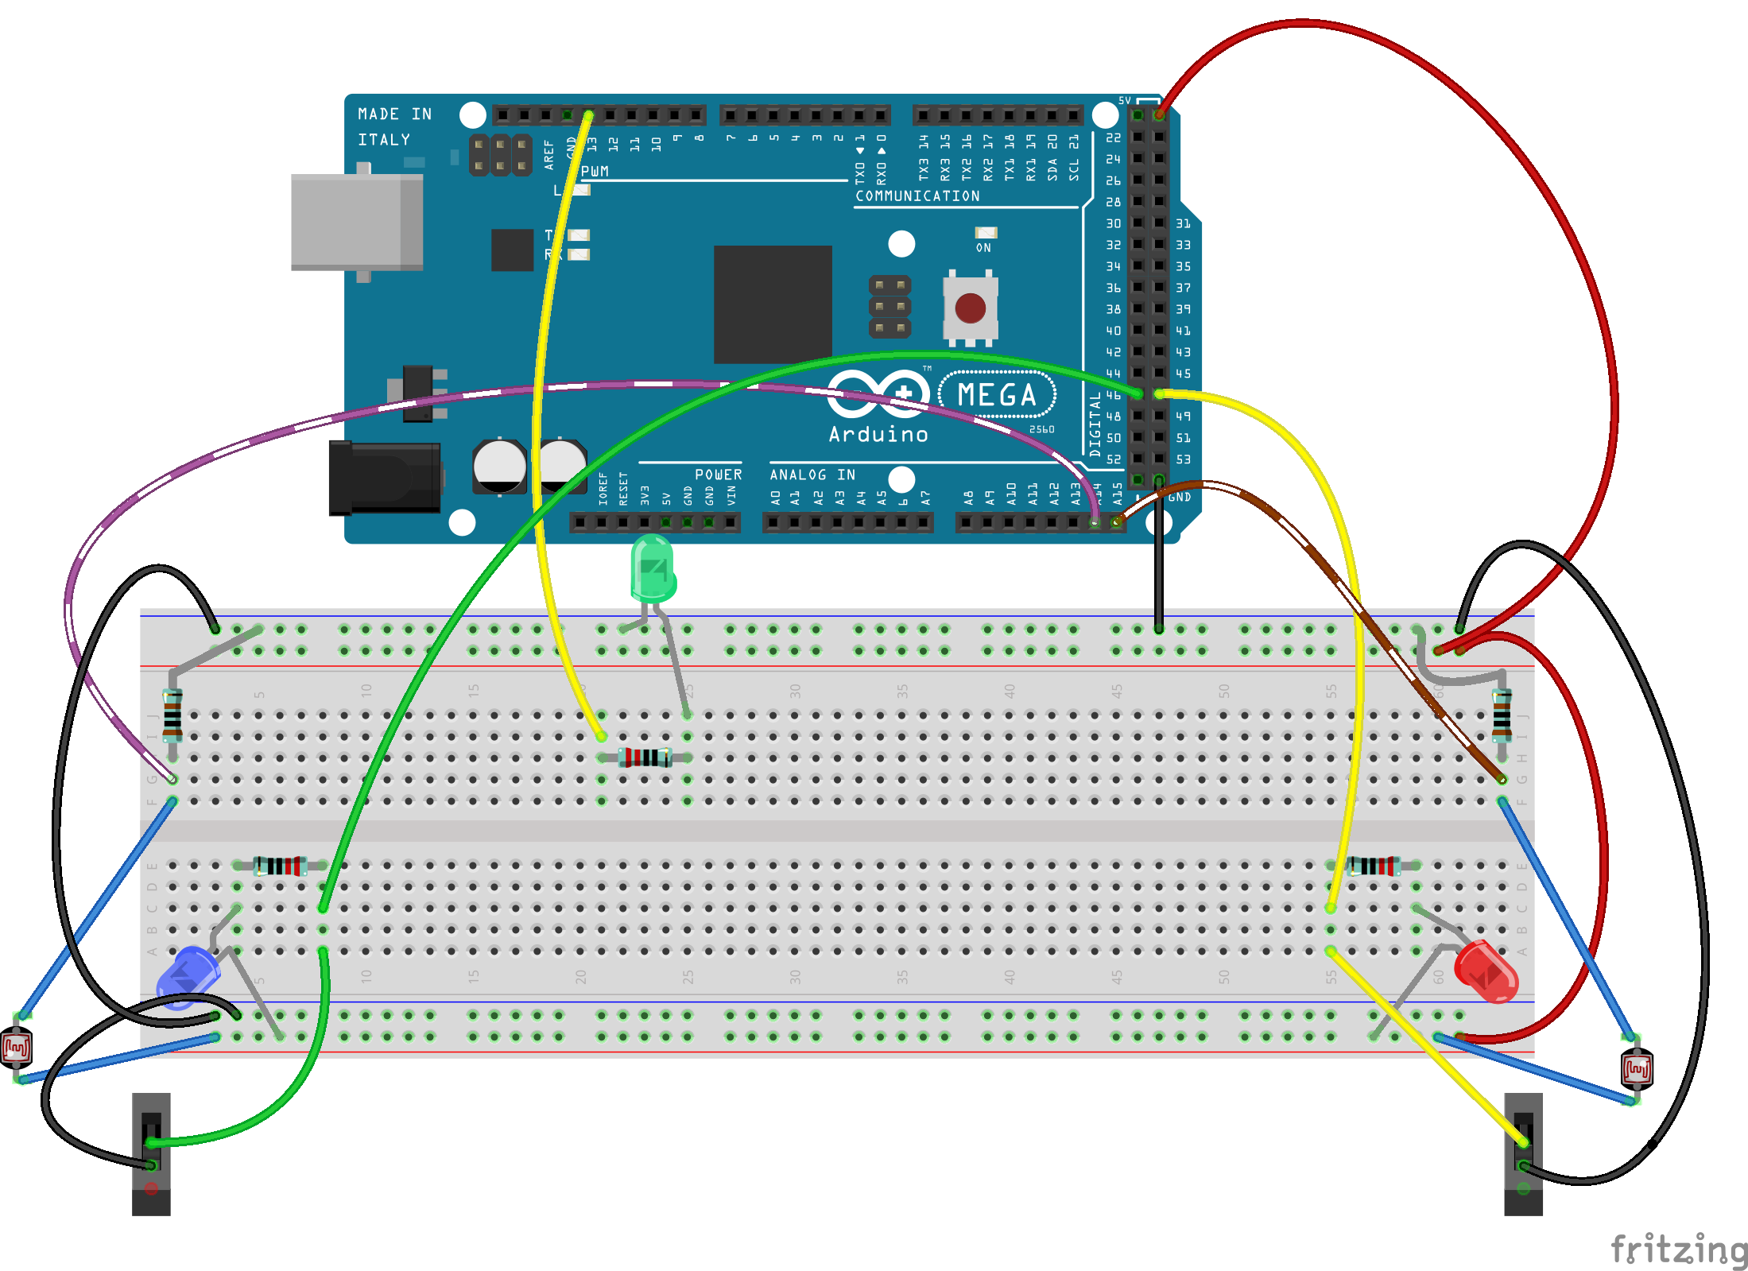
Add Light Sensors

Slide 9
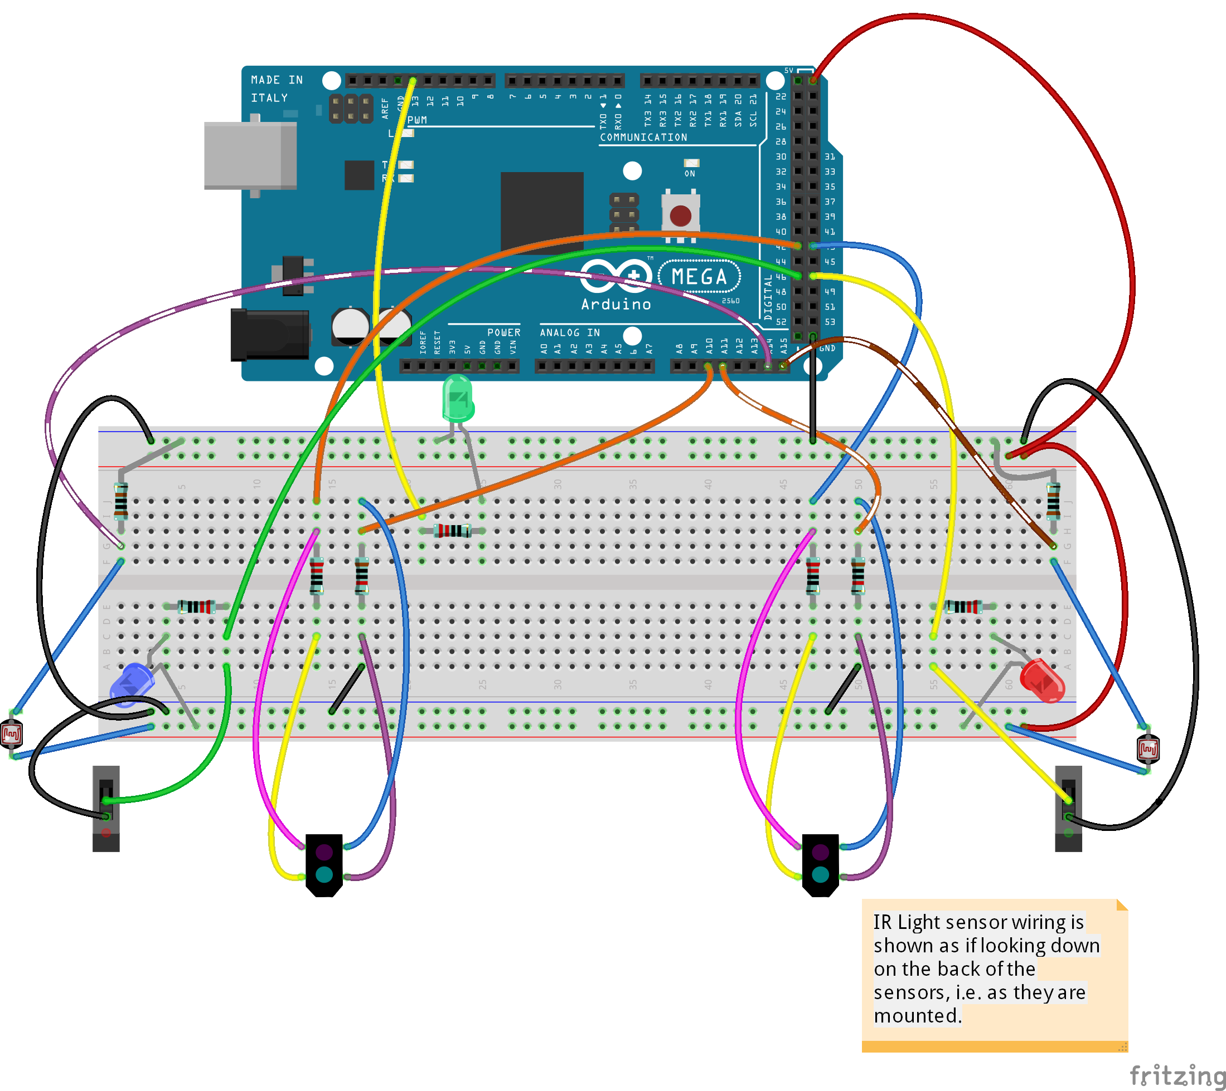
Add IR Sensors
Make sure the light blue LED is toward the front of the robot!

Slide 10
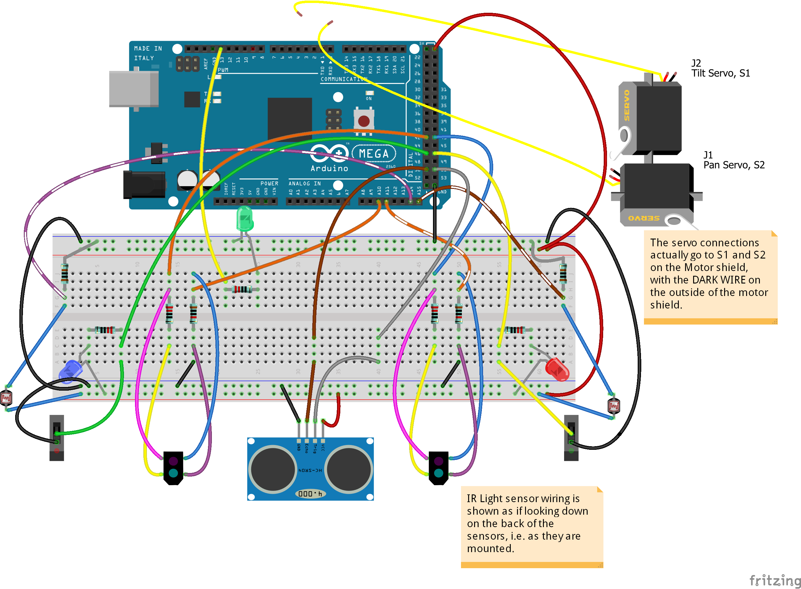
Add Sonic Sensor and Servo Motors

