Slide 1
PAPER REPLICATION
Validation accuracy results
CNN, ViT-Tiny, DINOv2 and VMamba
Best saved checkpoints on the shared 45-image validation split
31 August 2026

Slide 2
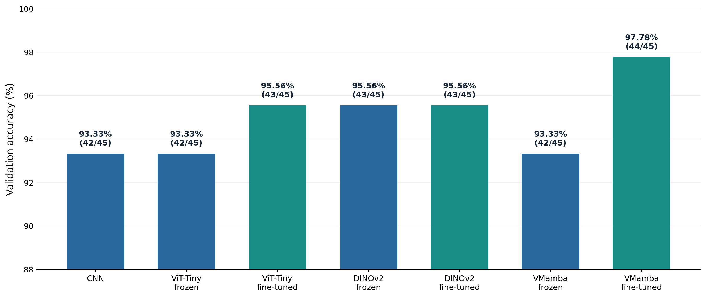
VALIDATION RESULTS
Best validation accuracy by model
All values use the best saved validation checkpoint. One image equals 2.22 percentage points.

Slide 3
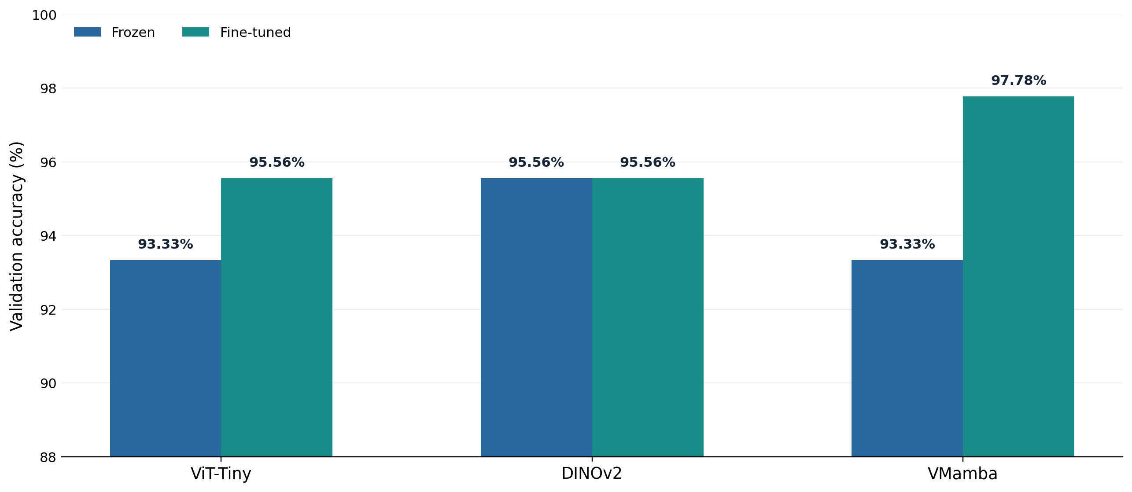
VALIDATION RESULTS
Effect of fine-tuning the pretrained models
Fine-tuning changed ViT-Tiny by +2.22 pp, DINOv2 by 0.00 pp, and VMamba by +4.44 pp.

Slide 4
INTERPRETATION
What the comparison shows
44/45
43/45
42/45
97.78%
95.56%
93.33%
VMamba fine-tuned
ViT-Tiny FT and both DINOv2 runs
CNN, ViT-Tiny frozen and VMamba frozen
These are validation results, not independent test results. The small split supports a controlled comparison, but not a claim of general architectural superiority.

