Slide 1

15
B.E.(I.T.) / Sem VIII / MAJOR PROJECT II-2025-26
Copyright Detection in Books
in Generative AI
Supervisor : Prof. Aruna Khubalkar
09 Glen John
45 John Joy
46 Joseph Antony
51 Savin Johnson
1

Slide 2
B.E.(I.T.) / Sem VIII / MAJOR PROJECT II-2025-26
15
Problem Statement
Generative AI models can unknowingly reproduce or mimic copyrighted content from their training data, raising legal and ethical concerns. This project aims to detect potential copyright infringement of English Literature in AI-generated text even without access to the original training dataset.
2

Slide 3
B.E.(I.T.) / Sem VIII / MAJOR PROJECT II-2025-26
15
Need of the Proposed System
Generative AI models risk reproducing or mimicking copyrighted content from their training data, leading to significant legal and ethical concerns.
There's a need to improve current copyright detection methods to identify subtle AI-driven infringement and stylistic imitation
A sophisticated system is needed to combine literal copy detection and stylometric analysis, protecting intellectual property, promoting ethical AI, and fostering trust in AI-generated content.
3

Slide 4
B.E.(I.T.) / Sem VIII / MAJOR PROJECT II-2025-26
15
Scope of the Problem
The project scope is to create and implement a specialized system that analyzes AI-generated text to find evidence of potential copyright infringement.
The analysis is strictly focused on comparing provided AI outputs against a specific set of copyrighted reference texts (literature content).
The scope is to combine two distinct analytical methods: copy detection (finding literal text matches) and stylometric analysis (identifying imitation of writing style).
4

Slide 5
B.E.(I.T.) / Sem VIII / MAJOR PROJECT II-2025-26
15
Literature Review
Core | Findings | Gap / Future Work highlighted by paper
Generative Artificial Intelligence and Copyright Law[4] | The paper examines key legal principles—authorship, fair use, and infringement—and analyzes how these concepts apply to generative AI within existing copyright law frameworks. | Future work in this area requires developing clearer legislation to address a legal landscape that is rapidly evolving.
The Study of Copyright Infringement Liability of Generative Artificial Intelligence[3] | This study evaluates legal liability frameworks and relevant legal factors to determine responsibility for copyright infringement in generative AI systems. | This paper highlights a gap in current approaches, pointing to the need for better technical solutions and more comprehensive legal frameworks.
Hybrid using Cosine and Stylometric[2] | The proposed hybrid approach combines cosine similarity and stylometric analysis to effectively detect both semantic and stylistic similarities in AI-generated text. | Needs validation, legal alignment, robustness to paraphrase, images, audio.
5

Slide 6
B.E.(I.T.) / Sem VIII / MAJOR PROJECT II-2025-26
15
Literature Review
Core | Findings / Techniques | Identified Gap
LLMs and Copyright Risks: Benchmarks and Mitigation[4] | The paper evaluates detection, training, and mitigation strategies aimed at reducing copyright infringement risks in large language models. | Future research needs to address how these mitigation strategies perform when scaling up the models, as well as investigate how large language models internalize copyrighted training data
Stylometry-based Fraud and Plagiarism Detection for Learning at Scale[1] | This research applies stylometric features and SVM-based classification to develop a highly scalable and accurate system for plagiarism detection. | A significant gap identified by this paper is the need to factor in human elements, such as integrating human evaluation or oversight alongside automated detection systems.
How would you use Sentence Transformers for an application like plagiarism detection or finding highly similar documents?[2] | This work utilizes sentence embeddings, similarity measures, and n-gram techniques to effectively identify paraphrased content and highly similar documents using transformer-based models. | Future work requires more rigorous validation of these practical applications and further fine-tuning of the transformer models to achieve optimal results.
6

Slide 7
15
B.E.(I.T.) / Sem VIII / MAJOR PROJECT II-2025-26
Tech Stack
Hardware Requirements
The system requires an Intel Core i5 (multi-core) processor to handle general processing and model operations efficiently. An NVIDIA RTX 3050/4050 GPU is recommended to accelerate embedding generation and similarity computations using CUDA. A minimum of 16 GB RAM is needed to load NLP models and process datasets smoothly, while a 512 GB SSD ensures fast storage access for models, embeddings, and cached data.
Software Requirements
The project is developed using Python 3.10+ due to its strong NLP and ML ecosystem. spaCy and Sentence-Transformers are used for linguistic processing and semantic similarity tasks, while PyStyl/FastStylometry support stylometric analysis. PyTorch serves as the ML framework, and FAISS is used for efficient vector similarity search. Development tools include Jupyter Notebook, VS Code, and Git for experimentation and version control.
7

Slide 8
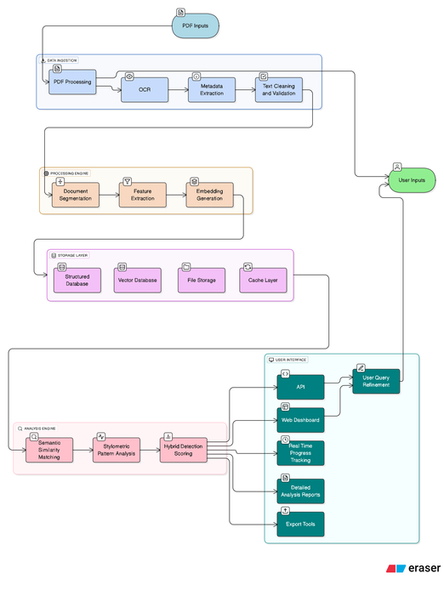
15
B.E.(I.T.) / Sem VIII / MAJOR PROJECT II-2025-26
System Architecture
8

Slide 9
B.E.(I.T.) / Sem VIII / MAJOR PROJECT II-2025-26
15
List Of Journals
Name Of Journals | Impact factor | Link
IEEE Access | 3.6 (JCR) | https://ieeeaccess.ieee.org/
TIJER Research Journal | 8.57 | https://tijer.org/tijer/
JNRID Research Journal | 9.57 | https://tijer.org/jnrid/
RJPN – IJ Publication | 7.37 | https://tijer.org/ijedr/submitpaper.php
ACM Transactions on Information Systems (TOIS) | 9.1 | https://dl.acm.org/journal/tois
9

Slide 10
15
B.E.(I.T.) / Sem VIII / MAJOR PROJECT II-2025-26
Drafted Paper as Per the selected Journal
Final Paper Link
10

Slide 11
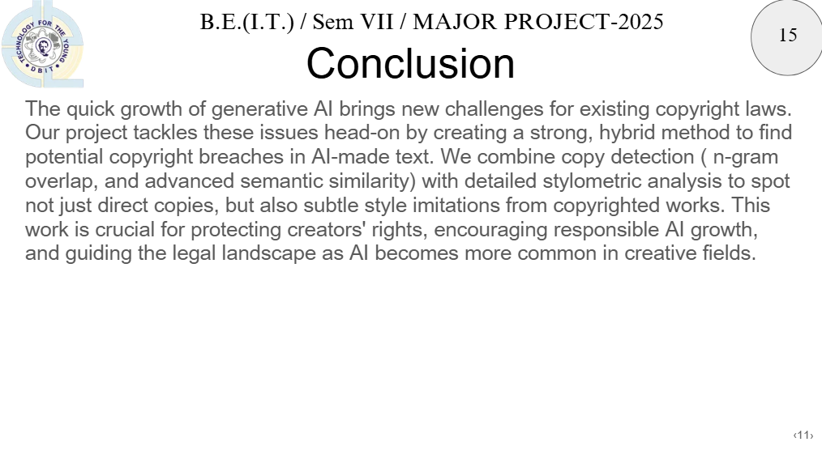

Slide 12
B.E.(I.T.) / Sem VIII / MAJOR PROJECT II-2025-26
15
Reference
[1] M. Krause, “Stylometry‑based Fraud and Plagiarism Detection for Learning at Scale,” *ResearchGate*, 2015.
Available: http://bit.ly/4kV1uYV
[2] M. S. Bhat and R. V. Dharaskar, “Innovative Framework for Context-based Recommendation using TF-IDF and Cosine Similarity,” *ResearchGate*, 2024. [Online].
Available: http://bit.ly/3UohrvF
[3] C. Opara, “StyloAI: Distinguishing AI-Generated Content with Stylometric Analysis,” *arXiv*, May 16, 2024. [Online].
Available: https://arxiv.org/abs/2405.10129
[4] N. Lucchi and S. Hunter, “Generative AI and Copyright – Training, Creation, Regulation,” Policy Department for Justice, Civil Liberties and Institutional Affairs, European Parliament, PE 774.095, July 9 2025. [Online].
Available: https://tinyurl.com/3vbsua88
12

Slide 13


13

