Slide 1
Python Programming{
GROUP B
Group project
[AI Tone mall]
< GROUP Members >
Chan Yi Fui 22234055
Hui Chi Hin 19222645
Lo Pui Yin 21235112
Tse Long Sang Nelson 21206678
Wong Yu Fei 22205918
}
Notes:
Welcome to our presentation on how our group of Python developers aims to revolutionize the security, integrity, responsibility, and tracing ability of AI_Tone Mall's online ordering and fulfillment systems. We are excited to showcase our innovative solutions and prove why we deserve a spot in the final round of the selection procedure. Let's dive in!

Slide 2
Outline
01
03
04
Introduction
02
Program Information
Application
Conclusion

Slide 3
Background
We are a group of Python Developers for handling the problem for the company.
Mission
“Say goodbye to fraudulent invoices!”
Our Python module provides a robust and adaptable hashing algorithm to ensure the authenticity of invoices generated by the online ordering systems.

Slide 4
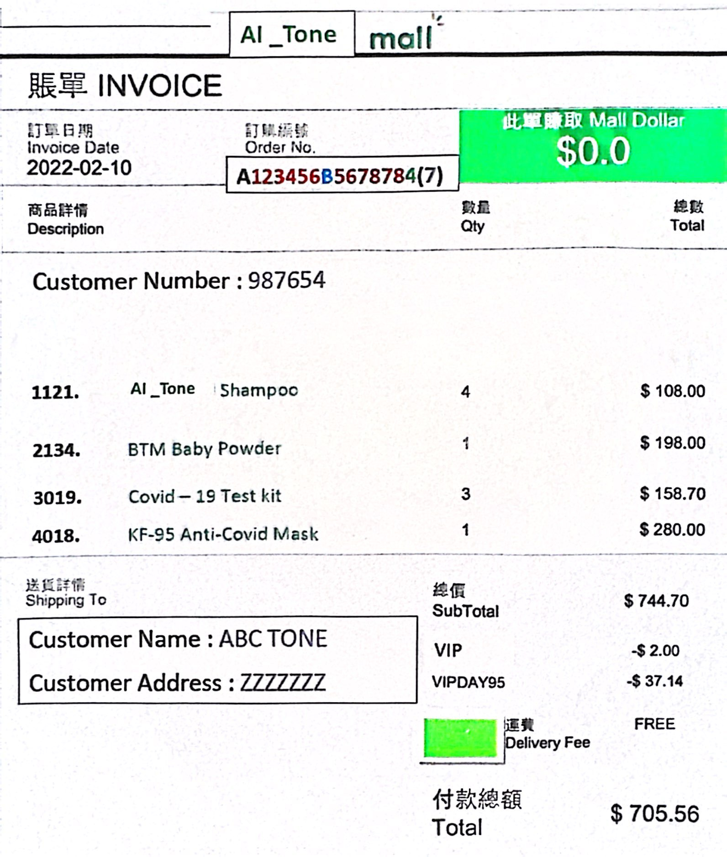
Objectives
Select and Print a Sample Invoice
1
User-Friendly Output
We have designed a seamless user output that allows the user to easily select one order from the audited file and print a copy of the sample invoice form. Our solution ensures a hassle-free experience.
2
Save to Text File
In addition to printing, our system enables the user to save the sample invoice into a text file, ensuring easy access and record-keeping.

Slide 5
Why Us????
1
Efficient Delivery
Studying logistics framework ensures timely and efficient delivery of AI Tone Mall products, improving customer satisfaction
2
Enhance Administrative Processes
Administrative Officer and Administrative Clerk team optimize administrative tasks, ensuring smooth operations for AI Tone Mall, even with limited IT knowledge.
3
Improve Order Handling
Order Clerk showcase their professional skills in managing orders, guaranteeing the accuracy and reliability of order processing for AI Tone Mall.

Slide 6
Securing Online Ordering Systems
Enhanced Security Measures
Ensuring Data Integrity
Our solutions strengthens the security of the online ordering system of AI Tone Mall, protects customer data, and prevents potential threats.
By implementing our innovative algorithms, we ensure the integrity of the data within AI Tone Mall's online ordering systems, mitigating the risk of data corruption or manipulation.
Increased Responsibility
Effortless Tracing Ability
With our solutions, AI Tone Mall can fulfill its responsibility to customers by providing a trustworthy and reliable online ordering experience and reduce the possibility of mistakes or discrepancies.
Our system includes seamless tracking function, which enables AI Tone Mall to track orders efficiently, provide accurate updates to customers and improve overall satisfaction.

Slide 7
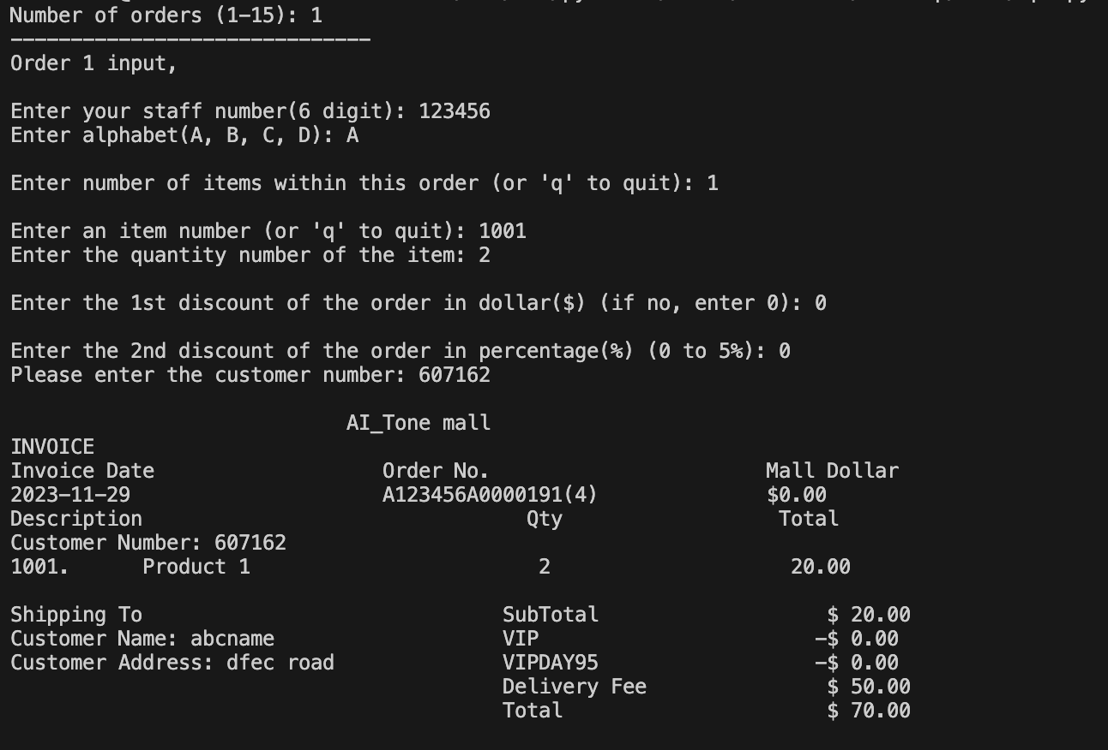
Necessary information by users
User Input:
Order Number:
Number of Order (1-15)
Staff number (6 Digits)
Modulus (Select one: A/B/C/D)
Number of item (1-9)
Quantity number of item
Discount 1 (Optional)
Discount 2 (Optional)

Slide 8
AI_TONE Programme information
Targeted User:
General Manager
External
Delivery
Customer
Logistic Manager
Accountant
Internal
AI Tone related
Accounting
Customer Address Information

Slide 9
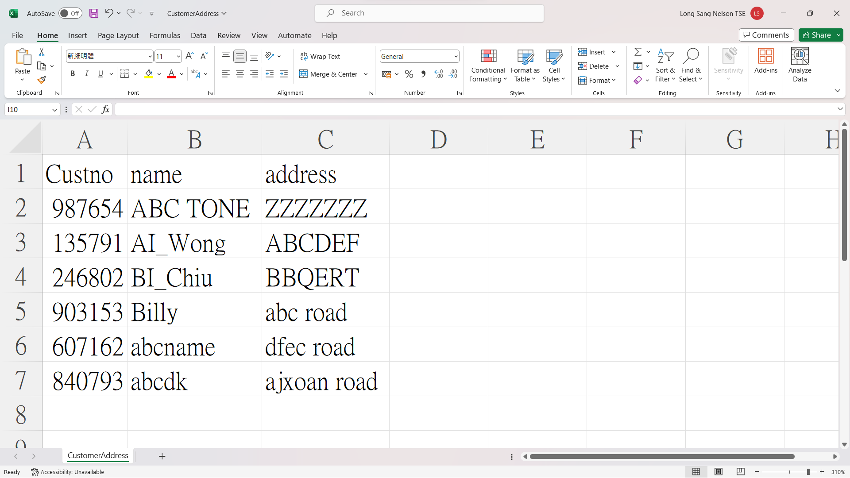
Read File
Customer File
Steps:
Read customer file (.csv)
Check
if the customer is existed
if Yes
return Name & Address
if No
Generate New Customer ID
Input Customer Name & Address
Update the CSV file & Return Customer Info

Slide 10
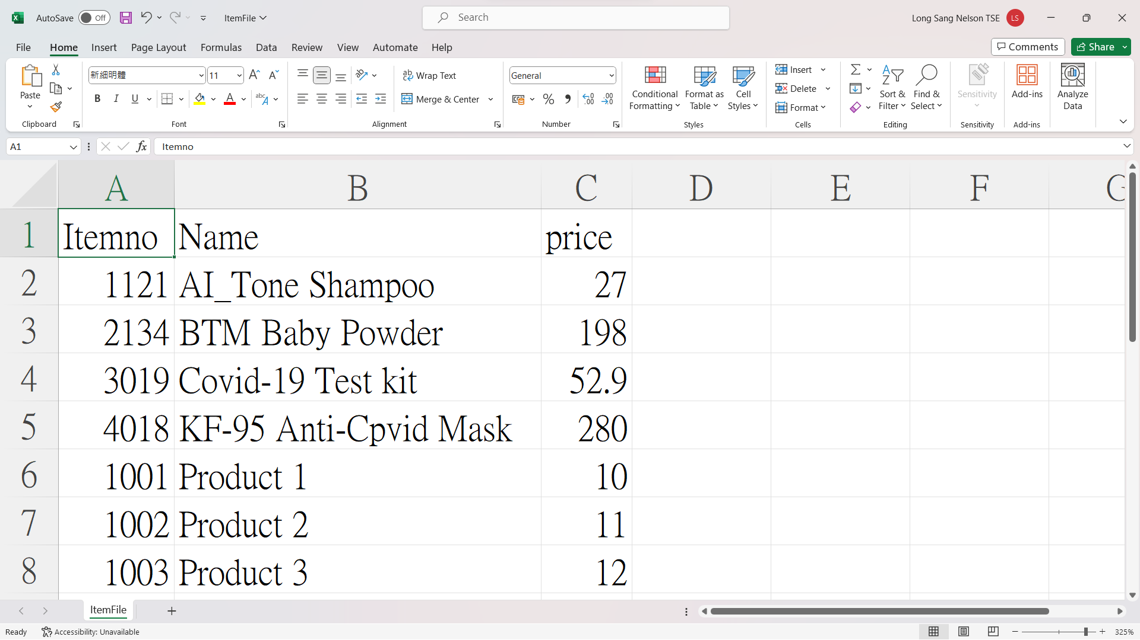
Read File
Item File:
Item No
Item Name
Item Price

Slide 11
Output
Invoice Order No.: A123456B5678784(7)
Audited File
Number of Order: 1-15
Hash Total of all Orders: Sum of Hash total
Individual Order Details
Order number
Staff number (6 Digits)
Modulus number (A/B/C/D)
Total amount ($)
Hash Total (3 Digits)

Slide 12
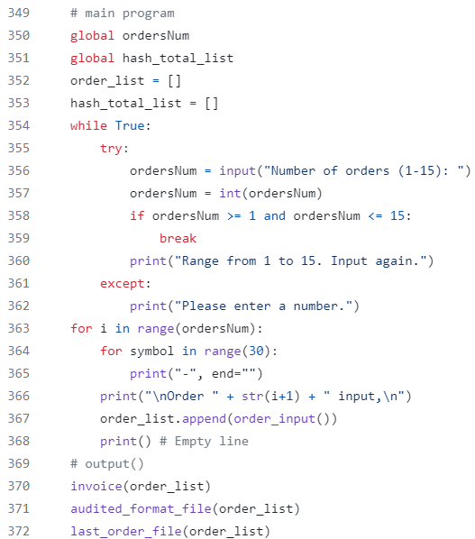
Application - Outline
3 main steps:
Input
Process
Output

Slide 13
Application - Function
Function
checkDigit
input_alphabet
cal_sub_total
Cost_Verification_Procedure
deliveryFee
hashTotal
malldollar
name_address
customer_exists
order_no
order_input
invoice
audited_format_file
last_order_file

Slide 14
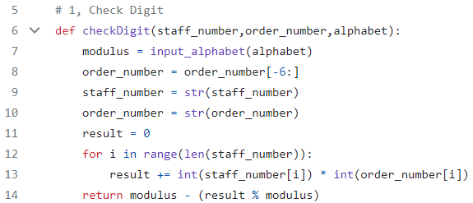
Application – checkDigit
Checking Digit:
To check () digit
Call function:input_alphabet

Slide 15
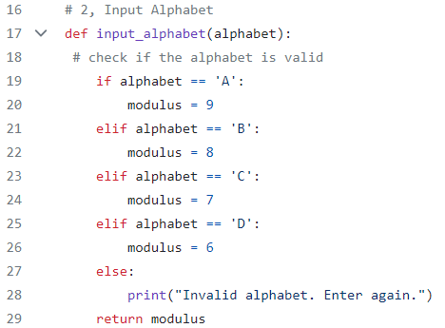
Application – input_alphabet
Input Alphabet:
To choose Modulus
Requirement:
(A/B/C/D)

Slide 16
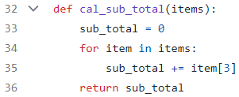
Application – cal_sub_total
Calculate sub total:
Add item price

Slide 17
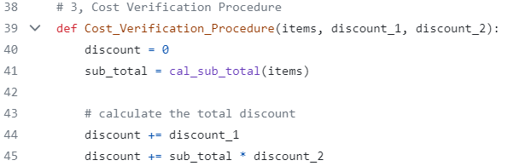
Application – Cost_Verification_Procedure
Cost Verification Procedure:
Calculate Discount 1 and 2 for sub total
Call function:cal_sub_total
Notes:
Discount 1
Discount 2
Delivery fees

Slide 18
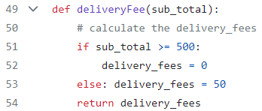
Application – deliveryFee
Deliver Fee:
Sub total ≥ $500 → Fee: $0
Sub total < $500 → Fee: $50

Slide 19
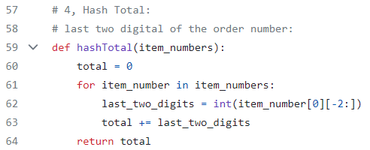
Application – hashTotal
Hash Total:
Sum of last 2 digits of item numbers

Slide 20
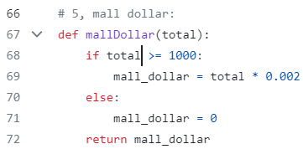
Application – mallDollar
Mall Dollar:
Total amount ≥ $1000
→ Mall Dollar: 0.2%
Total amount < $1000
→ Mall Dollar: 0

Slide 21
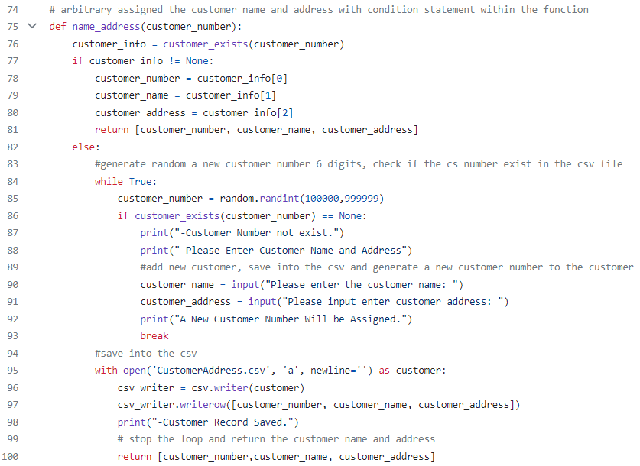
Application – name_address
Name and address:
Either Read customer file or Store New customer details into customer file
Requirement:
Customer Number
Customer Address
Customer Name If exists, then retrieve
If not exists, then add

Slide 22
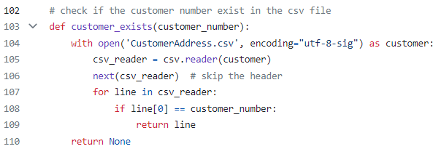
Application – customer_exists
Check if the Customer number existed from reading file ‘CustomerAddress.csv’

Slide 23
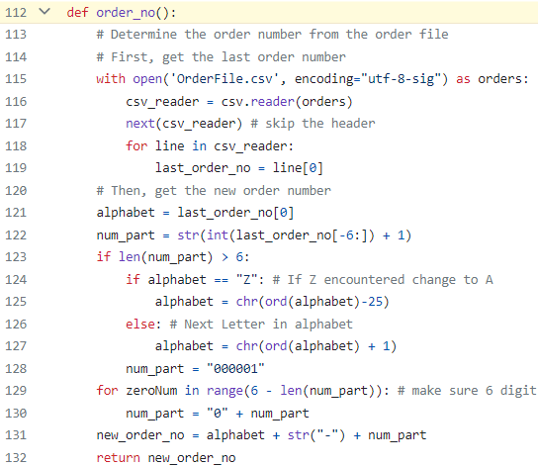
Application – order_no
Order Number:
Check Last order Number:
Read file ‘OrderFile.csv’
Create New order number:
- From A to Z
- From 0000001 to 999999

Slide 24
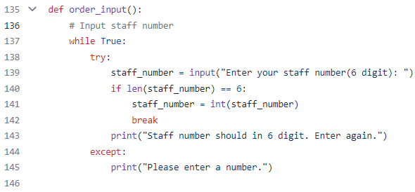
Application – order_input (7 Pages)
Staff Number:
To check if the imputed staff number is 6 digits
Requirement:
Staff number

Slide 25
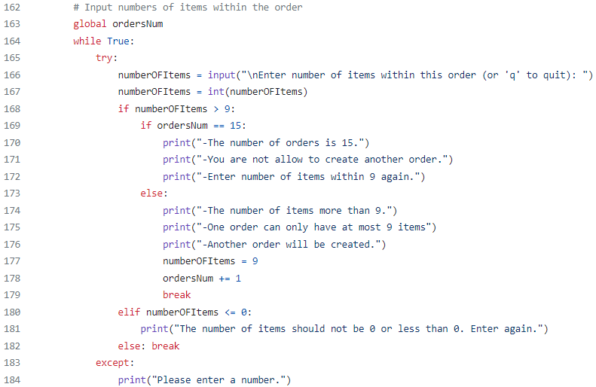
Application – order_input
Number of Items:
Input number of items
Requirement:
- Enter Number of Items
(Type "q" to quit the input)

Slide 26
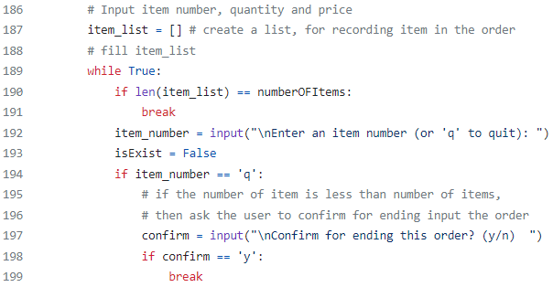
Application – order_input
Item number, quantity and price:
To check if the user input is matched the final input result
To check if the user want to exit earlier
Requirement:
Actual number of user inputted Item
Early exit of the input order

Slide 27
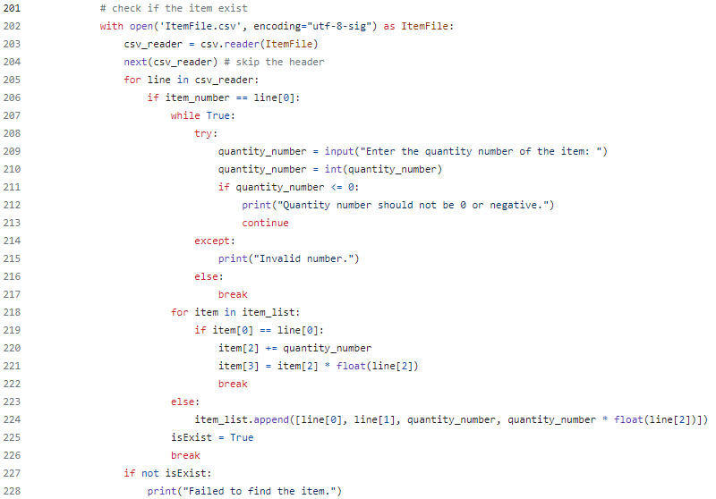
Application – order_input
Check item exist:
Read file ‘ItemFile.csv’
Item Not exist:
Remind User Failed to find
Requirement:
Enter quantity number of item

Slide 28
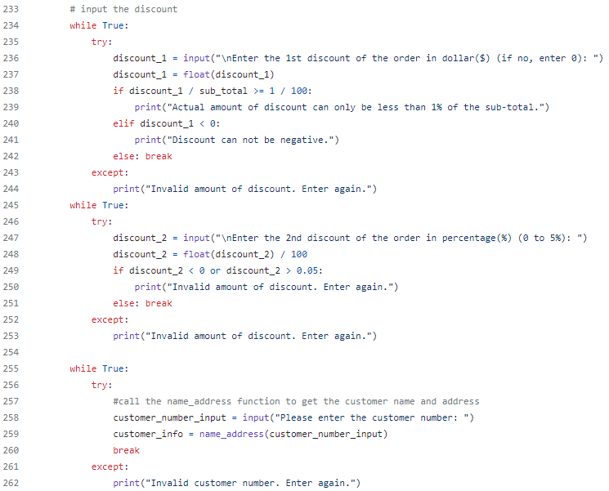
Application – order_input
Discount:
To calculate the discount
To verify and initialize the customer information
Requirement:
Discount 1: < 1% of Sub Total
Discount 2: 0%-5%
Customer Number

Slide 29
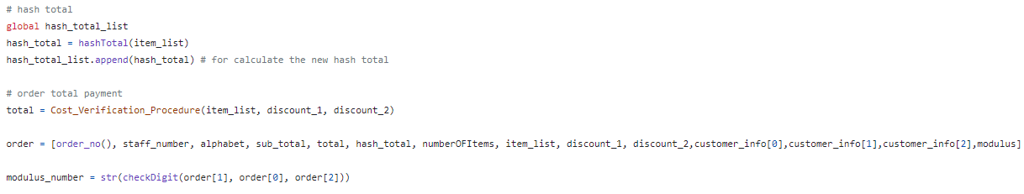
Application – order_input
1. Hash Total:
Calculate Hash Total
Call Function: hashTotal
2. Order Total Payment:
Calculate total amount
Call Function: Cost_Verification_Procedure, order_no, checkDigit

Slide 30
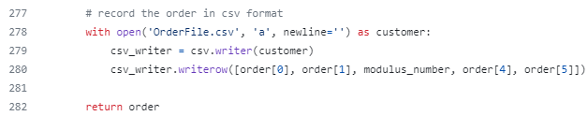
Application – order_input
Record Order in csv format

Slide 31
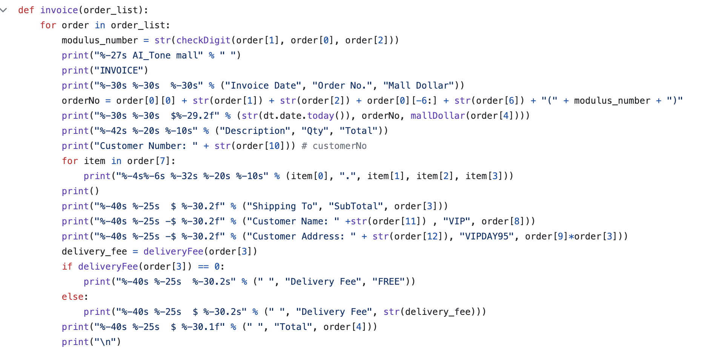
Application – Invoice
Generate Invoice:
Generate Sample invoice format for the system – output function
Requirement:
Loop the order list
Retrieve variable from the list

Slide 32
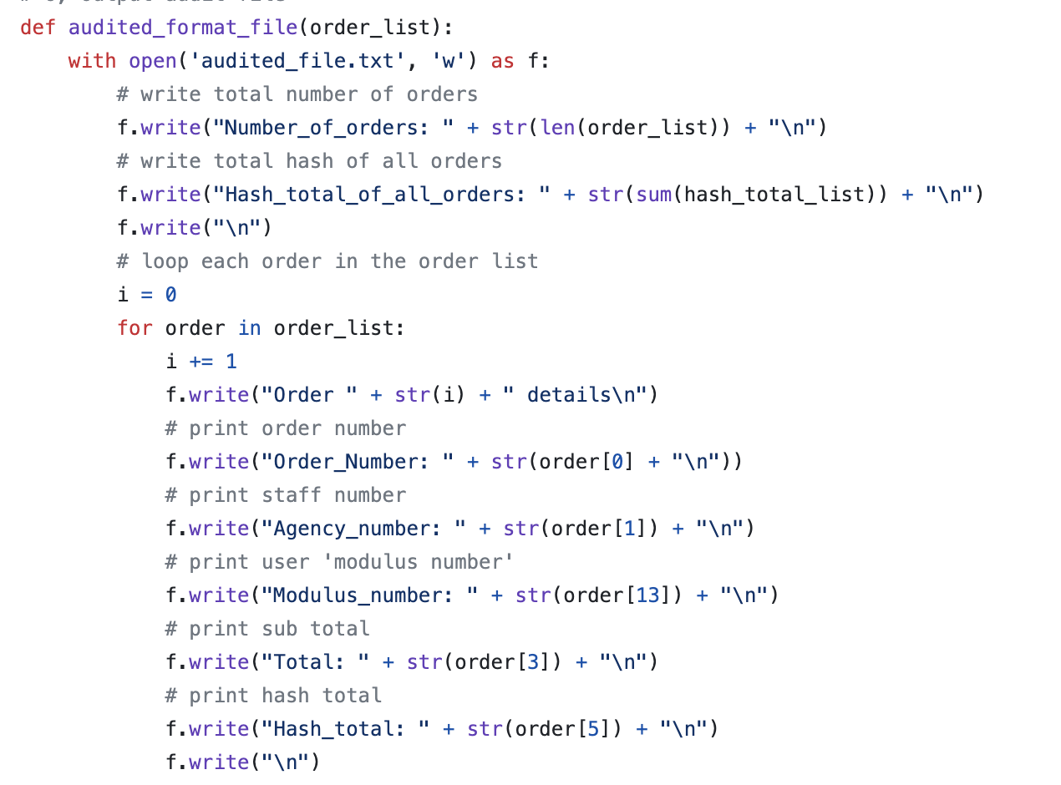
Application – Audited_Format_File
Generate Audited File:
Generate and save audited file format for accountants – output function
Requirement:
Loop the order list
Retrieve variable from the list

Slide 33
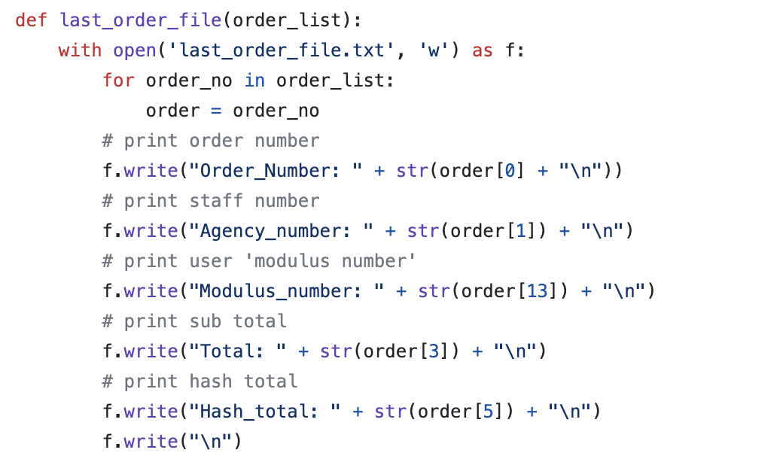
Application – last_order_file
Last Order File:
Create & Update processed order file for improving data consistency of the system
– output function
Requirement:
Loop the order list
Retrieve variable from the list

Slide 34
Conclusion
Continuous Improvement and Growth
1
Upskilling IT Knowledge
Highlight the importance of enhancing the IT skills of AI Tone Mall's staff, providing opportunities to unlock advanced features offered by various software platforms.
2
Advancing E-commerce Capabilities
Propose an expansion plan to incorporate advanced features into AI Tone Mall's E-commerce shop, empowering staff to take full advantage of the available technology.
3
Strategic Hosting Investment
Advocate for increased investment in the hosting company to embrace advanced features and drive growth in AI Tone Mall's online presence.
Notes:
Although This is just a roughly programming,

Slide 35
Q&A Session

Slide 36
THANK YOU

