Slide 1
Hospital Readmittance: a predictive study among diabetic patients
Big data and data science 95-865 spring 2019
Carol Xiang / Daniel Lesser

Slide 2
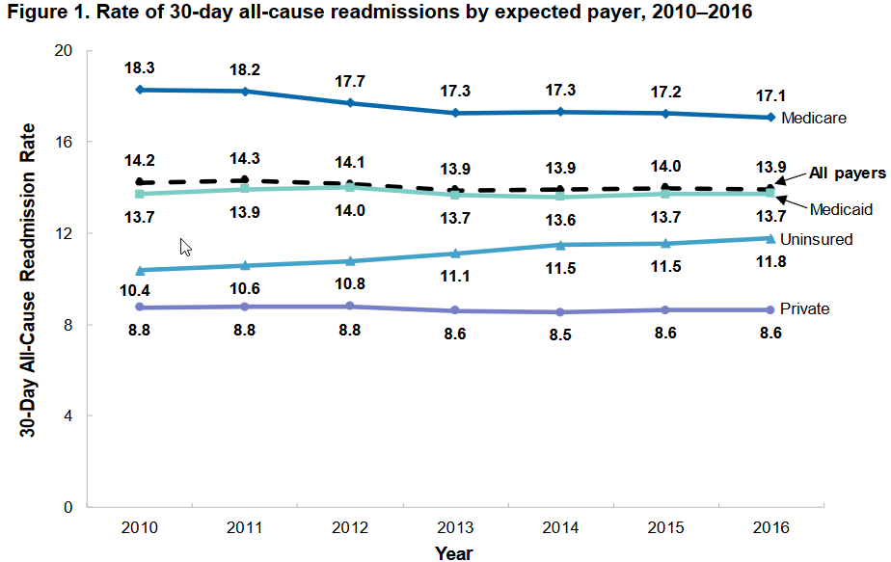
Health care expenditures are on the rise and readmission rates remain elevated
2

Slide 3
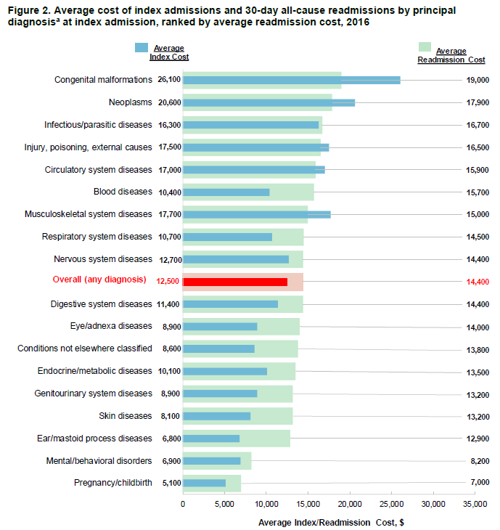
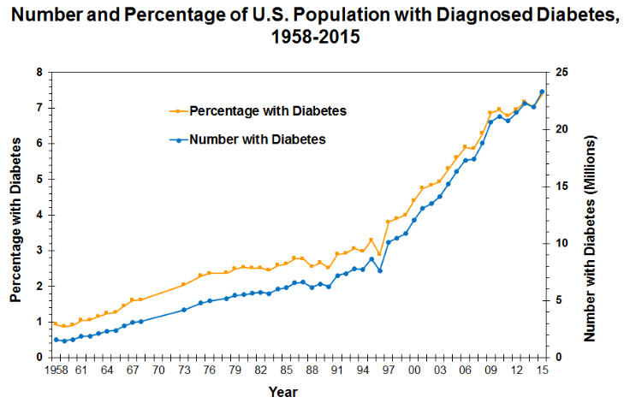
Readmissions cost more than a typical visit; Diabetes rates are on the rise
Average Hospital Admission Costs by Principal Diagnosis, 2016²
2
1

Slide 4
Problem statements
Can we reduce the cost of health care by identifying patients that are at risk of readmission and proactively offering them additional treatment or monitoring?
Can we improve patient outcomes by identifying patients that are at risk of readmission?
Can machine learning techniques be used to address these issues, specifically among diabetic patients?

Slide 5




Hypotheses
There are strong indicators within a patient’s medical history and admission circumstances that can be used to provide a real-time estimate of whether or not the patient is likely to be readmitted within 30 days.
Certain features we expect to be strong indicators include:
Admission Type
Number Meds
A1C Test Results
Increase in Meds

Slide 6
Data description
10 years of clinical care at 130 US hospitals covering 100,000 observations
Hospital admissions that included diabetes as a diagnosis
Laboratory tests and medications were administered
Length of stay between 1 and 14 days
>50 Features covering Basic Demographics, admission, medications, diseases
Days to patient readmission: <30 days, ≥30 days, no readmission

Slide 7
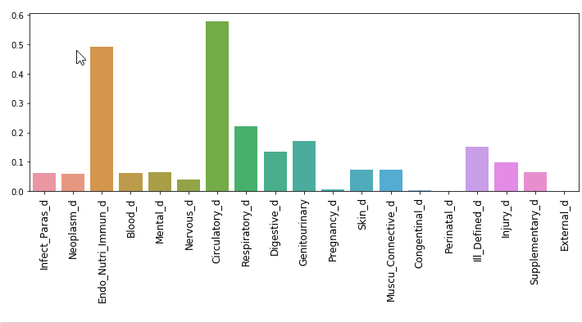
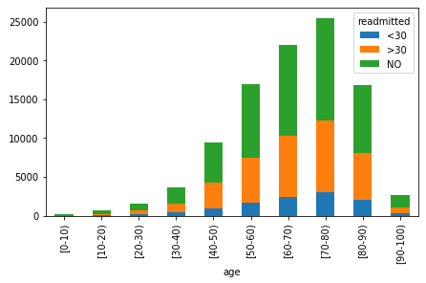
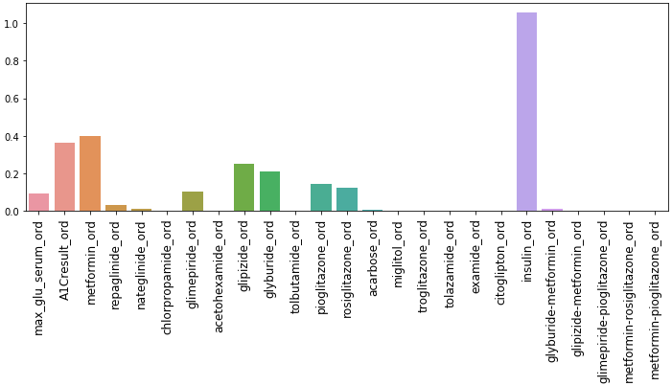
Common Diseases, Medications and Ages
Patients (%)
Patients (%)

Slide 8
Machine learning approaches
Classification Models
Naïve Bayes (Baseline)
Logistic Regression
Support Vector Machines
Decision Tree
Random Forest
Data Transformations
Removing Missing Values
Transforming categorical features into ordinal or binary features
Combining diagnoses into binary disease features
Feature creation (diabetes type)
Dimensionality Reduction

Slide 9
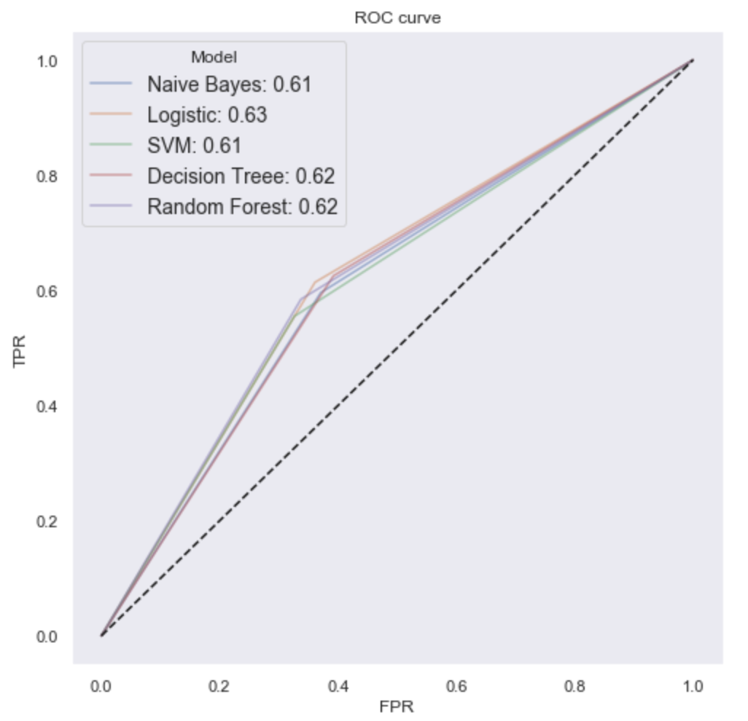
Logistic Regression is the best performing model
Hospital Administrators
Care about reducing cost
Want a low False Positive Rate to minimize unnecessary treatments
Hospital Physicians
Care about patient wellbeing
Want a high True Positive Rate to ensure all patients at risk receive treatment

Slide 10
Logistic Regression Findings
We are able to provide a directional prediction on whether or not a patient is likely to be readmitted within 30 days.
The follow features are the greatest contributors/detractors to readmittance:
Positive Impact on Readmittance | Negative Impact on Readmittance
Transferred to Psychiatric unit | Trauma admittance
Discharged to Medicare-approved swing bed | Referred to this hospital for outpatient services
Admitted as inpatient to hospital | Transfer from critical access hospital
Discharged to Rehab Facility | Referred to another hospital for outpatient services
Number of preceding inpatient visits | Increase in acetohexamide (diabetes) medication
Number of diagnoses | Discharged for neonatal aftercare
Discharged to home with home health service | Discharged to a federal care facility
Number of medications | Increase in troglitazone (diabetes) medication

Slide 11
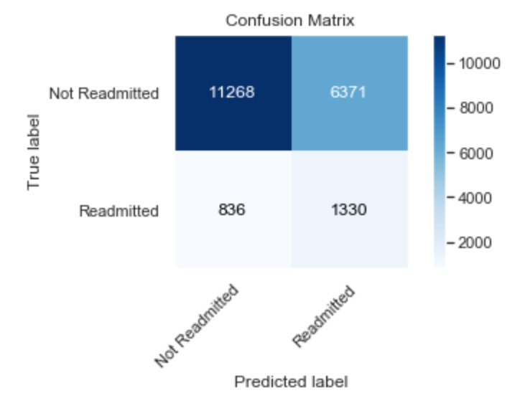
Suggestions: offer follow-up care to reduce patient recidivism
For patients that were identified at risk of readmittance, follow-up care and/or check-ins could be provided at cost to the hospital
Hourly home nurse cost of ~$30. Six visits over 2 weeks ~$180⁴
Cost of a readmittance for diabetic patients $13,500²
Cost of care for patients identified in test set: $1,386,180
Assuming 50% reduction in patient readmittance. Savings: $8,977,500

Slide 12
Opportunities for further research
Assess the impact of additional features on readmission that were not available or incomplete
Patient’s type of insurance (Payer Codes)
Robust demographics and medical histories
Expand the panel beyond diabetic patients to measure readmittance rates for a broader population

Slide 13
Citations
Research and Data Sources
1. “Data Finder - Health, United States - Products.” Centers for Disease Control and Prevention, Centers for Disease Control and Prevention, 29 Apr. 2019, www.cdc.gov/nchs/hus/contents2017.htm#093. https://www.cdc.gov/diabetes/statistics/slides/long_term_trends.pdf.
2. Bailey, Molly et al. Characteristics of 30-Day All-Cause Hospital Readmissions, 2010–2016. 2019, pp. 1–14, https://hcup-us.ahrq.gov/reports/statbriefs/sb248-Hospital-Readmissions-2010-2016.pdf.
3. Clore et al, John. UCI Machine Learning Repository, 29 Apr. 2019, https://archive.ics.uci.edu/ml/datasets/Diabetes+130-US+hospitals+for+years+1999-2008.
4. Slobac, Susan. “Cost of U.S. Home Health Care.” Disabled World, Disabled World, 10 Aug. 2017, www.disabled-world.com/disability/caregivers/home-care-costs.php.
Images
Nature, 29 Apr. 2019, www.nature.com/articles/nrendo.2014.161.
Vectorstock, 29 Apr. 2019, www.vectorstock.com/royalty-free-vector/pill-bottles-vector-428318.
AdwDiabetes, 29 Apr. 2019, https://www.adwdiabetes.com/articles/testing-a1c-levels.

