Slide 1

Technical assignment
Spectrum classification using Support Vector Machines (SVM)
Ole Krarup
21/01/2023

Slide 2
Outline
Problem statement
Solution method: Support Vector Machines (SVM)
Conceptual explanation of SVM
Python Notebook with answer implementation

Slide 3

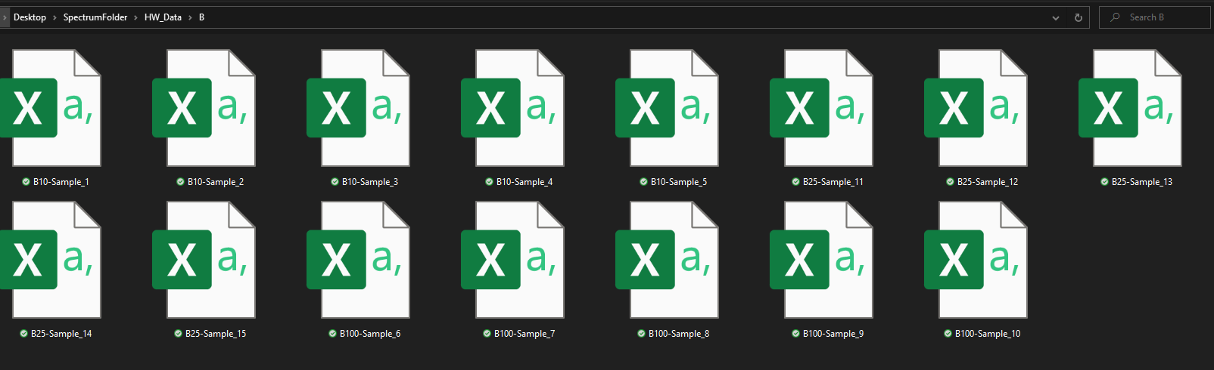
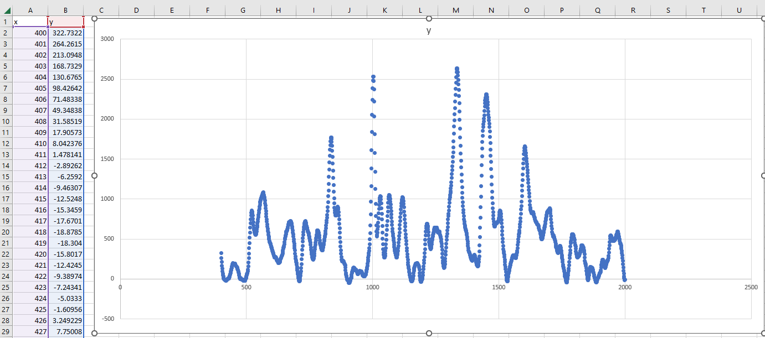
Problem Statement
Have: Measured spectra for 4 different compounds labelled “A”, “B”, “C”, “D”.
Want: Machine learning model trained on provided spectra, which can classify new spectra.

Slide 4
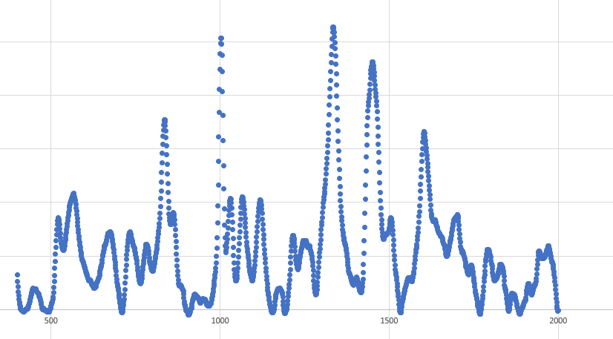
Observations:
Relatively few measurements ( less than 100 .csv files)
Spectra can be represented as vectors.
Must sort spectra into fixed categories (“hard” decision versus “soft” probability).
=
1601-d vector

Slide 5

Support Vector Machines
Appropriate for small datasets
Categorical classification
Code and documentation available in standard data-science packages (scikit-learn).

Slide 6
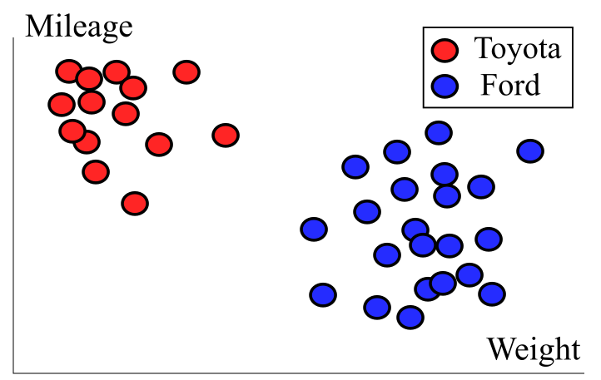
Explanation of SVM
Suppose we know the Weight, Mileage and make of a large number of cars (large set of 2-d vectors).
To distinguish between them in the future, we can draw a “border” like this -->
or like this -->
or like this -->
How to determine the “best” border?

Slide 7
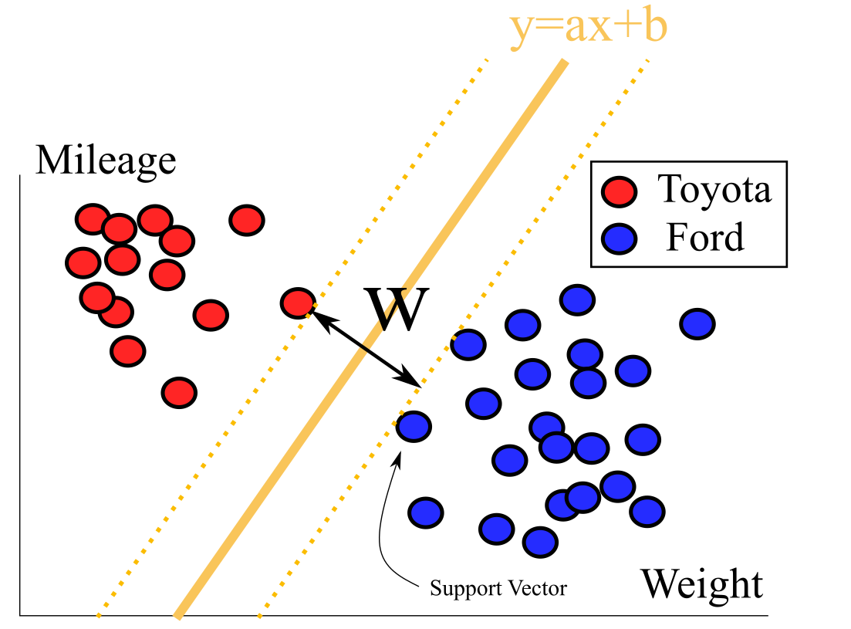
Maximize margin
Which choice of line parameters (a,b) maximizes the “gap” between the two categories, while ensuring that they remain separate?
Iteratively calculate distance from data-points to border and apply gradient descent to find optimal (a,b).

Slide 8
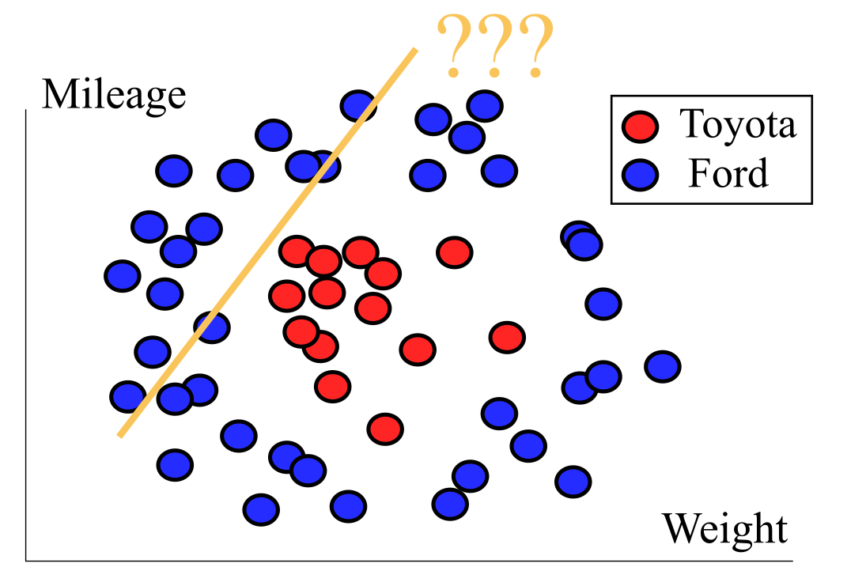
Problem!
Not all data can be separated with a straight line!
Either develop for maximizing distance to “complicated” function describing line or…
transform the data-points!

Slide 9
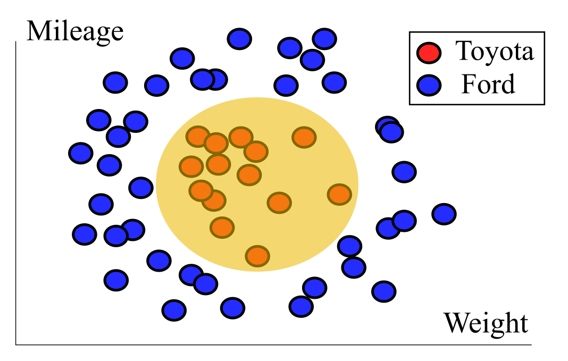
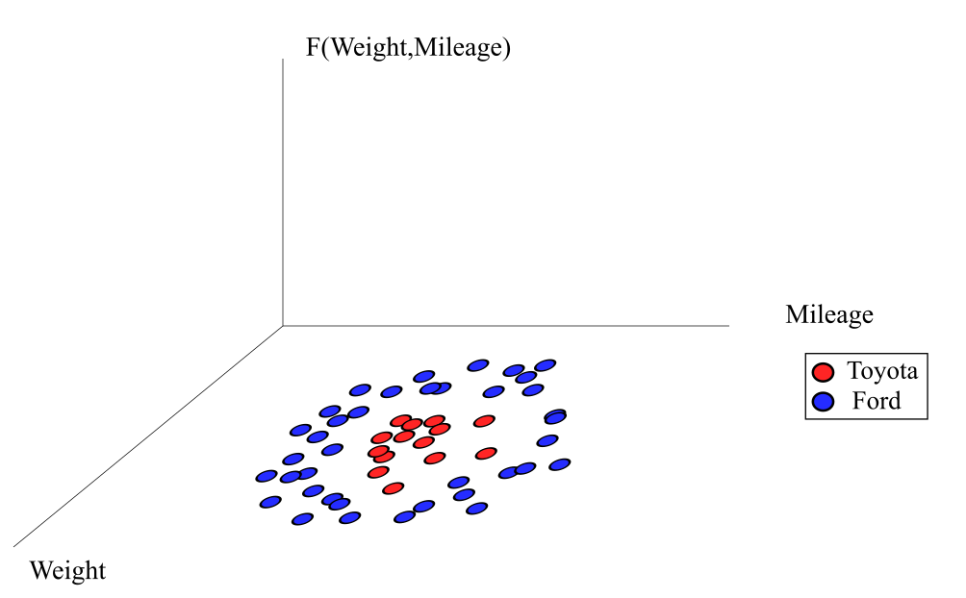
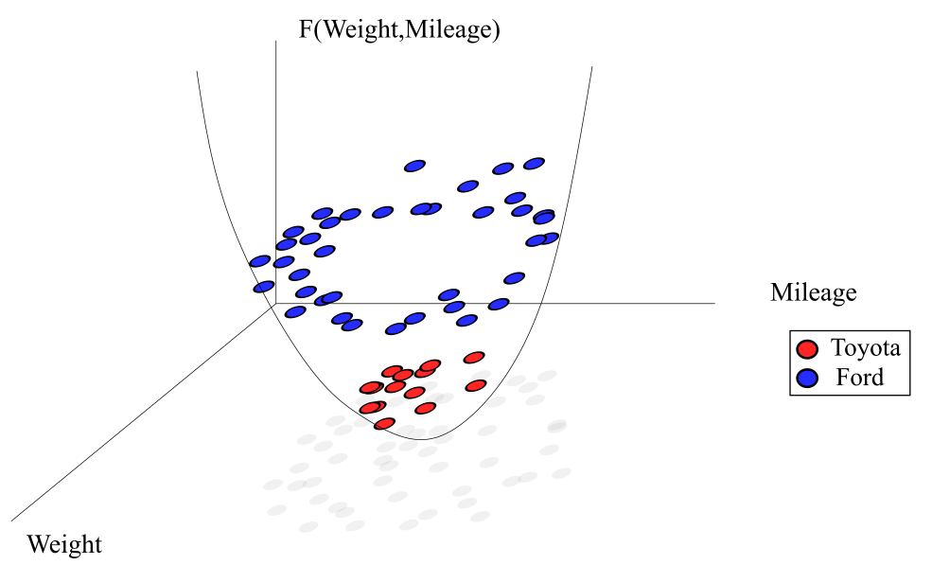
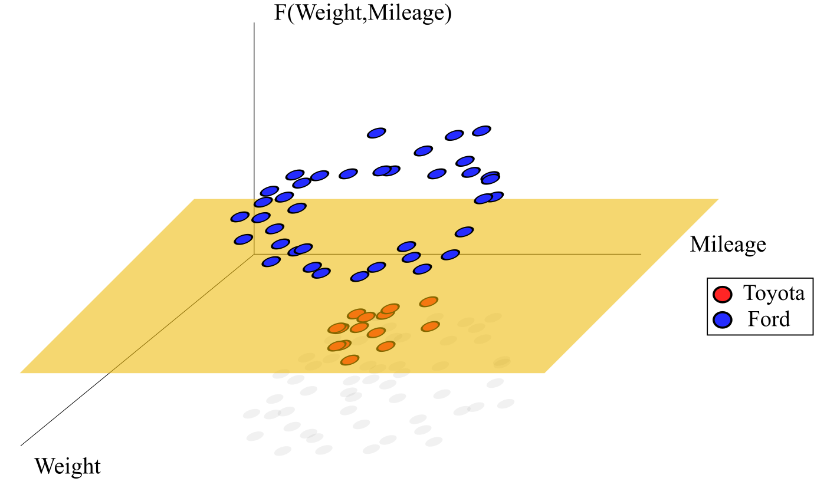
“Kernel-trick”

Slide 10

My solution
Answer.ipynb

