Slide 1
MWANGAZA MINIMART
33 MONTHS / 10 STORES
Customer & Sales
Intelligence
A practical analytics capstone for a fictional Kenyan retail chain
Kevin Ng’ang’a
Cohort 7
Data Science & Analytics
Lux Tech Academy
30th October 2026
Python • PostgreSQL • Statistics • Machine Learning • Power BI
Individual Data Science & Analytics Capstone | October 2026
Synthetic data · Educational demonstration

Slide 2
EXECUTIVE SUMMARY
What the analysis revealed
Three numbers a retail manager can act on immediately.
TOTAL NET REVENUE
CUSTOMERS AT RISK
OCTOBER 2026 FORECAST
KES 253.97M
4,250
50,136
316,277 transactions across 33 months
Loyalty customers with last purchase >90 days ago
Predicted units across all 10 stores
Management message
Focus on retention, prepare for seasonal shifts, and use store-level forecasts to guide purchasing.
Results describe a synthetic retailer; figures illustrate an end-to-end analytics workflow.
Synthetic retail dataset • Jan 2024–Sep 2026
02 / 14

Slide 3
BUSINESS CHALLENGE
From questions to evidence
The retailer wanted more than totals: it needed information for practical decisions.
WHO
WHAT
Who buys, when and how?
Which products drive revenue?
Payments, order values and customer groups
Product category and basket-level analysis
STORES
WHAT NEXT
Which stores perform best?
Which customers may leave?
Store and county comparisons
RFM segments and monthly demand forecast
10 stores • 8 counties • 19,000 registered customers • 99 products
Synthetic retail dataset • Jan 2024–Sep 2026
03 / 14

Slide 4
DATA PREPARATION
Trust the numbers before analysing them
Pandas pipeline with checks against the original order-level totals.
01
02
03
04
Import
→
Clean
→
Engineer
→
Validate
6 source CSVs
types, blanks, duplicates
calendar and sales features
reconcile totals
DUPLICATE LINES REMOVED
MISSING ITEM PRICES
UNUSUAL QUANTITIES
989
1,648
412
Repeated item IDs removed
Addressed using transaction values
Corrected after review
Validation: both tables reconcile to KES 253,971,298.29 and 1,227,235 units.
Synthetic retail dataset • Jan 2024–Sep 2026
04 / 14

Slide 5
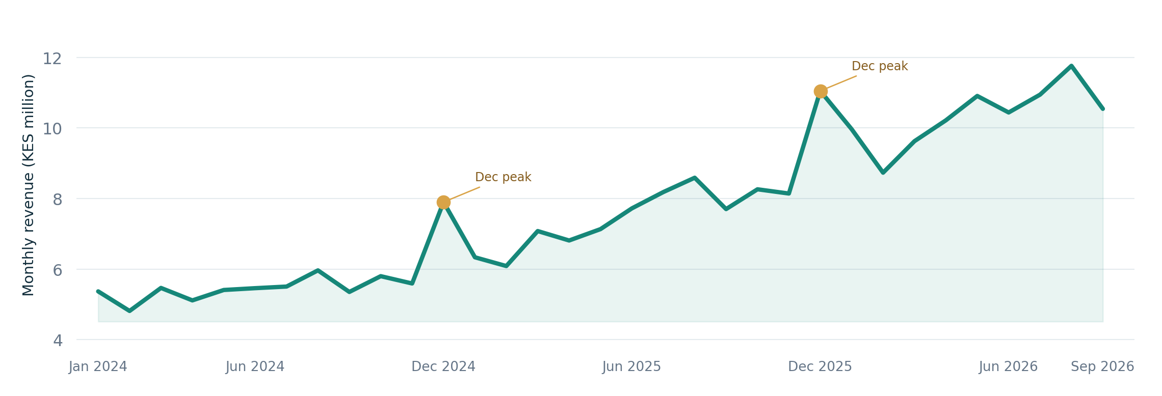
EXPLORATORY ANALYSIS
Revenue grew, with a seasonal December peak
Monthly net sales across the 33-month period.
Observation: revenue rises over time; December 2024 and 2025 show noticeable holiday-period spikes.
Orders table • Sum of net_amount_kes by calendar month
05 / 14

Slide 6
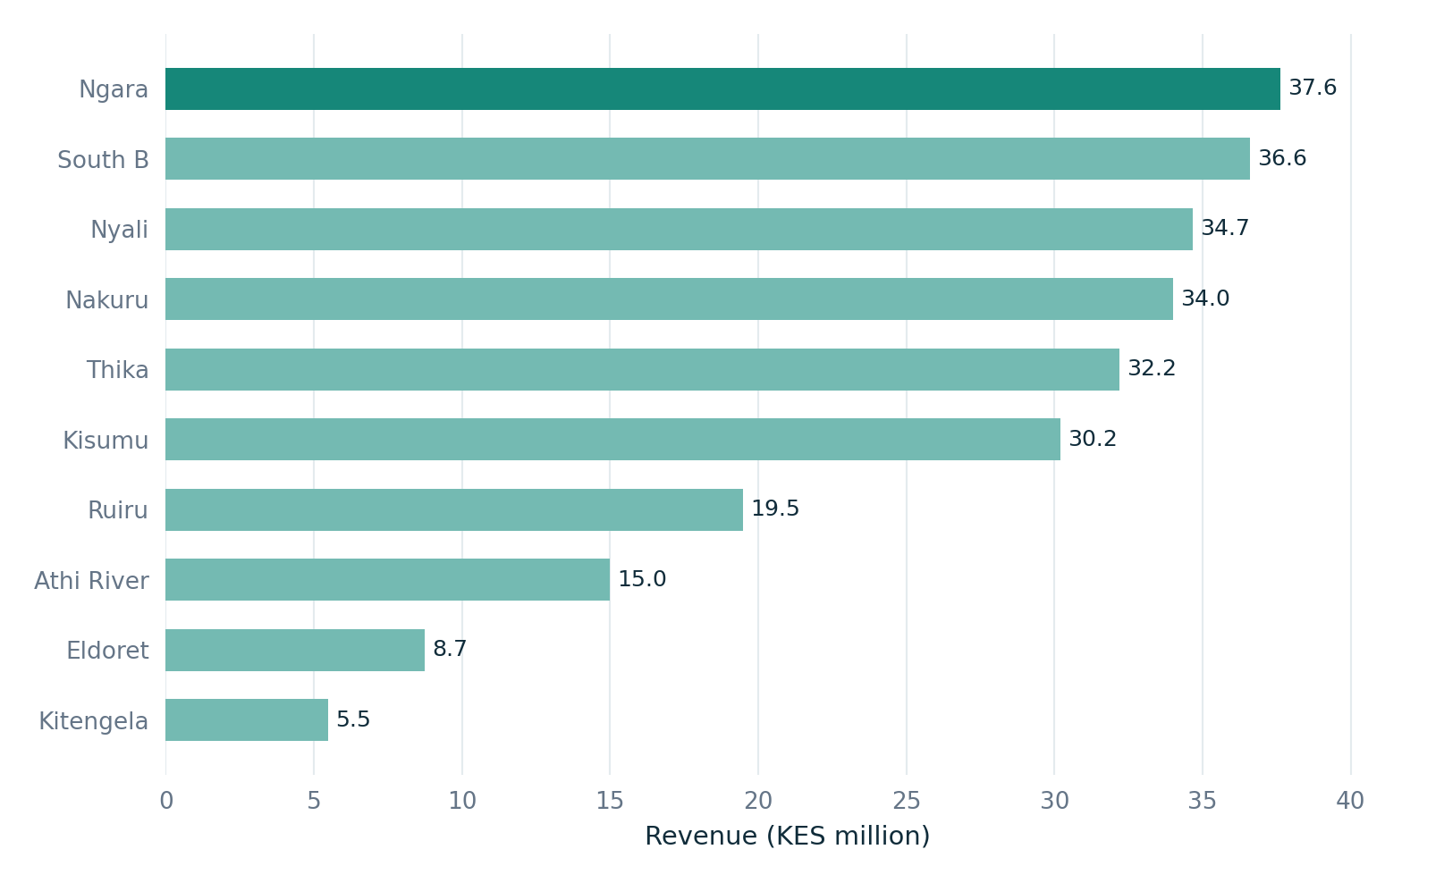
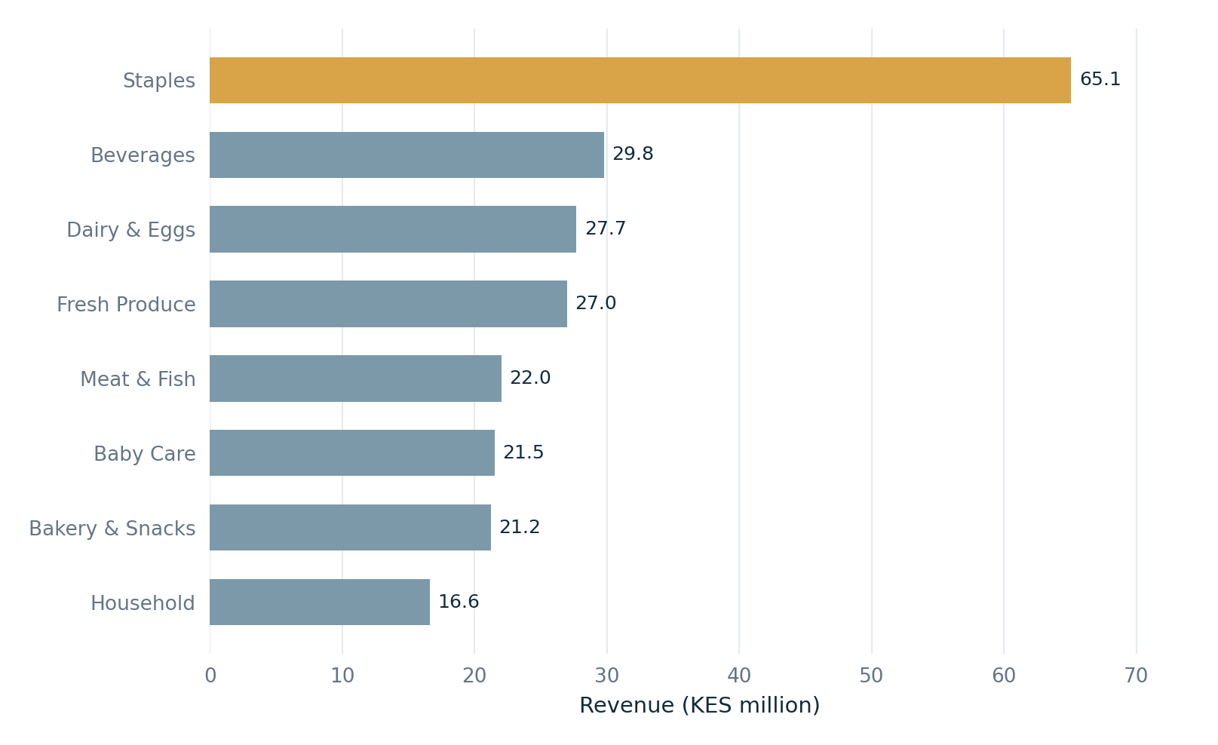
REVENUE DRIVERS
Where the money comes from
Rank stores and product categories by net revenue.
Store revenue
Category revenue
Ngara: KES 37.62M in revenue | Staples: KES 65.08M in revenue
Orders and deduplicated order items • Net revenue in KES
06 / 14

Slide 7
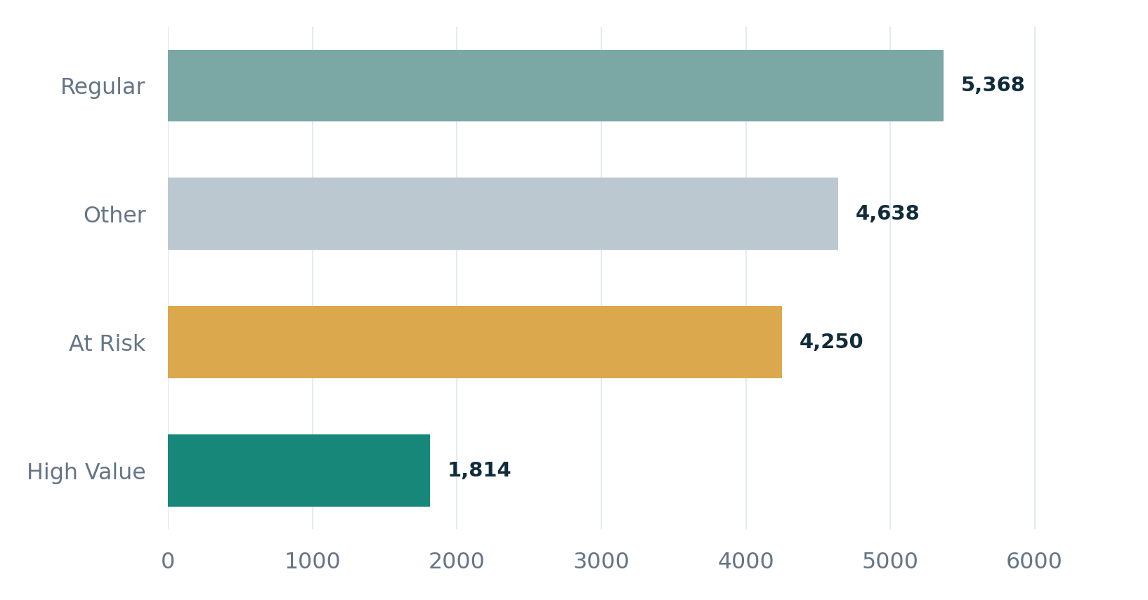
CUSTOMER INTELLIGENCE
Understand customer value and retention risk
RFM = recency (last purchase), frequency (order count) and monetary value (spend).
Customers by RFM segment
AT-RISK CUSTOMER COUNT
4,250
HIGH-VALUE CUSTOMERS
1,814
Segments cover 16,070 customers with recorded purchases; guest checkouts are not assigned an RFM segment.
PostgreSQL RFM analysis • Recency measured at 30 Sep 2026
07 / 14

Slide 8
STATISTICAL ANALYSIS
What differences are supported by the data?
Welch’s t-tests compare average order values; 95% confidence intervals show uncertainty.
NOT SIGNIFICANT
SIGNIFICANT
M-Pesa vs other payments
Promotions vs no promotion
KES 803.67 vs 801.91
KES 941.43 vs 751.71
Mean difference +KES 1.76
Mean difference +KES 189.72
p = 0.409 • CI [−2.42, 5.94]
p < 0.001 • CI [185.03, 194.41]
No clear evidence that M-Pesa orders have a different average value.
Promotional orders are associated with higher spending; this does not prove causation.
Assumptions: large groups support mean comparisons; skewness and repeat purchasers limit strict independence.
Welch’s independent-samples t-tests • Synthetic transactions
08 / 14

Slide 9
PREDICTIVE MODELLING
Forecast demand without looking into the future
Store-level monthly unit sales, using historical features and time-aware splits.
INPUT
BASELINE
MODEL
Previous 1, 2 and 3 months
of units sold + calendar month
Next month = previous
month’s units sold
Random Forest
100 decision trees
Chronological evaluation
TRAIN
VALIDATE
TEST
Apr 2024 – Mar 2026
162 store-month rows
Apr – Jun 2026
27 rows
Jul – Sep 2026
30 rows
We evaluate rolling one-month-ahead predictions: prior months’ actual sales are available when each prediction is made.
Ten stores; shorter histories for newer branches; 219 eligible store-month records
09 / 14

Slide 10
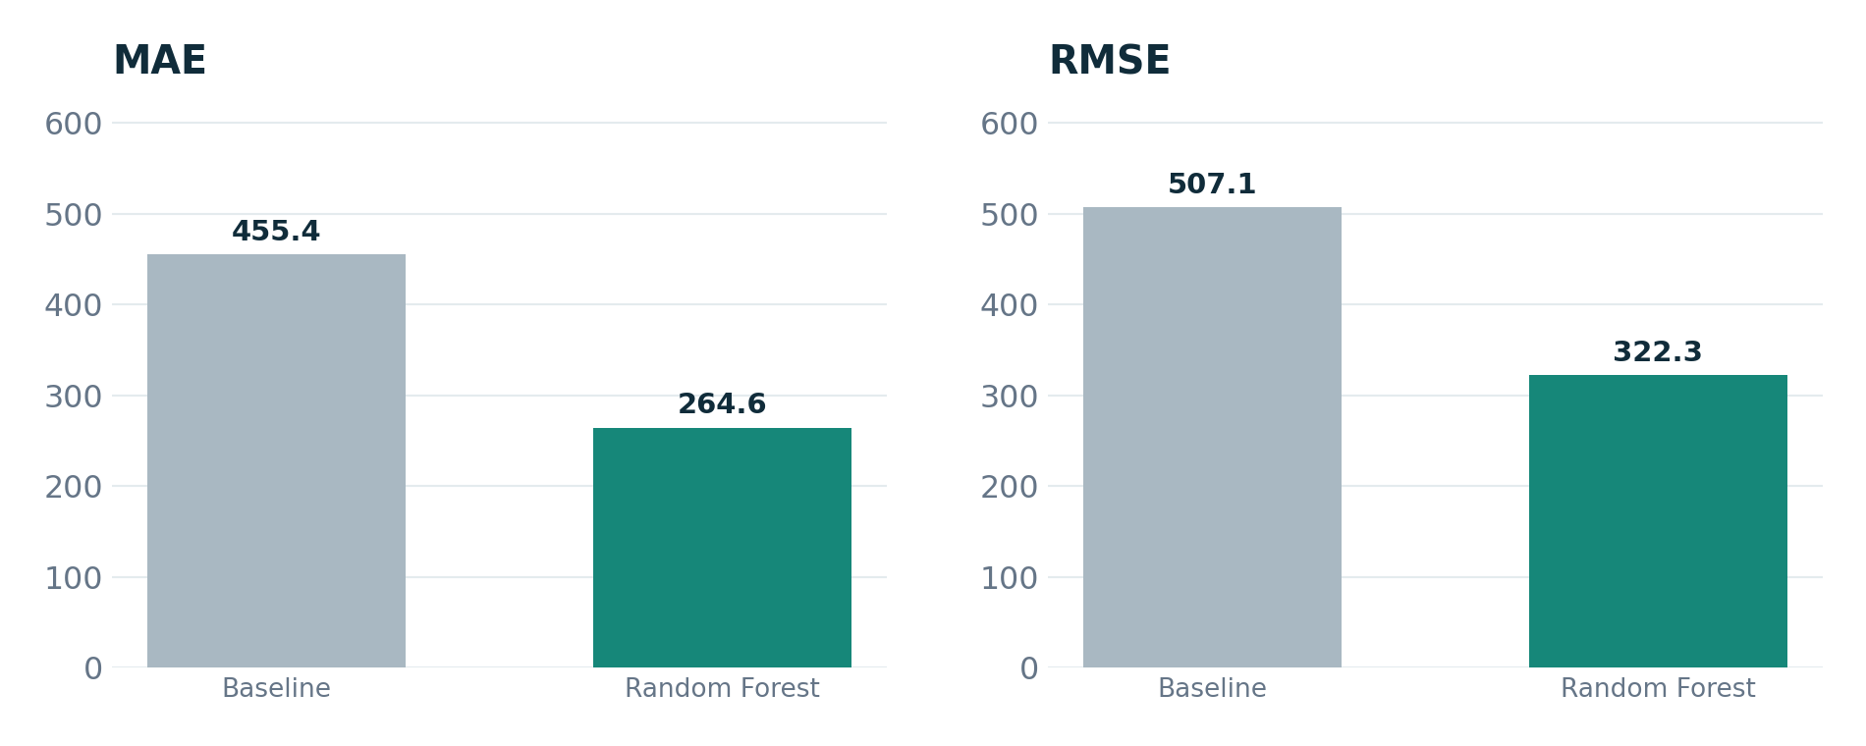
MODEL EVALUATION
The Random Forest beats the simple baseline
Final test set: July–September 2026 (30 store-month observations).
MAE IMPROVEMENT
41.9%
What the model gets wrong
S001 (Ngara), Aug 2026: forecast 5,643 vs actual 6,400 — an underprediction of 757 units. August spikes were difficult to anticipate.
MAE and RMSE are in units per store-month; lower is better
10 / 14

Slide 11
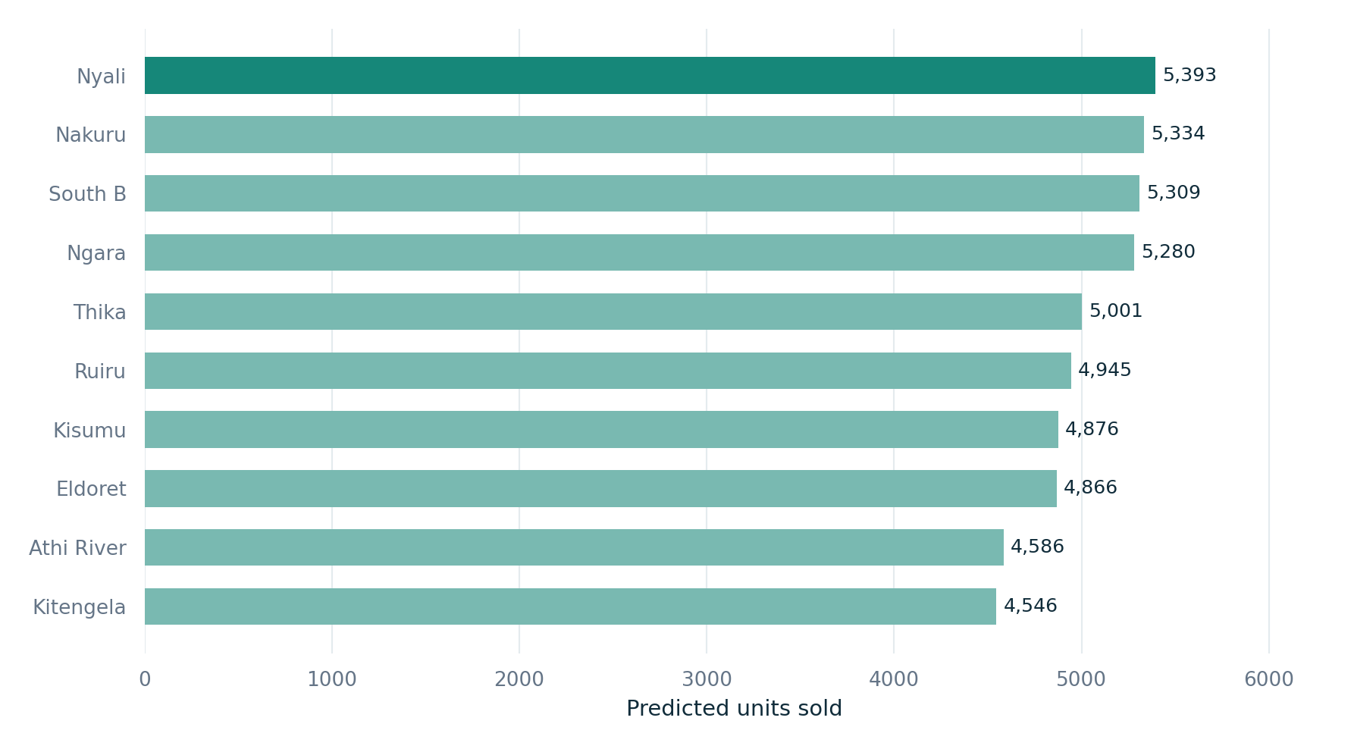
DEMAND FORECAST
October 2026: 50,136 predicted units
Forecast reflects estimated units sold, not guaranteed demand or required inventory.
TOTAL OCTOBER UNITS
50,136
All 10 stores
HIGHEST FORECAST
Nyali · 5,393
LOWEST FORECAST
Kitengela · 4,546
Synthetic retail dataset • Jan 2024–Sep 2026
11 / 14

Slide 12
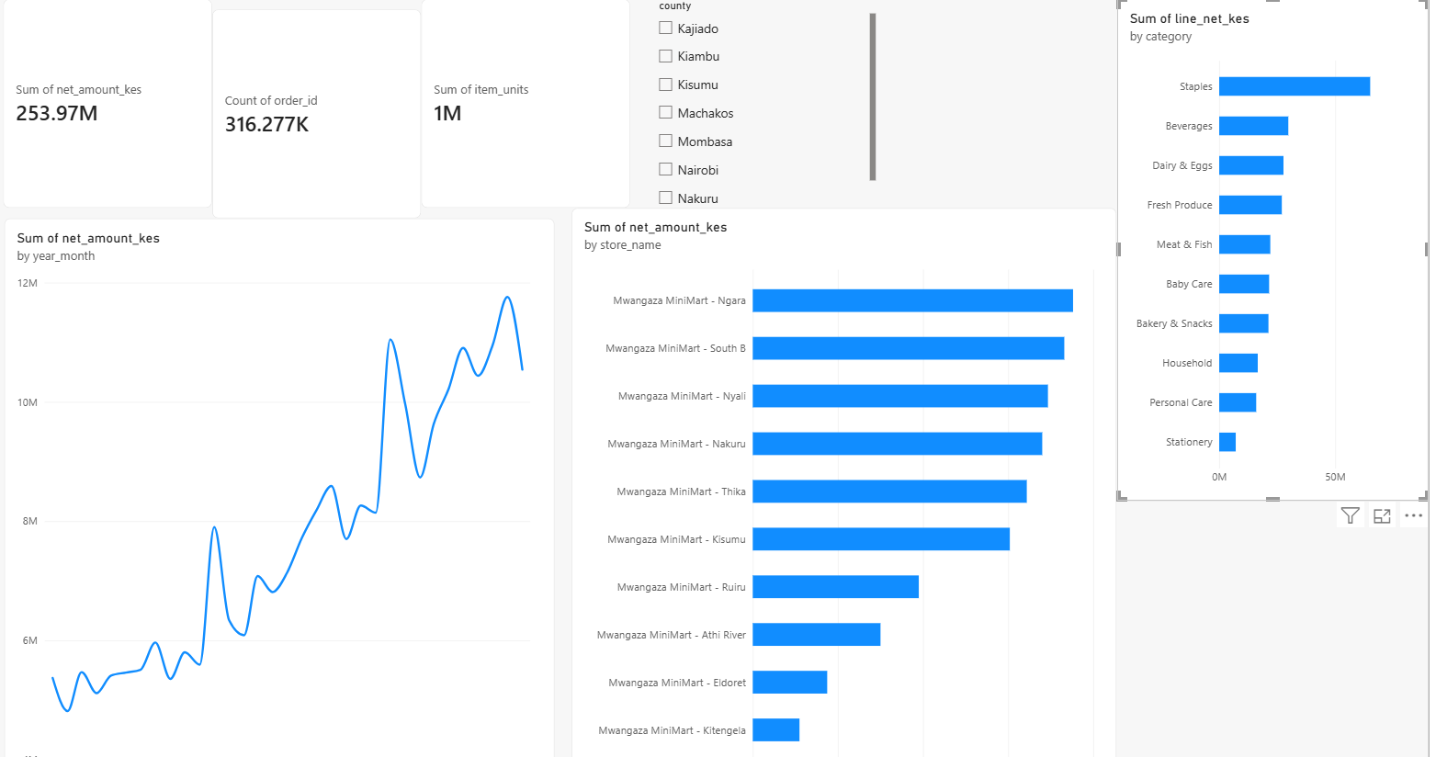
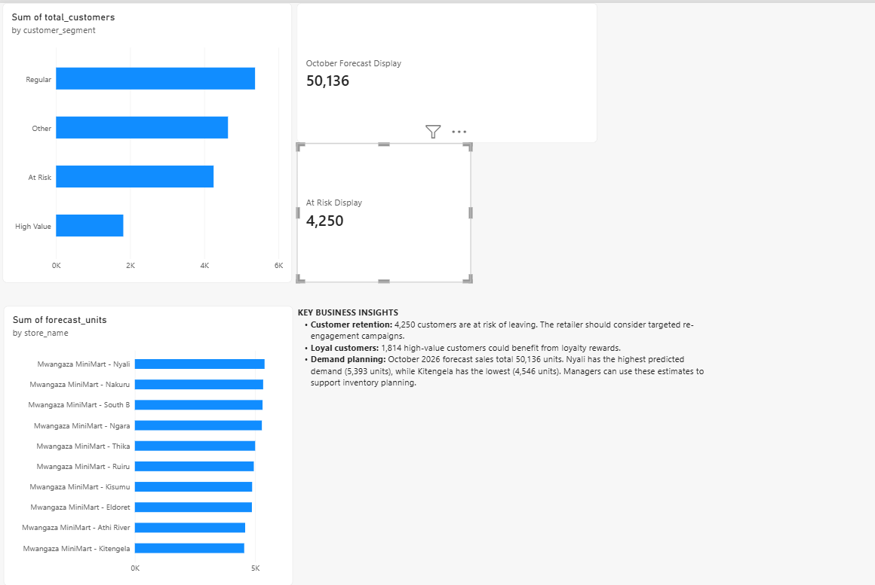
MANAGER DASHBOARD
From analysis to an interactive report
Power BI combines KPIs, store trends, product categories, customer segments and forecasts.
PAGE 1 / SALES PERFORMANCE
PAGE 2 / CUSTOMER & FORECAST
County slicer filters sales KPIs and charts.
RFM counts are overall; forecasts are shown by store.
Delivered as an editable Power BI .pbix file plus screenshots in dashboard/screenshots/.
Images from the Power BI dashboard developed for this project
12 / 14

Slide 13
BUSINESS RECOMMENDATIONS
Turn the results into store-manager actions
Prioritise decisions that can be measured and revisited.
01
MARKETING
02
STORE OPERATIONS
Retention
Inventory
Contact the 4,250 at-risk customers with targeted offers.
Use October store forecasts as a planning starting point.
03
MERCHANDISING
04
PLANNING
Assortment
Seasonality
Protect availability in Staples, the top-revenue category.
Prepare inventory and staffing for year-end sales peaks.
Decision principle: treat forecasts and segments as signals for action — then monitor actual outcomes.
Synthetic retail dataset • Jan 2024–Sep 2026
13 / 14

Slide 14
REPRODUCIBILITY & LIMITATIONS
A complete project someone else can run
Code, data, SQL evidence, Power BI file and visual documentation are kept together.
Run in this order
Interpret with care
1. Clone the GitHub repository and create .venv
Synthetic purchases, historical population data, non-causal comparisons and imperfect forecasts limit real-world claims.
2. Install packages from requirements.txt
3. Run notebooks/01 through notebooks/04
4. Import cleaned CSVs into PostgreSQL; run SQL file
Project repository
5. Open dashboard/Mwangaza_MiniMart_Dashboard.pbix
github.com/OleSuyaye/
kenyan_retailer_customer_sales_intelligence
Thank you • Questions?
Educational capstone • Findings and forecast from a fictional retailer
14 / 14

