Slide 1
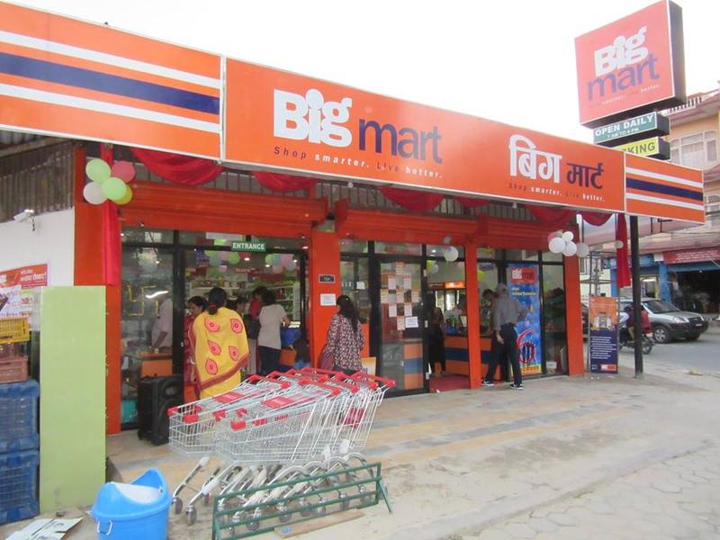
Machine Learning Project - Big Mart Sales Prediction

Slide 2

Big Mart Sales Prediction – Problem Statement
Big Mart has several outlets / stores around the world. This project is about predicting sales, so that Big Mart can perceive challenges early and plan marketing, recruitment, supply chain strategies.

Slide 3
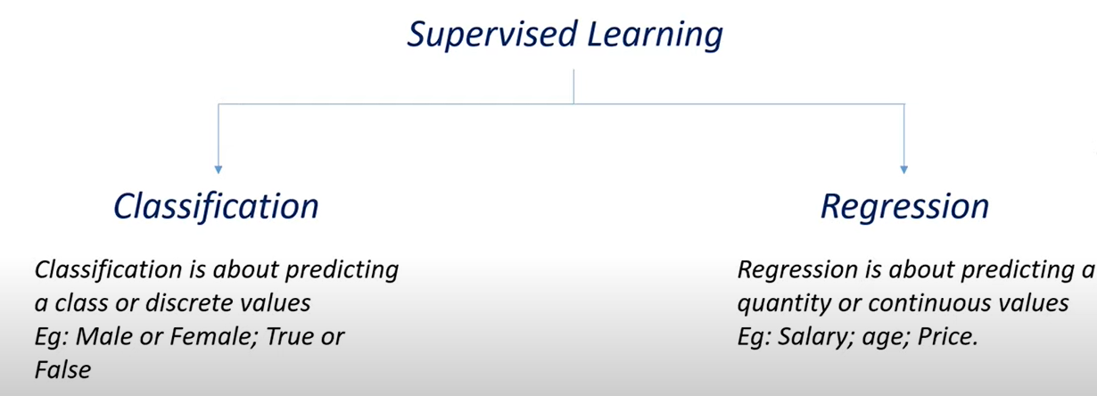
Big Mart Sales Predication – A Regression Model

Slide 4
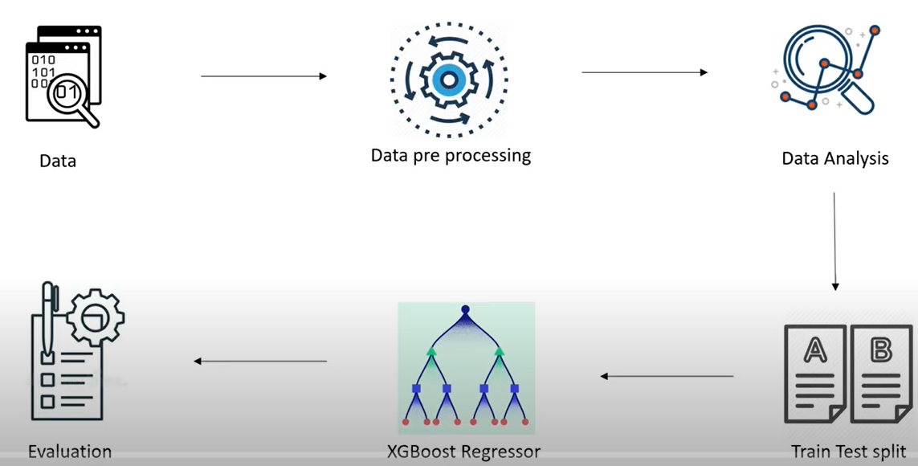
Big Mart Sales Prediction – Work Flow → Coding
https://www.kaggle.com/datasets/mrmorj/big-mart-sales
Linear Regression
DT Regressor

Slide 5
Thank you….

