Slide 1
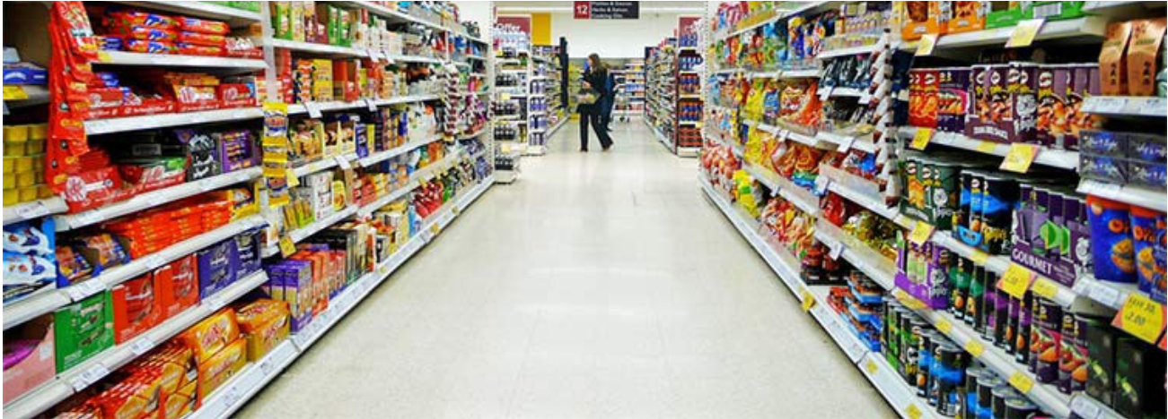
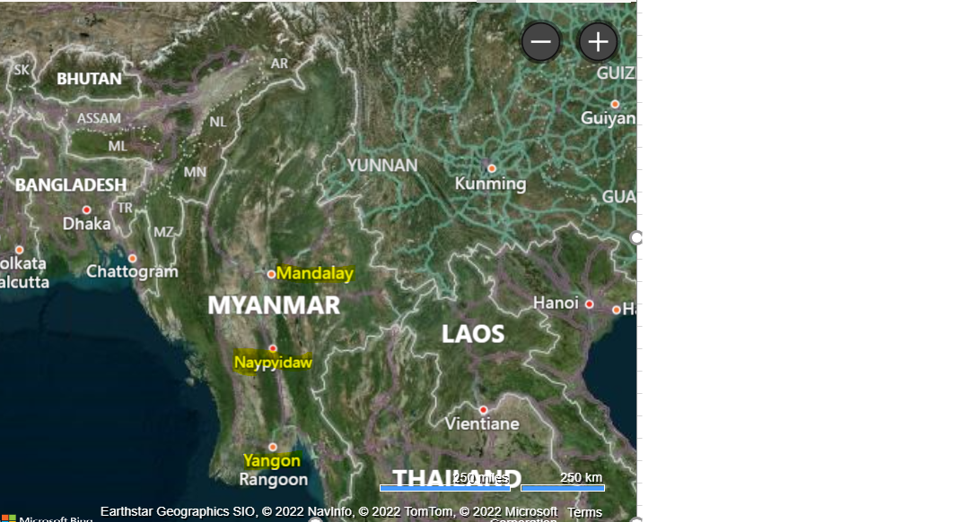
Data Analysis - Supermarket Sales in Myanmar

Slide 2
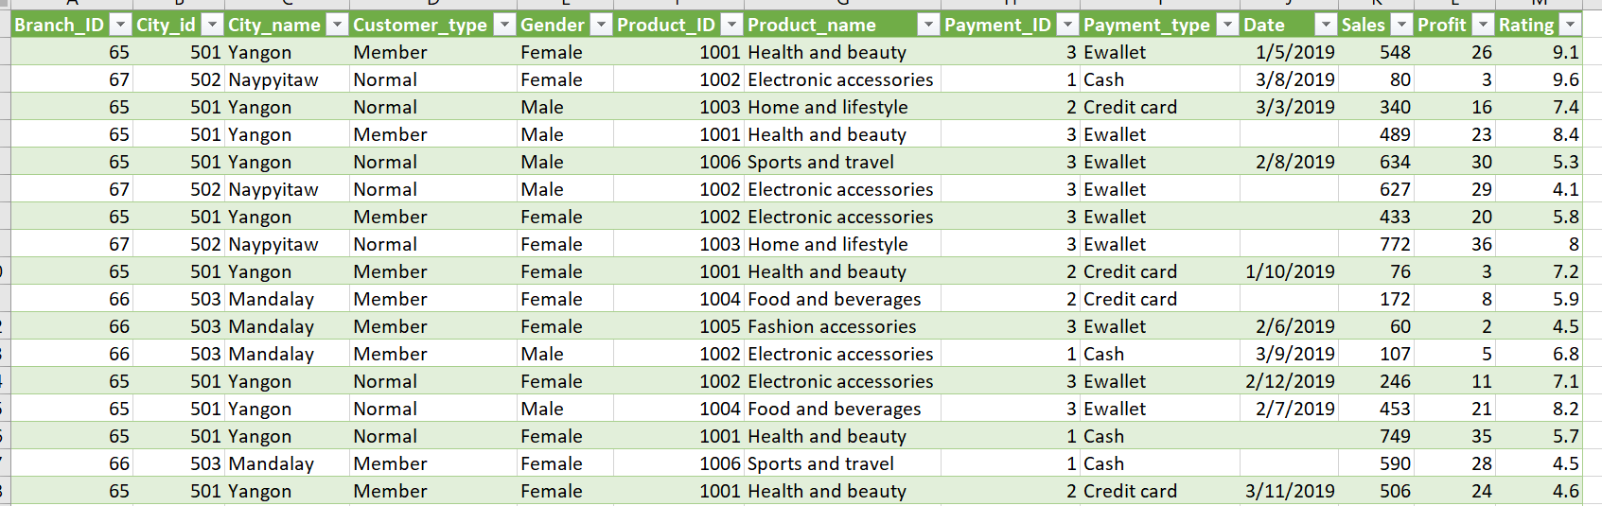
Data Analysis - Steps
Dataset of Superstore – Myanmar is downloaded from Kaggle
Dataset is related to the historical sales of Supermarket company, which has been recorded in 3 different branches ( Mandalay, Naypyidaw, Yangon) for 3 months (Jan-March 2019)
Dataset has 1000 rows of data in CSV format. This data is Cleaned, Transformed and then imported in SQL for further analysis

Slide 3
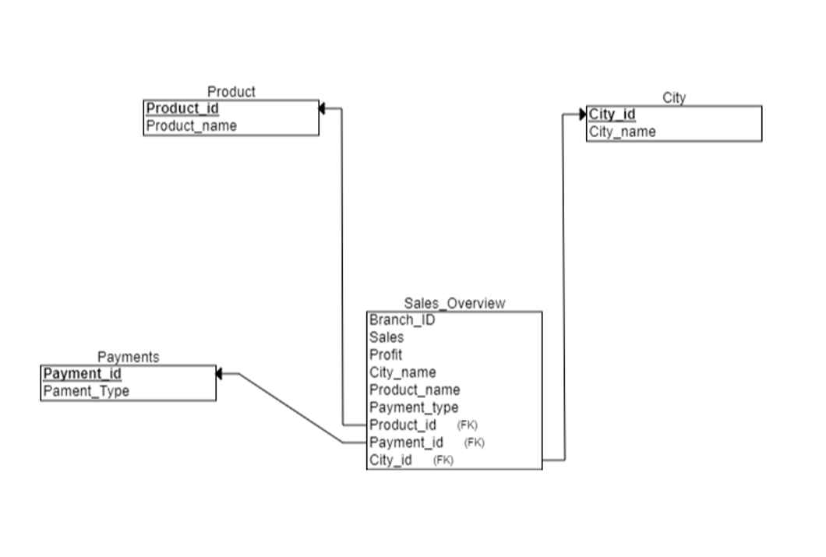
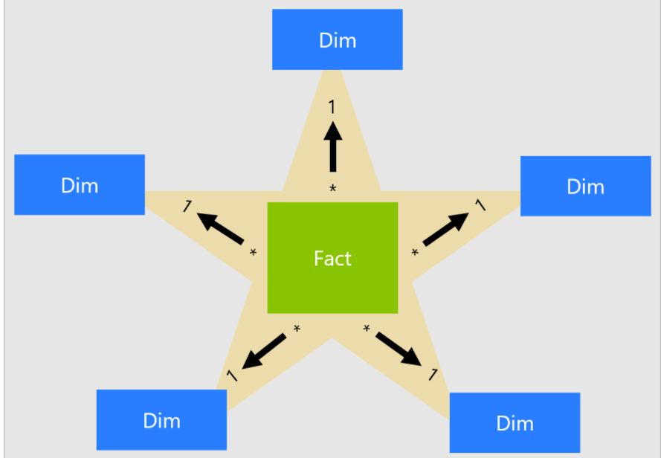
Star Relationship Schema - Supermarket in Myanmar
Note : Star schema is a modeling approach widely adopted by relational data warehouses. It requires modelers to classify their model tables as either dimension (such as Product, City…) or fact (such as Sales, Qty..)
https://docs.microsoft.com/en-us/power-bi/guidance/star-schema

Slide 10
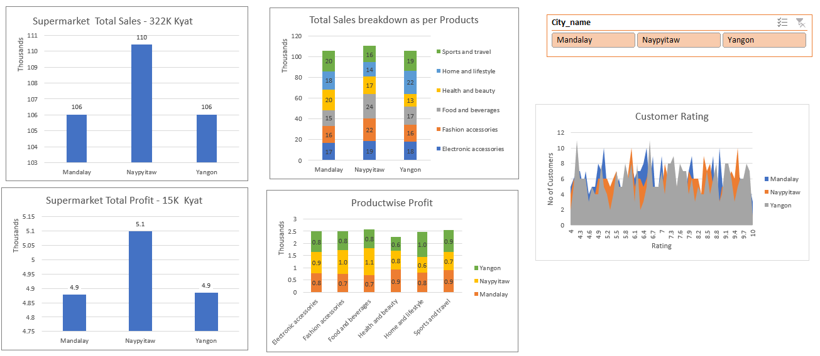
Dashboard

Slide 11
Thank you….

Slide 12
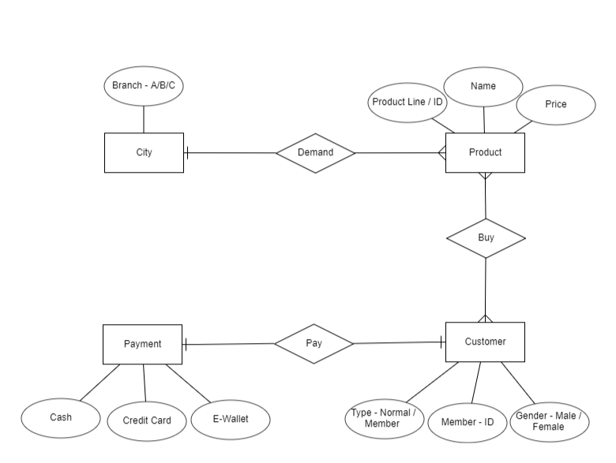
Backup : ER Diagram - Supermarket in Myanmar

