Slide 2
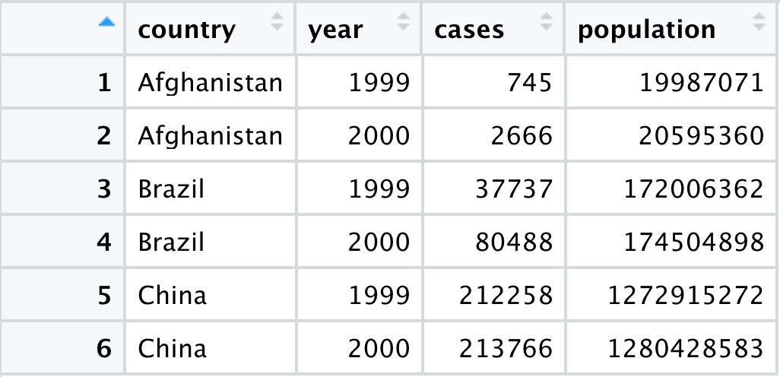
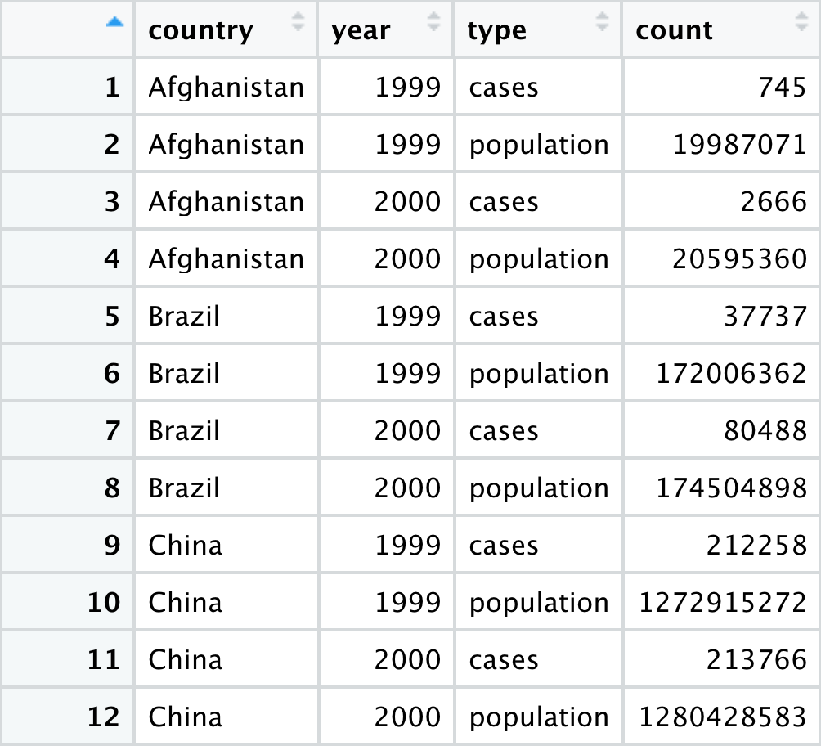
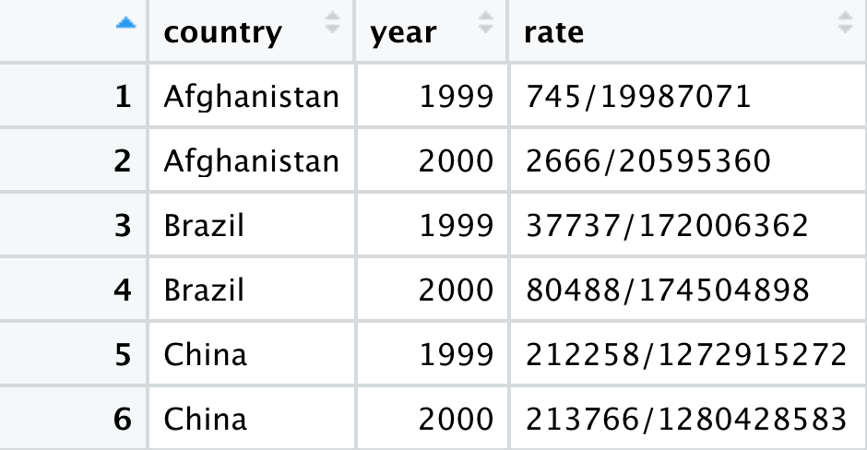
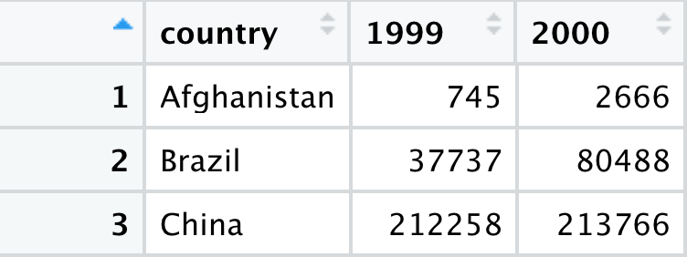


Different ways to display the same data
Which structure is tidy?

Slide 3

Different ways to display the same data
Tidy data

Slide 4
Exercise
Convert the coronavirus dataset to a wider format where the confirmed cases, deaths and recovered cases are shown in separate columns

