Slide 2
Learning objectives

Slide 3
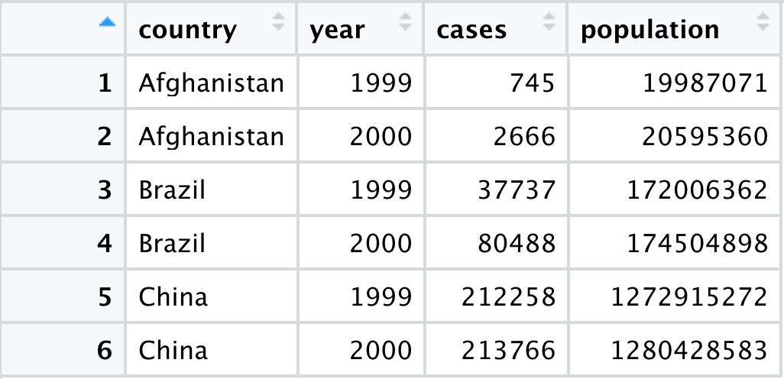
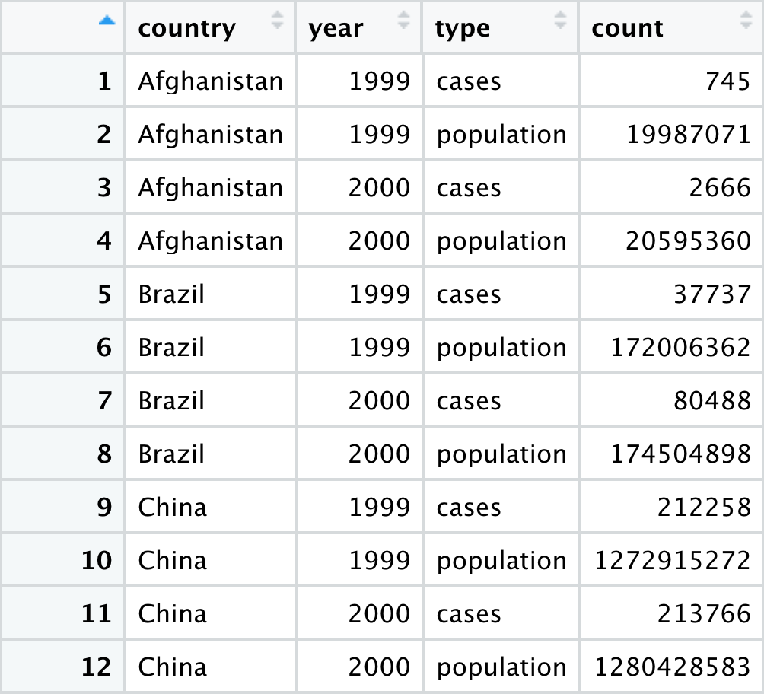
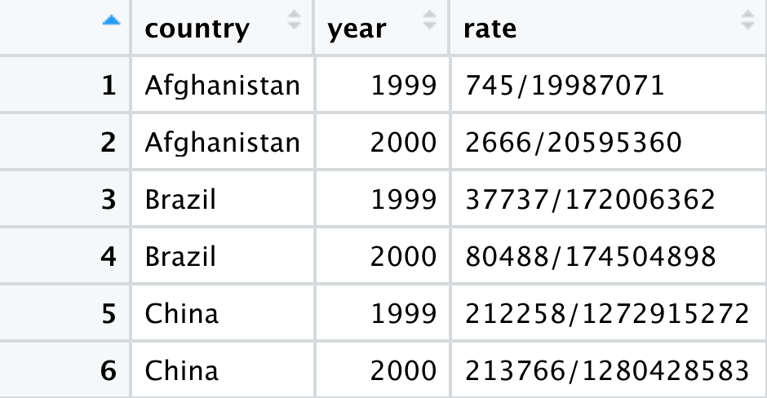
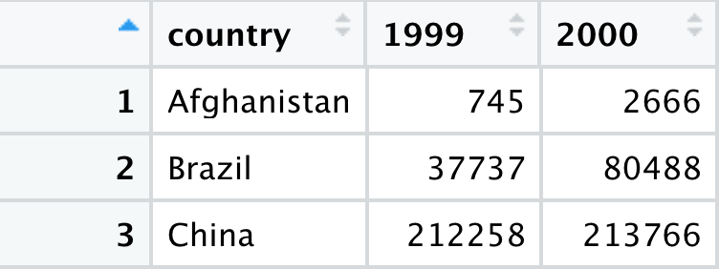
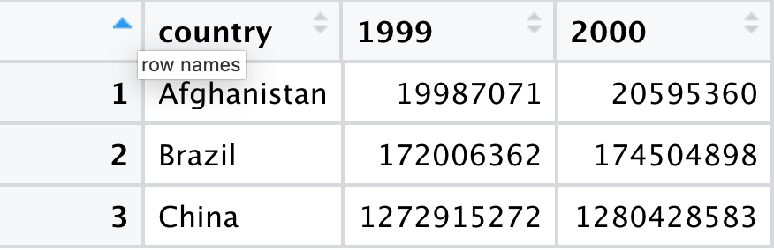
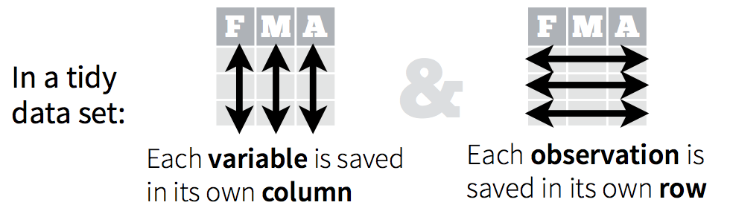
Different ways to display the same data
Which structure is tidy?

Slide 4
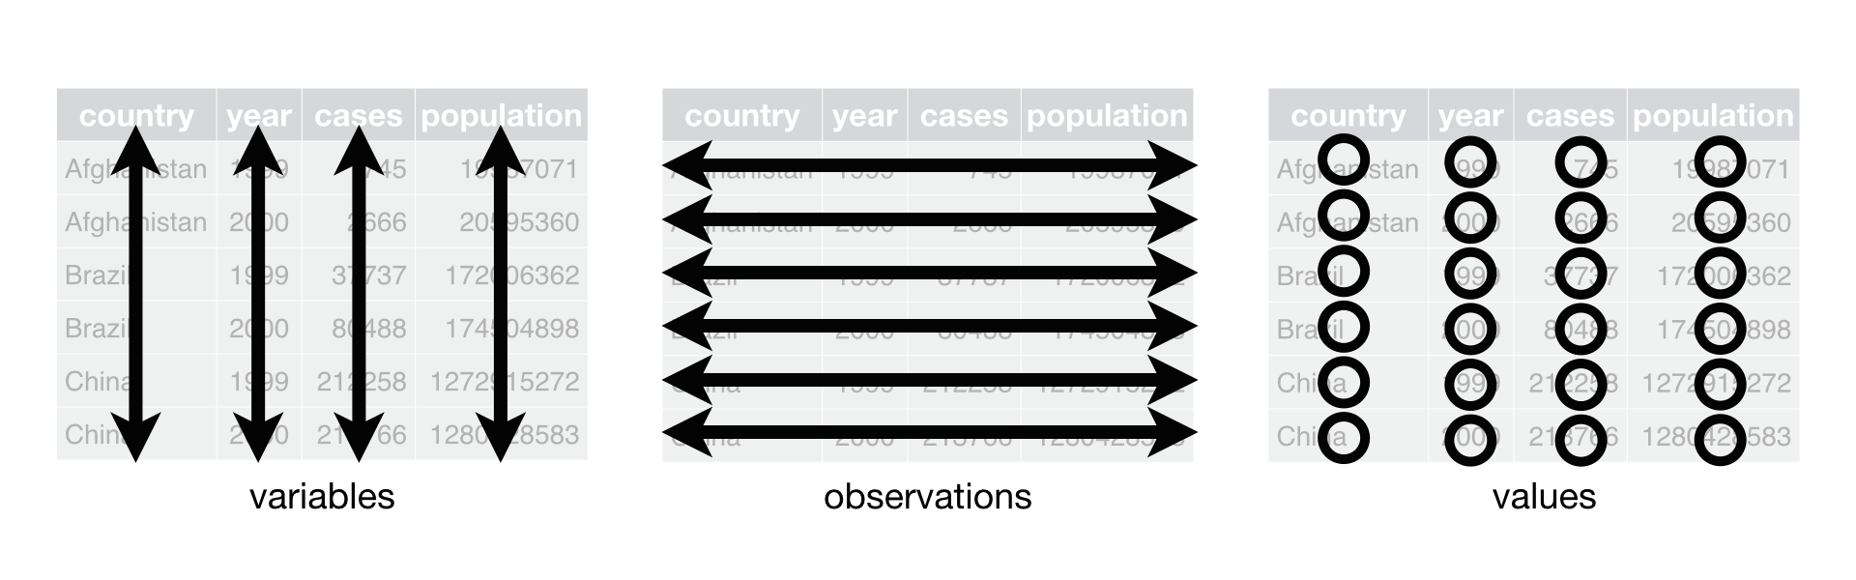
Different ways to display the same data
Tidy data

Slide 5
Exercise
Compute the rate for table2, and table4a + table4b. You will need to perform four operations:
Extract the number of TB cases per country per year.
Extract the matching population per country per year.
Divide cases by population, and multiply by 10000.
Store back in the appropriate place.
Which representation is easiest to work with? Which is hardest? Why?

Slide 6
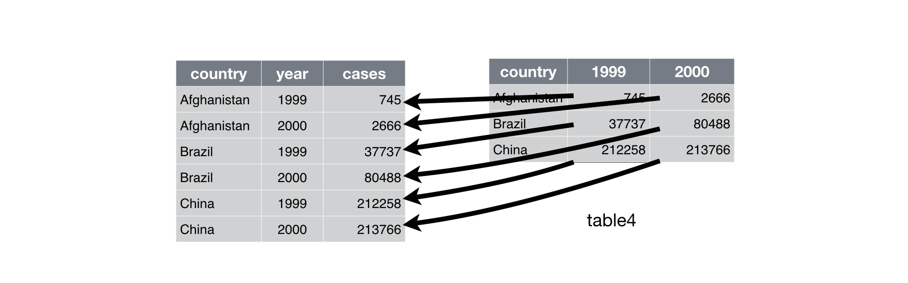
pivot_longer()
table4a %>%
pivot_longer(c(`1999`, `2000`), names_to = "year", values_to = "cases")

Slide 7
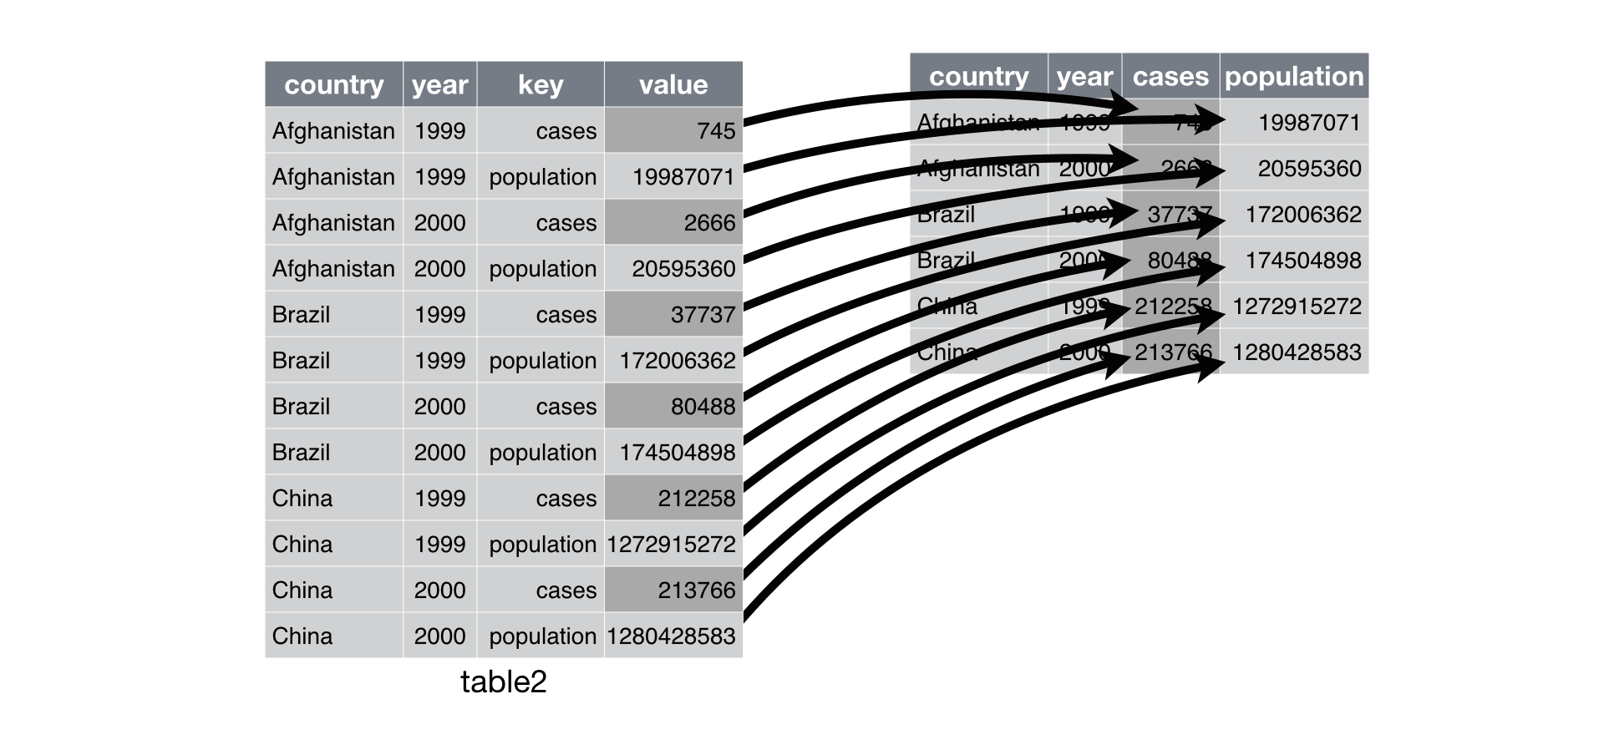
pivot_wider()
table2 %>%
pivot_wider(names_from = type, values_from = count)

Slide 8
separate()
table3 %>%
separate(rate, into = c("cases", "population"))
By default, separate() will split values wherever it sees a non-alphanumeric character (i.e. a character that isn’t a number or letter)

Slide 9
Exercise – LOTR data
After tidying the data and completing your analysis, you may want to output a table that has each race in its own column. Let’s use the pivot_wider() function to make such a table and save it as “lotr_wide”
OPTIONAL: Use the pivot_longer() function to transform you lotr_wide back to tidy format.

Slide 10
Exercise – coronavirus data
Convert the coronavirus dataset to a wider format where the confirmed cases, deaths and recovered cases are shown in separate columns
With this wide format data, make a bar chart of the total number of confirmed cases, deaths, and recoveries per day for the US

