Slide 1
Functions

Slide 2
Functions
Incorporate sets of instructions that you want to use repeatedly or that, because of their complexity, are better self-contained in a sub program and called when needed.
A function is a piece of code written to carry out a specified task; it can or can not accept arguments or parameters and it can or can not return one or more values.

Slide 3
Functions
Automate common tasks in a more powerful and general way than copy-and-pasting
Advantages:
You can give a function an evocative name that makes your code easier to understand.
As requirements change, you only need to update code in one place, instead of many.
You eliminate the chance of making incidental mistakes when you copy and paste (i.e. updating a variable name in one place, but not in another).

Slide 4
When should you write a function?
Whenever you’ve copied and pasted a block of code more than twice (i.e. you now have three copies of the same code)

Slide 5
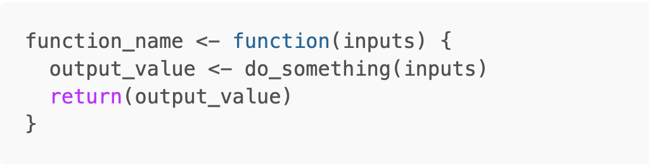
Basic syntax

Slide 6
Three key steps to creating a function
You need to pick a name for the function. Pick something that helps you understand what the function does
You list the inputs, or arguments, to the function inside function
You place the code you have developed in body of the function, a { } block that immediately follows function(...).

Slide 7
Three key steps to creating a function
You need to pick a name for the function. Pick something that helps you understand what the function does
You list the inputs, or arguments, to the function inside function
You place the code you have developed in body of the function, a { } block that immediately follows function(...).
Then it’s a good idea to do some testing with different inputs to make sure the function works as expected

Slide 8
Naming your functions
Short, but clearly evoke what the function does
Better to be clear than short
Generally, function names should be verbs, and arguments should be nouns.
Nouns are ok if the function computes a very well known noun (i.e. mean() is better than compute_mean())
A noun might be a better choice is if you’re using a very broad verb like “get”, “compute”, “calculate”, or “determine”

Slide 9
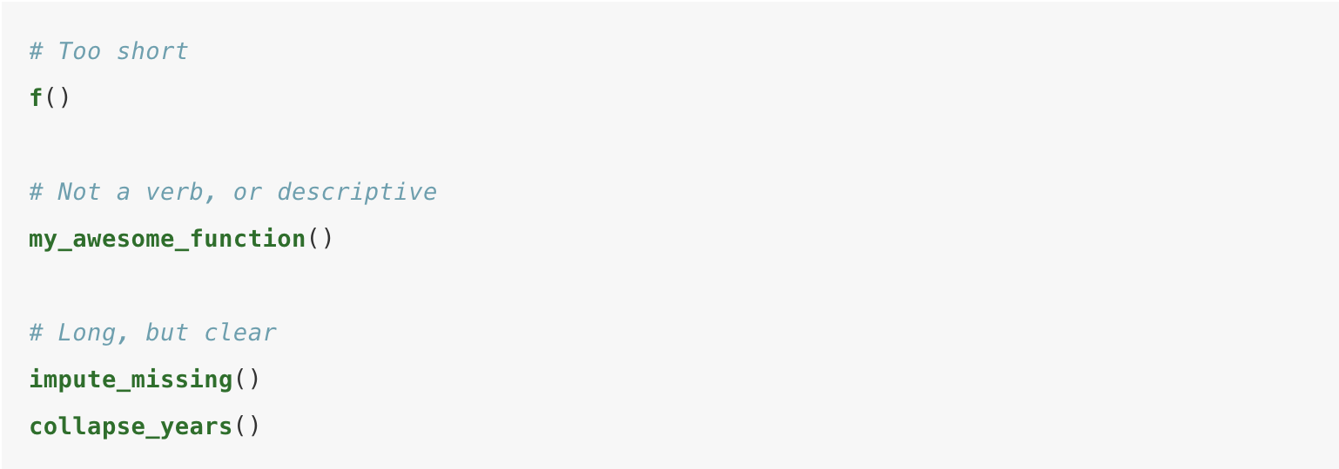
Example names

Slide 10
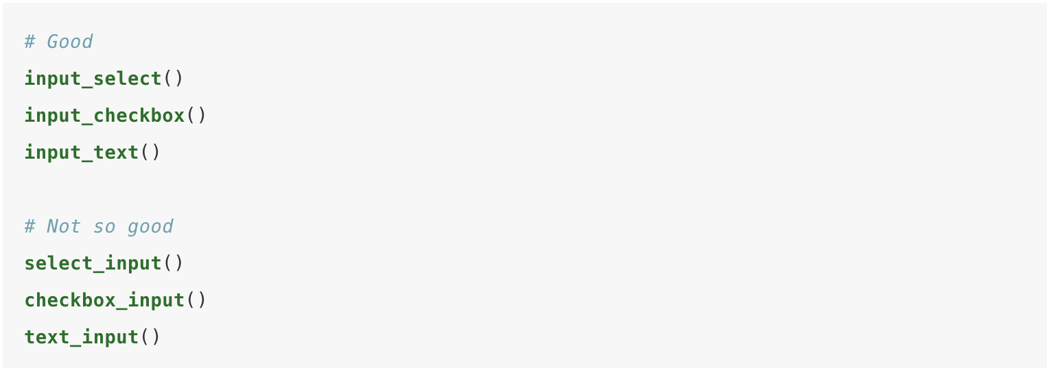
Use consistent prefix for related functions

Slide 11
Use commenting to explain your code and separate sections
# Explain “why”
Generally the ”what” and “how” should be clear from the code. If not, consider adding intermediate variables with useful names

Slide 12
Take-homes
Functions are both for computers and humans
R doesn’t care what your function is called, or what comments it contains, but these are important for human readers

Slide 13
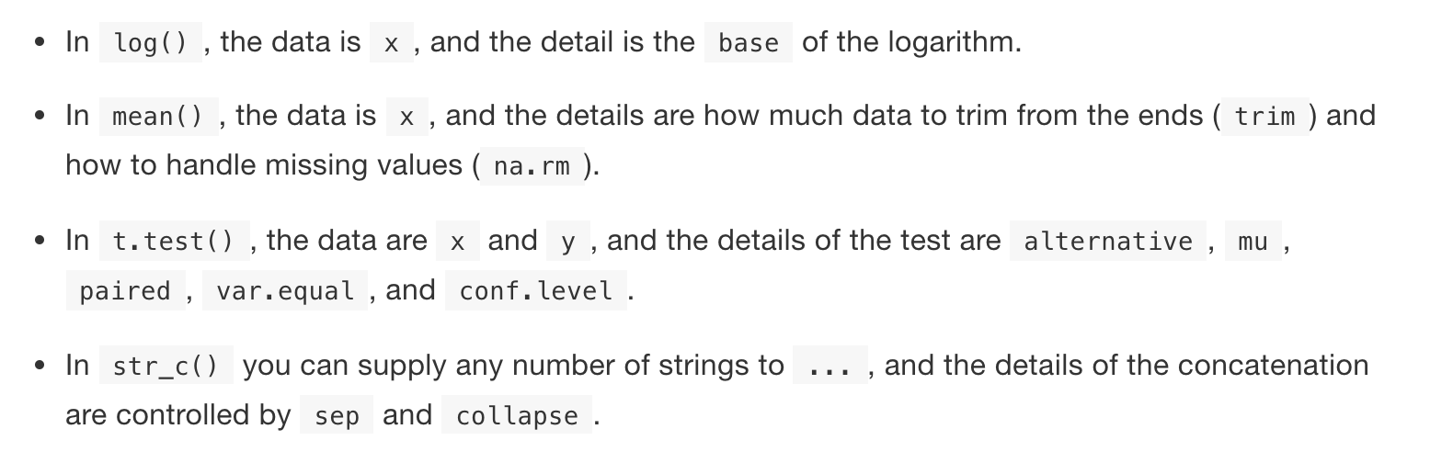
Function arguments
Two broad sets:
One set supplies the data to compute on
The other supplies arguments that control the details of the computation

Slide 14
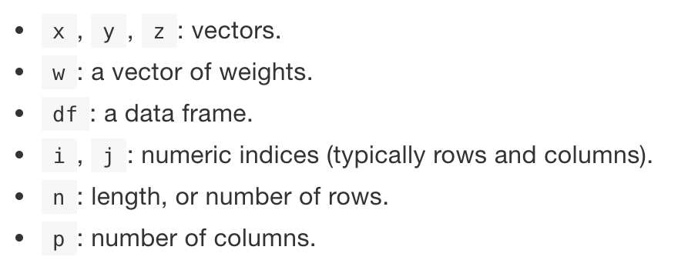
Choosing names
Common defaults:

Slide 15
What does a function return?
Usually the last statement it evaluates
Can choose to return early by using return()

Slide 16
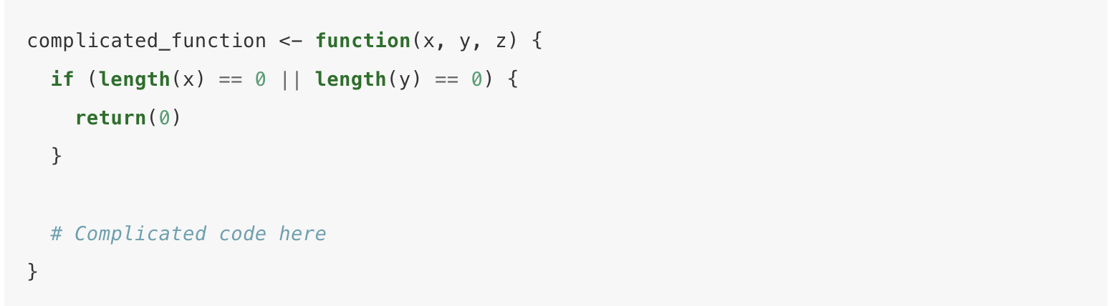
What does a function return?
Usually the last statement it evaluates
Can choose to return early by using return()

