Slide 1
Functions

Slide 2
Functions
Incorporate sets of instructions that you want to use repeatedly or that, because of their complexity, are better self-contained in a sub program and called when needed.
A function is a piece of code written to carry out a specified task; it can or can not accept arguments or parameters and it can or can not return one or more values.

Slide 3
Functions
Automate common tasks in a more powerful and general way than copy-and-pasting
Advantages:
You can give a function an evocative name that makes your code easier to understand.
As requirements change, you only need to update code in one place, instead of many.
You eliminate the chance of making incidental mistakes when you copy and paste (i.e. updating a variable name in one place, but not in another).

Slide 4
When should you write a function?
Whenever you’ve copied and pasted a block of code more than twice (i.e. you now have three copies of the same code)

Slide 5
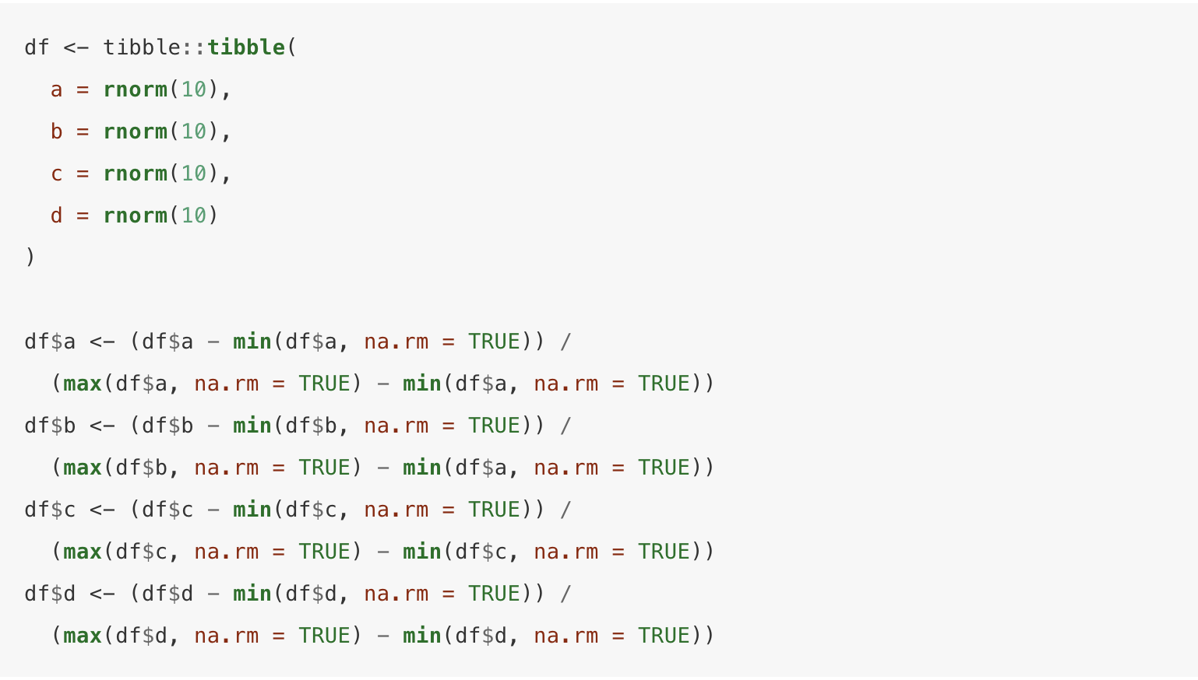

Slide 6
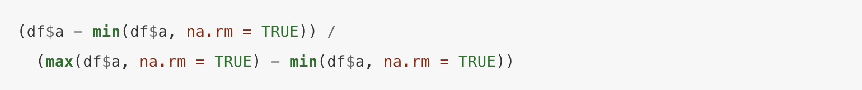
How many inputs?
Only df$a

Slide 7
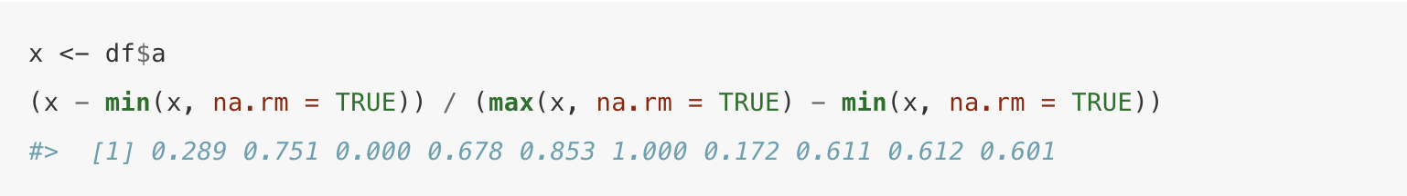
How many inputs?
Only df$a
To make the inputs more clear, it’s a good idea to rewrite the code using temporary variables with general names

Slide 8
How many inputs?
Only df$a
To make the inputs more clear, it’s a good idea to rewrite the code using temporary variables with general names
But we’re computing the range three times – rewrite to do in a single step

Slide 9
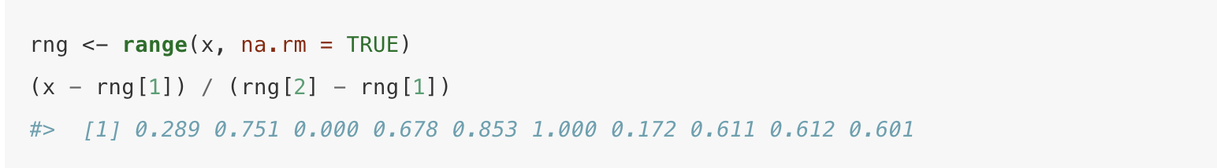
Range calculation in a single step:

Slide 10
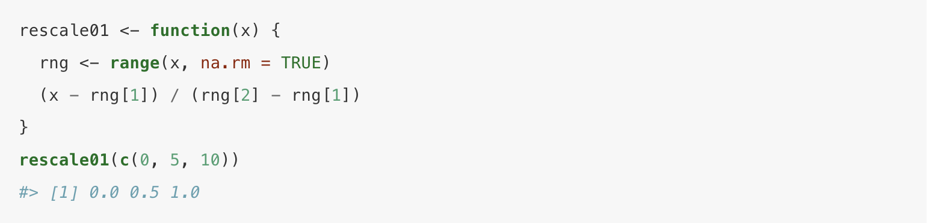
Range calculation in a single step:
Then write as a function:

Slide 11
Three key steps to creating a function
You need to pick a name for the function. Here I’ve used rescale01 because this function rescales a vector to lie between 0 and 1.
You list the inputs, or arguments, to the function inside function. Here we have just one argument. If we had more the call would look like function(x, y, z).
You place the code you have developed in body of the function, a { block that immediately follows function(...).

Slide 12
Three key steps to creating a function
You need to pick a name for the function. Here I’ve used rescale01 because this function rescales a vector to lie between 0 and 1.
You list the inputs, or arguments, to the function inside function. Here we have just one argument. If we had more the call would look like function(x, y, z).
You place the code you have developed in body of the function, a { block that immediately follows function(...).
Then it’s a good idea to do some testing with different inputs to make sure the function works as expected

Slide 13
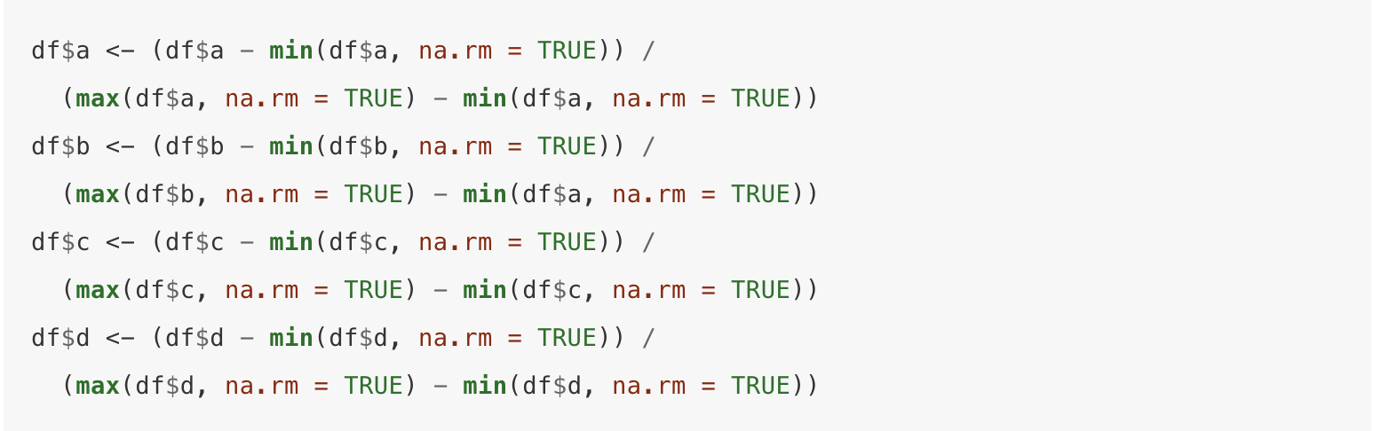
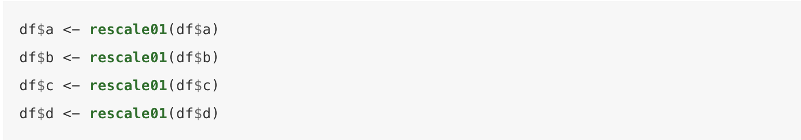
From this:
To this:

Slide 14
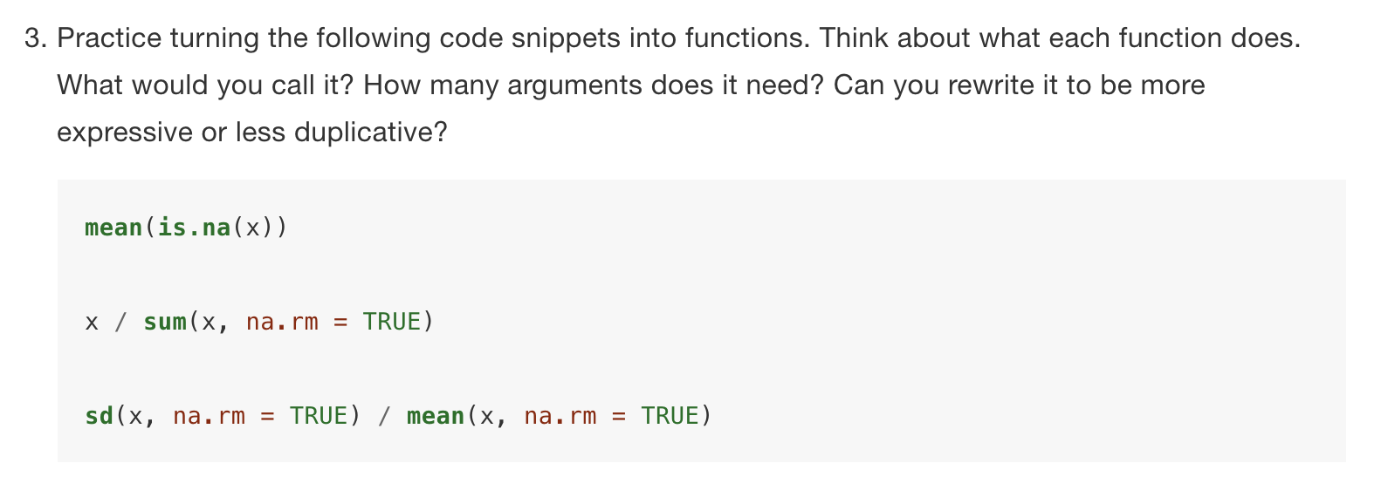
Exercises

Slide 15
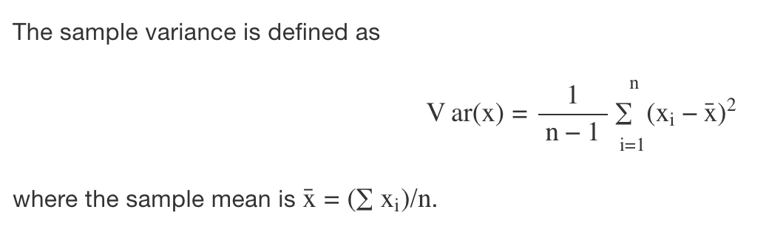
Exercise 19.2.1.4
Follow http://nicercode.github.io/intro/writing-functions.html to write your own functions to compute the variance. Compute the variance on gapminder$lifeExp

Slide 16
Exercise
Write both_na(), a function that takes two vectors of the same length and returns the number of positions that have an NA in both vectors.

Slide 17
Take-homes
Functions are both for computers and humans
R doesn’t care what your function is called, or what comments it contains, but these are important for human readers

Slide 18
Naming your functions
Short, but clearly evoke what the function does
Better to be clear than short
Generally, function names should be verbs, and arguments should be nouns.
Nouns are ok if the function computes a very well known noun (i.e. mean() is better than compute_mean())
A noun might be a better choice is if you’re using a very broad verb like “get”, “compute”, “calculate”, or “determine”

Slide 19
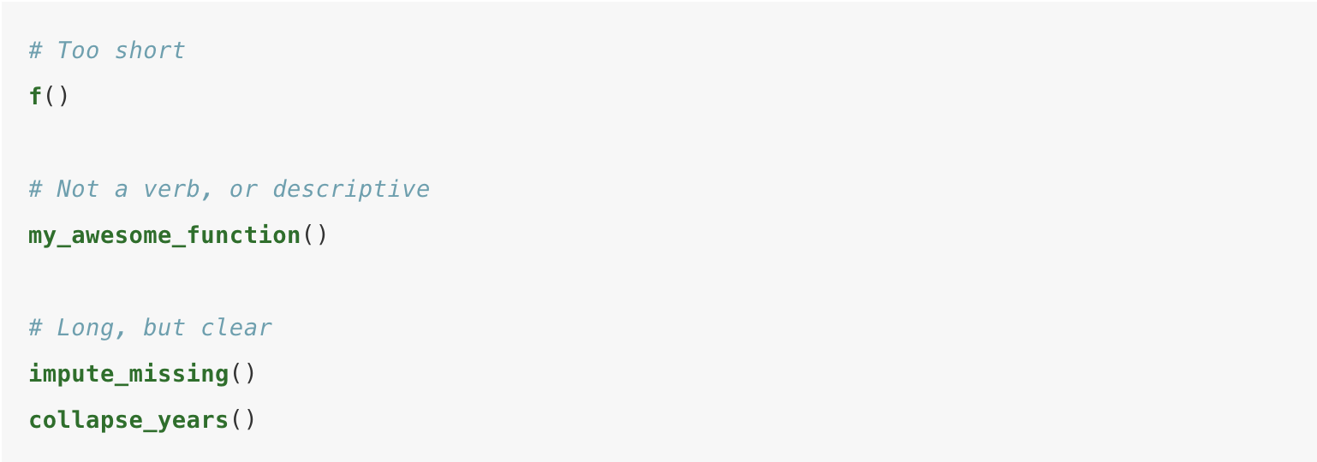
Example names

Slide 20
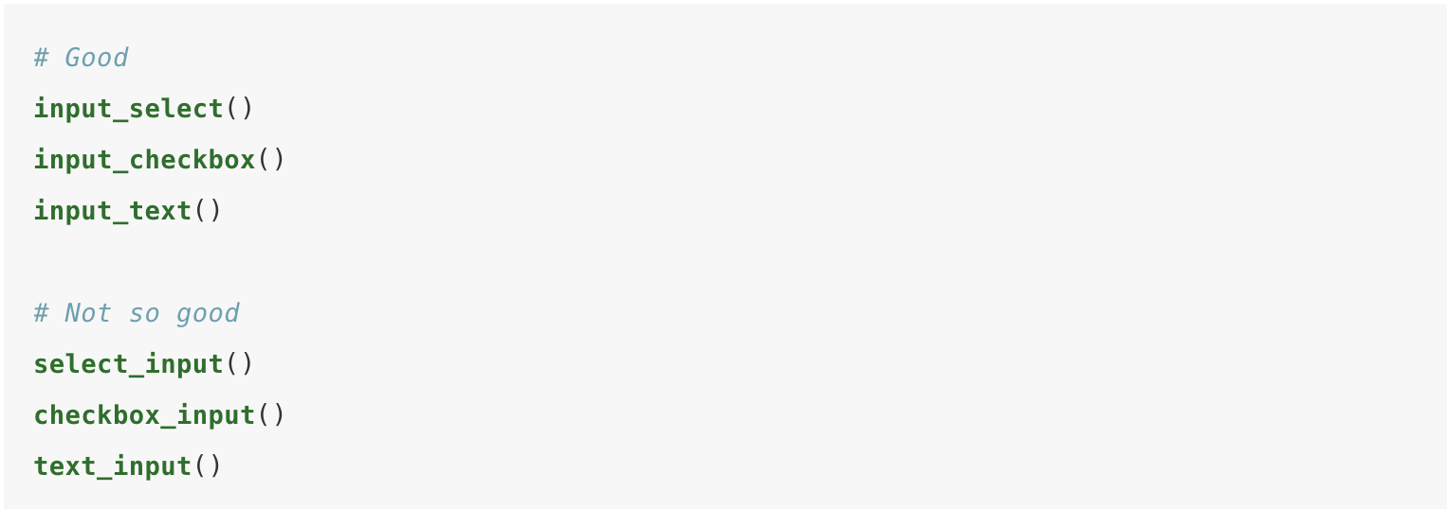
Use consistent prefix for related functions

Slide 21
Use commenting to explain your code and separate sections
# Explain “why”
Generally the ”what” and “how” should be clear from the code. If not, consider adding intermediate variables with useful names

Slide 22
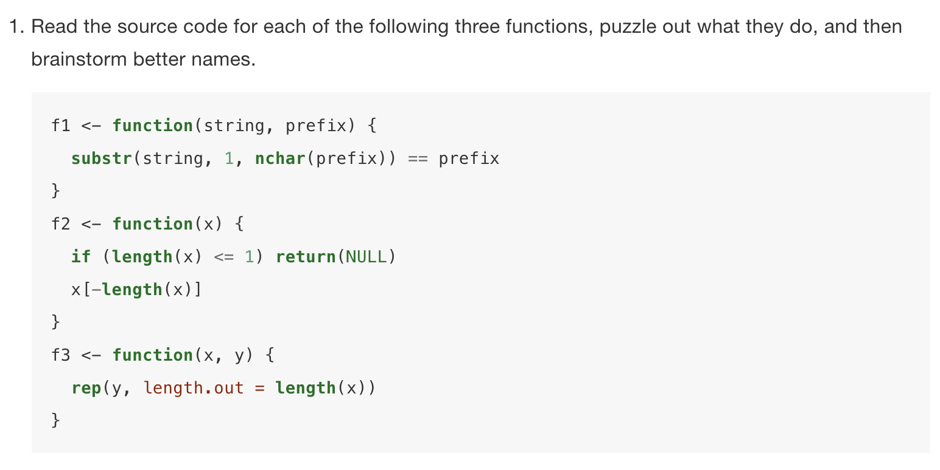
Exercise

Slide 24
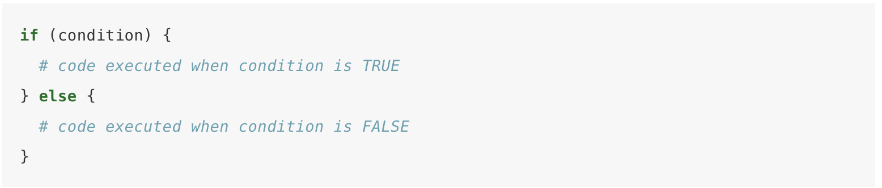
Conditional execution

Slide 25
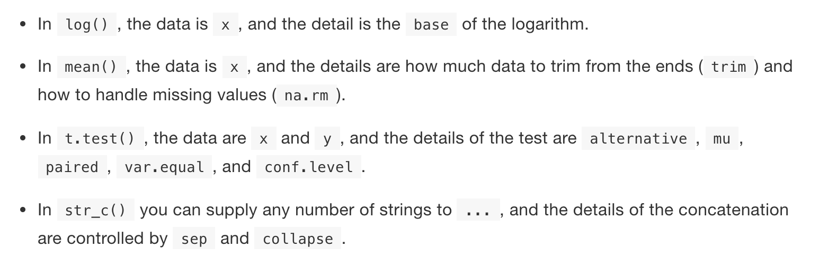
Function arguments
Two broad sets:
One set supplies the data to compute on
The other supplies arguments that control the details of the computation

Slide 26
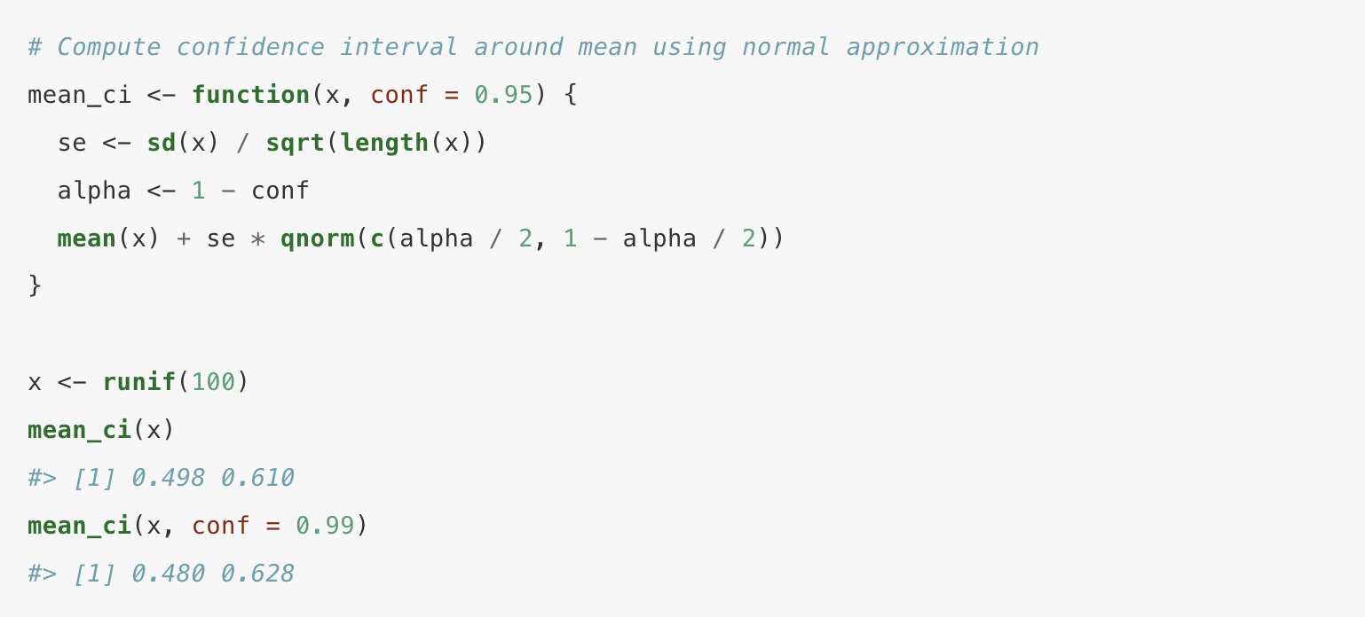
Default values

Slide 27
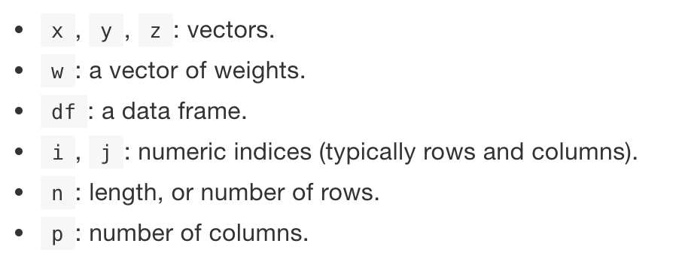
Choosing names
Common defaults:

Slide 28
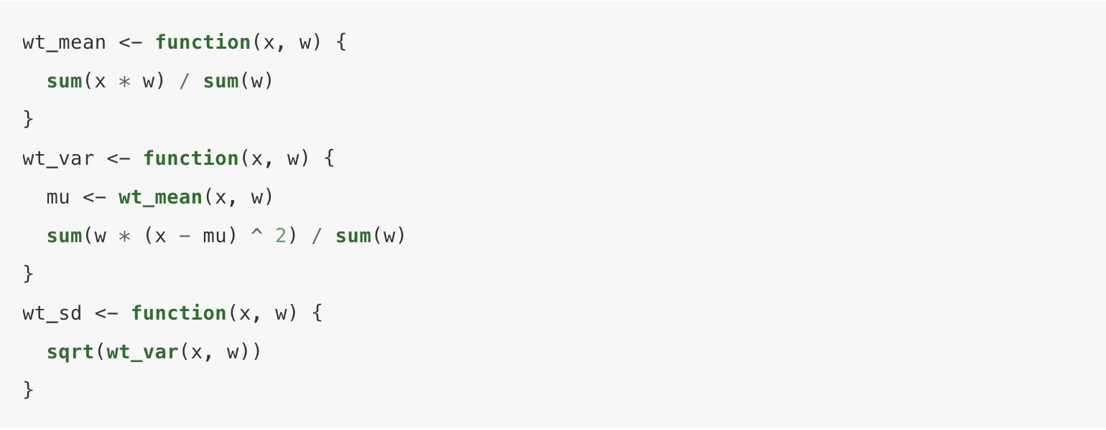
Checking values
Build important checks/constraints into your functions

Slide 29
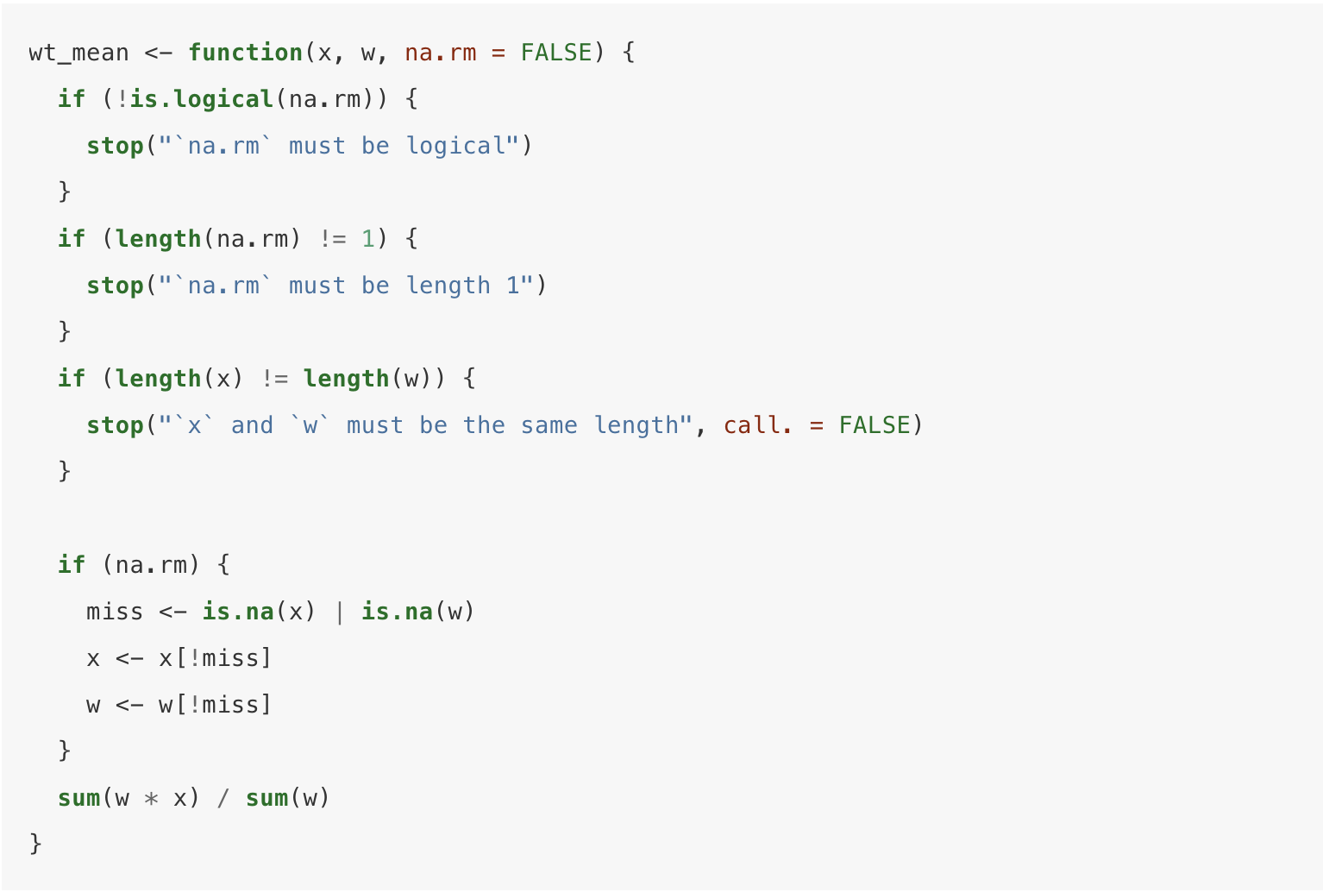

Slide 30
What does a function return?
Usually the last statement it evaluates
Can choose to return early by using return()

Slide 31
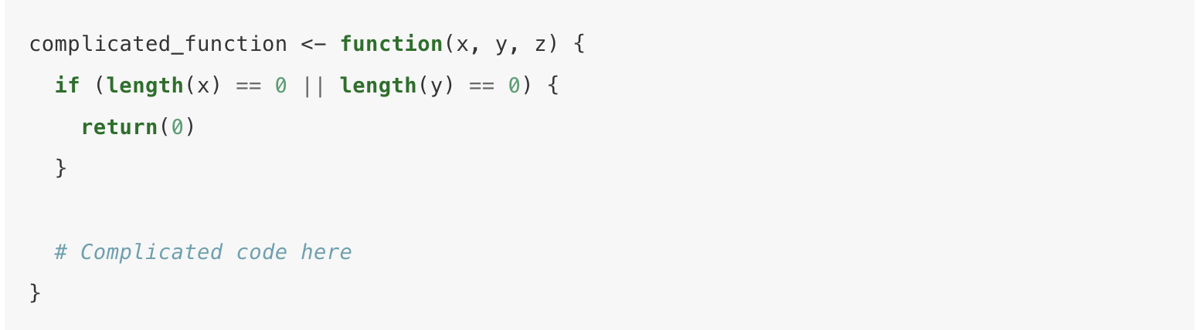
What does a function return?
Usually the last statement it evaluates
Can choose to return early by using return()

Slide 32
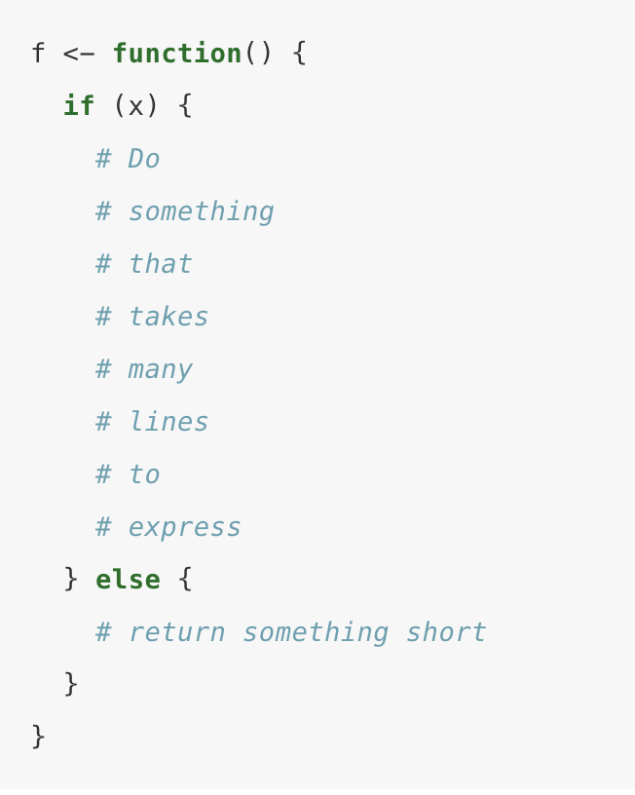

Slide 33
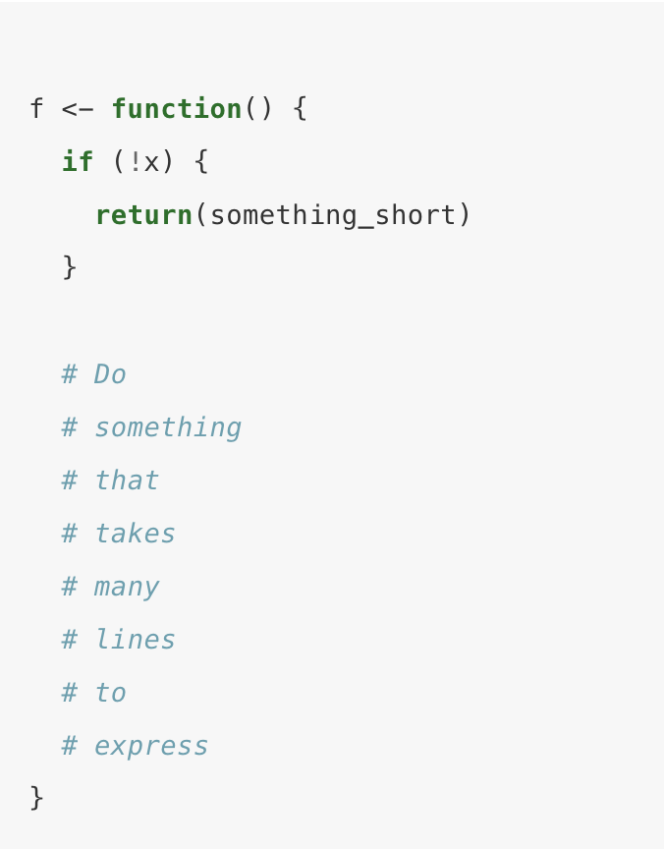

Slide 34
Writing pipeable functions
Know the return value’s object type for each operation
Transformations
An object is passed to the function’s first argument and a modified object is returned
Side-effects
The passed object is not transformed, but action performed on object (e.g. plotting or saving file)
“Invisibly” return the first argument, so that while they’re not printed they can still be used in a pipeline

Slide 35
Function environments
f <- function(x) { x + y }
This will work – be careful!

