Slide 2
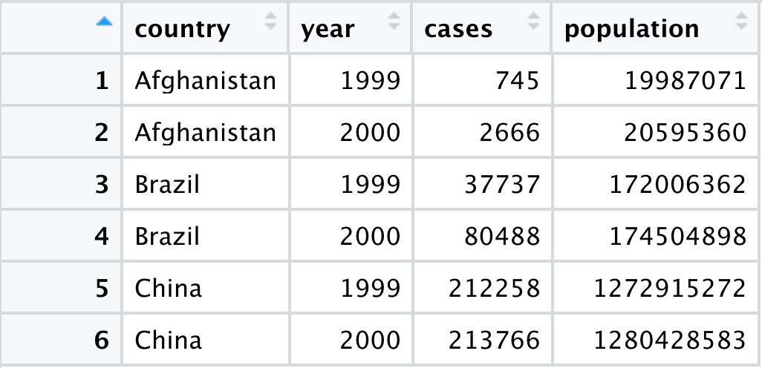
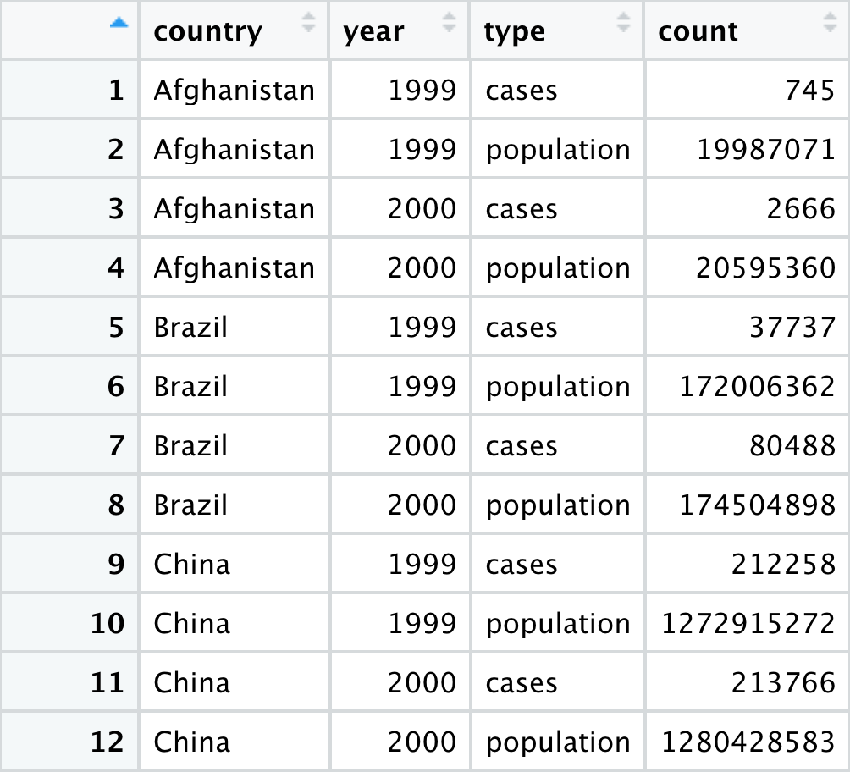
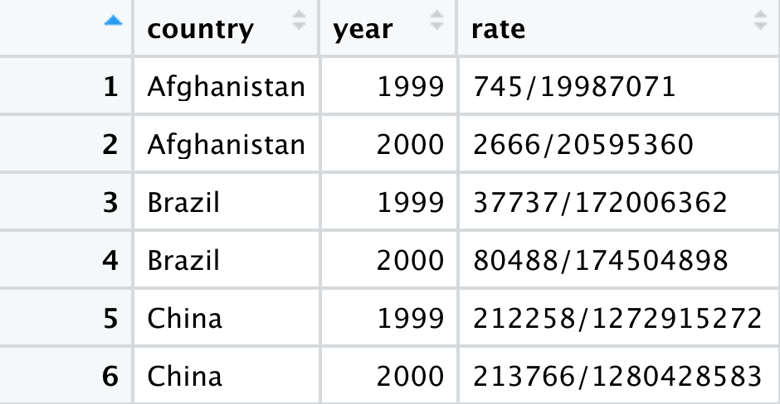
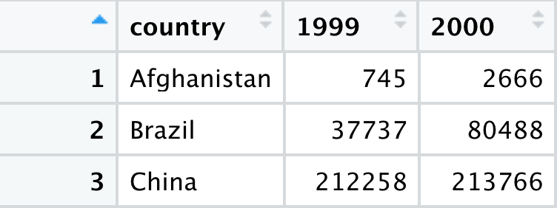
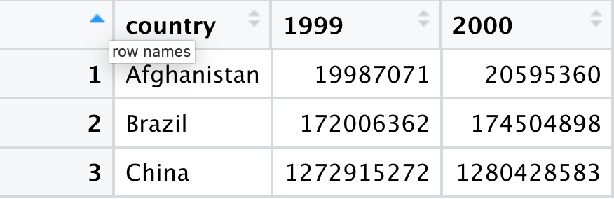
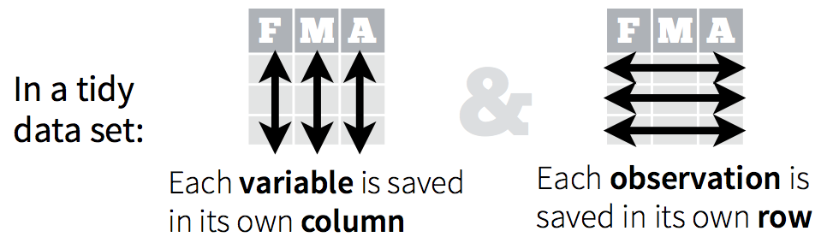
Different ways to display the same data
Which structure is tidy?

Slide 3
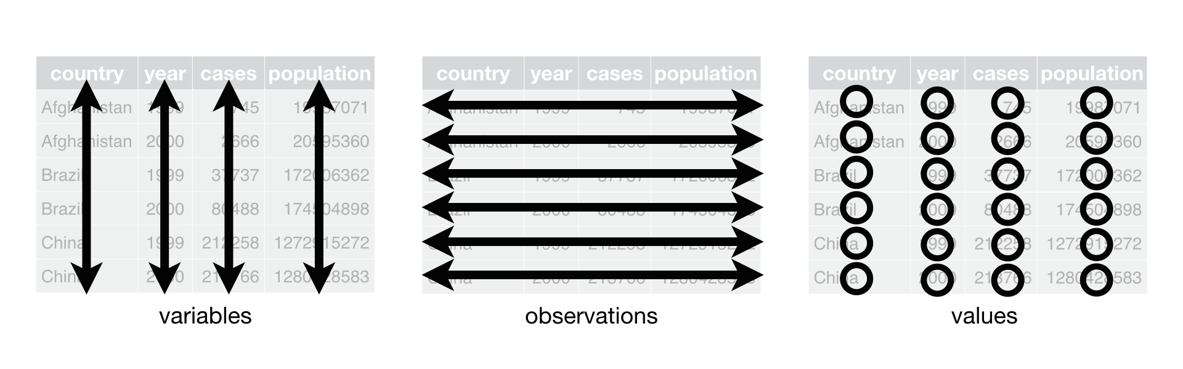
Different ways to display the same data
Tidy data

Slide 4
Exercise
Compute the rate for table2, and table4a + table4b. You will need to perform four operations:
Extract the number of TB cases per country per year.
Extract the matching population per country per year.
Divide cases by population, and multiply by 10000.
Store back in the appropriate place.
Which representation is easiest to work with? Which is hardest? Why?

Slide 5
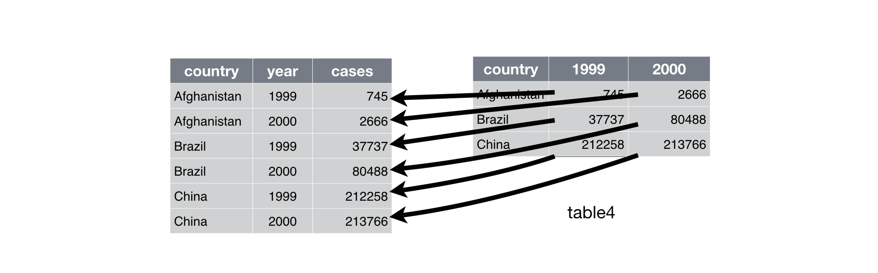
pivot_longer()
table4a %>%
pivot_longer(c(`1999`, `2000`), names_to = "year", values_to = "cases")

Slide 6
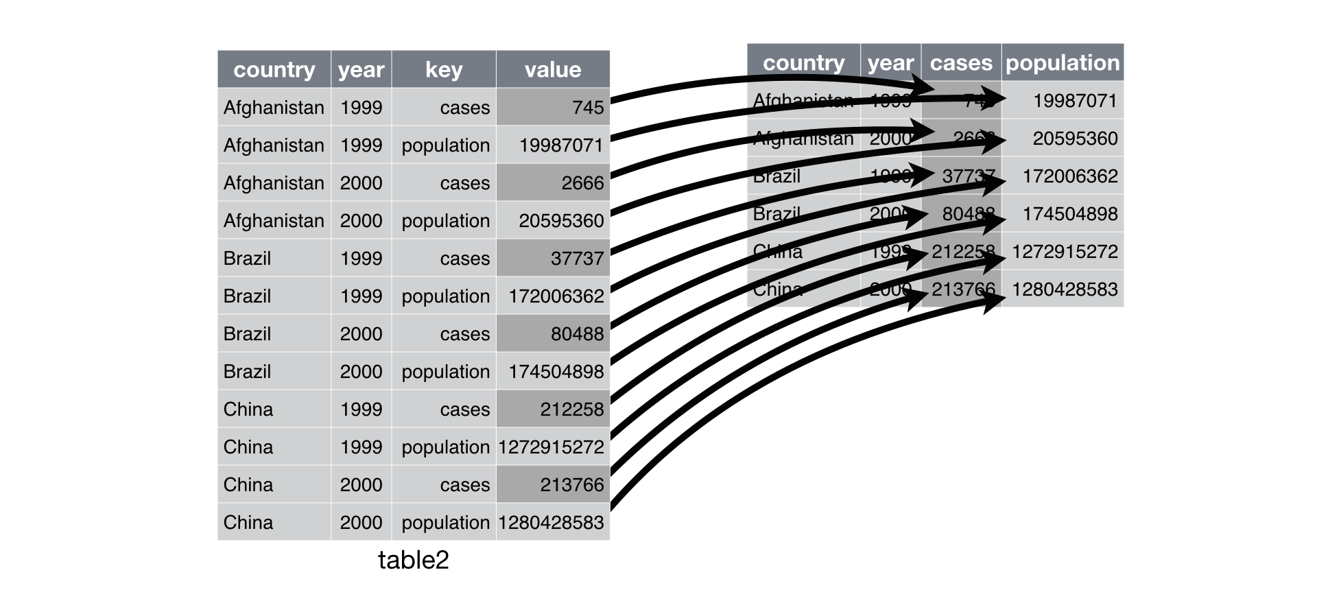
pivot_wider()
table2 %>%
pivot_wider(names_from = type, values_from = count)

Slide 7
separate()
table3 %>%
separate(rate, into = c("cases", "population"))
By default, separate() will split values wherever it sees a non-alphanumeric character (i.e. a character that isn’t a number or letter)

Slide 8
Exercise
Convert the coronavirus dataset to a wider format where the confirmed cases, deaths and recovered cases are shown in separate columns

