Slide 1
Graduate Student Individual Development Plan Training
Zoe Ziliak Michel
zmichel@ucsd.edu
June 5, 2014

Slide 2
Agenda
Introductions
Overview of what IDP Is
What are NIH and OGS Policies for IDPs?
Review of NIH notice and policies
Questions from audience
Introduction of IDP Form
Skill Assessment
Career Exploration/Objective
Mentors
Goal Setting
Mentor Input
IDP Progress

Slide 3
Agenda Continued
Work on Poster
Poster Session – Guest Faculty Dr. Geoffrey Chang
Break into groups with one moderator per group
Each person presents poster to group (5-8 mins.)
Questions and Feedback
Lunch will be coming at 12:45

Slide 4
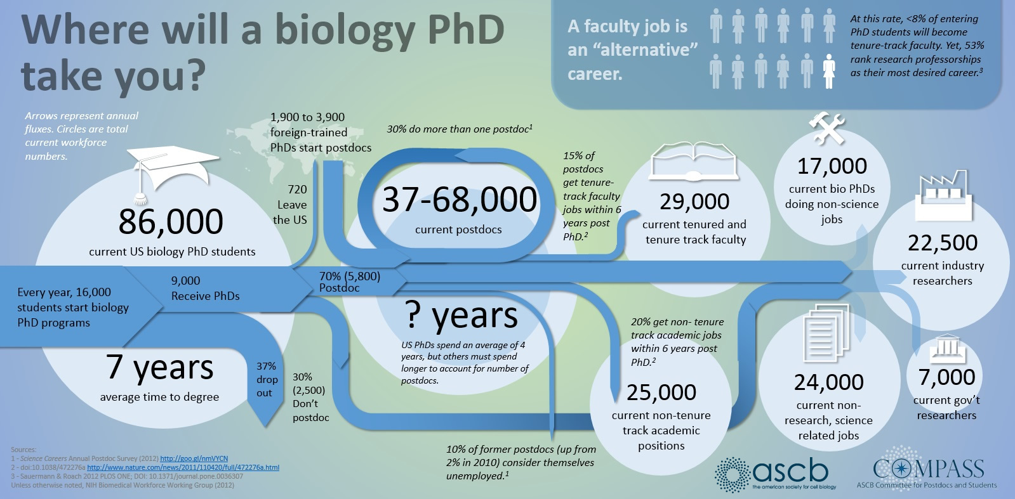
Background: PhDs in the Workforce
http://www.ascb.org/ascbpost/index.php/compass-points/item/285-where-will-a-biology-phd-take-you
Notes:
PhDs end up in a variety of careers
I have found the most current statistics from the NIH’s Biomedical Workforce Group Report (http://acd.od.nih.gov/biomedical_research_wgreport.pdf) that came out June 2012. There is more information in the report under “Career Outcomes”, but the following are highlights of that report in hopes to answer your questions.
Although the vast majority of people holding biomedical PhDs are employed (i.e. unemployment is very low), the proportion of PhDs that move into tenured or tenure-track faculty positions has declined from ~34 percent in 1993 to ~26 percent today. In contrast the proportion of non-tenured faculty has stayed relatively constant during the same period, while increasing in absolute numbers. The percentages of biomedical Ph.D.s in industry and government have remained relatively constant. The categories that have seen growth are science-related occupations that do not involve the conduct of research and occupations that do not require graduate training in science.
They also have a graph that categorizes the Post-Training Workforce (128,000 Biomedical US-trained PhDs) in the following:
Science related non-research – 18% (includes individuals employed by industry, government, or other who do not conduct research. However, many of the careers represented are closely related to the conduct of biomedical research and require graduate training in biomedical science. Examples of such careers include program and review officers at NIH and managers in many biotechnology companies. The 18% in this box is comprised of 13% PhDs employed by industry, 2.5% by government, and 2.5% other.)
Government research – 6%
Academic research or teaching – 43% (23% tenured)
Industrial research – 18%
Non-science related – 13%
Unemployed – 2%
Overall, approximately 30% of biomedical PhDs work in the biotech and pharmaceutical industries in research and non-research positions and all individuals
employed by government comprise ~9%.
2012 Biomedical Workforce Working Group Report recommends “NIH should require individual development plans (IDPs) for all NIH-supported postdoctoral ... this requirement should be included in the review criteria of training grants.”

Slide 5
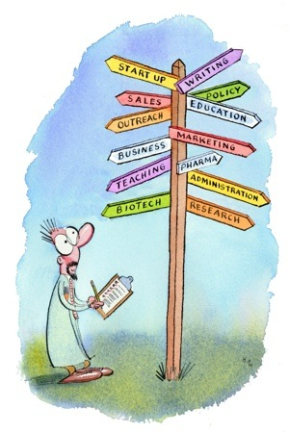

Individual Development Plan (IDP)
An IDP is a dynamic document that identifies and outlines career goals and is a tool to manage career development throughout graduate training.
It is created by the grad student in partnership with the faculty and additional mentors.
IDP includes:
Career goal(s) – Consider having a Plan A and B
Skills that need development to achieve career goal
~4-5 realistic goals per year to address those needed skills
Discussion comments of faculty and additional mentors about goals
Updates and revisions every year to reflect changes in career/research objectives
- http://myidp.sciencecareers.org/
Notes:
What is an individual development plan? Has anyone ever heard of it before this workshop?
(Ask participants to explain & if they have used one before)
IDPs have been traditionally used in the business world for employees, but more and more universities are starting to establish them as a required tool for postdocs and graduate students. UC San Diego has joined the ranks of those universities.
IDPs are specific to the each person, meaning he or she will design and implement the plan according to his or her career objectives.
(Go over what the plan entails as detailed on the slide)
These plans are meant to be discussed with your faculty mentor to assist the development of long-term and short-term goals. You are also encouraged to have additional mentors, especially if your faculty mentor does not possess the insight into your career goal as others may.
IDPs benefit both the postdoc and faculty mentor by providing a tool for communication.
Plus, this plan will help you keep your career goals in mind and motivate you as you progress towards the end of your training and transition into your career.

Slide 6
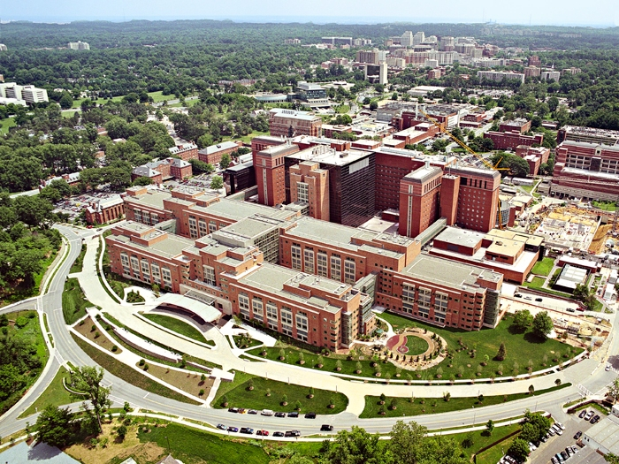
Benefits of an IDP
Survey of over 7600 postdocs conducted by Sigma Xi¹ found that having a structured postdoctoral program (such as an IDP) correlated with a successful postdoc experience (i.e. better job satisfaction, fewer conflicts, better “grades” for advisors and more productivity).
National Institutes of Health (NIH) strongly encourages all postdocs and grad students on NIH-sponsored awards to use an IDP & expects institutional reporting by October 2014³.
http://rockhealth.com/2012/04/ask-the-expert-nih-grants/
¹ Davis G. (2005). “Doctors Without Orders.” American Scientist, 93 (3), supplement 1-13
² Investing in the Future: NIGMS Strategic Plan for Biomedical and Behavioral Research Training 2011 (http://publications.nigms.nih.gov/trainingstrategicplan/)
³ NOT-OD-13-093 http://grants.nih.gov/grants/guide/notice-files/not-od-13-093.html
Notes:
I want to stress how important thinking about your future is for a successful postdoc experience. A 2003 study found that only 2 elements had a correlation with a successful experience –attending career and professional development opportunities and having a structured postdoc plan, such as an IDP.
In addition, NIGMS put out a report in 2011 stating that one of the action plans for all their sponsored awards is to strongly encourage the use of an IDP.
Lastly, a notice from NIH in July 2013 stated that IDPs are encouraged for postdocs. Plus, they are expecting universities to report on this usage. Although, IDPs are currently encouraged by the NIH, it is most likely a matter of time before they are required for training awards.

Slide 7
New NIH IDP Policy
NIH requesting IDPs for all NIH-funded grad students and postdocs effective October 1, 2014
IDP completion should be reported as part of the RPPR (annual progress report)
IDP itself will not be submitted to NIH
IDP will be updated each year.
See NOT-OD-13-093 and Rock Talk from July 23, 2013
Notes:
I want to stress how important thinking about your future is for a successful postdoc experience. A 2003 study found that only 2 elements had a correlation with a successful experience –attending career and professional development opportunities and having a structured postdoc plan, such as an IDP.
In addition, NIGMS put out a report in 2011 stating that one of the action plans for all their sponsored awards is to strongly encourage the use of an IDP.
Lastly, a notice from NIH in July 2013 stated that IDPs are encouraged for postdocs. Plus, they are expecting universities to report on this usage. Although, IDPs are currently encouraged by the NIH, it is most likely a matter of time before they are required for training awards.

Slide 8
Skills Assessment
What are skills?
The ability to do something well; expertise
The ability to do something that comes from training, experience, or practice
Skills Analysis of a Research Assistant
Notes:
A skill is…
(Go over list)
Research Assistant skill exercise
Write out what the audience suggests are duties of a research assistant, such as “update protocols”. Next write out what skills are needed to perform these duties, such as written and verbal communication skills. Try to get 6-7 duties to get the audience into the exercise then choose 2 or 3 duties to break into skills. Skills can range from communication skills to technical skills, problem solving, analytical. Have them look at their sheets for ideas as well to create a tie in with the exercise they did before coming in.

Slide 9
Skills Assessment: Worksheet
Was it easy for you to break down your skills with this assessment?
How did you think about your skills?
What experiences did you use when thinking about your skills?
Notes:
Find a partner, the person sitting next to you is fine. Ideally at least one of you (hopefully both!) will have filled out the skills assessment ahead of time. Each of you takes 5 minutes to discuss the following questions:
Was it easy for you to break down your skills with this assessment?
How did you think about your skills?
What experiences did you use when thinking about your skills?
(Pose each question to the group to discuss each in pairs; 5 mins./question)
If you did not complete the worksheet, look at one specific section such as communication or problem solving. Quickly fill out that section and then use that for the basis of your conversation. We will ask a few groups to share their observations at the end of the 10 minutes.
(Back to group)
What did you notice in your discussion? Did something jump out, any observations you or your partner made either now or while taking the assessment originally?

Slide 10
Career Exploration: Personality
Please Understand Me by Keirsey & Bates and What Color Is Your Parachute? by Bolles
So What are you Going to Do with That? By Basalla & Debelius
Career Services Center offers MBTI for free
Keirsey Temperament Sorter - http://www.keirsey.com/sorter/register.aspx
StrengthsFinder – identify natural talents to build into strengths
Top 5 strengths (out of 34) for only $9.99 https://www.gallupstrengthscenter.com/Purchase/
Notes:
Something to consider for your profession is how your personality will fit into a career type. There are many ways to understand your personality type with various personality assessments. For example, there are books that you can check out from the Office of Postdoctoral and Visiting Scholar Affairs, such as the Please Understand Me book about Keirsey Temperament Sorter and the classic, What color is your parachute? Both are available to check out from the Postdoc Office’s Resource Library. Please see Ginger about that.
You can also try the Keirsey Temperament Sorter online, which is free.
Lastly, you can pay a minimum fee online to use Clifton’s StrengthsFinder that identifies natural talents that with a time investment can become a strength. The full 34 strengths version is $89.

Slide 11


Career Exploration: Options
Consider your options
Informational interviews – best way to assess a career path and expand your network
Science Careers – excellent articles & resources http://sciencecareers.sciencemag.org/
MyIDP - A free, online program developed by Science Careers with a predicted rank of 20 scientific career paths which best fit your skills and interests
http://www.MyIDP.sciencecareers.org
Notes:
Consider how to explore various careers. If you are interested or just heard about a new one that strikes your fancy, go on an informational interview. Does anyone not know what this is?
(Wait for audience to respond and if positive, ask s/he to describe this)
This is a short meeting with someone who has a particularly interesting job and you ask a series of questions about that job. There are many question suggestions online as to what to ask, such as “what is a typical day like? What is the career trajectory for this job and what is the potential for career advancement” etc. I suggest seeking those templates out and defining your own list.
[Personal Anecdote]
When I was considering a new job, I tried to go on as many of these as possible. Usually I contacted the person who was a friend of a friend or acquaintance and I either took he/she out for coffee or called if time and/or location were restricted. This is a great non-pressure situation because you are not asking for a job and it’s inherently flattering to be asked for your opinion. However, do be respectful of this person’s time. Keep the interview brief (~30 mins).
If you are a postdoc in a scientific field, another way to consider different careers is by perusing Science Careers website. It has a lot of great articles and perspectives on varying career tracks.
In fact, Science Careers has designed a version of an IDP called myIDP. Has anyone used this before? It was sent out as a suggestion in the email with the Skills Assessment worksheet, so I hope that some of you have tried it. One of the features that I really like is the assessment tool. This allows you rate your interests, skills and values for the career prediction. You can use this summary as a guide to help you assess your skills.

Slide 12
Career Exploration: myIDP
Career Path | Skills Match | Interests Match
Science education for non-scientists: Education or public outreach specialist such as at a science museum or scientific society | 79% | 79%
Sales and marketing of science-related products: Medical science liaison; technical sales representative; marketing specialist | 84% | 72%
Science education for K-12 schools: Classroom teacher; curriculum developer; science specialist | 77% | 74%
Science policy: Public affairs/government affairs staff at scientific societies, foundations, government entities, or think tanks | 79% | 69%
Support of science-related products: Technical support specialist; field application specialist; product development scientist or engineer | 87% | 62%
Teaching-intensive careers in academia: A primarily teaching faculty position in a research university, liberal arts college, community college | 78% | 69%
Research administration: Research administrator in private or public research institutions, government or academia, including compliance officers, grants and contracts officers; dean or director of research programs | 78% | 66%
Intellectual property: Patent agent; patent attorney; technology transfer specialist | 79% | 63%
Public health related careers: Public health program analyst or evaluator; epidemiologist; biostatistician; medical informaticist | 81% | 59%
Drug/device approval and production: Regulatory affairs professional; quality control specialist | 77% | 63%
Notes:
For those of you that did take the opportunity to try myIDP online assessment tool, you may see something like this. One thing to note about the career prediction is that it is not prescriptive! Consider this a jumping off point to see if these careers are something you are interested in pursuing. Some may not interest you at all. You need to make the final decision about your career aspirations.

Slide 13
Career Objectives
Professional/Career Objective
(e.g. position within Academia, Industry, Government, Other)
1st Choice | Researcher at a university
2nd Choice | Teach at a community college
Notes:
Let’s begin creating your IDP! This part of the presentation follows the IDP form that I emailed and have printed out copies if needed. This is the standard IDP form that UC San Diego created for postdocs and graduate students. There are many forms available. We suggest using this one, but find that suits your needs if this form does not.
First on the form is writing down your career objectives. Just a note: don’t worry about changing your mind with the IDP. You frequently will! This goes for all of your IDP. It is a living document.
OK, many of you probably have a career objective in mind. Show of hands how many do have a career objective. It is OK if your career objective is to learn more about a certain career. Go ahead and write that in your first choice. However, it is never a bad idea to have a back-up plan if you first choice does not work out. How many by show of hands have a back up plan? Again, a good strategy is to have a Plan B. Feel free to make up to a Plan Z or Worst Case Scenario.

Slide 14
Mentors
Mentor(s) Please list your primary faculty advisor and other mentors (strongly encouraged) to enhance the training experience by supporting your development in various skill sets.
Mentorship (6 C’s)¹
Collaborative
Collegial
Cooperative
Confidential
Confidence-building
Comforting
Mentor 1 | Dr. Gettajob (Research Mentor)
Department & Institution | Dept. of Bright Futures; UC San Diego
¹ The Postdoctoral Experience in the SBE Sciences Report. October 29, 2010. (http://www.nationalpostdoc.org/index.php/publications-5/mentoring-plans)
Notes:
The next part of the IDP is to choose your mentors. Mentorship is not only critical for the IDP, but also for a successful postdoc experience. One of your mentors will be your faculty mentor, the person who is overseeing your research training. A positive mentorship should have the 6 Cs.
In addition, we recommend you have more than one mentor. This person or persons can be highly valuable, especially if your career objective is one where you faculty mentor might not have much insight. So how do you go about finding mentors?

Slide 15
How to Choose Mentors
Mentorship
Dos
Identify someone who has the job you want and a connection (i.e. college ties, professional association, child’s softball coach’s sister, etc.)
Contact him/her about a specific problem or advice – start of a relationship
Make interactions enjoyable – go out for coffee/lunch; be nice, enthusiastic, grateful and respect the mentor’s time
Be a mentor yourself
Don’ts
Ask “will you be my mentor”
Expect him/her to work around your schedule
Take him/her for granted
Notes:
There are some mentor do’s and don’ts.
*Make sure you know what you want in a mentor (similar process when choosing a postdoctoral lab). You may already know this person, such as your PhD advisor. If you do not have any prospects or just met someone who you think would make an excellent mentor, you have some time to cultivate the relationship before you ask he/she for input on your IDP.
*Show mentors how to help you, even if interested in helping, they may not know where to start. Come to them with a particular problem, like I would like help assessing my long-term goals on this IDP. Or even phrase it as asking for career advice.
*This is a relationship that requires attention and nurturing. Keep in mind how to make the relationship equally beneficial.
* Lastly, a great way to be an excellent mentee is to be a mentor yourself. You will understand the dynamics that your mentor is facing and the differences that each mentor/mentee relationship has. You may already be a mentor and not realize it. For example, do you help a graduate student or undergrad in conducting research? You are most likely mentoring that person as well.
*However, there are some don’t associated with mentoring.
*If you are looking for a mentor, don’t call someone out of the blue and he/she to be your mentor. If formally cold call a person and ask “will you be mentor”, this puts people off because it seems like an enormous amount of time with little payoff for them. The beginning of this relationship needs a little finesse. Most mentors are not a formal arrangement (like your faculty mentor). It can simply be a person that you seek counsel from regularly or for major life decisions.
Personal Anecdote:
For example, when I was an undergrad I had a wonderful instructor that I ended up working for as a laboratory technician between undergrad and grad school. I consulted with him about where to go to grad school and even in grad school about how to pick my advisor. I even asked for his advice for transitioning from a postdoc to this position. He is a mentor to me. So, if you have a similar relationship, you may also have a mentor other than your faculty mentor.
*Again be respectful of everyone’s time. You are busy and so are your mentors. Plan ahead for these interactions. However, if your mentor keeps pushing your meeting times aside, you may want to consider replacing that mentor (or at least have an additional one).
*This is a relationship that will take time and energy to flourish. Investing the time in getting to know mentors and potential mentors is necessary. For a prosperous mentor/mentee relationship, both of you will need to answer the question: Is this a person with whom I can establish a trusting relationship? And each needs to consider the ways in which the relationship might benefit both of them.
*Lastly, the most important factor is that both mentor and mentee recognize and accept that an effective relationship is a “two-way street,” that both parties share responsibility for its success, and that clear, consistent, and open communication is essential.

Slide 16
A Secret IDP?
What if I’m not ready to tell my dissertation advisor that I’m considering an alt-ac career?
Notes:
There are some mentor do’s and don’ts.
*Make sure you know what you want in a mentor (similar process when choosing a postdoctoral lab). You may already know this person, such as your PhD advisor. If you do not have any prospects or just met someone who you think would make an excellent mentor, you have some time to cultivate the relationship before you ask he/she for input on your IDP.
*Show mentors how to help you, even if interested in helping, they may not know where to start. Come to them with a particular problem, like I would like help assessing my long-term goals on this IDP. Or even phrase it as asking for career advice.
*This is a relationship that requires attention and nurturing. Keep in mind how to make the relationship equally beneficial.
* Lastly, a great way to be an excellent mentee is to be a mentor yourself. You will understand the dynamics that your mentor is facing and the differences that each mentor/mentee relationship has. You may already be a mentor and not realize it. For example, do you help a graduate student or undergrad in conducting research? You are most likely mentoring that person as well.
*However, there are some don’t associated with mentoring.
*If you are looking for a mentor, don’t call someone out of the blue and he/she to be your mentor. If formally cold call a person and ask “will you be mentor”, this puts people off because it seems like an enormous amount of time with little payoff for them. The beginning of this relationship needs a little finesse. Most mentors are not a formal arrangement (like your faculty mentor). It can simply be a person that you seek counsel from regularly or for major life decisions.
Personal Anecdote:
For example, when I was an undergrad I had a wonderful instructor that I ended up working for as a laboratory technician between undergrad and grad school. I consulted with him about where to go to grad school and even in grad school about how to pick my advisor. I even asked for his advice for transitioning from a postdoc to this position. He is a mentor to me. So, if you have a similar relationship, you may also have a mentor other than your faculty mentor.
*Again be respectful of everyone’s time. You are busy and so are your mentors. Plan ahead for these interactions. However, if your mentor keeps pushing your meeting times aside, you may want to consider replacing that mentor (or at least have an additional one).
*This is a relationship that will take time and energy to flourish. Investing the time in getting to know mentors and potential mentors is necessary. For a prosperous mentor/mentee relationship, both of you will need to answer the question: Is this a person with whom I can establish a trusting relationship? And each needs to consider the ways in which the relationship might benefit both of them.
*Lastly, the most important factor is that both mentor and mentee recognize and accept that an effective relationship is a “two-way street,” that both parties share responsibility for its success, and that clear, consistent, and open communication is essential.

Slide 17
Skills Assessment: Grad Student
Training Skills Assessment
Please list the postdoc/graduate student’s skill strengths and ones that require improvement in the postdoc/graduate student defined areas of training to help the individual reach the desired career objective.
Suggested Areas of Training
Research Activities
Research Productivity (i.e. publications, presentations, patents, etc.)
Professional Development (e.g. professional associations, conferences/meetings, workshops, improvement of teaching methods, etc.)
Other (customized by grad student)
 | Areas of Strength (Area of Training) | Areas to Develop (Area of Training)
Grad Student | Objective Writing (Research Productivity) | Persuasive writing (Research Productivity)
Notes:
The next part of the IDP is to assess the skills that you have for your career objective and also those skills you want to develop. For example, you may be an excellent scientific writer, but you would like to increase your persuasive writing skills to convince funding agencies that your project is the one to fund!
The IDP form suggests characterizing your skills into areas of training.
(Go over each)
However, other than your technical skills, you may not have thought much about this before. This is why we spent time on skill assessment earlier, so you should have ample resources for this section.

Slide 18

Skills Assessment: Mentors
This portion is to be completed by the graduate student and mentors. Alternatively, the graduate student via correspondence with mentors can summarize the skills section.
Set up introductory meeting to share IDP with mentor
Discuss career objective and not just research strategy
Explain your career goals, what an IDP is, and your skill assessment
 | Strong Skills (In Each Area of Training) | Skills to Develop (In Each Area of Training)
Mentor1 Input
Other benefits of an IDP with faculty mentor
Clear expectations between student and mentor about research and career goals
Timely and constructive feedback by the mentor to ensure the student’s realization of goals
Empowerment of the student to manage career trajectory, explore career options and provide a path to independence
Notes:
Once you understand the skills that you have and also the skills that you lack for your career objective, set up meetings with your mentors to discuss your skills in regards to that career objective. Your mentors may have a better awareness about how your skills align with your career objectives.
PB: In particular the IDP is a very helpful tool for communication with your faculty mentor. This allows you to: (go through the list and press button for each).

Slide 19
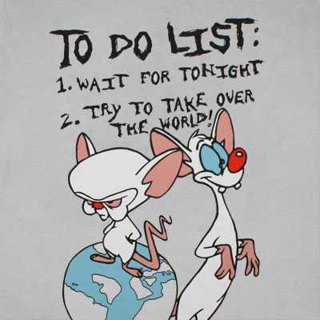
Goal Setting
Annual Plan
The postdoc/graduate student will work with mentors to create goals and specific action steps to address and gain the skills necessary for the anticipated career.
Create SMART goals
Specific: Is it focused and unambiguous?
Measurable: Could someone identify whether or not you achieved this goal?
Action-oriented: what action is required on your part?
Realistic: Considering difficulty and timeframe, is this goal attainable?
Time-bound: By when should you complete this goal?
Turn to your neighbor and discuss a goal and if it SMART or not
Goal 1 (Area of Training) | Action Step | Frequency (i.e. weekly) | Target Completion Date
http://www.tumblr.com/tagged/take%20over%20the%20world/
Notes:
The next part of the IDP is to set some goals. This is the ever evolving part of your IDP and also the most important to follow through on. Now that you know what skills you need to hone, you need to set goals to achieve those skills.
*However, to give a little structure to this goal setting, try to create a SMART goal. What is a SMART goal?
*It is a specific, measurable, action-oriented, realistic and time-bound goal.
So what are some example goals? Practice presentation skills, schedule informational interview with science policy expert, learn new laboratory technique, etc.
Take a minute to think about a SMART goal.
(Allow 1 min.)
*Now turn to your neighbor and both of you either discuss a goal you wrote down or a new one to determine if it is a SMART goal or not.
(Allow ~5 mins.)

Slide 20
Goal Example
Annual Plan
Action steps to take
Present research at conference and meet at least 3 people in my field
Sign up for listservs (professional association, OPVSA etc.) for discipline-related networking events in area
Go on at least 2 informational interviews
Goal 1 (Area of Training) | Action Step | Frequency (i.e. weekly) | Target Completion Date
Build Professional Network (Professional Development)
Notes:
Let’s discuss an example goal. I have decided that I want to build my professional network. How do I do that? Any suggestions?
(Allow audience to make suggestions)
*Here is what I decided on for some action steps. I have plans to attend a conference and give a poster presentation. What better place to meet people in my field and get my research out there. This is a wonderful opportunity to network with potential future colleagues.
Also, I want to start attending some networking events in my area. I will sign up for different listservs to see what events are happening.
Lastly, I want to go on at least two informational interviews to meet people who hold the job that I want.

Slide 21
Goal Example
Annual Plan
Frequency
Upcoming conference in August
One available every month, make it to one every other month
N/A
Goal 1 (Area of Training) | Action Step | Frequency (i.e. weekly) | Target Completion Date
Build Professional Network (Professional Development) | Present research at conference and meet at least 3 people in my field Sign up for listservs (professional association, OPVSA etc.) for discipline-related networking events in area Go on at least 2 informational interviews
Notes:
Now I have to decide on the timing of these goals as these are for the entire year.
*What is the frequency of these action steps? The conference is in February, so that one is easy.
From my listserv announcements, it seems that one networking event happens every month. However, with all my obligations, I really only have time to go to one every other month.
Finally, I’m not sure yet who my informational interviewees will be so, I can not schedule this in advance. Hopefully I will meet a few candidates during my networking events. However, as soon as I’ve found them, I will ask for an interview at their earliest convenience.

Slide 22
Goal Example
Annual Plan
Target completion date
September 2014
June 2015
June 2015
Goal 1 (Area of Training) | Action Step | Frequency (i.e. weekly) | Target Completion Date
Build Professional Network (Professional Development) | Present research at conference and meet at least 3 people in my field Sign up for listservs (professional association, OPVSA etc.) for discipline-related networking events in area Go on at least 2 informational interviews | Upcoming conference in August One available every month, make it to one every other month N/A
Notes:
*Lastly, I want to keep on task, so I’ve set some target completion dates for these action steps. I will be finished with the conference in February, but I want to follow up with the people I met, so I’ll give myself a month leniency.
Both the other two action steps are ongoing, but I want to make sure I complete everything before the end of this year’s IDP, which will be January of next year.

Slide 23
Goal Example: Micro Goals
Annual Plan
Set Micro Goals
Identify 3-4 people you might like to interview
Compose email/reach out by phone to set time/date
Select questions for interview
Follow up with thank you notes
Solidify connection (follow-up emails/invitation to connect on LinkedIn)
Goal 1 (Area of Training) | Action Step | Frequency (i.e. weekly) | Target Completion Date
Build Professional Network (Professional Development) | Present research at conference and meet at least 3 people in my field Sign up for listservs (professional association, OPVSA etc.) for discipline-related networking events in area Go on at least 2 informational interviews | Upcoming conference in August One available every month, make it to one every other month N/A | September 2014 June 2015 June 2015
Notes:
However, even these larger action steps can be further broken down into micro goals.
*Let’s take the last action step: Go on at least 2 informational interviews.
*Micro goals for this action step can be...
(Go through list)

Slide 24
Long-term Goals
5 Year Plan Overview
Need to design a plan for the entirety of your training at UC San Diego (long-term goals).
The duration of training may not be 5 years (depending on how long you have left in your program), so create a plan appropriate to your anticipated length of training.
Some goals may have to be met before you can advance to the next, more important goal for your career path. Use this portion to plan for those milestones.
Notes:
In addition to your annual plan, you need to consider your long-term goals for your entire postdoctoral training.
In the form, this is termed as your 5 year plan. Of course, this will vary for how long your postdoctoral training at UC San Diego. 5 years is the longest that you can be considered a postdoc in the UC system, but that may be too long for your own postdoctoral training. Please plan accordingly.
One thing to keep in mind about your training is that certain goals may have to be met before you can advance to the next stage of your training. For example, if your career goal is to be an academic professor, you may want to apply for a K99 award from the NIH and have to do this in your 3 year of your postdoc.

Slide 25
Mentor Input
After defining your goals for the year, share with mentor(s)
Set up a meeting with individual mentors to
discuss goals, which may be separate from
a research strategy meeting.
If mentor(s) unavailable, can discuss via email.
Add/revise/update goals according to mentor input
Implement plan!
Notes:
Now that you have some goals in mind, you need to share them with your mentors. Ideally, this will be a face-to-face meeting with each mentor to discuss these short-term and long-term goals. Of course, everyone is busy and it can be difficult to make time for a face-to-face meeting. Therefore, you can have a discussion via email if necessary. Just make sure to capture the mentor’s input so you may keep a record of it on your IDP.
*After this meeting you will take into account the comments of your mentors and add, revise and/or update your goals.
*Final step – start working on achieving those goals!!

Slide 26
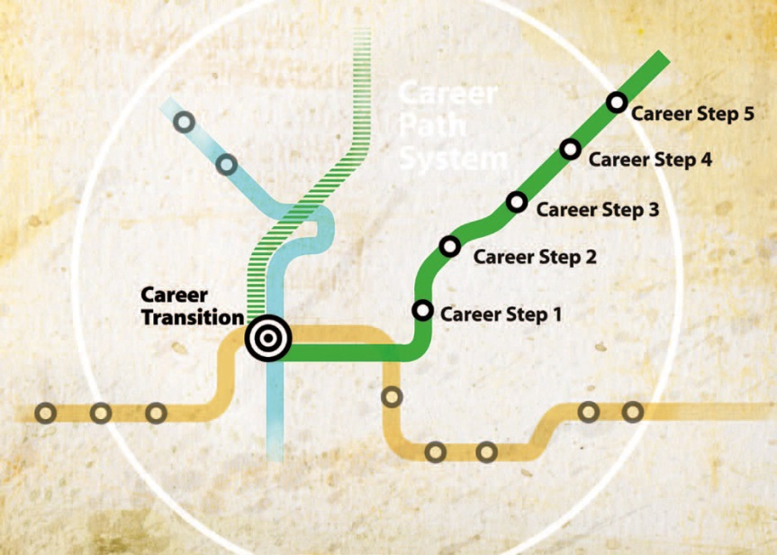
Professional Development Seminars & Workshops Available to Grad Students
Wednesday Workshops from OGS
Center for Teaching Development (CTD)
Career Services Center (Toni Mahoney)
-http://www.nasa.gov/offices/oce/appel/ask/issues/48/48i_goddard_career-path_tool.html
Notes:
If your goals consist of increasing your career and professional development, consider attending the workshops and seminars that our office puts on throughout the year. This is just a sampling of some events we have.
Check out our website postdoc.ucsd.edu for a calendar of events. You can sign up for the postdoc listserv at the same website that sends out a Weekly Post about upcoming events and announcements for postdocs.

Slide 27
IDP Progress
This plan will be updated and revised each year, when the postdoc/grad student will assess each goal if it was met, still in progress or needs revision.
Date: ___Met Goal ___ In Progress ___ Needs Revision
Continue to strive toward your set goals
Revise/update IDP as necessary
Goal 1 (Area of Training) | Action Step | Frequency (i.e. weekly) | Target Completion Date
Notes:
Now looking forward, you have your IDP in place for the year. What else do you need to do?
You will continue to work towards your goals. Once you have completed one, check it off with a date. You may need to change these goals throughout the year. If so, don’t forget to consult your mentors.

Slide 28
Annual IDP Progress
Subsequent years
Revise/update and add new goals to your annual and 5 year plans
Share with mentors
Notes:
For the remainder of the time that you are a postdoc, you will continue to work on your IDP every year. So next year, you will set and hopefully complete a new set of goals and share with your mentors. You will turn that into our office and along with the mentors signature page or confirmation email at the end of that year.
Lastly, feel free to have an IDP buddy. This will help you set goals and keep on track.

Slide 29
IDP Buddy?
Notes:
For the remainder of the time that you are a postdoc, you will continue to work on your IDP every year. So next year, you will set and hopefully complete a new set of goals and share with your mentors. You will turn that into our office and along with the mentors signature page or confirmation email at the end of that year.
Lastly, feel free to have an IDP buddy. This will help you set goals and keep on track.

Slide 30
Questions About Creating an IDP?
Notes:
For the remainder of the time that you are a postdoc, you will continue to work on your IDP every year. So next year, you will set and hopefully complete a new set of goals and share with your mentors. You will turn that into our office and along with the mentors signature page or confirmation email at the end of that year.
Lastly, feel free to have an IDP buddy. This will help you set goals and keep on track.

Slide 31
IDP Poster Session
Write out your name, department and research project title
Write out your career objective
Examples
Tenure track professor at research intensive university
Explore more about becoming a fighter pilot
Write out 5 goals to accomplish your career objective
Each person will present his or her career objective and the goals on how they will work toward achieving that career objective (~8 mins.) in a group with a moderator
The moderator and group will help determine if the presenter has goals that are realistic and achievable
Notes:
Now we will move on to the poster session. You will take one of the large Post-it notes to use as a poster. There are markers and regular sized Post-it Notes for you to use on your poster, along with scissors and tape.
On the poster you will write, your name, department and research project title to give the group a little background on you. Then you will write out your career objective. If you are uncertain about a particular career path, you can write that you are going to explore more about that profession. Remember this is not set in stone, but you need to start somewhere. Then you will write out 5 goals to accomplish for the year. Remember to make them SMART goals. You will have 30 mins. to complete this.
Next we will break into groups where you will present your poster to the group and moderator. The group will discuss your goals to ensure they are achievable and realistic in terms of your career objective. You will have up to 8 mins. to present. Please be willing to participate in the discussion when you are not presenting.

Slide 32
IDP Poster Example
Name: Sarah Student
Department of Bioengineering
Project title: Improving Reusable Ceramic-Metal Modular Junctions for Total Hip Replacements
Career Objective: Explore more about careers in science writing
Goals
Create an outline for my first author manuscript and begin to design preliminary figures this weekend.
Examine science writing blogs and email scholarly journal editors for information to gain science writing experience every two weeks.
Submit a request to present at a small conference in the fall to discuss research and network with experts in my field.
Organize a journal club to improve my organizational and leadership skills to begin in the next few months.
Every 6 months, investigate funding options for project and create spreadsheet to keep up on deadlines for submission to plan applications accordingly.
Notes:
Here is an example of a poster. Begin creating your poster!

Slide 33
Questions and Feedback?
OGS – Zoe Ziliak Michel (zmichel@ucsd.edu)
Career Services – Toni Mahoney (ammahoney@ucsd.edu)
CTD – Peter Newbury (pnewbury@ucsd.edu)
Notes:
Here is an example of a poster. Begin creating your poster!

