Slide 1
Clustering Evaluation
Generated from results/evaluation_metrics.json

Slide 2
Table of Contents
1. Evaluation Overview
2. Metrics
3. Visuals
4. Conclusions

Slide 3
Metrics
silhouette: 0.2137299633550709
calinski_harabasz: 363.1813083084194
davies_bouldin: 1.8710996226749597
adjusted_rand: 0.0432763315647142
adjusted_mutual_info: 0.0353912593666423
purity: 0.46716697936210133
n_samples: 1599
n_clusters: 2

Slide 4
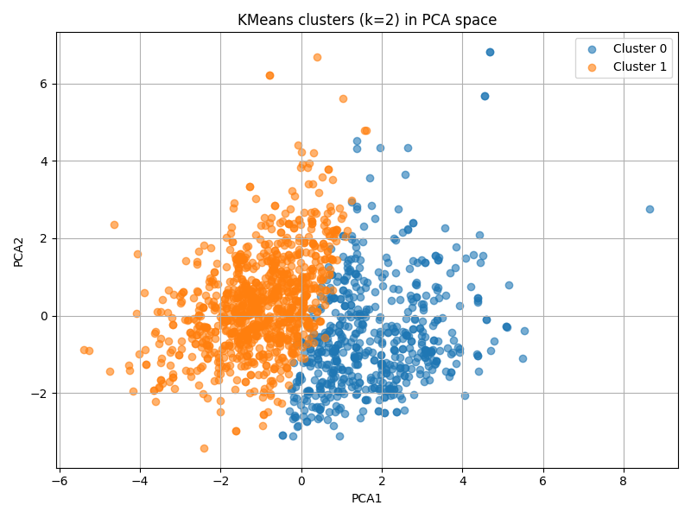

Slide 5
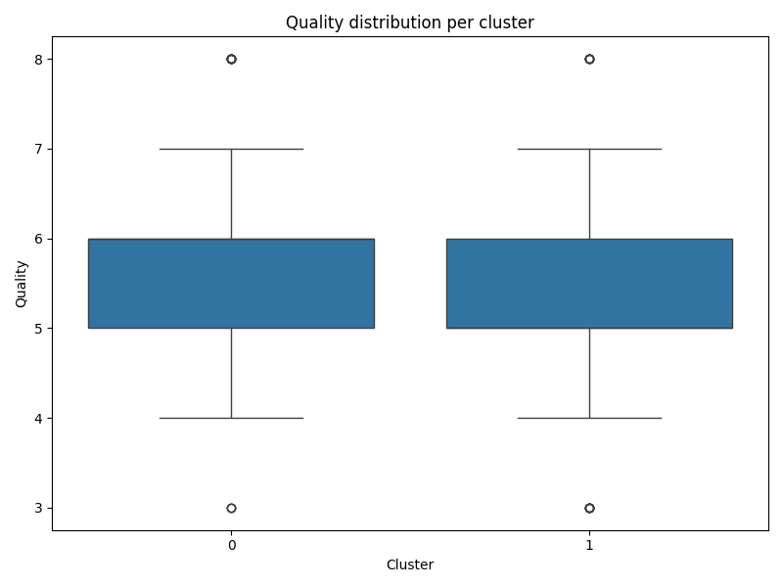

Slide 6
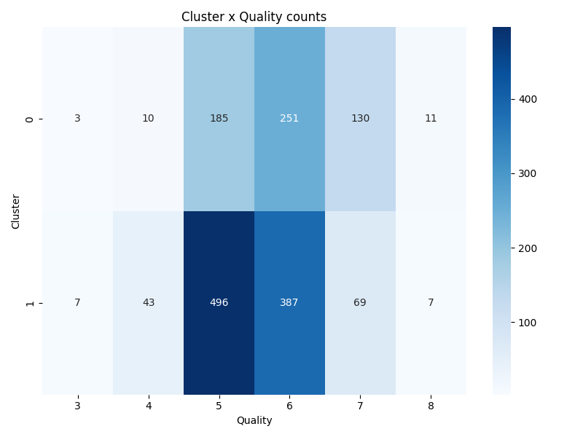

Slide 7
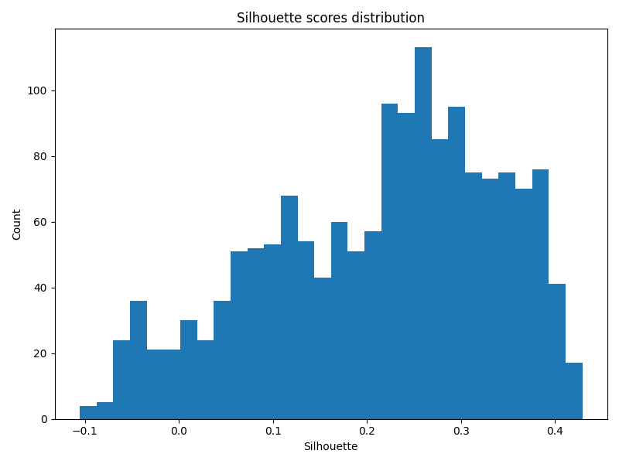

Slide 8
Conclusions
Key takeaways:
- Silhouette ~0.21 → moderate separation
- Low ARI / AMI / Purity → weak alignment with labels

