Slide 1
Software Engineering COMP 201
Lecturer: Sebastian Coope
Ashton Building, Room G.18
E-mail: coopes@liverpool.ac.uk
COMP 201 web-page:
http://www.csc.liv.ac.uk/~coopes/comp201
Lecture 2 – Software Processes

Slide 2
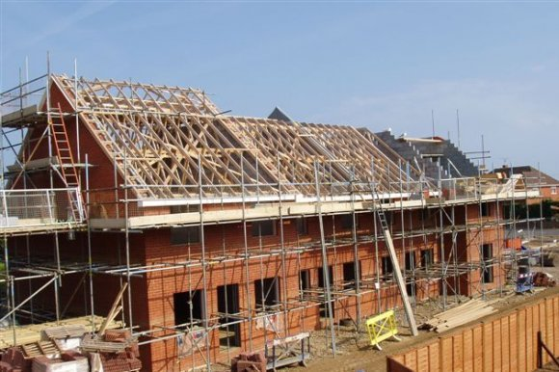
Processes (building a house)

Slide 3
Tasks
What to build?
Where to build?
How much money?
Get the money
Design the build (Detailed plans, timescales etc.)
Get permissions?
Start with foundations
Build up from foundations
Fully test everything
When basic structure complete, make sure it is looks right
Show to customer
Re-adjust to customers feedback

Slide 4
Questions?
Does the previous list apply to Software?

Slide 5
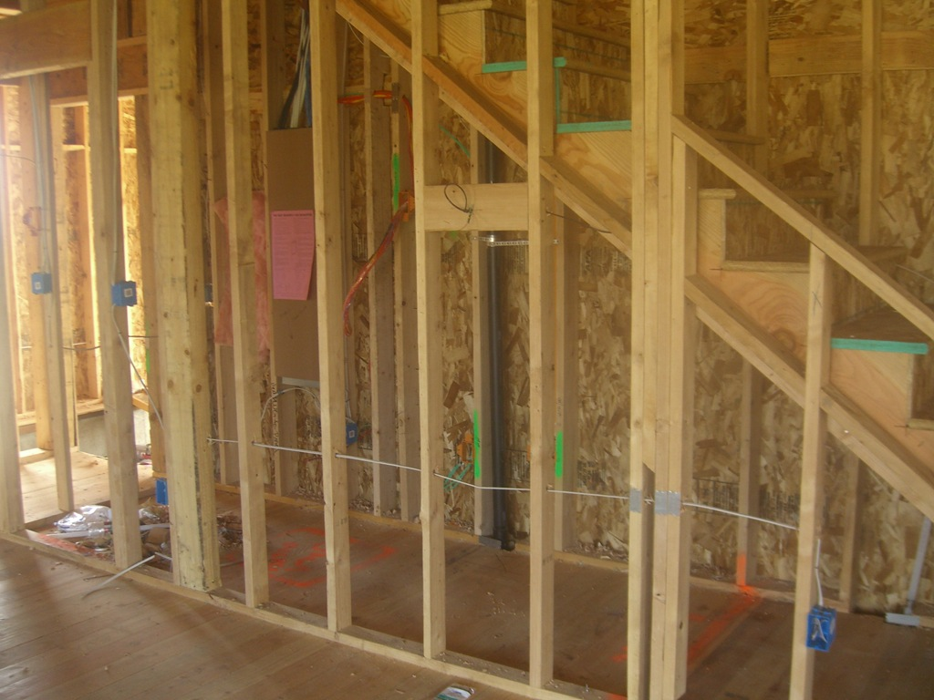
Task order (early fix is easy)

Slide 6
What is a Process … ?
When we provide a service or create a product we always follow a sequence of steps to accomplish a set of tasks
You do not usually
put up the drywall before the wiring for a house is installed or
bake a cake before all the ingredients are mixed together
We can think of a series of activities as a process
During this lecture we shall see some examples of software development processes that are used to ensure software is developed in a systematic way using tried and tested techniques

Slide 7
What is a Process … ?
Any process has the following characteristics
It prescribes all of the major activities
It uses resources and produces intermediate and final products
It may include sub-processes and has entry and exit criteria
The activities are organized in a sequence
Constraints or controls may apply to activities
(budget constraints, availability of resources , etc.)

Slide 8
Process Building development
Architect
Design
house
Get
Planning permission
Secure
funding
(re)Draw plans
(re)Specify build
Site survey
Plans/
specifications

Slide 9
Software Processes
When the process involves the building of some product we refer to the process as a life cycle
Software development process – software life cycle
Coherent sets of activities for
Specifying,
Designing,
Implementing and
Testing software systems

Slide 10
Processes and software
Software (unlike buildings/bridges etc.)
Can be changed at anytime
Is often required to change often after construction
Benefits
Software can be improved almost without limit
Leading to problems
Software often gets faults as it evolves
Software cost is hard to manage
Problems with user’s experience and expectations

Slide 11
The Software Process
The Software Process is a structured set of activities required to develop a software system consisting of
Specification
Design and implementation
Validation
Evolution
A software process model is an abstract representation of a process
It presents a description of a process from some particular perspective

Slide 12
Generic Software Process Models
The Waterfall Model (classic engineering, example bridge building)
Separate and distinct phases of specification and development
Evolutionary Development (more like product engineering)
Specification and development are interleaved
Formal Systems Development (example - ASML)
A mathematical system model is formally transformed to an implementation
Reuse-Based Development
The system is assembled from existing components

Slide 13
Waterfall Model
The drawback of the waterfall model is the difficulty of accommodating change after the process is underway

Slide 14
Waterfall Model Problems
Inflexible partitioning of the project into distinct stages
This makes it difficult to respond to changing customer requirements
Therefore, this model is only appropriate when the (final) requirements are well-understood (rare in software)
Waterfall model describes a process of stepwise refinement
Based on hardware engineering models
Widely used in military and aerospace industries

Slide 15
Reality check!
Practically no one in industry follows the waterfall method as shown exactly here to produce software
Why bother, then?
Each stage is an important step in software development
It’s easy to remember
The sequence is important
Spec. before Design
Design before coding etc.
Many industry practises could do with improvement!

Slide 16
Why Not a Waterfall
But software is different from hardware :
No fabrication step
Program code is another design level
Hence, no “commit” step – software can always be changed…!
No body of experience for design analysis (yet)
Most analysis (testing) is done on program code
Hence, problems are often not detected until late in the process
Waterfall model takes a static view of requirements
It ignores changing needs
Lack of user involvement once specification is written
Unrealistic separation of specification from the design
Doesn’t accommodate prototyping, reuse, etc.

Slide 17
Evolutionary Development
Rather than using the waterfall model we may use evolutionary development which is based upon the idea of developing an initial implementation , exposing it to the user and refining it based upon their response.
Exploratory development
Objective is to work with customers and to evolve a final system from an initial outline specification.
Should start with well-understood requirements.
The system evolves by adding new features as they are proposed by customer.

Slide 18
Evolutionary Development
Throw-away prototyping
Objective is to understand the system requirements. Should start with poorly understood requirements
Develop “quick and dirty” system quickly;
Expose to user comment;
Refine;
Until an adequate system is developed.
Particularly suitable where:
detailed requirements not possible;
powerful development tools (e.g. GUI) available

Slide 19
Evolutionary Development

Slide 20
Evolutionary Development
Problems
Lack of process visibility
Systems are sometimes poorly structured
Special skills (e.g. in languages prototyping) may be required
Applicability
All types of system but rare in safety critical

Slide 21
Reality check
In reality all modern development has a degree of evolutionary development BUT is hybrid (see SCRUM later)
Sometimes the specification is mostly completed at the start and then added to
The evolution cycles pre-determined
100 functions
In phase 1 develop functions 1-30
In phase 2 develop functions 31-80
In phase 3 develop functions 81-100

Slide 22
Formal Systems Development
Based on the transformation of a mathematical specification through different representations to an executable program
Transformations are ‘correctness-preserving’ so it is straightforward to show that the program conforms to its specification
Embodied in the ‘Cleanroom’ approach (which was originally developed by IBM) to software development

Slide 23
Formal Systems Development

Slide 24
Formal Transformations

Slide 25
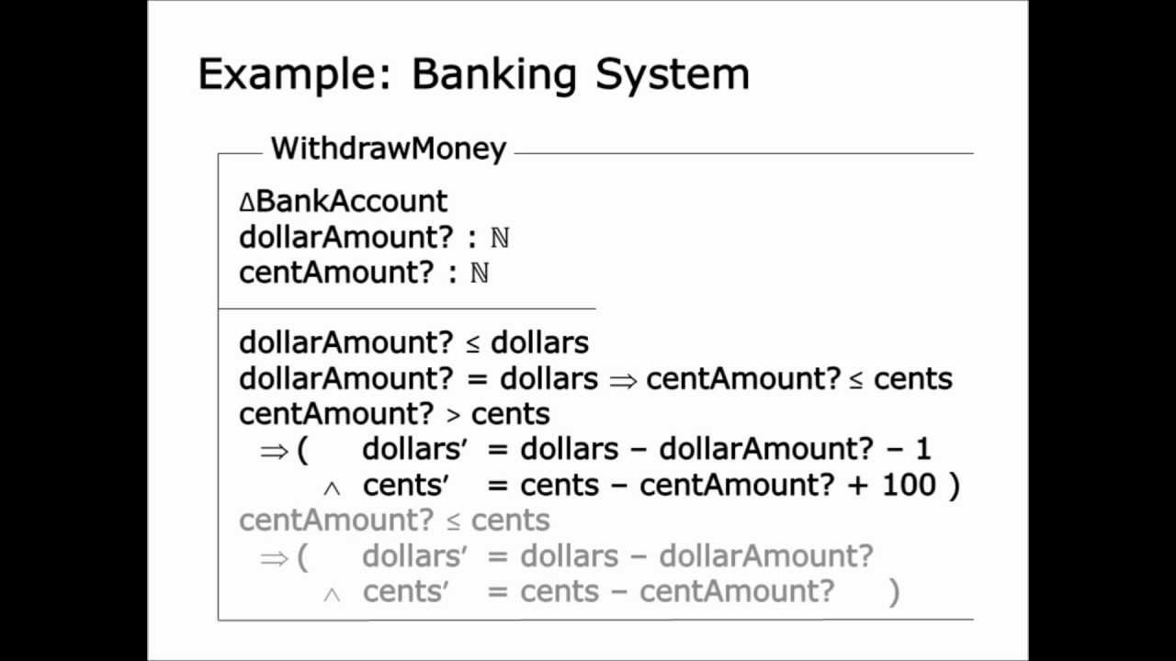
Example code (in Z)

Slide 26
Formal Systems Development
Problems
Need for specialised skills and training to apply the technique (Higher initial cost)
Difficult to formally specify some aspects of the system such as the user interface
Can be more time consuming than other approaches (increased time to market)
Many stake holders cannot understand the specification
Applicability
Critical systems especially those where a safety or security case must be made before the system is put into operation

Slide 27
Process Iteration
Modern development processes take iteration as fundamental, and try to provide ways of managing, rather than ignoring, the risk
System requirements ALWAYS evolve in the course of a project so process iteration where earlier stages are reworked is always part of the process for large systems
Iteration can be applied to any of the generic process models

Slide 28
Agile development
Lightweight approach to software development
Example include Scrum and XP
Focused on
Code development as code activity
Test driven development (tests developed before code)
Often use pair programming
Iterative development
Self organised teams

Slide 29
Incremental Development (example Scrum)
Rather than deliver the system as a single delivery, the development and delivery is broken down into increments with each increment delivering part of the required functionality
User requirements are prioritised and the highest priority requirements are included in early increments
Once the development of an increment is started, the requirements are frozen though requirements for later increments can continue to evolve

Slide 30
Incremental Development Advantages
Customer value can be delivered with each increment so system functionality is available earlier
Early increments act as a prototype to help elicit requirements for later increments
Lower risk of overall project failure
The highest priority system services tend to receive the most testing

Slide 31
In Reality
Most software processes involve
Prototyping
Iterative building
Why
It reduces risk of making the wrong product
It allows the software to undergo more testing
It produces working product as we go along, so less chance of inventory loss

Slide 32
Process is context dependent
Nuclear power station/air traffic control
Highly formalised processes
Detailed testing specifications
Web development for small website
Prototyping
Web development for large website
SCRUM development, storyboarding

Slide 33
Final question
The specification is by a long margin
The MOST critical phase of any software engineering project
Why?

Slide 34
Lecture Key Points
Software processes are the activities involved in producing and evolving a software system. They are represented in a software process model
General activities are specification, design and implementation, validation and evolution
Generic process models describe the organisation of software processes
Iterative process models describe the software process as a cycle of activities

