Slide 1
Software Engineering COMP 201
Lecturer: Sebastian Coope
Ashton Building, Room G.18
E-mail: coopes@liverpool.ac.uk
COMP 201 web-page:
http://www.csc.liv.ac.uk/~coopes/comp201
Lecture 7 – System Models

Slide 2
Lecture Overview
System models are abstract descriptions of systems whose requirements are being analysed
Objectives - To explain why the context of a system should be modelled as part of the RE process
To describe
Behavioural modelling (FSM, Petri-nets),
Data modelling and
Object modelling (Unified Modelling Language, UML)

Slide 3
System Models
User requirements must be written in such a way that non-technical experts can understand them, e.g., by using natural language
Detailed system requirements may be expressed in a more technical way however
One widely used technique is to document the system specification as a set of system models
These are graphical representations which describe business processes and the system to be developed
They are an important bridge between the analysis and design processes

Slide 4
System Modelling
System modelling helps the analyst to understand the functionality of the system and models are used to communicate with customers
Different models present the system from different perspectives:
External perspective showing the system’s context or environment
Behavioural perspective showing the behaviour of the system
Structural perspective showing the system or data architecture

Slide 5
“A Picture Paints a Thousand Words”

Slide 6
System Model Advantages
They can be easier to understand than using a verbose natural language description
System models can leave out unnecessary details of the system so way may focus on what is important
A system representation should maintain all the information of a system
An abstraction deliberately simplifies the system and picks out its most salient characteristics
Different models can focus on different approaches to abstraction

Slide 7
System Model Weaknesses
They do not model non-functional system requirements
They do not usually include information about whether a method is appropriate for a given problem
They may produce too much documentation
System models are sometimes too detailed and difficult for users to understand

Slide 8
Model Types
Data processing model - showing how the data is processed at different stages
Composition model - showing how entities are composed of other entities
Architectural model - showing principal sub-systems
Classification model - showing how entities have common characteristics
Stimulus/response model - showing the system’s reaction to events

Slide 9
Context Models
Context models are used to illustrate the boundaries of a system
Identifying the boundaries of the system to be developed is not always straightforward
Social and organisational concerns may affect the decision on where to position system boundaries
Architectural models show the system and its relationship with other systems

Slide 10
Example – Architectural Model of an ATM System

Slide 11
Process Models
Process models show the overall process and the processes that are supported by the system
In process models it is implicit 1 process is completed before another process begins
Process models are similar to flow charts
Data flow models may be used to show the processes and the flow of information from one process to another
The data flow models it is implicit that processes will happen in parallel (concurrent processing)

Slide 12
Example Process Model
Equipment Procurement Process
Within system boundary

Slide 13
Behavioural Models
Behavioural models are used to describe the overall behaviour of a system
Two types of behavioural model
Data processing models that show how data is processed as it moves through the system
State machine models that show the systems response to events
Both of these models are required for a description of the system’s behaviour

Slide 14
Data-Processing Models
Data flow diagrams are used to model the system’s data processing
These show the processing steps as data flows through a system
IMPORTANT part of many analysis methods
Simple and intuitive notation
Show end-to-end processing of data

Slide 15
Example - Order Processing Data Flow Diagram

Slide 16
Data Flow Diagrams
Data Flow Diagrams track and document how the data associated with a process is helpful to develop an overall understanding of the system
Data flow diagrams may also be used in showing the data exchange between a system and other systems in its environment

Slide 17
Data Flow Diagrams
Data Flow Diagrams have an advantage in that they are simple and intuitive and can thus be shown to users who can help in validating the analysis
Developing data flow diagrams is usually a top-down process
We begin by evaluating the overall process we wish to model before considering sub-processes
Data flow diagrams show a functional perspective where each transformation represents a single function or process which is particularly useful during requirements analysis since it shows end-to-end processing.

Slide 18
DFD Context diagram

Slide 19
Level 0 DFD
3SFE519 S Coope 2004

Slide 20
Level 1 DFD Operation control
3SFE519 S Coope 2004
slide 20

Slide 21
Statechart Diagrams
Statechart Diagrams (or State machine models ) show the behaviour of the system in response to external and internal events
They show the system’s responses to stimuli (the event-action paradigm) so are often used for modelling real-time systems
Statechart diagrams show system states as nodes and events as arcs between these nodes. When an event occurs, the system moves from one state to another
Statecharts are an integral part of the Unified Modeling Language (UML)

Slide 22
Statechart Diagrams
An initial state is denoted by a solid circle and is optional (sometimes the system will start in different places and thus the initial state should be omitted).
If required, a final state can also be used; this is denoted by a solid circle with a ring around it.
We use a level of abstraction so that we can observe the essential behaviour of the system we want to model.
Rounded rectangles are used for states. Each state contains two components, the state name and a brief description of the action performed in that state (see next slide).

Slide 23
Example - Microwave Oven Model
A state machine model does not show flow of data within the system
Q: Why is there no final state?

Slide 24
Microwave Oven Stimuli

Slide 25
Statecharts
Statecharts also allow the decomposition of a model into sub-models (see figure on next slide).
A brief description of the actions is included following the ‘do’ in each state (the word “do” is optional).
Can be complemented by tables describing the states and the stimuli.

Slide 26
Statechart Diagram

Slide 27
Statechart Diagrams
The label on an arc can denote the method called to move from one state to the next (the event).
A guard is used to ensure that the system only moves from one state to the other if the expression is satisfied.
A state can contain a subdiagram within it (also called a composite state). This is useful for example when we wish to model a subsystem or substates.
On the next slide, we can see all these elements of a UML statechart diagram

Slide 28
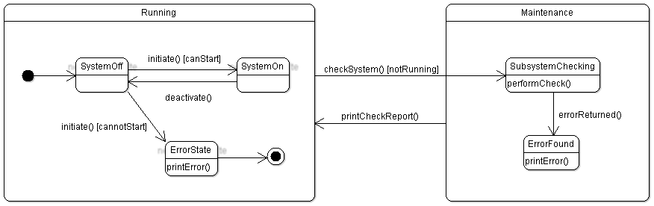
Statechart Diagrams
Guard
Initial state
Final state
Composite
States
Actions

Slide 29
Actions
You can put actions after the event using a /
Ink available/clear display
Out of ink
Idle
Ink low/show error message

Slide 30
More hints on state charts
Often have an Idle state where the process is not active
All states need some exit (no deadlock, even in error conditions)
Use multiple state charts to keep the design simple
Do NOT need to have a state chart as sub state of other state chart
System can be described by multiple state machines running concurrently

Slide 31
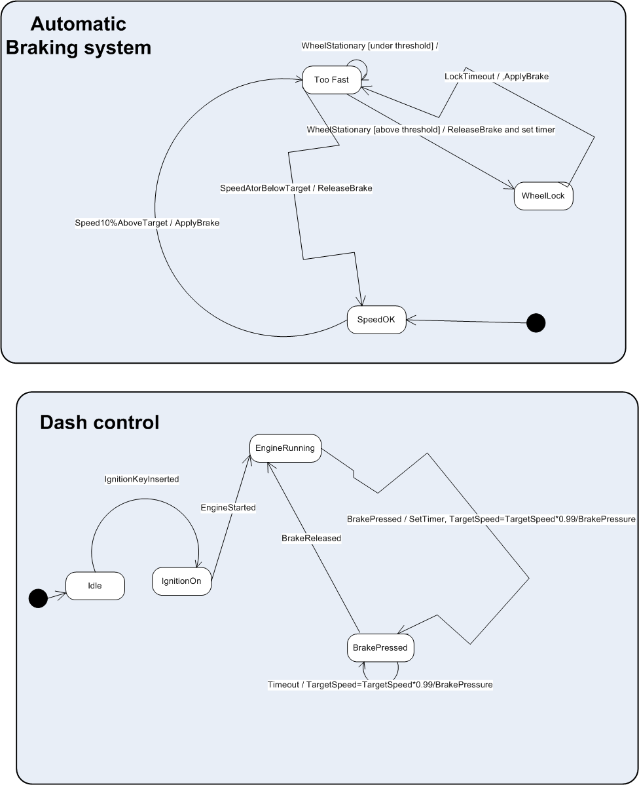

Slide 32
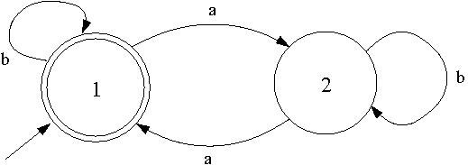
Finite State Machines
Finite State Machines (FSM), also known as Finite State Automata (FSA) are models of the behaviours of a system or a complex object, with a limited number of defined conditions or modes, where mode transitions change with circumstance.
Question: What language does this FSA recognise?

Slide 33
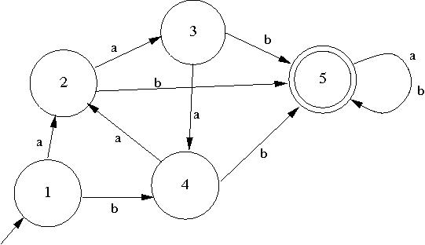
Finite State Machines - Definition
A model of computation consisting of
a set of states,
a start (initial) state,
an input alphabet, and
a transition function that maps input symbols
and current states to a next state
You may recall finite state
machines (or automata)
from COMP209.
What language is recognised by this FSA?

Slide 34
Finite State Machines - Definition
Computation begins in the start state with an input string. It changes to new states depending on the transition function.
states define behaviour and may produce actions
state transitions are movement from one state to another
rules or conditions must be met to allow a state transition
input events are either externally
or internally generated, which
may possibly trigger rules and
lead to state transitions.

Slide 35
Lecture Key Points
A model is an abstract system view. Complementary types of model provide different system information.
Context models show the position of a system in its environment with other systems and processes.
Data flow models may be used to model the data processing in a system.
State machine models model the system’s behaviour in response to internal or external events

