Slide 1
Software Engineering COMP 201
Lecturer: Sebastian Coope
Ashton Building, Room G.18
E-mail: coopes@liverpool.ac.uk
COMP 201 web-page:
http://www.csc.liv.ac.uk/~coopes/comp201
Lecture 20 – More on Class Models

Slide 2
Lecture Outline
Aggregation and composition
Roles
Navigability
Qualified association
Derived association
Constraints
Association classes
Interfaces and abstract classes

Slide 3
Aggregation and Composition
Aggregation and composition are kinds of association:
Instead of just showing that two classes are associated we may choose to show more about what kind of association this is
Aggregation and composition are both ways of recording that an object of one class is part of an object of another class.

Slide 4
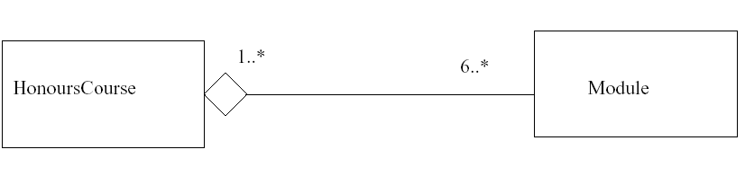
Module is a Part of an HonoursCourse
The notation with open diamond, denotes aggregation, which is more general way of denoting a part-whole relationship in UML

Slide 5
Aggregation
Aggregation is essentially a conceptual notion:
seeing an aggregation in a class model should help you to understand the relationships between the classes at an informal level
BUT it does not give you any more formal information about how they must be implemented or what you can do with them
Usually we do not name an aggregation association since it is usually “is a part of”.

Slide 6
Composition
Composition is a special kind of aggregation which imposes some further restrictions.
In composition association, the whole strongly owns its parts
If the whole object is copied or deleted, its parts are copied or deleted with it
The multiplicity at the whole end of a composition association must be 1 or 0..1
A part cannot be part of more than one whole by composition

Slide 7
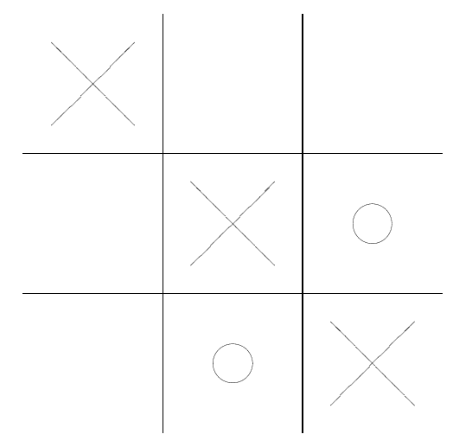
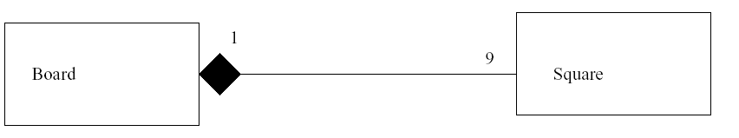
Example Noughts and Crosses (Tic-Tac-Toe)
Composition is denoted similarly to aggregation, except that the diamond is filled in

Slide 8
Examples
Consider the following scenarios and determine whether we should use composition or aggregation:
The relationship between an Employee and a Team?
The relationship between a Wheel and a Car?
The relationship between an Account and a Customer?

Slide 9
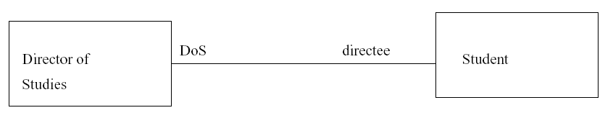
Roles
Often you can read an association name in both directions (‘is taking’, ’is taken by’)
Sometimes, however, it is more readable to have separate names for the roles that the objects play in the association.

Slide 10
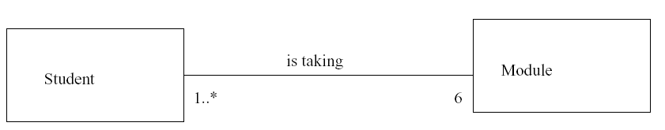
Association with no Navigability
The diagram records that:
For each object of class Student there are six objects of class Module which are associated with the Student;
For each object of class Module there are some Student objects (the number of students is unspecified) associated with the Module.

Slide 11
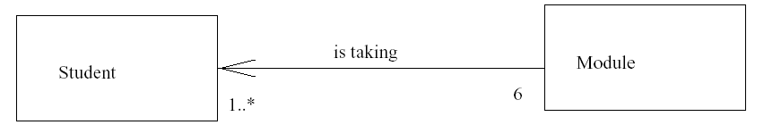
Navigability
We can put an arrow on one or both ends of the association line to represent that it is possible for messages to be sent in the direction of the arrow
We say that Module knows about Student, but not vice versa.

Slide 12
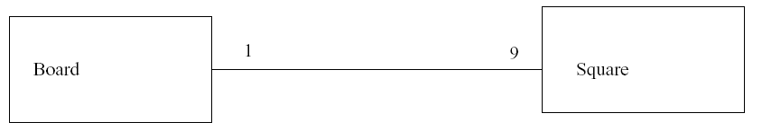
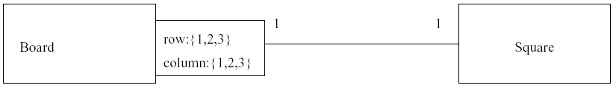
Qualified Associations
Occasionally it is helpful to give finer detail about an association than we have so far.
Square is identified relative to the board it’s on by attributes raw and column, each taking a value between 1 and 3

Slide 13
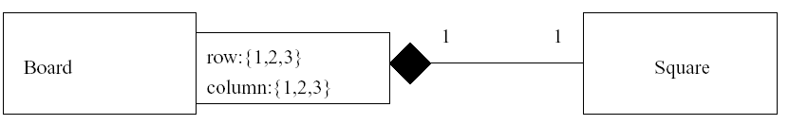
Qualified Composition
In fact we can combine the qualified association notation with the other association notations
For example, we can add back the information that this particular association is a composition

Slide 14
Derived Associations
Imagine that a student takes a module and a lecturer teaches a module. Do we also have to record that a lecturer teaches students? Is it necessary, or already implied by the other two associations?
UML has the concept of derived associations to deal with such situations to emphasise to the designer that there is no need to implement this behaviour directly.

Slide 15
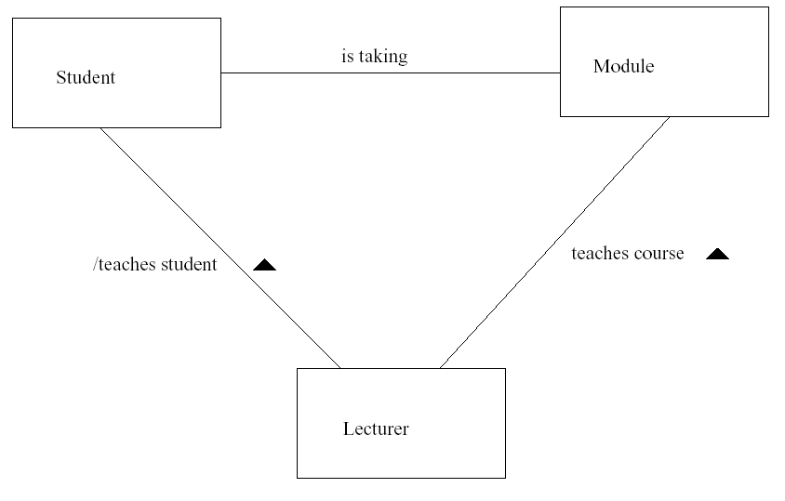
Derived Associations
A derived association exists automatically once we have implemented the main association
A derived association as shown using a slash in front of its name
The black triangles indicate which direction of the association the name describes.

Slide 16
Constraints
A constraint is a condition that must be satisfied by any correct implementation of a design
The formal constraints can be written in OCL, the Object Constraint Language (developed by IBM)
OCL is intended to be
Formal, so that constraints written in it are unambiguous
Easy to use, so that every developer can write constraints

Slide 17
XOR Constraints
Imagine that we know that a Copy is either a Book or a Journal in our design.
If we simply have two associations, one between Copy-Book and another between Copy-Journal, this will not rule out the (nonsensical) possibility of having a Copy which is both a Book and a Journal, or with neither..
On the next slide we can see this situation modelled in a class diagram..

Slide 18
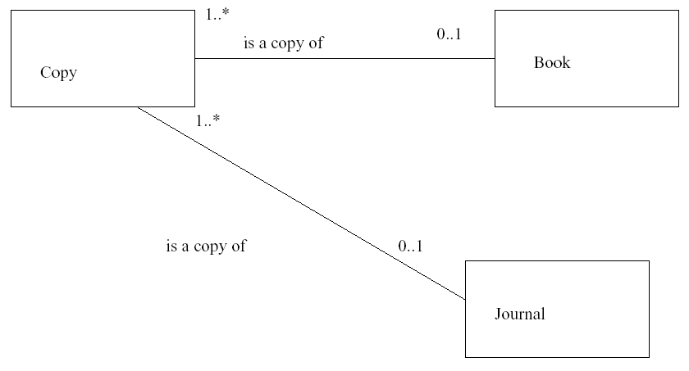
XOR Constraints
Can a Copy be both a Book and a Journal; or neither?

Slide 19
XOR Constraints
To get round this problem, we may use an xor constraint which is not written in OCL, but is a specially defined constraint in UML.
Xor stands for “exclusive or”. If we have two possibilities, A and B, then A xor B means either A or B but not both (this is a widely used concept in computer science).
It is also sometimes written as : in logic.

Slide 20
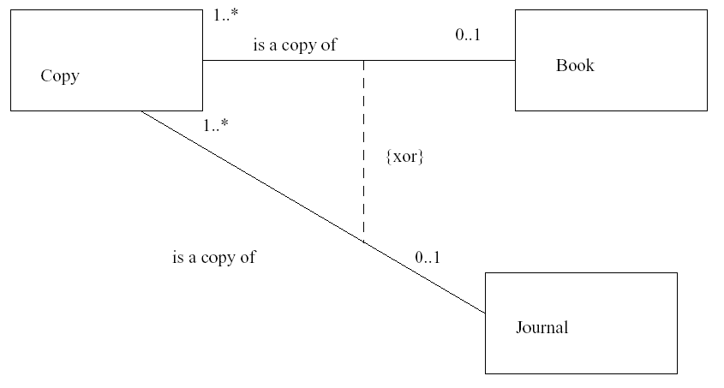
XOR Constraint
Each Copy object now represents either a copy of Book or a copy of Journal

Slide 21
Association Classes
Sometimes the association between classes itself may need attributes and operations.
For example, consider the situation that a Student class is associated with a Module class. Where should the students grade for that module be stored? Is it a part of the Student class? The Module Class?
The grade really belongs to the association of these two classes..

Slide 22
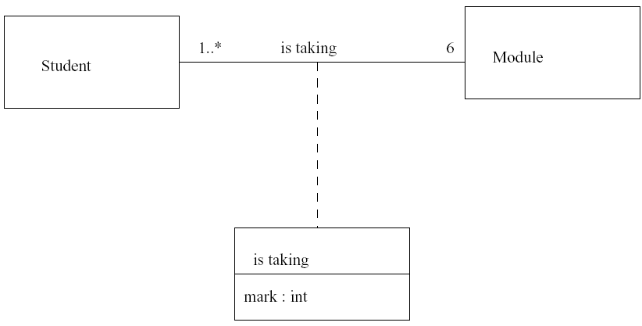
Association Classes
An association class is both an association and a class.

Slide 23
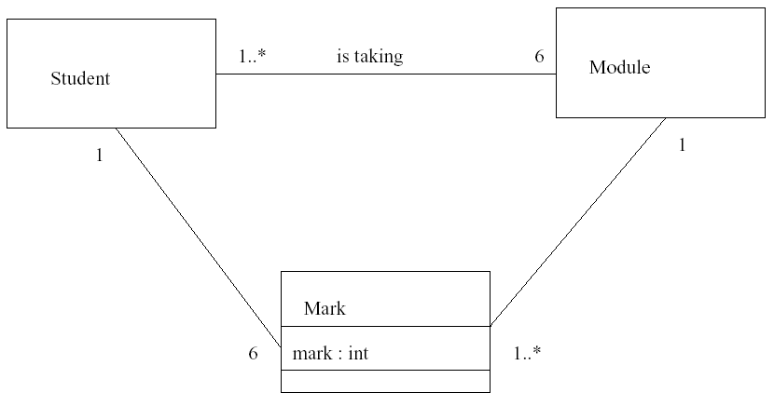
Avoiding an Association Class

Slide 24
Interfaces
An interface specifies operations of some model element visible outside of the class. In UML2, an interface may specify some attributes and associations.
All the elements of such an interface in a class diagram are public. The notation is to use a rectangle just like a class but with a “<<interface>>” string.

Slide 25
Abstract Classes
An interface is similar to the idea of an abstract class, which can be modeled in UML by using the word “abstract” on the class icon as a property.
An abstract class is one in which, for at least one operation, the implementation of that method is not defined. Thus the class cannot be instantiated.
A class where no method has an implementation is essentially an interface that we saw on the previous slide.

Slide 26
Lecture Key Points
We have seen some more features of class diagrams such as
Aggregation and composition
Navigability
Associations
Constraints
Interfaces
Next lecture we will be looking at interaction diagrams and specifically sequence diagrams.

