Slide 1
Software Engineering COMP 201
Lecturer: Sebastian Coope
Ashton Building, Room G.18
E-mail: coopes@liverpool.ac.uk
See Vital for all notes
Lecture 1 – Module Introduction

Slide 2
What is SOFTWARE ENGINEERING
ENGINEERING
Making stuff
But
In a structured and disciplined manner!
Using tried and tested approaches
SOFTWARE
Code (instructions)
Data designs (data base schemas)

Slide 3
Why Software Engineering?
Software development is hard !
Important to distinguish :
“easy” systems (one developer, one user, experimental use only)
“hard” systems (multiple developers, multiple users, products)
Experience with “easy” systems is misleading
Single person techniques do not scale up
Analogy with bridge building:
Over a stream = easy, one person job
Over River Severn … ? (the techniques do not scale)

Slide 4
Why Software Engineering ?
The problem is complexity
There are many sources of complexity, but size is key:
The Linux kernel contains >13 million lines of code
Windows XP contains >40 million lines of code
Software engineering is about managing this complexity.

Slide 5
Why Software Engineering ?
Software failure can be very serious
Software controls safety critical systems
Software protects sensitive data
Software is involved in systems which handle money
Software Engineering has to
Produce software which has a very low chance of faulting
Be able to demonstrate/proof that software has very low chance of fault
Testing or program proving

Slide 6
Why software engineering
Costs
$150 billion world wide (Gartner)
Integration
All mobile devices contain software
Science
All science uses software

Slide 7
Software engineering tasks
Define requirements
What should it do?
Design the product
Design how the product should look and be constructed
UI design, software module design, data design (what data?)
Implement and test
Coding, testing and validation
Managing the process
Software project management

Slide 8
Teaching Method
Series of 30 lectures (3hrs per week)
Independent Student Reading
Practical work (3 Assignments)
----------------------- Course Assessment ----------------------
A two-hour examination: 60%
Coursework: 40%
-----------------------------------------------------------------------

Slide 9
Teaching Method
All lecture notes are on vital
Assignments will also be posted on the vital. There will be two assignments (part 1 and 2) each worth 10% of the COMP201 grade and another assignment worth 20% of the grade
If you have any questions or problems:
Catch me at end of lecture
E-mail me with question directly
Make appointment via email in my office

Slide 10
COMP201 Practicals
Practical slots: (from WEEK TWO)
1 hour/week
Use these sessions to do your coursework
COMP 201
Assignment 1 – Part 1 Requirements Engineering (10%)
Use case analysis, non-functional requirements
Assignment 1 – Part 2 Design and implementation (10%)
Assignment 2 – Modelling with UML (20%)

Slide 11
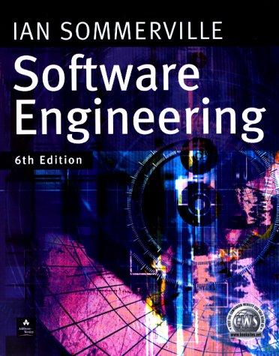

Recommended Course Textbooks
I. Sommerville (2001,2004, 2007)
Software Engineering 6th ,7th or 8th Edition,
Addison-Wesley, Harlow, Essex, UK
P. Stevens with R. Pooley (2000),
Using UML: Software Engineering with Objects and Components, 1st or 2nd Edition,
Addison-Wesley, Harlow, Essex, UK

Slide 12
Outline Syllabus
Introduction to Software Engineering
Software models
Software requirements
Formal Specification
Software Design and Implementation
UML (Unified Modeling Language)
Software verification, validation and testing
Management of Software Projects & Cost Estimation

Slide 13

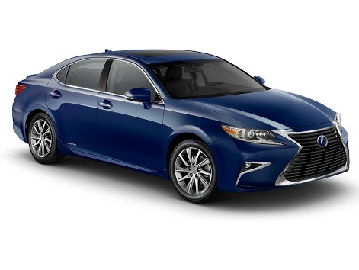


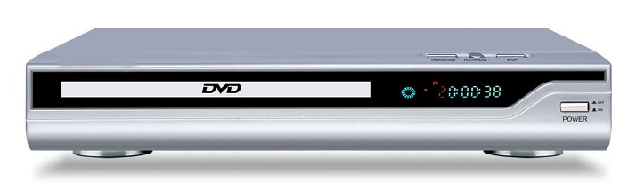
Software

Slide 14
Software Engineering
The economies of ALL developed nations are dependent on software.
More and more systems are software controlled
Software engineering is concerned with theories, methods and tools for professional software development.
Some software can be classified as critical (air traffic control, medical software, nuclear reactor control software..).

Slide 15
Software Engineering
Software costs often dominate computer system costs. The costs of software on a PC are often greater than the hardware costs.
Software costs more to maintain than it does to develop. For systems with a long life, maintenance costs may be several times development costs.
Software engineering is concerned with cost-effective software development.
Critical Systems must be verifiably reliable to avoid significant environmental, human or financial costs.

Slide 16
FAQs about Software Engineering
What is:
software?
a software process?
software engineering?
a software process model?

Slide 17
What is Software?
Computer programs and associated documentation
Software products may be developed for a particular customer or may be developed for a general market
Software products may be
Generic - developed to be sold to a range of different customers
Bespoke (custom) - developed for a single customer according to their specification

Slide 18
Examples
Programs
Applications, apps, embedded systems
Documents
User manuals
Content
Designs and specifications

Slide 19
What is Software Engineering?
Software engineering is an engineering discipline which is concerned with all aspects of software production
Software engineers should
adopt a systematic and organised approach to their work
use appropriate tools and techniques depending on
the problem to be solved,
the development constraints and
the resources available

Slide 20
What is the Difference between Software Engineering and Computer Science?
Computer Science
Software Engineering
is concerned with
theory
fundamentals
Algorithms, data structures, complexity theory, numerical methods
the practicalities of developing
and delivering useful software
SE deals with practical problems in
complex software products
Computer science theories are currently insufficient to act as a complete underpinning for software engineering, BUT it is a foundation for practical aspects of software engineering

Slide 21
Good Software Engineers
Tend to
Not keep making the SAME mistakes again and again
(so document your mistakes)
Communicate well with others
Work well in teams
Document their work
Produce code which can be fixed/modified easily by others
Can predict their own productivity
Being a good software engineer
Is not very easy!

Slide 22
SE History
Software Engineering was first introduced in 1968 during a conference about the “software crisis” when the introduction of third generation computer hardware led to more complex software systems than before
Early approaches were based on informal methodologies leading to
Delays in software delivery
Higher costs than initially estimated
Unreliable, difficult to maintain software
Need for new methods and techniques to manage the production of complex software.

Slide 23
Major Software Failures
Therac-25 (1985-1987) : six people overexposed during treatments for cancer
Taurus (1993) : the planned automatic transaction settlement system for London Stock Exchange cancelled after five years of development
Ariane 5 (1996) : rocket exploded soon after its launch due error conversion (16 floating point into 16-bit integer leading to an exception)
The Mars Climate Orbiter : assumed to be lost by NASA officials (1999): different measurement systems (Imperial and metric)

Slide 24
Recent example
Healthcare.gov (US government project)
Coding was started before requirements completed in detail
You could actually see errors in code by merely looking at Javascript.. Example missing code with comments in place
"TODO: add functionality to show alert text after too many tries at log in“
Testing was squeezed to get site delivered in time
There was no manual backup on launch
Incremental in launch is as important as incremental in development

Slide 25
2018 Software Issues
TSB bank April
Users locked out of accounts
Users logged in could see others user’s account details
US airline failure blackouts

Slide 26
However …
Important progress has been made:
Ability to produce more complex software has increased
New technologies have led to new SE approaches
A better understanding of the activities involved in software development
Effective methods to specify, design and implement software have been developed
New notations and tools have been produced

Slide 27
What is a Software Process?
A Software Process is a set of activities whose goal is the development or evolution of software
Fundamental activities in all software processes are:
Specification - what the system should do and its development constraints
Development - production of the software system (design and implementation)
Validation - checking that the software is what the customer wants
Evolution - changing the software in response to changing demands

Slide 28
What is a Software Process Model?
A Software Process Model is a simplified representation of a software process, presented from a specific perspective
Examples of process perspectives:
Workflow perspective - represents inputs, outputs and dependencies
Data-flow perspective - represents data transformation activities
Role/action perspective - represents the roles/activities of the people involved in the software process
Generic process models
Waterfall
Evolutionary development
Formal transformation
Integration from reusable components

Slide 29
What are the Costs of Software Engineering?
Roughly 60% of costs are development costs, 40% are testing costs. For custom software, evolution costs often exceed development costs
Costs vary depending on the type of system being developed and the requirements of system attributes such as performance and system reliability
Distribution of costs depends on the development model that is used

Slide 30
What is CASE ? (Computer-Aided Software Engineering)
Software systems which are intended to provide automated support for software process activities, such as requirements analysis, system modelling, debugging and testing
Upper-CASE
Tools to support the early process activities of requirements and design
Lower-CASE
Tools to support later activities such as programming, debugging and testing

Slide 31
What are the Attributes of Good Software?
The software should deliver the required functionality and performance to the user and should be maintainable, dependable, efficient and usable.
Maintainability
Software must (easily) evolvable to meet changing needs
Dependability
Software must be trustworthy (work with all data)
Efficiency
Software should not make wasteful use of system resources
Usability
Software must be usable by the users for which it was designed

Slide 32
Key Challenges in Modern Software Engineering?
Software engineering in the 21st century faces 4 key challenges:
Legacy systems
Old, valuable systems must be maintained and updated
Heterogeneity
Systems are distributed and include a mix of hardware and software
Delivery
There is increasing pressure
for faster delivery of software
Trust
Developing techniques that demonstrate that
software can be trusted by its users

Slide 33
Professional and Ethical Responsibility
Software engineering involves wider responsibilities than simply the application of technical skills.
Software engineers must behave in an honest and ethically responsible way if they are to be respected as professionals.
Ethical behaviour is more than simply upholding the law.

Slide 34
Issues of Professional Responsibility
Confidentiality
Engineers should normally respect the confidentiality of their employers or clients even without a formal confidentiality agreement.
Competence
Engineers should not misrepresent their level of competence. They should not knowingly accept work which is beyond their competence.

Slide 35
Issues of Professional Responsibility
Intellectual property rights
Engineers should be careful to ensure that the intellectual property of employers and clients is protected and know the local laws governing IP.
Computer misuse
Software engineers should not use their technical skills to misuse other people’s computers.

Slide 36
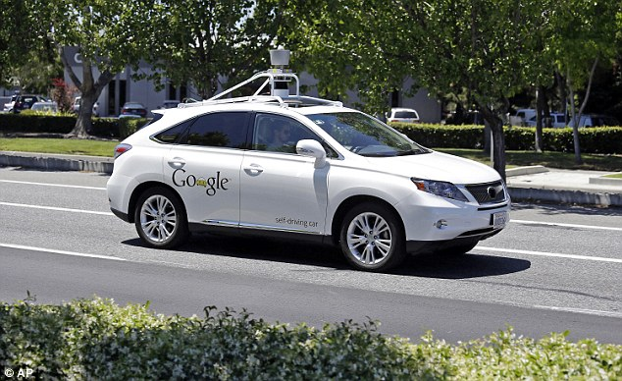
Ethics and software engineering

Slide 37
Ethics for the 21st Century
What if a robot you design the AI software for
Hurts (kills) someone, causes damage
Who is responsible?
You?
The owner of the robot?
The robot?
What if a robot you design and produce, designs and produces another robot? Etc. etc.

Slide 38
Lecture Key Points
We have seen the reasons for requiring solid software engineering principles in modern systems
Software engineering is an engineering discipline concerned with all aspects of software production.
Software products consist of developed programs and their associated documentation with several essential product attributes such as maintainability, dependability, efficiency and acceptability.
Software Engineers have responsibilities to the engineering profession and society and should not simply be concerned with technical issues.

Slide 39
Next Lecture
Use cases

