Slide 1
Software Engineering COMP 201
Lecturer: Sebastian Coope
Ashton Building, Room G.18
E-mail: coopes@liverpool.ac.uk
COMP 201 web-page:
http://www.csc.liv.ac.uk/~coopes/comp201
Lecture 18 – Introductory Case Study

Slide 2
Introduction to UML
During this lecture, we shall see how various features of the Unified Modeling Language (UML) can help to reduce ambiguities and increase understanding of a proposed system
We will be studying an introductory case study based on a health clinic system and giving an introduction to:
Use case diagrams
Class diagrams
Sequence diagrams
State diagrams

Slide 3
The Problem
The most difficult part of any design project is understanding the task you are attempting
Example: you have been contacted to develop a computer system for a university medical clinic.
The clinic needs the following types of service
Staff management
Booking appointments
Keeping records
You are asked to build an interactive system which handles all of these aspects online.

Slide 4
Clarifying the Requirements
Different users will have different, sometimes conflicting, priorities
Users are not likely to have clear, easily expressed views of what they want
It is hard to imagine working with a system of which you have only seen a description

Slide 5
Facts about the Requirements
Doctors, patients, admin staff
Appointments
Treatments
Homework
Specify the facts about
the requirements that
an ideal system
would satisfy.

Slide 6
Use Case Model
If a system is to be seen as having high quality, it must meet the needs of its users.
So we take a user-oriented approach to systems analysis.
We identify the users of the system and the tasks they must undertake with the system.
We also seek information about which tasks are most important, so that we can plan the development accordingly.

Slide 7
What do we Mean by “Users” and “Tasks”?
UML uses as technical terms “actors” and “use cases”
An actor is a user of a system in a particular role (an actor can also be an external system)
For example. Our system will have an actor Receptionist representing the person who interacts with the system to book an appointment
A use case is a task which an actor needs to perform with the help of the system,
such as BookAppointment

Slide 8
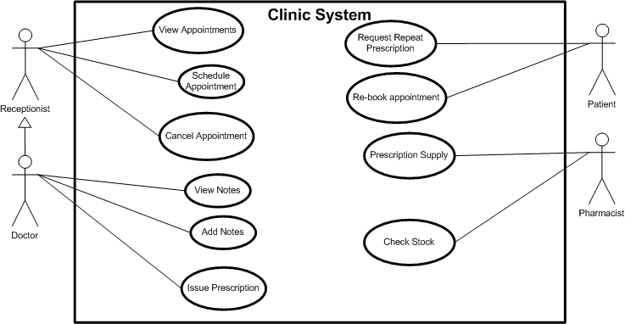
Use Case Diagram for the clinic

Slide 9
Scope and Iterations
To limit the risk, it is better to aim to get to the ideal system in several steps or iterations.
The first iteration results in the delivery of a system with only the most basic and essential functionality;
Later iterations enhance the system
One of the main purposes of use cases is to help identify suitable dividing lines between interactions:
An interaction can deliver enough of the system to allow certain use cases to be carried out, but not others

Slide 10
Limiting Requirements
It is important not to invent new requirements for the system. After examining use-cases, it is often easy to think of new things the system could or should do, but these must first be discussed with the customer.
For example, perhaps it would be good to inform the doctor that a drug is out of stock via their online system? But this may not be what is wanted by the Dr, this may cause an overload of information!

Slide 11
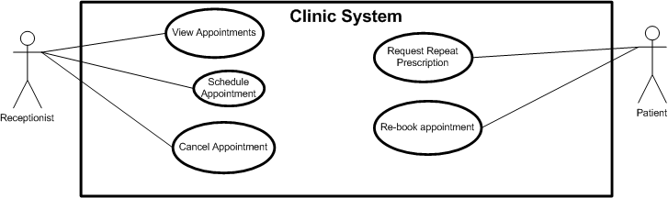
Use Case Diagram for the First Iteration
Let us suppose that after discussing priorities with the customers we decide that the first iteration of the system should provide:
View appointments, schedule appointment, cancel appointment, re-book appointment, request repeat prescription

Slide 12
Use Case Advantages
It may be easier to identify the amount of time required to implement all the required features of the system.
Such details can often be optimistically overlooked.
We can identify which requirements are important to key strategic (or most influential) personnel in the company.
By providing this functionality early, we can show the potential value of the software and avoid the project being cancelled.

Slide 13
Use Case Advantages
We may decide to implement more risky use cases first since we would hopefully still have contingency to tackle problems that arise
In other words, early in the development we have more flexibility in terms of time, money, design choices etc.
Use cases can be used to derive validation checks on the developed system, in order that it provides all required functionality.

Slide 14
Identifying Classes
In the standard jargon of analysis we often talk about the key domain abstractions.
Identifying the right classes is one of the main skills of OO development.
We start the process of identifying the key domain abstractions using the following approach, which is known as the noun identification technique.

Slide 15
Identifying a list of candidate classes
Clinic, appointments and treatment system
Before seeing a doctor or nurse the patient needs to make an appointment. The appointment will be made by the receptionist, before making the appointment the patient needs to ask the patient which doctor they wish to see and if the appointment is a standard appointment or urgent appointment. The receptionist will use this information, check the appointment schedule and find a free slot and make the booking. When the patient sees the Dr, the Dr will sometimes issue a prescription. The patient may at some time request a repeat issue of their prescription. Receptionists can also cancel appointments. Each doctor has a maximum of 2000 patients registered to them.
Take a coherent, concise statement of the requirement of the system
Underline its noun and noun phrases, that is, identify the words and phases that denote things
This gives a list of candidate classes, which we can then whittle down and modify to get an initial class list for the system

Slide 16
Removing Superfluous Candidates
In this particular case, we discard:
Clinic, because it is outside the scope of our system
Urgent appointment redundant covered by appointment
Time, because it is a measure, not a thing
Free slot, because it is vague (we need to clarify it)
System, because it is part of the meta-language of requirements description, not a part of the domain

Slide 17
This leaves:
Doctor
Nurse
Receptionist
Patient
Appointment
Prescription

Slide 18
Relations between Classes
Next we identify and name important real-world relationships or associations between our classes
We do this for two reasons:
To clarify our understanding of the domain, by describing our objects in terms of how they work together;
To sanity-check the coupling in our system, i.e. make sure that we are following good principles in modularising our design
We shall now see the relations for the clinic system example..

Slide 19
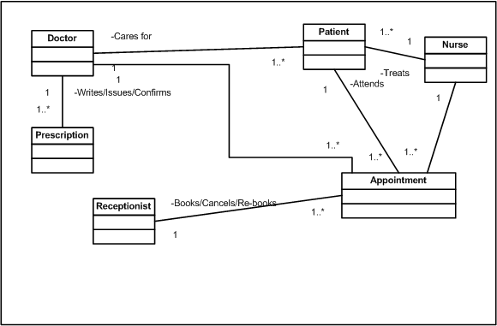
Initial Class Model of the Health Clinic
These are multiplicities which we shall study in detail next lecture..

Slide 20
Lets Revise our Class Model
Finally, we may notice that
Doctor shares all the same associations that Nurse does, and that
this agrees with our intuition that both nurse and doctor are health care staff.
Recording this in the class diagram will clarify our understanding of the situation, that there is a generalization relationship between these classes
Inheritance, Dr and Nurse are both health care staff and receptionist is also staff
Notice Staff and HealthCareStaff are additional classes to help with inheritance

Slide 21
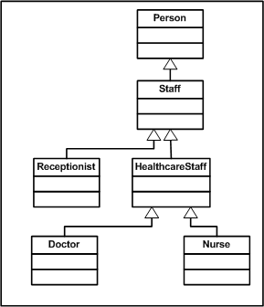
Revised Health Class Model (hierarchy)

Slide 22
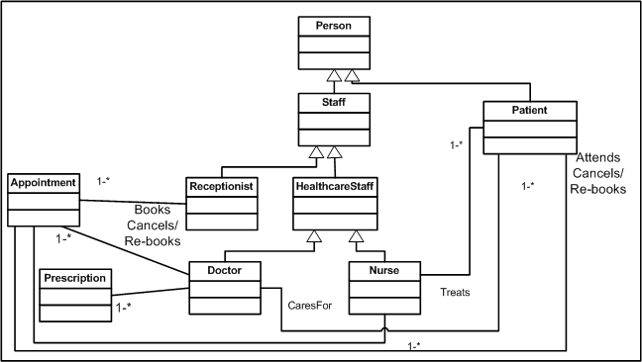
Revised Health Class Model

Slide 23
The System in Action
A class diagram gives a static view of the system, but we know nothing about the dynamic behaviour
In UML we can use interaction diagrams to show how messages pass between objects of the system to carry out some task
This will also show how the various classes realize the different use cases we identified in the use case diagram

Slide 24
An Example Sequence Diagram
Consider what happens in the appointment booking scenario when a user wishes to make an appointment
The receptionist must check that the person is a valid patient
Then the doctor object must be checked to see if there are any available appointments
If there are any suitable slots available, a new appointment should be created and assigned to the doctor.
We now see how this is recorded in a sequence diagram

Slide 25
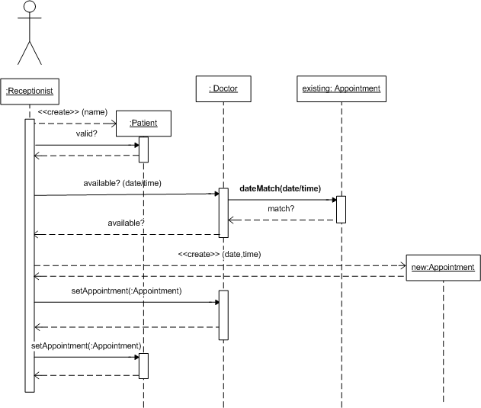
Interaction Shown on a Sequence Diagram

Slide 26
Sequence Diagrams
We shall see more on sequence diagrams later, but note their general structure and that they record which actors and classes are involved in an interaction.
In this example the interaction is very simple, there is a single execution path and nothing occurs in parallel; in more complex scenarios, sequence diagrams can clarify the working of a system to a greater extent

Slide 27
State Diagrams
Objects in the system have a state which is all the data which it currently encapsulates
For example, a Doctor object on the health system can be available or fully booked
Running methods on the object can cause a change in state, i.e., by booking appointments to the doctor object we change its internal state.
Changes in object states can be modelled by a state diagram..

Slide 28
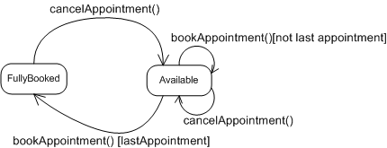
Changes of the System: State Diagrams
State diagram for class Doctor
We will consider state diagrams again in more detail in a later lecture

Slide 29
Lecture Key Points
We have seen an introduction to the Unified Modelling Language (UML)
We studied an introductory case study based on a health clinic system with an introduction to:
Use case diagrams
Class diagrams
Sequence diagrams
State diagrams

