Slide 1
Software Engineering COMP 201
Lecturer: Sebastian Coope
Ashton Building, Room G.18
E-mail: coopes@liverpool.ac.uk
COMP 201 web-page:
http://www.csc.liv.ac.uk/~coopes/comp201
Essentials of Interaction Diagrams

Slide 2
Outline
Use case diagrams
Collaborations
Interaction on collaboration diagrams
Sequence diagrams
Messages from an object to itself
Suppressing detailed behaviour
Creation and deletion of objects
Timing

Slide 3
Recap … Use Case Diagrams
Use case diagrams show the interaction of users of the system with the functionality of the system.
A use case is a functional component of the system that accomplishes a specific task, and is represented by an ellipse.
An actor, depicted as a stickman figure, is a user (human or non-human) of the system performing a specific role.
Use case diagrams are used early in the development process to refine the functional specifications, identify user interface requirements and to define the scope of the project.

Slide 4
Use Case Diagram Example
Remember, a use case diagram show the functionality of the system but not the sequence of events (the sequence of events or alternate courses of action inside a single use case can be shown in its description).
Shopping System
Place Order
Validate Customer
Seller
Track Order

Slide 5
UML Use Cases
Remember that it’s also necessary to describe each use case. To describe a use case, we could use natural language, structured natural language, sequence diagrams, state diagrams etc.
If we use an <<extend>> relation, we should also describe which of the use cases will be chosen.
The <<include>> and <<extend>> relations are an advanced feature and should be used with care; remember they add to the complexity of the diagram.

Slide 6
Recap … Class Diagrams
A Class diagram shows the static structure of the system.
It defines model elements such as classes, interfaces, and user-defined data types, their internal structure, and their relationships to each other.
Relationships, or associations, are shown as lines connecting elements, and are annotated to describe the relationships and their cardinality (1..1, 1..*, 0..*, etc.).
Inheritance (generalize/specialize), aggregation (comprises), and composition (has) relationships are also captured in this diagram.

Slide 7
Class Diagrams
Class attributes and their data types are identified here, as are the operations and their return types.
Visibility is indicated by +, #, or - for public, protected, or private attributes or operations respectively.
The class diagram plays a vital role in the transition from design to implementation as it contains sufficient detail to begin the coding process.
It is often used to partition responsibilities among the project team members, and to guide and measure the implementation process.

Slide 8
Class Diagram Example

Slide 9
Important UML Models
We have now seen the two most important UML models:
The use case model, which describes the tasks which the system must help to perform
The class model, which describes the classes which are to be implemented and the relationships between them
UML’s interaction diagrams allow us to record, in detail, how objects interact to perform a task

Slide 10
Collaborations
UML provides two sorts of interaction diagram,
sequence diagrams and
collaboration diagrams.
Collectively, the objects which interact to perform some task, together with the links between them, are known as a collaboration
Objects - Each object is shown as rectangle, which is labelled objectName: className
Links - Links between objects are shown like associations in the class model.
Actors - Actors can be shown as on a use-case diagram

Slide 11
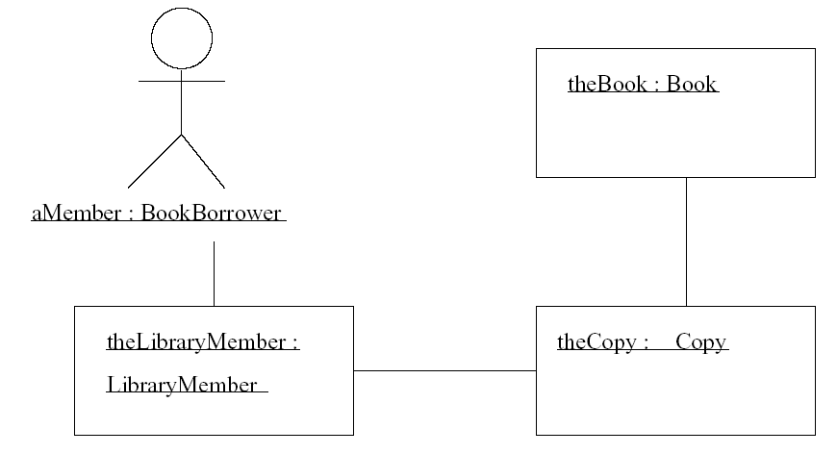
A Simple Collaboration, Showing no Interaction
A collaboration, without any interaction shown, is rather like an instance of part of the class model. It shows objects, links and actors

Slide 12
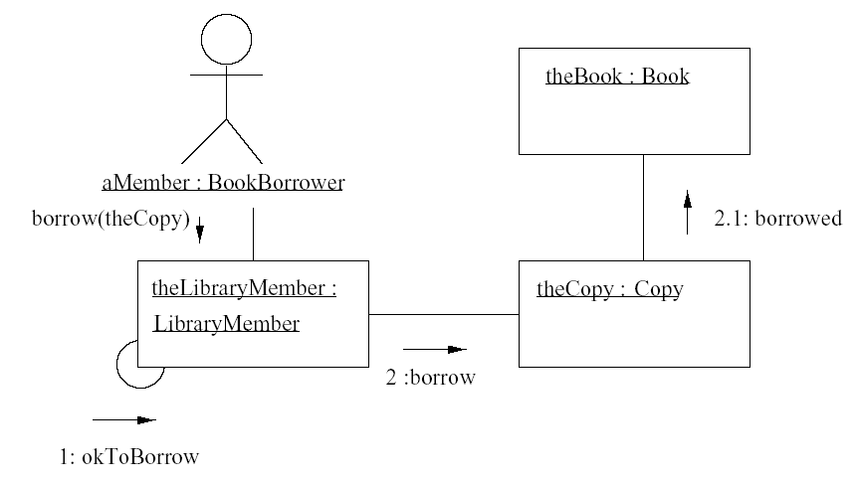
Interaction on Collaboration Diagrams
Each labelled arrow represents a message sent from the object at the tail of the arrow to the object at the point of the arrow.
Furthermore, the target object must understand the message
That is, the class of the object at the point of the arrow must provide the appropriate operation

Slide 13
Sequence Diagrams
A sequence diagram shows the objects and actor which take part in a collaboration at the top of dashed lines.
Sequence diagrams are applicable to modeling real-time interactive systems or complex scenarios.

Slide 14
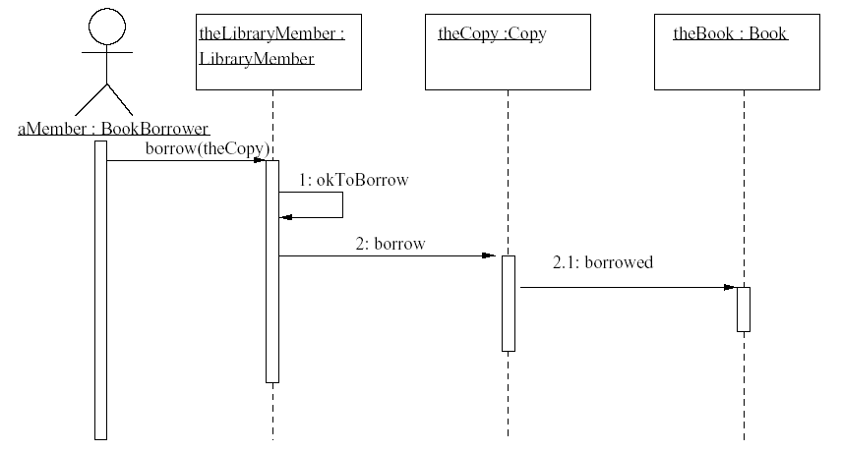
Interaction Shown on a Sequence Diagram

Slide 15
The vertical dimension of a sequence diagram represents time
The horizontal dimension represents the different objects or roles that participate in the interactive sequence.
An object’s lifeline is shown as a narrow vertical bar.

Slide 16
Time is assumed to pass as we move from the top to the bottom of the diagram.
Messages between objects are shown as solid line arrows, and their returns are shown as dashed line arrows.

Slide 17
Homework
1) List all the pairs of classes that can communicate directly with each other.
2) For each class, list all the methods that need to be included, based on this sequence diagram
resource manager
Res. Mgr. Win: UI
:Worker
:Skill
:SkillLevel
find worker
find worker by name
find skill
find skill by name
assign skill to worker
[worker does not currently have skill] assign skill to worker

Slide 18
Messages from an Object to Itself
An object may, and frequently does, send a message to itself (i.e. An object calls another method on itself; Java uses keyword “this”).
On a collaboration diagram you show a link from the object to itself, and messages pass along that link in the usual way
On a sequence diagram, you show a message arrow from the object’s lifeline back to itself.

Slide 19
Messages from an Object to Itself
In pure object oriented programming,
every function invocation is the result of a message, and
objects may send messages to themselves so often that an interaction diagram becomes cluttered
You might choose to omit messages from an object to itself, counting such things as internal computation within the object. This is a type of abstraction.

Slide 20
Suppressing Detailed Behaviour
It is often sensible to describe interaction at a higher level, rather than showing every message between every pair of objects.
To do this we define a (full) sub-collaboration of a collaboration
Collaboration is a collection of objects and links between them
Sub-collaboration is a subset of the objects, together with the links connecting those objects.

Slide 21
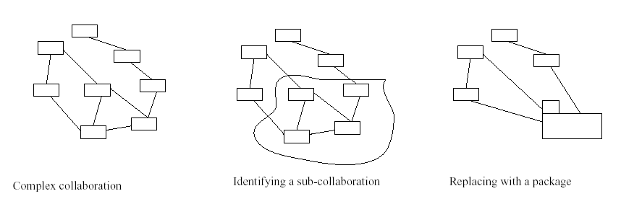
Using a Package to Simplify a Collaboration

Slide 22
Creation and Deletion of Objects
The set of objects involved in an interaction is not always static; objects may be created and deleted during an interaction.
Collaboration diagram
These show which objects are created and destroyed during an interaction by adding the constraints {new} {destroyed}.
If the object is both created and destroyed in the same interaction, it can be labelled {transit}
Sequence diagram
These show an object being created by putting its object box part-way down the page, at the point it is created
Destruction of an object is shown by its activation ending with a large X.

Slide 23
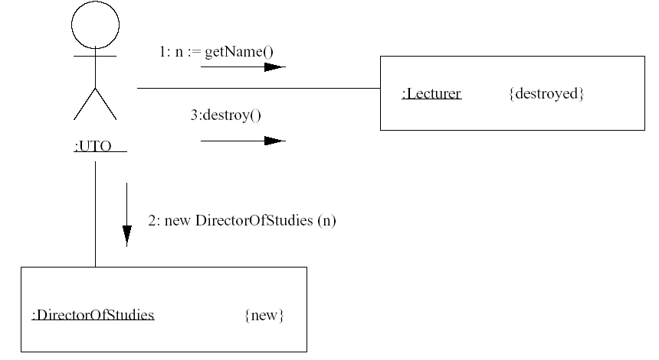
Example Collaboration Diagram

Slide 24
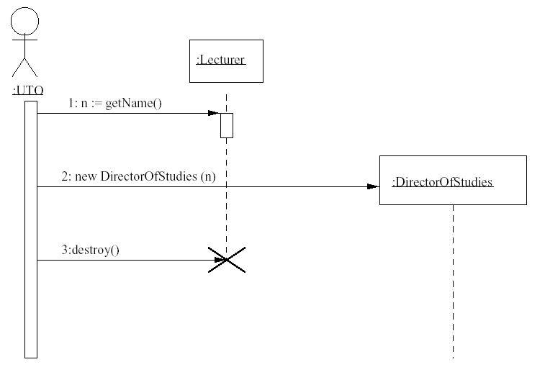
Example Sequence Diagram
This object is only created at this point..
The Lecturer object is destroyed here..

Slide 25
Timing
The major advantage of sequence diagrams over collaboration diagrams is their ability to represent the passage of time graphically.
So far we have let the diagram indicate only the relative ordering of messages.
Sometimes, however, the actual times are important.
A system in which actual times are important is called a real-time system.

Slide 26
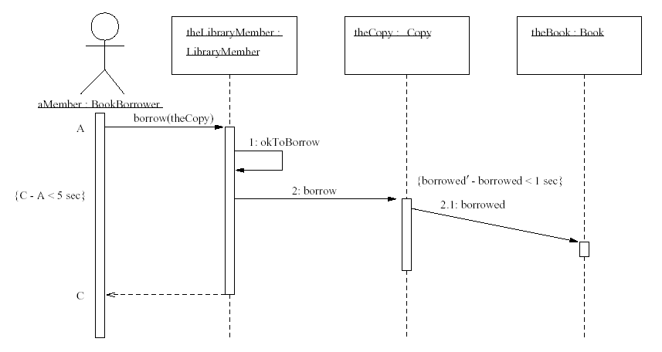
Timing Constraints on a Sequence Diagram

Slide 27
Activity Diagrams
Activity diagrams describe how activities are coordinated.
For example, an activity diagram may be used (like an interaction diagram) to show how an operation could be implemented
An activity diagram is particularly useful
when you know that an operation has to achieve a number of different things, and
you want to model what the essential dependencies between them are, before you decide in what order to do them
Activity diagrams are much better at showing this clearly than interaction diagrams.

Slide 28
Activity Diagrams
We may identify different use-cases for example but some must be completed before others can begin. Recording the order in which we must complete these use-cases can be aided by using an activity diagram
Activity diagrams record the dependencies between activities, such as which things can happen in parallel and which must occur sequentially.

Slide 29
Activity Diagrams
At the UML semantics level, activity diagrams are state diagrams extended for convenience with some extra notation
Elements of activity diagrams
Activity
Transition
Synchronization bar
Decision diamond
Start and stop markers

Slide 30
Activity Diagrams
Activity – An activity is recorded like the notation for a state. However, we do not have transitions as a result of event, rather as the finishing of an activity.
Activity edge – an arrow to indicate where to move in the diagram after an activity finishes. These can be labelled with a guard condition.
Synchronisation bar – a thick horizontal bar describing the co-ordination of activities which must all be completed before the activity edges leading from the bar are fired.

Slide 31
Activity Diagrams
Decision Diamond – can be used to show decisions as an alternative to guards on separate states leaving the same activity.
Stop/Start markers – are used in the same way as in a state diagram (initial/final states).
Let’s see an example of an activity diagram for a library system (note that we partition the diagram to activities involving a library member and those also involving the librarian)..

Slide 32
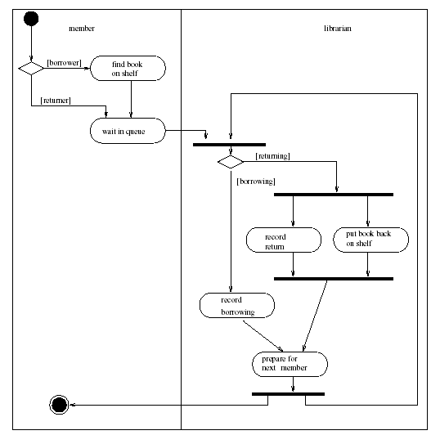
Business Level Activity Diagram of a Library

Slide 33
Activity Diagrams and State Diagrams:
We can see several differences between activity diagrams and state diagrams:
Activity diagrams do not normally include events
Activity is intended to proceed, following the flow described by diagram, without getting stuck. Thus usually one of the guards of an edge leaving an activity should be satisfied
Concurrent activities can be modelled by using the synchronisation bar notation.

Slide 34
Lecture Key Points
We have seen Collaboration Diagrams and Interactions on them.
We have also studied sequence diagrams to represent the passage of time graphically and timing constraints that may be imposed upon them.

