Slide 1
Software Engineering COMP 201
Lecturer: Sebastian Coope
Ashton Building, Room G.18
E-mail: coopes@liverpool.ac.uk
COMP 201 web-page:
http://www.csc.liv.ac.uk/~coopes/comp201
Software Testing

Slide 2
Defect Testing
Defect testing involves testing programs to establish the presence of system defects

Slide 3
Objectives
To understand testing techniques that are geared to discover program faults
To introduce guidelines for interface testing
To understand specific approaches to object-oriented testing
To understand the principles of CASE tool support for testing

Slide 4
Topics Covered
Defect testing
Integration testing
Object-oriented testing
Testing workbenches

Slide 5
The Testing Process
Component testing
Testing of individual program components
Usually the responsibility of the component developer (except sometimes for critical systems)
Tests are derived from the developer’s experience
Integration testing
Testing of groups of components integrated to create a system or sub-system
The responsibility of an independent testing team
Tests are based on a system specification

Slide 6
Testing Phases

Slide 7
Defect Testing
The goal of defect testing is to discover defects in programs
A successful defect test is a test which causes a program to behave in an anomalous way
Tests show the presence not the absence of defects

Slide 8
Testing Priorities
Only exhaustive testing can show a program is free from defects. However, exhaustive testing is impossible
Tests should exercise a system's capabilities rather than its components
Testing old capabilities is more important than testing new capabilities
Testing typical situations is more important than boundary value cases

Slide 9
Test Data and Test Cases
Test data Inputs which have been devised to test the system
Test cases Inputs to test the system and the predicted outputs from these inputs if the system operates according to its specification

Slide 10
Test plan template
Name of case | Description | Input data | Action | Expected output | Actual output | Success/ Fail
LoginOKPass | Tests login with a good username and password | Username=test1 Password=pass1 | Click login | OK | Login OK | Success
LoginBadPass | Tests login with good username but wrong password | Username=test1 Password=pass2 | Click login | Failed to Login | Failed to login | Success
LoginNoPass | Tests login with password field empty | Username=test1 Password= | Click login | Failed to login | Login OK | Fail

Slide 11
The Defect Testing Process

Slide 12
Black-box Testing
An approach to testing where the program is considered as a ‘black-box’
The program test cases are based on the system specification
Test planning can begin early in the software process

Slide 13
Black-box Testing

Slide 14
Equivalence Partitioning
Input data and output results often fall into different classes where all members of a class are related
Each of these classes is an equivalence partition where the program behaves in an equivalent way for each class member
Test cases should be chosen from each partition

Slide 15
Equivalence Partitioning

Slide 16
Equivalence Partitioning
Partition system inputs and outputs into ‘equivalence sets’
If input is a 5-digit integer between 10,000 and 99,999, equivalence partitions are <10,000, 10,000-99, 999 and > 10, 000
Choose test cases at the boundary of these sets
00000, 09999, 10000, 99999, 10001
These are more likely to display erroneous behaviour than choosing random values

Slide 17
Equivalence Partitions

Slide 18
Search Routine Specification
procedure Search (Key : ELEM ; T: ELEM_ARRAY;
Found : in out BOOLEAN; L: in out ELEM_INDEX) ;
Pre-condition
-- the array has at least one element
T’FIRST <= T’LAST
Post-condition
-- the element is found and is referenced by L
( Found and T (L) = Key)
or
-- the element is not in the array
( not Found and
not (exists i, T’FIRST >= i <= T’LAST, T (i) = Key ))

Slide 19
Search Routine – Input Partitions
Inputs which conform to the pre-conditions
Inputs where a pre-condition does not hold
Inputs where the key element is a member of the array
Inputs where the key element is not a member of the array

Slide 20
Testing Guidelines (Sequences)
Test software with sequences which have only a single value
Use sequences of different sizes in different tests
Derive tests so that the first, middle and last elements of the sequence are accessed
Test with sequences of zero length

Slide 21
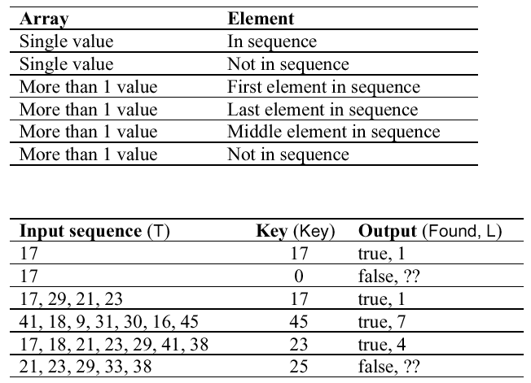
Search Routine – Input Partitions

Slide 22
Structural Testing
Sometime called white-box testing
Derivation of test cases according to program structure. Knowledge of the program is used to identify additional test cases
Objective is to exercise all program statements (not all path combinations)

Slide 23
White-box Testing

Slide 24
Binary search (Java)

Slide 25
Binary Search - Equiv. Partitions
Pre-conditions satisfied, key element in array
Pre-conditions satisfied, key element not in array
Pre-conditions unsatisfied, key element in array
Pre-conditions unsatisfied, key element not in array
Input array has a single value
Input array has an even number of values
Input array has an odd number of values

Slide 26
Binary Search Equiv. Partitions

Slide 27
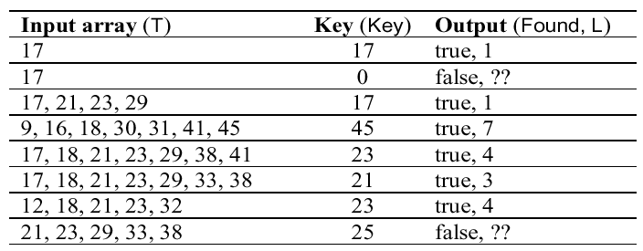
Binary Search - Test Cases

Slide 28
Path Testing
The objective of path testing is to ensure that the set of test cases is such that each path through the program is executed at least once
The starting point for path testing is a program flow graph that shows nodes representing program decisions and arcs representing the flow of control
Statements with conditions are therefore nodes in the flow graph

Slide 29
Program Flow Graphs
Describes the program control flow. Each branch is shown as a separate path and loops are shown by arrows looping back to the loop condition node
Used as a basis for computing the cyclomatic complexity
Cyclomatic complexity = “Number of edges - Number of nodes + 2” in the program control flow graph

Slide 30
Cyclomatic Complexity
The number of tests to test all control statements equals the cyclomatic complexity
Cyclomatic complexity equals the number of conditions in a program plus one.
Useful if used with care. Does not imply adequacy of testing.
Although all paths are executed, all combinations of paths are not executed

Slide 31
Lecture Key Points
Test parts of a system which are commonly used rather than those which are rarely executed
Equivalence partitions are sets of test cases where the program should behave in an equivalent way
Black-box testing is based on the system specification
Structural testing identifies test cases which cause all paths through the program to be executed

