Slide 1
Deep Learning
Week 15
Intro to Reinforcement Learning
Why you should care

Slide 2
Supervised learning
Given:
    objects and answers
    algorithm family
    loss function
Find:

Slide 3
Supervised learning
Given:
    objects and answers
    algorithm family
    loss function
Find:
[banner,page], ctr
linear / tree / NN
MSE, crossentropy

Slide 4
Supervised learning
Great... except if we have no reference answers

Slide 5


Online Ads
Great... except if we have no reference answers
We have:
  YouTube at your disposal
  Live data stream
  (banner & video features, #clicked)
  (insert your favorite ML toolkit)
We want:
  Learn to pick relevant ads
Ideas?

Slide 6


Duct tape approach
Common idea:
  Initialize with naïve solution
  Get data by trial and error and error and error and error
  Learn (situation) → (optimal action)
  Repeat

Slide 7

Giant Death Robot (GDR)
Great... except if we have no reference answers
We have:
  Evil humanoid robot
  A lot of spare parts
    to repair it :)
We want:
  Enslave humanity
  Learn to walk forward
Ideas?

Slide 8
Duct tape approach (again)
Common idea:
  Initialize with naïve solution
  Get data by trial and error and error and error and error
  Learn (situation) → (optimal action)
  Repeat

Slide 9
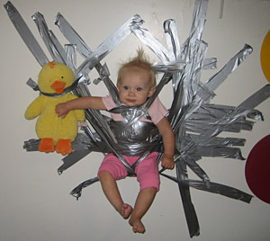


Duct tape approach

Slide 10
Problems
Problem 1:
  What exactly does the “optimal action” mean?
  Extract as much
  money as you can right now
  VS
Make user happy
so that he would visit you again

Slide 11
Problems
Problem 2:
  If you always follow the “current optimal” strategy, you may never discover something better.
  If you show the same banner to 100% users, you will never learn how other ads affect them.
  Ideas?

Slide 12
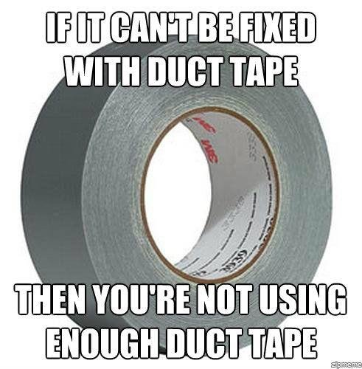
Duct tape approach

Slide 13

Reinforcement learning

Slide 14

What is: bandit
observation
Agent
action
Feedback
Examples:
  banner ads (RTB)
  recommendations
  medical treatment

Slide 15

What is: bandit
observation
Agent
action
Feedback
Examples:
  banner ads (RTB)
  recommendations
  medical treatment

Slide 16
What is: bandit
observation
Agent
action
Feedback
Examples:
  banner ads (RTB)
  recommendations
  medical treatment
Q: what's observation, action and feedback in the banner ads problem?

Slide 17
What is: bandit
observation
Agent
action
Feedback
user features
time of year
trends
show
banner
click,
money
Examples:
  banner ads (RTB)
  recommendations
  medical treatment

Slide 18
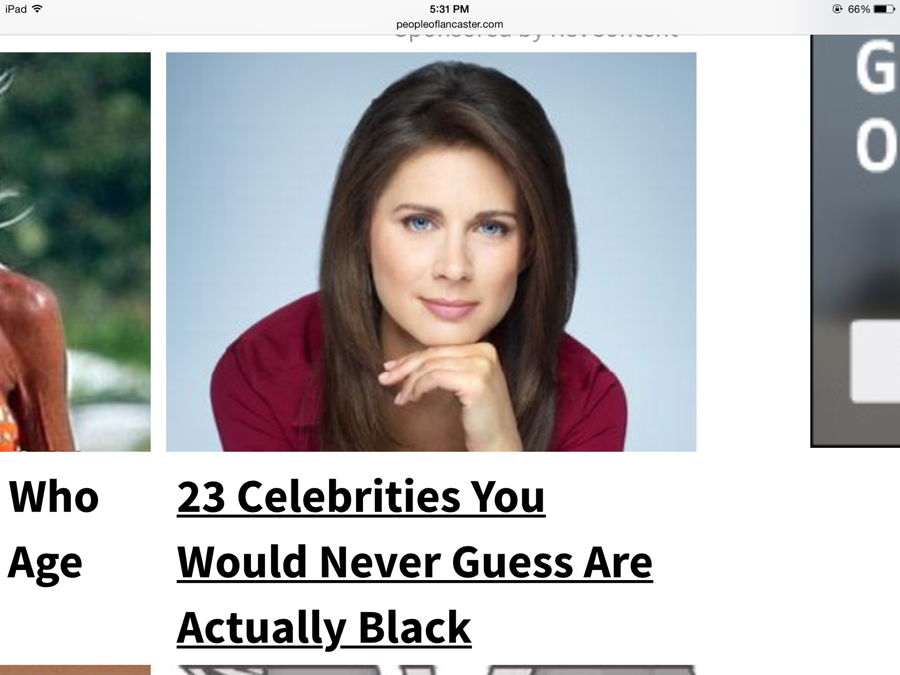
What is: bandit
observation
Agent
action
Feedback
user features
time of year
trends
show
banner
click,
money
Q: You're Yandex/Google/Youtube.
There's a kind of banners that would have great click rates: the “clickbait”.
Is it a good idea to show clickbait?

Slide 19
What is: bandit
observation
Agent
action
Feedback
Q: You're Yandex/Google/Youtube.
There's a kind of banners that would have great click rates: the “clickbait”.
Is it a good idea to show clickbait?
No, no one will trust you after that!

Slide 20
What is: decision process
Agent
observation
action
Environment

Slide 21
What is: decision process
Agent
Can do anything
observation
action
Can't even see
(worst case)
Environment

Slide 22

Reality check: web
Cases:
  Pick ads to maximize profit
  Design landing page to maximize user retention
  Recommend movies to users
  Find pages relevant to queries
Example
  Observation – user features
  Action – show banner #i
  Feedback – did user click?

Slide 23




Reality check: dynamic systems

Slide 24

Reality check: dynamic systems
Cases:
    Robots
    Self-driving vehicles
    Pilot assistant
    More robots!
Example
  Observation: sensor feed
  Action: voltage sent to motors
  Feedback: how far did it move
    forward before falling

Slide 25




Reality check: videogames
  Q: What are observations, actions and feedback?

Slide 26


Other use cases
Personalized medical treatment
Even more games (Go, chess, etc)
  Q: What are observations, actions and feedback?

Slide 27


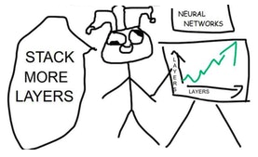
Other use cases
Conversation systems
  learning to make user happy
Quantitative finance
  portfolio management
Deep learning
  optimizing non-differentiable loss
  finding optimal architecture

Slide 28

The MDP formalism
Markov Decision Process
  Environment states:
  Agent actions:
  Rewards
  Dynamics:

Slide 29
The MDP formalism
Markov Decision Process
  Markov assumption

Slide 30

Total reward
Total reward for session:
Agent's policy:
Problem: find policy with
highest reward:

Slide 31
Objective
The easy way:
is an expected sum of rewards
that agent with policy earns per session

Slide 32
Objective
The easy way:
is an expected sum of rewards
that agent with policy earns per session
The hard way:

Slide 33
How do we solve it?
General idea:
  Play a few sessions
  Update your policy
  Repeat

Slide 34
Objective

Slide 35
Objective
Expected reward:
We need a gradient!

Slide 36
Objective
Agent's policy
True action value
state visitation frequency
(may depend on policy)
Q: how do we compute that?

Slide 37
Objective
True action value
a.k.a. E[ R(s,a) ]
sample N sessions

Slide 38
Objective
True action value
a.k.a. E[ R(s,a) ]
sample N sessions
Can we optimize policy now?

Slide 39
Objective
parameters “sit” here
True action value
a.k.a. E[ R(s,a) ]
We don't know how to compute dJ/dtheta

Slide 40
Objective
Wish list:
  Analytical gradient
  Easy/stable approximations

Slide 41
Log-derivative trick
Simple math
(try chain rule)

Slide 42
Log-derivative trick
Simple math

Slide 43
Policy gradient
Analytical inference

Slide 44
Policy gradient
Analytical inference
Trivia: anything curious about that formula?

Slide 45
Policy gradient
Analytical inference
that's expectation :)

Slide 46
Policy gradient
Analytical inference

Slide 47
Policy gradient (REINFORCE)
Policy gradient
Approximate with sampling

Slide 48
REINFORCE algorithm
Initialize NN weights
Loop:
  Sample N sessions z under current
  Evaluate policy gradient
  Ascend

Slide 49
REINFORCE baselines
Initialize NN weights
Loop:
  Sample N sessions z under current
  Evaluate policy gradient
What is better for learning:
random action in good state
or
great action in bad state?

Slide 50
REINFORCE baselines
We can subtract arbitrary baseline b(s)

Slide 51
REINFORCE baselines
We can subtract arbitrary baseline b(s)
Q: Can you simplify the second term?
Note that b(s) does not depend on a

Slide 52
REINFORCE baselines
A: How to simplify the second term

Slide 53
REINFORCE baselines
We can subtract arbitrary baseline b(s)
Gradient direction doesn’t change!

Slide 54
REINFORCE baselines
Gradient direction stays the same
Variance may change
Gradient variance:
as a random variable over (s, a)

Slide 55
REINFORCE baselines
Gradient direction stays the same
Variance may change
Gradient variance:
as a random variable over (s, a)
If b(s) correlates with Q(s,a), variance decreases

Slide 56
REINFORCE baselines
Gradient direction stays the same
Variance may change
Gradient variance:
as a random variable over (s, a)
Q: can you suggest any such b(s)?

Slide 57
REINFORCE baselines
Gradient direction stays the same
Variance may change
Gradient variance:
as a random variable over (s, a)
Naive baseline: b = moving average Q
over all (s, a), Var[b(s)] = 0, Cov[Q, b] > 0

Slide 58

Duct tape zone
Superior algorithms exist
  For harder environments google A3C, PPO, TRPO
Regularize with entropy
  to prevent premature convergence
Learn on parallel sessions
  Or super-small experience replay
Use logsoftmax for numerical stability

Slide 59

Q: How is RL different
from supervised learning?

Slide 60

What-what learning?
      Supervised learning
  Learning to approximate reference answers
  Needs correct answers
  Model does not affect the input data
      Reinforcement learning
  Learning optimal strategy
by trial and error
  Needs feedback on agent's own actions
  Agent can affect it's own observations

Slide 61
What-what learning?
      Unsupervised learning
  Learning underlying
  data structure
  No feedback required
  Model does not affect the input data
      Reinforcement learning
  Learning optimal strategy
by trial and error
  Needs feedback on agent's own actions
  Agent can affect its own observations

Slide 62
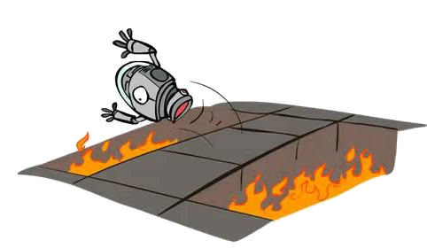
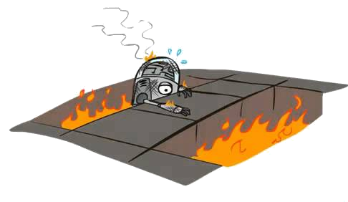
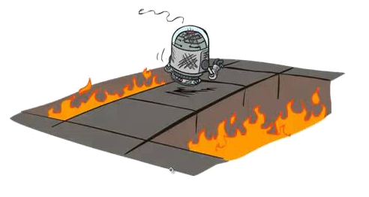
Reinforcement learning is easy!
1. take action
2. get reward
3. improve policy

Slide 63
Reinforcement learning is challenging!
How to explore?
Can agent
cheat reward?
What if there’s many actions?
Which actions
caused reward?
1. take action
2. get reward
How to infer
actions from
game image?
Sparse
rewards?
How not to
break anyting
when acting?
Which rewards are easier to learn?
Continuous
actions?
What if there are
multiple agents?
How do I formulate
my problem for RL?
How to define
policy model?
What if observations
are incomplete?
When not
to use RL?
take supervised
data into account?
best way to learn
from limited data?
did my algorithm overfit to simulation?
3. improve policy
How do I know
if it converged or not?

Slide 64
Now go and implement that :)

