Slide 1
Development of a Valid Model of Input Data
Collection of raw data
Identify underlying statistical distribution
Estimate parameters
Test for goodness of fit
Notes:
30

Slide 2
Identifying the Distribution
Histograms
  Notes: Histograms may infer a known pdf or pmf.
  Example: Exponential, Normal, and Poisson distributions are frequently encountered, and less difficult to analyze.
Probability plotting (good for small samples)
Notes:
30

Slide 3
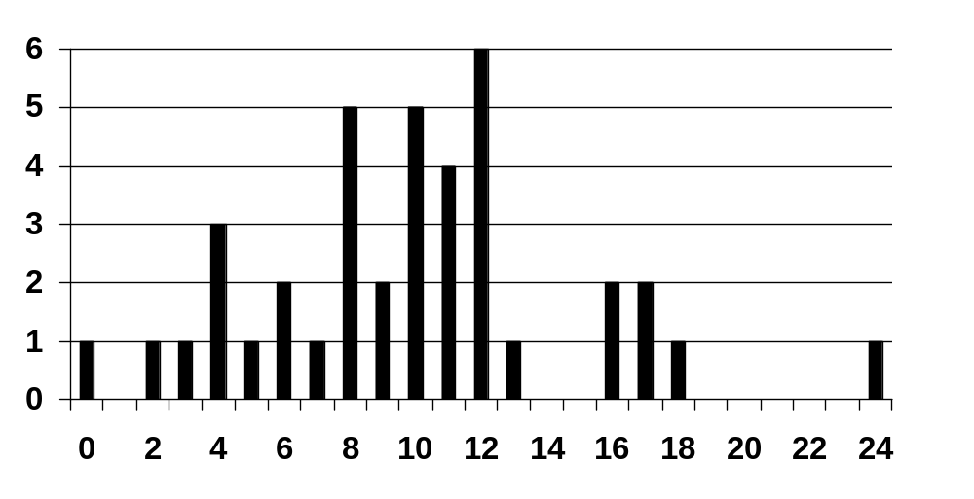
Sample Histograms
Coarse, ragged, and appropriate histogram
(Figure 1) (1) Original Data - Too ragged
Notes:
30

Slide 4
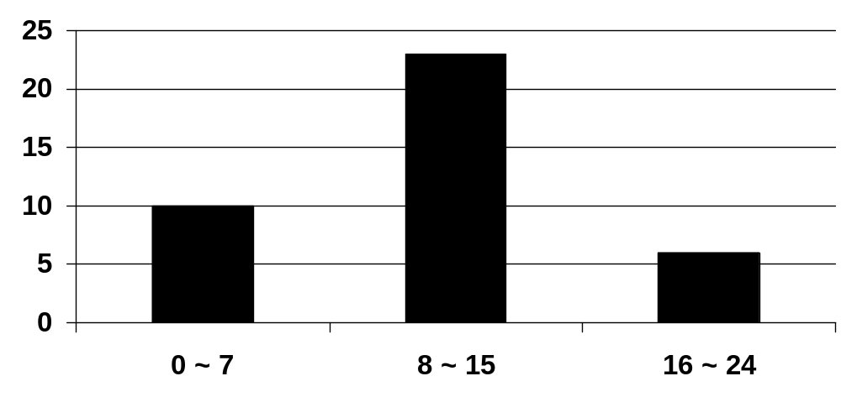
Sample Histograms (cont.)
Coarse, ragged, and appropriate histogram
(Figure 1) (2) Combining adjacent cells - too coarse
Notes:
30

Slide 5
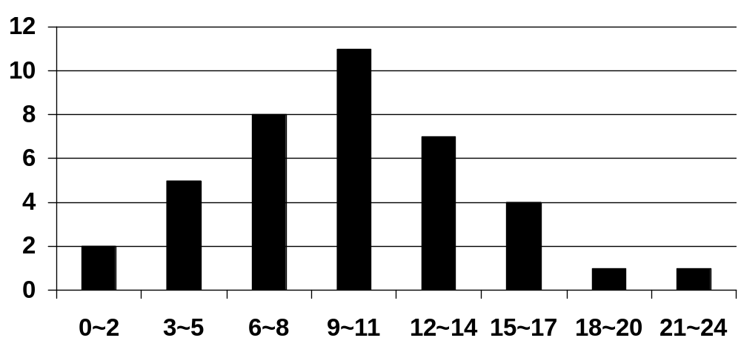
Sample Histograms (cont.)
Coarse, ragged, and appropriate histogram
(Figure 1) (3) Combining adjacent cells - appropriate
Notes:
30

Slide 6
Discrete Data Example
The number of vehicles arriving at the northwest corner of an intersection in a 5-minute period between 7:00 a.m. and 7:05 a.m. was monitored for five workdays over a 20-week period. Following table shows the resulting data. The first entry in the table indicates that there were 12 5-minute periods during which zero vehicles arrived, 10 periods during which one vehicle arrived, and so on.
Notes:
30

Slide 7
Discrete Data Example (cont.)
Arrivals Arrivals
per Period Frequency per Period Frequency
0 12 6 7
1 10 7 5
2 19 8 5
3 17 9 3
4 10 10 3
5 8 11 1
Since the number of automobiles is a discrete variable, and since there are ample data, the histogram can have a cell for each possible value in the range of data. The resulting histogram is shown in Figure 2
Notes:
30

Slide 8
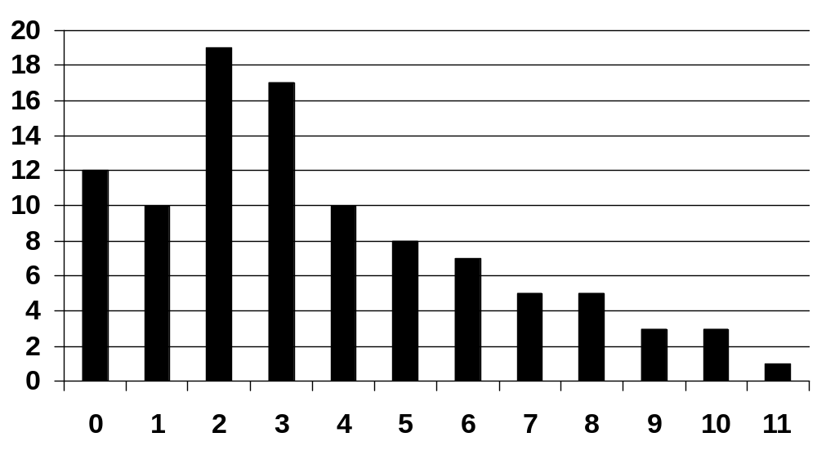
Histogram of number of arrivals per period
(Figure 2) Number of arrivals per period
Notes:
30

Slide 9
Continuous Data Example
Life tests were performed on a random sample of 50 PDP-11 electronic chips at 1.5 times the normal voltage, and their lifetime (or time to failure) in days was recorded:
79.919 3.081 0.062 1.961 5.845 3.027 6.505 0.021 0.012 0.123
6.769 59.899 1.192 34.760 5.009 18.387 0.141 43.565 24.420 0.433
144.695 2.663 17.967 0.091 9.003 0.941 0.878 3.371 2.157 7.579
0.624 5.380 3.148 7.078 23.960 0.590 1.928 0.300 0.002 0.543
7.004 31.764 1.005 1.147 0.219 3.217 14.382 1.008 2.336 4.562
Notes:
30

Slide 10
Continuous Data Example (cont.)
Chip Life (Days) Frequency Chip Life (Days) Frequency
0 ≤ x_{i} < 3 23 30 ≤ x_{i} < 33 1
3 ≤ x_{i} < 6 10 33 ≤ x_{i} < 36 1
6 ≤ x_{i} < 9 5 .......... .....
9 ≤ x_{i} < 12 1 42 ≤ x_{i} < 45 1
12 ≤ x_{i} < 15 1 .......... .....
15 ≤ x_{i} < 18 2 57 ≤ x_{i} < 60 1
18 ≤ x_{i} < 21 0 .......... .....
21 ≤ x_{i} < 24 1 78 ≤ x_{i} < 81 1
24 ≤ x_{i} < 27 1 .......... .....
27 ≤ x_{i} < 30 0 143 ≤ x_{i} < 147 1
Electronic Chip Data
Notes:
30

Slide 11
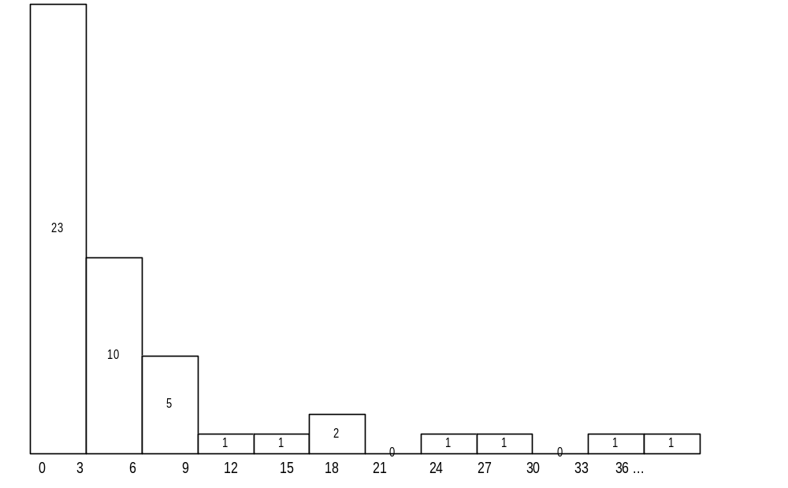
Continuous Data Example (cont.)
(Figure 3) Histogram of chip life
Notes:
30

Slide 12
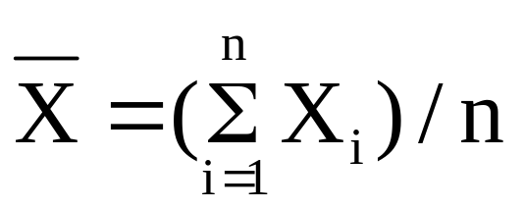
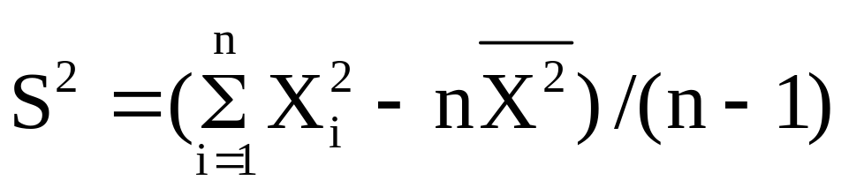
Parameter Estimation
The sample mean, X, is defined by
  --- (Eq 1)
And the sample variance, S², is defined by
  --- (Eq 2)
Notes:
30

Slide 13
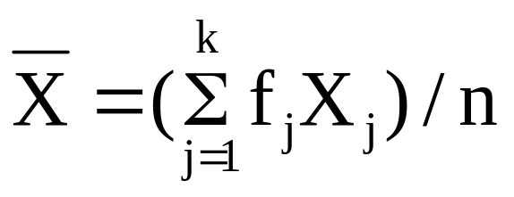
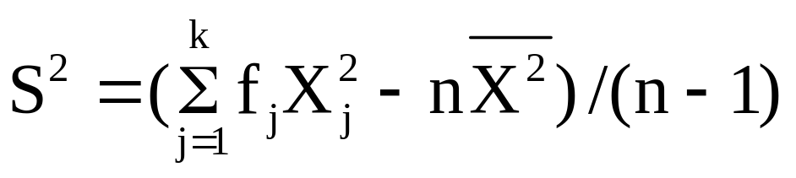
Parameter Estimation (cont.)
If the data are discrete and grouped in a frequency distribution, Eq1 and Eq2 can be modified to provide for much greater computational efficiency.
The sample mean can be computed by
--- (Eq 3)
And the sample variance, S², is defined by
--- (Eq 4)
Notes:
30

Slide 14
Suggested Estimators for distr. often used in Simulation
Distribution Parameter(s) Suggested Estimator(s)
Poisson α α = X
Exponential λ λ = 1 / X
Gamma β, θ  β = see(Table A.8)
 θ = 1 / X
Uniform b b = {(n + 1) / n } ⋅ [max(X)]
on (0, b) (unbiased)
Normal μ, σ^{2} μ = X
σ² = S² (unbiased)
Notes:
30

Slide 15
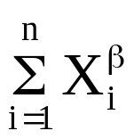
Suggested Estimators for distr. often used in Simulation
Distribution Parameter(s) Suggested Estimator(s)
Weibull α, β  β₀ = X / S
with v = 0  β_{j} = β_{j-1} − f(β_{j-1}) / f ‘(β_{j-1})
Iterate until convergence
α = {(1/n) ⋅ } ^{1/β}
Notes:
30

Slide 16
Goodness-of-Fit Tests
The Kolmogorov-Smirnov test and the chi-square test were introduced. These two tests are applied in this section to hypotheses about distributional forms of input data.
Notes:
30

Slide 17
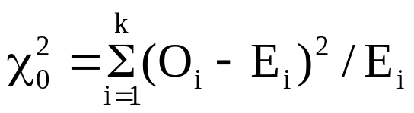
Goodness-of-Fit Tests
Chi-Square Test
This test is valid for large sample sizes, for both discrete and continuous distributional assumptions when parameters are estimated by maximum likelyhood. The test procedure begins by arranging the n observations into a set of k class intervals or cells. The test statistic is given by
--- (Eq 5)
where O_{i} is the observed frequency in the ith class interval and E_{i} is the expected frequency in that class interval.
Notes:
30

Slide 18
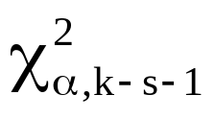
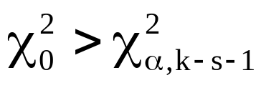
Goodness-of-Fit Tests
Chi-Square Test (cont.)
The hypotheses are:
H₀: the random variable, X, conforms to the distributional assumption with the parameter(s) given by the parameter estimate(s)
H₁: the random variable, X, does not conform
The critical value is found in Table A.6. The null hypothesis, H₀, is rejected if
Notes:
30

Slide 19
Goodness-of-Fit Tests
Chi-Square Test (cont.)
(Table 1) Recommendations for number of class intervals for continuous data
Sample Size, Number of Class Intervals,
n k
20 Do not use the chi-square test
50 5 to 10
100 10 to 20
>100 √n to n/5
Notes:
30

Slide 20
Goodness-of-Fit Tests
Chi-Square Test (cont.)
(Example:)
(Chi-square test applied to Poisson Assumption)
In the previous example, the vehicle arrival data were analyzed. Since the histogram of the data, shown in Figure 2, appeared to follow a Poisson distribution, the parameter, α = 3.64, was determined. Thus, the following hypotheses are formed:
H₀: the random variable is Poisson distributed
H₁: the random variable is not Poisson distributed
Notes:
30

Slide 21
Goodness-of-Fit Tests
Chi-Square Test (cont.)
The pmf for the Poisson distribution was given:
⎧(e^{-α} α^{x}) / x! , x = 0, 1, 2 ... p(x) = ⎨ (Eq 6)
⎩0 , otherwise
For α = 3.64, the probabilities associated with various values of x are obtained using equation 6 with the following results.
p(0) = 0.026 p(3) = 0.211 p(6) = 0.085 p(9) = 0.008
p(1) = 0.096 p(4) = 0.192 p(7) = 0.044 p(10) = 0.003
p(2) = 0.174 p(5) = 0.140 p(8) = 0.020 p(11) = 0.001
Notes:
30

Slide 22
Goodness-of-Fit Tests
Chi-Square Test (cont.)
Observed Frequency, Expected Frequency, (O_{i} - E_{i})² / E_{i}
x_{i} O_{i} E_{i}
0 12 2.6 7.87
1 10 22 9.6 12.2
2 19 17.4 0.15
3 17 21.1 0.80
4 10 19.2 4.41
5 8 14.0 2.57
6 7 8.5 0.26
7 5 4.4
8 5 2.0
9 3 17 0.8 7.6 11.62
10 3 0.3
11 1 0.1
100 100.0 27.68
(Table 2) Chi-square goodness-of fit test for example
Notes:
30

Slide 23
Goodness-of-Fit Tests
Chi-Square Test (cont.)
With this results of the probabilities, Table 2 is constructed. The value of E₁ is given by np₁ = 100 (0.026) = 2.6. In a similar manner, the remaining E_{i} values are determined. Since E₁ = 2.6 < 5, E₁ and E₂ are combined. In that case O₁ and O₂ are also combined and k is reduced by one. The last five class intervals are also combined for the same reason and k is further reduced by four.
Notes:
30

Slide 24

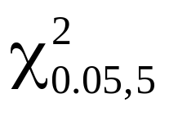
Goodness-of-Fit Tests
Chi-Square Test (cont.)
The calculated is 27.68. The degrees of freedom for the tabulated value of χ² is k-s-1 = 7-1-1 = 5. Here, s = 1, since one parameter was estimated from the data. At α = 0.05, the critical value is 11.1. Thus, H₀ would be rejected at level of significance 0.05. The analyst must now search for a better-fitting model or use the empirical distribution of the data.
Notes:
30

Slide 25
Chi-Square Test with
Equal Probabilities
Continuous distributional assumption
==> Class intervals equal in probability
P_{i} = 1 / k
since E_{i} = nP_{i} ≥ 5
==> n / k ≥ 5 (substitution)
and solve for k yields
k ≤ n / 5
Notes:
30

Slide 26
Chi-Square Test for
Exponential Distribution
(Example)
Since the histogram of the data, shown in Figure3 (histogram of chip life), appeared to follow an exponential distribution, the parameter λ = 1/X = 0.084 was determined. Thus, the following hypotheses are formed:
H₀: the random variable is exponentially distributed
H₁: the random variable is not exponentially distributed
Notes:
30

Slide 27
Chi-Square Test for
Exponential Distribution (cont.)
In order to perform the chi-square test with intervals of equal probability, the endpoints of the class intervals must be determined. The number of intervals should be less than or equal to n/5. Here, n=50, so that k ≤10. In table 1, it is recommended that 7 to 10 class intervals be used. Let k = 8, then each interval will have probability p = 0.125. The endpoints for each interval are computed from the cdf for the exponential distribution, as follows:
Notes:
30

Slide 28
Chi-Square Test for
Exponential Distribution (cont.)
F(a_{i}) = 1 - e^{-λai} (Eq 7)
where a_{i} represents the endpoint of the ith interval, i = 1, 2, ..., k. Since F(a_{i}) is the cumulative area from zero to a_{i} , F(a_{i}) = ip, so Equation 7 can be written as
ip = 1 - e^{-λai}
or
e^{-λai} = 1 - ip
Notes:
30

Slide 29
Chi-Square Test for
Exponential Distribution (cont.)
Taking the logarithm of both sides and solving for a_{i} gives a general result for the endpoints of k equiprobable intervals for the exponential distribution, namely
a_{i} = {-1/λ} ln(1 - ip), i = 0, 1, ..., k (Eq 8)
Regardless of the value of λ , equation 8 will always result in a₀ = 0 and a_{k} = ∞.
With λ = 0.084 and k = 8, a₁ is determined from equation 8 as
a₁ = {-1/0.084}ln(1 - 0.125) = 1.590
Notes:
30

Slide 30
Chi-Square Test for
Exponential Distribution (cont.)
Continued application of equation 8 for i = 2, 3, ... 7 results in a₂ ,... a₇ as 3.425, 5.595, 8.252, 11.677, 16.503, and 24.755. Since k = 8, a₈ = ∞. The first interval is [0, 1.590), the second interval is [1.590, 3.425), and so on. The expectation is that 0.125 of the observations will fall in each interval. The observations, expectations, and the contributions to the calculated value of are shown in Table 3.
Notes:
30

Slide 31
Chi-Square Test for
Exponential Distribution (cont.)
Class Observed Frequency, Expected Frequency, (O_{i} - E_{i})² / E_{i}
Intervlas O_{i} E_{i}
[0, 1.590) 19 6.25 26.01
[1.590, 3.425) 10 6.25 2.25
[3.425, 5.595) 3 6.25 0.81
[5.595, 8.252) 6 6.25 0.01
[8.252, 11.677) 1 6.25 4.41
[11.677, 16.503) 1 6.25 4.41
[16.503, 24.755) 4 6.25 0.81
[24.755, ∞) 6 6.25 0.81
50 50 39.6
(Table 3) Chi-Square Goodness-of-fit test
Notes:
30

Slide 32

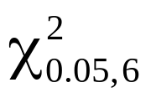
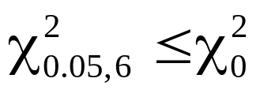
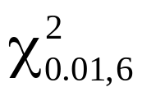
Chi-Square Test for
Exponential Distribution (cont.)
The calculated value of is 39.6. The degrees of freedom are given by k - s - 1 = 8 - 1 - 1 = 6. At α = 0.05, the tabulated value of is 12.6. Since , the null hypothesis is rejected. (The value of is 16.8, so the null hypothesis would also be rejected at level of significance α = 0.01.)
Notes:
30

Slide 33
Simple Linear Regression
Suppose that it is desired to estimate the relationship between a single independent variable x and a dependent variable y. Suppose that the true relationship between y and x is a linear relationship, where the observation, y, is a random variable and x is a mathematical variable. The expected value of y for a given value of x is assumed to be
E(y|x) = β₀+ β₁x (Eq 9)
where β₀ = intercept on the y axis; an unknown constant; β₁ = slope, or change in y for a unit change in x; an unknown constant.
Notes:
30

Slide 34
Simple Linear Regression (cont.)
It is assumed that each observation of y can be described by the model
y = β₀+ β₁x + ε (Eq 10)
where ε is a random error with mean zero and constant variance σ². The regression model given by equation 10 involves a single variable x and is commonly called a simple linear regression model.
Notes:
30

Slide 35
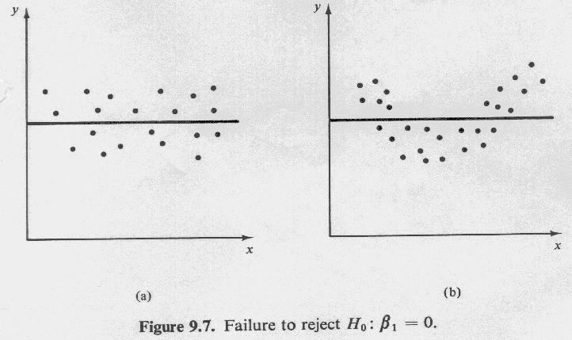
Simple Linear Regression (cont.)
Notes:
30

Slide 36
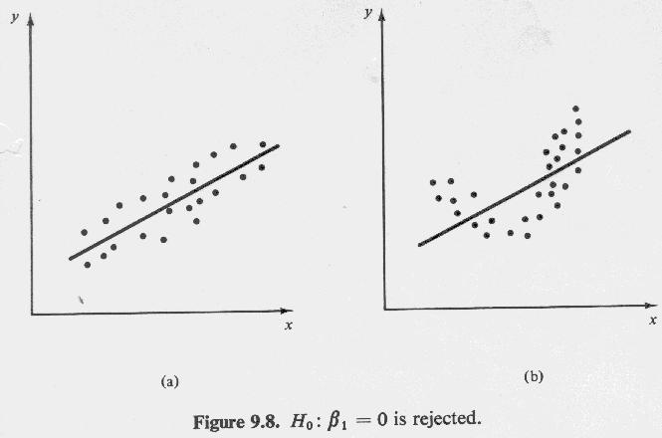
Simple Linear Regression (cont.)
Notes:
30

Slide 37
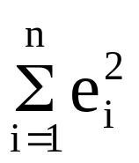

Simple Linear Regression (cont.)
The appropriate test statistic for significance of regression is given by
t₀ = β₁ / √ (MS_{E}/S_{xx})
where MS_{E} is the mean squared error. The error is the difference between the observed value y_{i}, and the predicted value, y_{i}, at x_{i}, or e_{i} = y_{i} - y_{i}. The squared error is given by and the mean squared error, given by
is an unbiased estimator of σ² = V(ε_{i}).
Notes:
30

