Slide 1
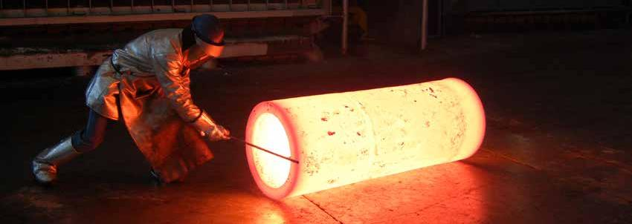

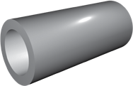
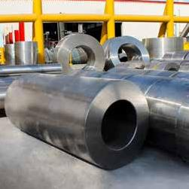
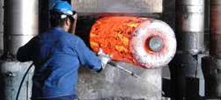
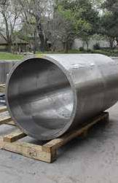
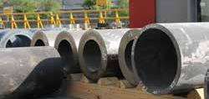
HOLLOWS
The inside diameter of our hollows is forged into the part rather than bored from a bar, which makes them an excellent option that eliminates extra time, cost and material waste. Since we forge them as a single component; we pass along several benefits to our customers by saving production time and increasing part strength.
MANUFACTURING CAPABILITIES
Range | O.D. up to 60 in
Range | I.D. up to 30 in
Range | Weight up to 55,000 lb.
Material | Carbon Steel, Alloy Steel, Tool Steel, Stainless Steel.
Heat Treat | Normalizing, Quenching, Tempering, Annealing, Solution Annealing, Spherodizing, Aging, Stress Relieving.
Testing | Destructive and Non-Destructive.
Machining | Available CNC machining capabilities: vertical & horizontal turning, milling, boring, drilling, deep drilling.
Forging evolution. | INTL.: +52 (81) 8153-0321 | USA TOLL FREE: 1 888 882 0959 | MEXICO TOLL FREE: 01-800-2537-472

Slide 2

MATERIAL STOCKING GRADES
Classification
Grade
UNS Number
DIN
Werkstoff Nr
A105
K03504
C22.8
1.0460
1010
G10100
CK10
1.1121
1018
G10180
CK15
1.1141
1020
G10200
CK20
1035
G10350
CK35
1.1181
Carbon and Low
Alloy steels
1045
G10450
CK45
1.1191
1050
G10500
CK50
1080
G10800
CK80
1552
G15520
A350 Grade LF6
A350 Grade LF2
K03011
C22.8
1.0460
A694
E355
1.0580
4130
G41300
25CrMo4
1.7218
4140
G41400
42CrMo2
1.7225
4145
G41450
4320
G43200
4330
4340
G43400
34CrNiMo6
1.6582
Alloy Steels
52100
100Cr6
1.3505
8620
G86200
21NiCrMo22
1.6543
8630
G86300
1.6545
A182 Grade F5
K41545
12CrMo195
1.7362
A 182 Grade F11
K11597
13CrMo4-5
1.7335
A 182 Grade F22
K21590
10CrMo9-10
1.7380
A707 Grade L5
A707 Grade 3W
Tool Steels
H13
T20813
X 40 CrMoV 5-1
1.2344
P20
T51620
40CrMnNiMo8-6-4
1.2311
L6
T61206
55NiCrMoV6
1.2713
A182 F44
S31254
X1CrNiMoN20-18-7
1.4547
A182 F51
S31803
X 2 CrNiMoN22-5-3
1.4462
A182 F53
S32750
X2CrNiMoN25-7-4
1.4410
A182 F60
S32205
A182 F91
K90901
X 10 CrMoVNb9-1
1.4903
15-5 PH
S15500
X5CrNiCuNb15-5
1.4545
17-4 PH
S17400
X5CrNiCuNb 17-4
1.4542
304
S30400
X5CrNi18-10
1.4301
304L
S30403
X5CrNi18-9
1.4306
310
S31000
X8 CrNi 25-21
1.4845
Stainless Steels
316
S31600
X5CrNiMo17 12-2
1.4401
316L
S31603
X2CrNiMo17 12-2
1.4404
321
S32100
X6CrNiTi18-10
1.4541
347
S34700
X6CrNiNb18-10
1.4551
410
S41000
X12Cr13
1.4006
420
S42000
X46Cr13
1.4034
422
S42200
1.4935
431
S43100
X17CrNi16-2
1.4057
X 22 CrNiMoV 12-1
1.4923
F6NM
S41500
X11CrMo 12-1
Alloy 718
N07718
X 3 CrNiMo 13-4
1.4313
Alloy 718 Plus
NiCr19Fe19Nb5Mo3
2.4668
Waspaloy
N07001
NiCr20Co13Mo4Ti3Al
2.4654
Alloy 909
N19909
X4NiCo38Nb
Alloy 907
N19907
X4NiCo38Nb
Alloy 625
N06625
NiCr22Mo9Nb
2.4856
Alloy 600
N06600
NiCr15Fe8
2.4816
Alloy 617
N06617
NiCr23Co12Mo
2.4663
Alloy X
N06002
NiCr22Fe18Mo
2.4665
Alloy H230
N06230
NiCo29Cr28Si
2.4880
Superalloys
Alloy 188
R30188
CoCr22NiW
2.4683
Alloy H242
N10242
Alloy HR120
N08120
NiFe33Cr25Co
2.4854
Nimonic 80
N07080
NiCr20TiAl
2.4952
Alloy 825
N08825
NiCr 21 Mo
2.4858
Alloy 800 H
N08800/N08810
X8 NiCrAlTi 32-21
1.4876 / 1.4958
Alloy C276
N10276
NiMo 16 Cr 15 W
2.4819
Monel 400
N04400
NiCu 30 Fe
2.4360
Alloy C263
N07263
NiCo20Cr20Mo6Ti2Al
2.4650
S66286
X5 NiCrTi 26-15
1.4980
Thermo Span
N07041
NiCr19Co11MoTi
2.4973
Al 6061
Al 7075
Aluminum
Al 2618
Al 2014
Al 2219
Al 7050
Ti-6-4
R56400
TiAl6V4
3.7165
Ti 6-2-4-2
R54620
TiAl6Sn2Zr4Mo2
3.7145
Titanium
Ti 21s
R58210
Ti 834
Ti-407
Forging evolution. | INTL.: +52 (81) 8153-0321 | USA TOLL FREE: 1 888 882 0959 | MEXICO TOLL FREE: 01-800-2537-472

