Slide 1
Producing Readable Output with iSQL*Plus
Notes:
Schedule: Timing Topic
35 minutes Lecture
35 minutes Practice
70 minutes Total

Slide 2
Objectives
After completing this lesson, you should be able to
do the following:
Produce queries that require a substitution variable
Customize the iSQL*Plus environment
Produce more readable output
Create and execute script files
Notes:
Lesson Aim
In this lesson, you will learn how to include iSQL*Plus commands to produce more readable SQL output.
You can create a command file containing a WHERE clause to restrict the rows displayed. To change the condition each time the command file is run, you use substitution variables. Substitution variables can replace values in the WHERE clause, a text string, and even a column or a table name.

Slide 3
Substitution Variables
I want to query different values.
... salary = ? …
… department_id = ? …
... last_name = ? ...
User
Notes:
Substitution Variables
The examples so far have been hard-coded. In a finished application, the user would trigger the report, and the report would run without further prompting. The range of data would be predetermined by the fixed WHERE clause in the iSQL*Plus script file.
Using iSQL*Plus, you can create reports that prompt the user to supply their own values to restrict the range of data returned by using substitution variables. You can embed substitution variables in a command file or in a single SQL statement. A variable can be thought of as a container in which the values are temporarily stored. When the statement is run, the value is substituted.
Instructor Note
Demo: 7_varno.sql, 7_varyes.sql
Purpose: To illustrate returning all rows and using a case-insensitive query with substitution variables.
With iSQL*Plus 9.0.1.0.1, there is a bug when using &substitution and wildcards (%) for character values.
This bug has been reported. The 7_varyes.sql will produce an error in iSQL*Plus, but the concept is important for students continuing classes using other products (such as Forms, Reports). You may want to demonstrate 7_varyes.sql in the SQL*Plus environment as an option.

Slide 4
Substitution Variables
Use iSQL*Plus substitution variables to:
Temporarily store values
  Single ampersand (&)
  Double ampersand (&&)
  DEFINE command
Pass variable values between SQL statements
Dynamically alter headers and footers
Notes:
Substitution Variables
In iSQL*Plus, you can use single ampersand (&) substitution variables to temporarily store values.
You can predefine variables in iSQL*Plus by using the DEFINE command. DEFINE creates and assigns a value to a variable.
Examples of Restricted Ranges of Data
Reporting figures only for the current quarter or specified date range
Reporting on data relevant only to the user requesting the report
Displaying personnel only within a given department
Other Interactive Effects
Interactive effects are not restricted to direct user interaction with the WHERE clause. The same principles can be used to achieve other goals. For example:
Dynamically altering headers and footers
Obtaining input values from a file rather than from a person
Passing values from one SQL statement to another
iSQL*Plus does not support validation checks (except for data type) on user input.
Instructor Note
A substitution variable can be used anywhere in SQL and iSQL*Plus commands, except as the first word entered at the command prompt.

Slide 5
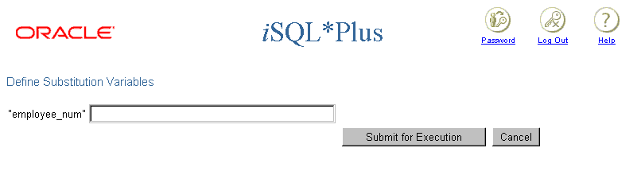
Using the & Substitution Variable
Use a variable prefixed with an ampersand (&) to prompt the user for a value.
SELECT employee_id, last_name, salary, department_id
FROM employees
WHERE employee_id = &employee_num ;
Notes:
Single-Ampersand Substitution Variable
When running a report, users often want to restrict the data returned dynamically. iSQL*Plus provides this flexibility by means of user variables. Use an ampersand (&) to identify each variable in your SQL statement. You do not need to define the value of each variable.
The example on the slide creates an iSQL*Plus substitution variable for an employee number. When the statement is executed, iSQL*Plus prompts the user for an employee number and then displays the employee number, last name, salary, and department number for that employee.
With the single ampersand, the user is prompted every time the command is executed, if the variable does not exist.

Slide 6
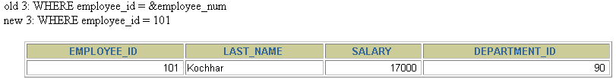
Using the & Substitution Variable
2
101
1
Notes:
Single-Ampersand Substitution Variable
When iSQL*Plus detects that the SQL statement contains an &, you are prompted to enter a value for the substitution variable named in the SQL statement. Once you enter a value and click the Submit for Execution button, the results are displayed in the output area of your iSQL*Plus session.

Slide 7

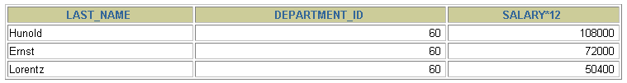
Character and Date Values with Substitution Variables
Use single quotation marks for date and character
values.
SELECT last_name, department_id, salary*12
FROM employees
WHERE job_id = '&job_title' ;
Notes:
Specifying Character and Date Values with Substitution Variables
In a WHERE clause, date and character values must be enclosed within single quotation marks. The same rule applies to the substitution variables.
Enclose the variable in single quotation marks within the SQL statement itself.
The slide shows a query to retrieve the employee names, department numbers, and annual salaries of all employees based on the job title value of the iSQL*Plus substitution variable.
Note: You can also use functions such as UPPER and LOWER with the ampersand. Use UPPER('&job_title') so that the user does not have to enter the job title in uppercase.

Slide 8
Specifying Column Names,
Expressions, and Text
Use substitution variables to supplement the
following:
WHERE conditions
ORDER BY clauses
Column expressions
Table names
Entire SELECT statements
Notes:
Specifying Column Names, Expressions, and Text
Not only can you use the substitution variables in the WHERE clause of a SQL statement, but these variables can also be used to substitute for column names, expressions, or text.
Example
Display the employee number and any other column and any condition of employees.
SELECT employee_id, &column_name
FROM employees
WHERE &condition;
If you do not enter a value for the substitution variable, you will get an error when you execute the preceding statement.
Note: A substitution variable can be used anywhere in the SELECT statement, except as the first word entered at the command prompt.

Slide 9
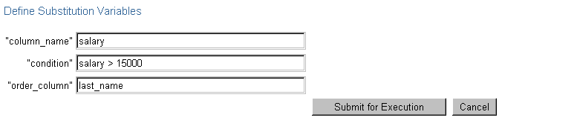
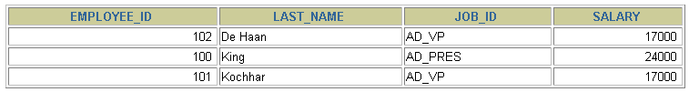
Specifying Column Names,
Expressions, and Text
SELECT employee_id, last_name, job_id,
&column_name
FROM employees
WHERE &condition
ORDER BY &order_column ;
Notes:
Specifying Column Names, Expressions, and Text (continued)
The slide example displays the employee number, name, job title, and any other column specified by the user at run time, from the EMPLOYEES table. You can also specify the condition for retrieval of rows and the column name by which the resultant data has to be ordered.
Instructor Note
Demo: 7_expr.sql
Purpose: To illustrate changing column names and conditions by using substitution variables

Slide 10
Defining Substitution Variables
You can predefine variables using the iSQL*Plus DEFINE command.
  DEFINE variable = value creates a user variable with the CHAR data type.
If you need to predefine a variable that includes spaces, you must enclose the value within single quotation marks when using the DEFINE command.
A defined variable is available for the session
Notes:
Defining Substitution Variables
You can predefine user variables before executing a SELECT statement. iSQL*Plus provides the DEFINE command for defining and setting substitution variables:
Instructor Note
Mention that iSQL*Plus commands can continue onto multiple lines and that they require the continuation character, the hyphen.

Slide 11
DEFINE and UNDEFINE Commands
A variable remains defined until you either:
  Use the UNDEFINE command to clear it
  Exit iSQL*Plus
You can verify your changes with the DEFINE command.
DEFINE job_title = IT_PROG
DEFINE job_title
DEFINE JOB_TITLE = "IT_PROG" (CHAR)
UNDEFINE job_title
DEFINE job_title
SP2-0135: symbol job_title is UNDEFINED
Notes:
The DEFINE and UNDEFINE Commands
Variables are defined until you either:
Issue the UNDEFINE command on a variable
Exit iSQL*Plus
When you undefine variables, you can verify your changes with the DEFINE command. When you exit iSQL*Plus, variables defined during that session are lost.

Slide 12
Using the DEFINE Command with
& Substitution Variable
Create the substitution variable using the DEFINE command.
Use a variable prefixed with an ampersand (&) to substitute the value in the SQL statement.
DEFINE employee_num = 200
SELECT employee_id, last_name, salary, department_id
FROM employees
WHERE employee_id = &employee_num ;
Notes:
Using the DEFINE Command
The example on the slide creates an iSQL*Plus substitution variable for an employee number by using the DEFINE command, and at run time displays the employee number, name, salary, and department number for that employee.
Because the variable is created using the iSQL*Plus DEFINE command, the user is not prompted to enter a value for the employee number. Instead, the defined variable value is automatically substituted in the SELECT statement.
The EMPLOYEE_NUM substitution variable is present in the session until the user undefines it or exits the iSQL*Plus session.

Slide 13
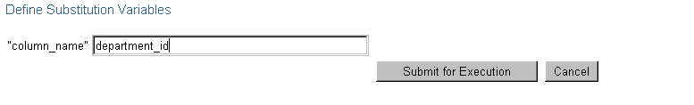
Using the && Substitution Variable
Use the double-ampersand (&&) if you want to reuse
the variable value without prompting the user each
time.
SELECT employee_id, last_name, job_id, &&column_name
FROM employees
ORDER BY &column_name;
…
Notes:
Double-Ampersand Substitution Variable
You can use the double-ampersand (&&) substitution variable if you want to reuse the variable value without prompting the user each time. The user will see the prompt for the value only once. In the example on the slide, the user is asked to give the value for variable column_name only once. The value supplied by the user (department_id) is used both for display and ordering of data.
iSQL*Plus stores the value supplied by using the DEFINE command; it will use it again whenever you reference the variable name. Once a user variable is in place, you need to use the UNDEFINE command to delete it.

Slide 14
Using the VERIFY Command
Use the VERIFY command to toggle the display of the
substitution variable, before and after iSQL*Plus
replaces substitution variables with values.
SET VERIFY ON
SELECT employee_id, last_name, salary, department_id
FROM employees
WHERE employee_id = &employee_num;
old 3: WHERE employee_id = &employee_num
new 3: WHERE employee_id = 200
Notes:
The VERIFY Command
To confirm the changes in the SQL statement, use the iSQL*Plus VERIFY command. Setting SET VERIFY ON forces iSQL*Plus to display the text of a command before and after it replaces substitution variables with values.
The example on the slide displays the old as well as the new value of the EMPLOYEE_ID column.

Slide 15
Customizing the iSQL*Plus Environment
Use SET commands to control current session.
Verify what you have set by using the SHOW command.
SET system_variable value
SET ECHO ON
SHOW ECHO
echo ON
Notes:
Customizing the iSQL*Plus Environment
You can control the environment in which iSQL*Plus is currently operating by using the SET commands.
Syntax
SET system_variable value
In the syntax:
system_variable is a variable that controls one aspect of the session environment
value is a value for the system variable
You can verify what you have set by using the SHOW command. The SHOW command on the slide checks whether ECHO had been set on or off.
To see all SET variable values, use the SHOW ALL command.
For more information, see iSQL*Plus User’s Guide and Reference, “Command Reference.”

Slide 16
SET Command Variables
ARRAYSIZE {20 | n}
FEEDBACK {6 | n |OFF | ON}
HEADING {OFF | ON}
LONG {80 | n}| ON | text}
SET HEADING OFF
SHOW HEADING
HEADING OFF
Notes:
SET Command Variables
Note: The value n represents a numeric value. The underlined values indicate default values. If you enter no value with the variable, iSQL*Plus assumes the default value.

Slide 17
iSQL*Plus Format Commands
  COLUMN [column option]
  TTITLE [text | OFF | ON]
  BTITLE [text | OFF | ON]
  BREAK [ON report_element]
Notes:
Obtaining More Readable Reports
You can control the report features by using the following commands:
Guidelines
All format commands remain in effect until the end of the iSQL*Plus session or until the format setting is overwritten or cleared.
Remember to reset your iSQL*Plus settings to the default values after every report.
There is no command for setting an iSQL*Plus variable to its default value; you must know the specific value or log out and log in again.
If you give an alias to your column, you must reference the alias name, not the column name.

Slide 18
The COLUMN Command
Controls display of a column:
CLE[AR]: Clears any column formats
HEA[DING] text: Sets the column heading
FOR[MAT] format: Changes the display of the column using a format model
NOPRINT | PRINT
NULL
COL[UMN] [{column|alias} [option]]
Notes:
COLUMN Command Options

Slide 19
Using the COLUMN Command
Create column headings.
COLUMN last_name HEADING 'Employee|Name'
COLUMN salary JUSTIFY LEFT FORMAT $99,990.00
COLUMN manager FORMAT 999999999 NULL 'No manager'
Display the current setting for the LAST_NAME column.
COLUMN last_name
Clear settings for the LAST_NAME column.
COLUMN last_name CLEAR
Notes:
Displaying or Clearing Settings
To show or clear the current COLUMN command settings, use the following commands:

Slide 20
COLUMN Format Models
Element
9
0
$
L
.
,
Description
Single zero-suppression digit
Enforces leading zero
Floating dollar sign
Local currency
Position of decimal point
Thousand separator
Example
999999
099999
$9999
L9999
9999.99
9,999
Result
1234
001234
$1234
L1234
1234.00
1,234
Notes:
COLUMN Format Models
The slide displays sample COLUMN format models.
The Oracle server displays a string of pound signs (#) in place of a whole number whose digits exceed the number of digits provided in the format model. It also displays pound signs in place of a value whose format model is alphanumeric but whose actual value is numeric.

Slide 21
Using the BREAK Command
Use the BREAK command to suppress duplicates.
BREAK ON job_id
Notes:
The BREAK Command
Use the BREAK command to divide rows into sections and suppress duplicate values. To ensure that the BREAK command works effectively, use the ORDER BY clause to order the columns that you are breaking on.
Syntax
BREAK on column[|alias|row]
In the syntax:
column[|alias|row suppresses the display of duplicate values for a given column
Clear all BREAK settings by using the CLEAR command:
CLEAR BREAK

Slide 22
Using the TTITLE and BTITLE Commands
Display headers and footers.
Set the report header.
Set the report footer.
TTI[TLE] [text|OFF|ON]
TTITLE 'Salary|Report'
BTITLE 'Confidential'
Notes:
The TTITLE and BTITLE Commands
Use the TTITLE command to format page headers and the BTITLE command for footers. Footers appear at the bottom of the page.
The syntax for BTITLE and TTITLE is identical. Only the syntax for TTITLE is shown. You can use the vertical bar (|) to split the text of the title across several lines.
Syntax
TTI[TLE]|BTI[TLE] [text|OFF|ON]
In the syntax:
text represents the title text (enter single quotes if the text is more than one word).
OFF|ON toggles the title either off or on. It is not visible when turned off.
The TTITLE example on the slide sets the report header to display Salary centered on one line and Report centered below it. The BTITLE example sets the report footer to display Confidential. TTITLE automatically puts the date and a page number on the report.

Slide 23
Using the TTITLE and BTITLE Commands
Display headers and footers.
Set the report header.
Set the report footer.
TTI[TLE] [text|OFF|ON]
TTITLE 'Salary|Report'
BTITLE 'Confidential'
Notes:
The TTITLE and BTITLE Commands (continued)
Note: The slide gives an abridged syntax for TTITLE and BTITLE. Various options for TTITLE and BTITLE are covered in another SQL course.
Instructor Note
SQL*Plus 3.3 introduced the commands REPHEADER and REPFOOTER. REPHEADER places and formats a specified report header at the top of each report or lists the current REPHEADER definition. REPFOOTER places and formats a specified report footer at the bottom of each report or lists the current REPFOOTER definition.

Slide 24
Creating a Script File to Run a Report
  1. Create and test the SQL SELECT statement.
  2. Save the SELECT statement into a script file.
  3. Load the script file into an editor.
  4. Add formatting commands before the SELECT statement.
  5. Verify that the termination character follows the SELECT statement.
Notes:
Creating a Script File to Run a Report
You can either enter each of the iSQL*Plus commands at the SQL prompt or put all the commands, including the SELECT statement, in a command (or script) file. A typical script consists of at least one SELECT statement and several iSQL*Plus commands.
How to Create a Script File
1. Create the SQL SELECT statement at the SQL prompt. Ensure that the data required for the report is accurate before you save the statement to a file and apply formatting commands. Ensure that the relevant ORDER BY clause is included if you intend to use breaks.
2. Save the SELECT statement to a script file.
3. Edit the script file to enter the iSQL*Plus commands.
4. Add the required formatting commands before the SELECT statement. Be certain not to place iSQL*Plus commands within the SELECT statement.
5. Verify that the SELECT statement is followed by a run character, either a semicolon (;) or a slash (/).

Slide 25
Creating a Script File to Run a Report
  6. Clear formatting commands after the SELECT statement.
  7. Save the script file.
  8. Load the script file into the iSQL*Plus text window, and click the Execute button.
Notes:
How to Create a Script File (continued)
6. Add the format-clearing iSQL*Plus commands after the run character. Alternatively, you can store all the format-clearing commands in a reset file.
7. Save the script file with your changes.
8. Load the script file into the iSQL*Plus text window, and click the Execute button.
Guidelines
You can include blank lines between iSQL*Plus commands in a script.
If you have a lengthy iSQL*Plus or SQL*Plus command, you can continue it on the next line by ending the current line with a hyphen (-).
You can abbreviate iSQL*Plus commands.
Include reset commands at the end of the file to restore the original iSQL*Plus environment.
Note: REM represents a remark or comment in iSQL*Plus.

Slide 26
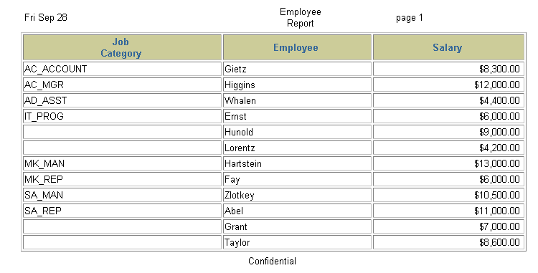
Sample Report
…
Notes:
Example
Create a script file to create a report that displays the job ID, last name, and salary for every employee whose salary is less than $15,000. Add a centered, two-line header that reads “Employee Report” and a centered footer that reads “Confidential.” Rename the job title column to read “Job Category” split over two lines. Rename the employee name column to read “Employee.” Rename the salary column to read “Salary” and format it as $2,500.00.

Slide 27
Sample Report
…
Notes:
Example (continued)
SET FEEDBACK OFF
TTITLE 'Employee|Report'
BTITLE 'Confidential'
BREAK ON job_id
COLUMN job_id HEADING 'Job|Category'
COLUMN last_name HEADING 'Employee'
COLUMN salary HEADING 'Salary' FORMAT $99,999.99
REM ** Insert SELECT statement
SELECT job_id, last_name, salary
FROM employees
WHERE salary < 15000
ORDER BY job_id, last_name
/
REM clear all formatting commands ...
SET FEEDBACK ON
COLUMN job_id CLEAR
COLUMN last_name CLEAR
COLUMN salary CLEAR
CLEAR BREAK
...

Slide 28
Summary
In this lesson, you should have learned how to:
Use iSQL*Plus substitution variables to store values temporarily
Use SET commands to control the current iSQL*Plus environment
Use the COLUMN command to control the display of a column
Use the BREAK command to suppress duplicates and divide rows into sections
Use the TTITLE and BTITLE commands to display headers and footers
Notes:
Summary
In this lesson, you should have learned about substitution variables and how useful they are for running reports. They give you the flexibility to replace values in a WHERE clause, column names, and expressions. You can customize reports by writing script files with:
Single ampersand substitution variables
Double ampersand substitution variables
The DEFINE command
The UNDEFINE command
Substitution variables in the command line
You can create a more readable report by using the following commands:
COLUMN
TTITLE
BTITLE
BREAK

Slide 29
Practice 7 Overview
This practice covers the following topics:
Creating a query to display values using substitution variables
Starting a command file containing variables
Notes:
Practice 7 Overview
This practice gives you the opportunity to create files that can be run interactively by using substitution variables to create run-time selection criteria.

Slide 30
Notes:
Practice 7
Determine whether the following two statements are true or false:
1. The following statement is valid:
DEFINE & p_val = 100
True/False
2. The DEFINE command is a SQL command.
True/False
3. Write a script to display the employee last name, job, and hire date for all employees who
started between a given range. Concatenate the name and job together, separated by a space
and comma, and label the column Employees. In a separate SQL script file, use the DEFINE command to provide the two ranges. Use the format MM/DD/YYYY. Save the script files as lab7_3a.sql and lab7_3b.sql.
DEFINE low_date = 01/01/1998
DEFINE high_date = 01/01/1999
4. Write a script to display the last names, job IDs, and department names for every employee in a given location. The search condition should allow for case-insensitive searches of the department location. Save the script file as lab7_4.sql.

Slide 31
Notes:
Practice 7 (continued)
5. Modify the code in lab7_4.sql to create a report containing the department name, employee last name, hire date, salary, and annual salary for each employee in a given location. Label the columns DEPARTMENT NAME, EMPLOYEE NAME, START DATE, SALARY, and ANNUAL SALARY, placing the labels on multiple lines. Resave the script as lab7_5.sql, and execute the commands in the script.

