Slide 1

“MEAN Stack” .replace(“A”, “OpenUI5”)
Yavor Ivanov, SAP Labs Bulgaria
Petya Markova-Bogdanova, SAP Labs Bulgaria
June 28, 2019

Slide 2
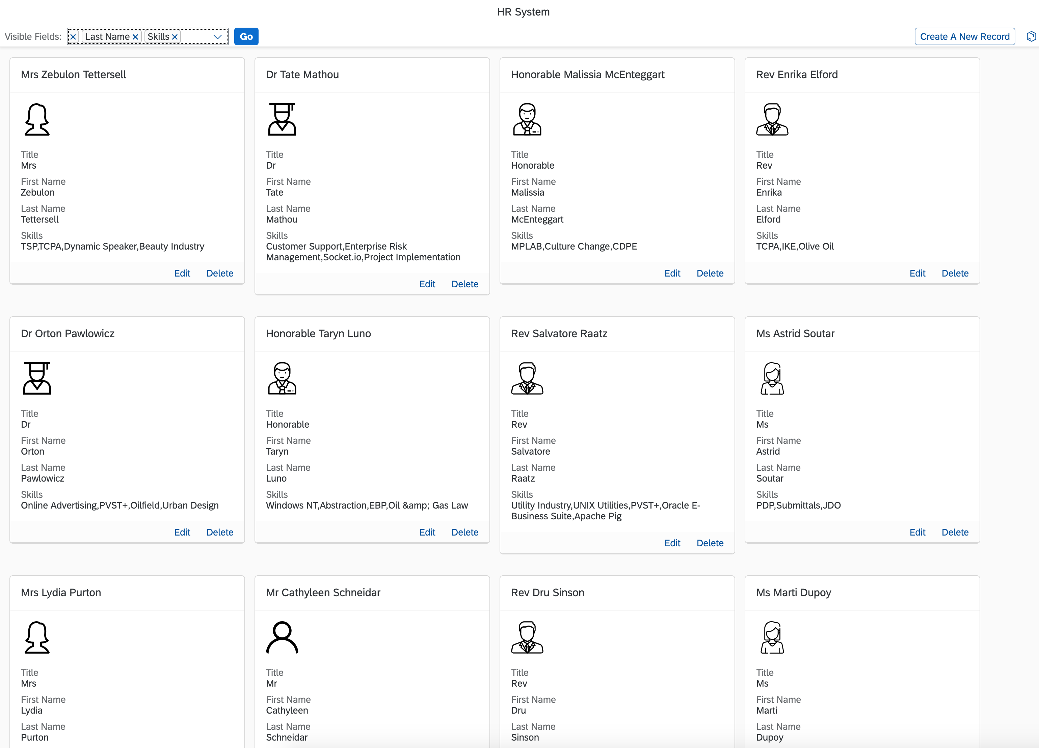
Our App

Slide 3
Agenda
Frontend
UI5
TypeScript
GraphQL Client
PWA
Backend
Node
Express
MongoDB
GraphQL Server
Steps
Bootstrap- initial project with dependencies.
Build a simple static server.
Frontend codding
Backend + GraphQL
Build a self-containing UI5 app
UI5 as Progressive Web App
* Bonus

Slide 4
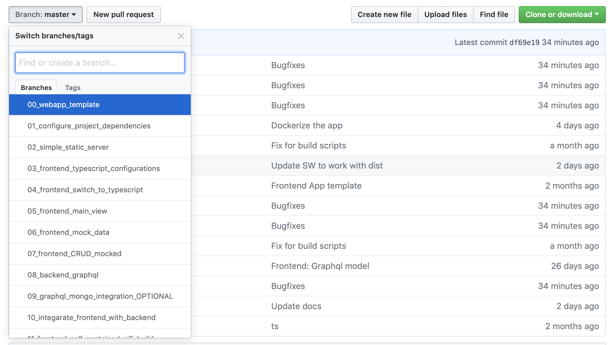
Session Structure

Slide 5
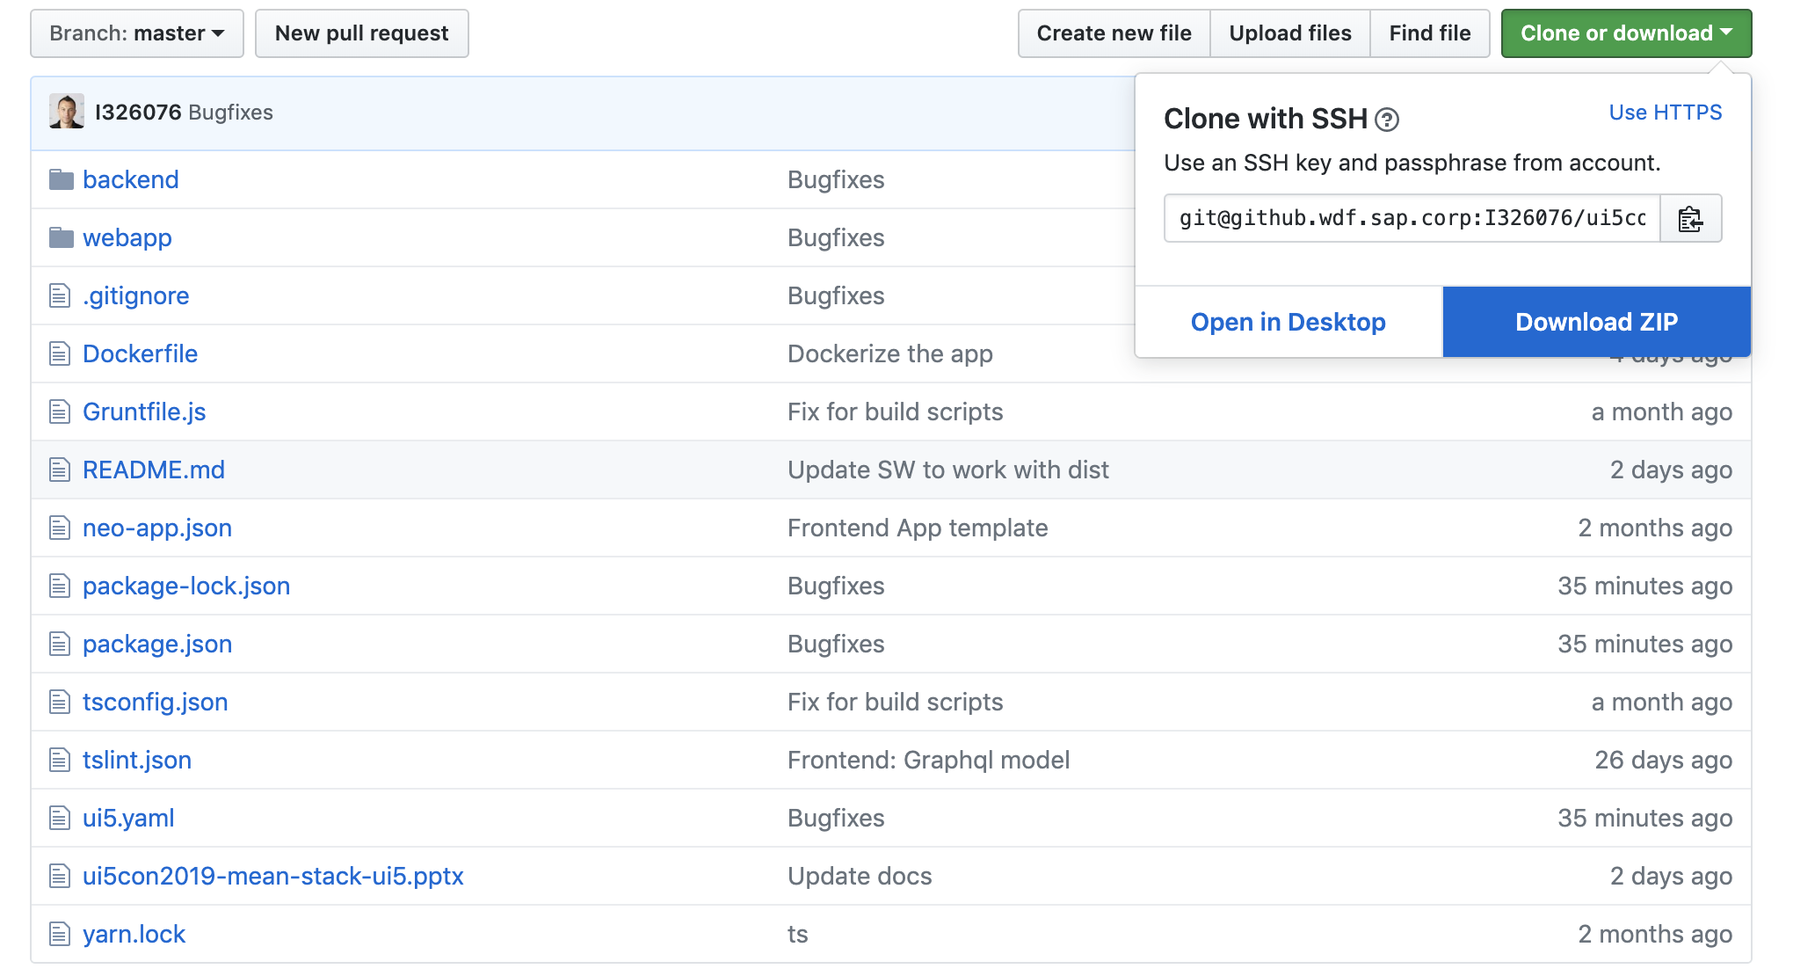
Session Structure

Slide 6
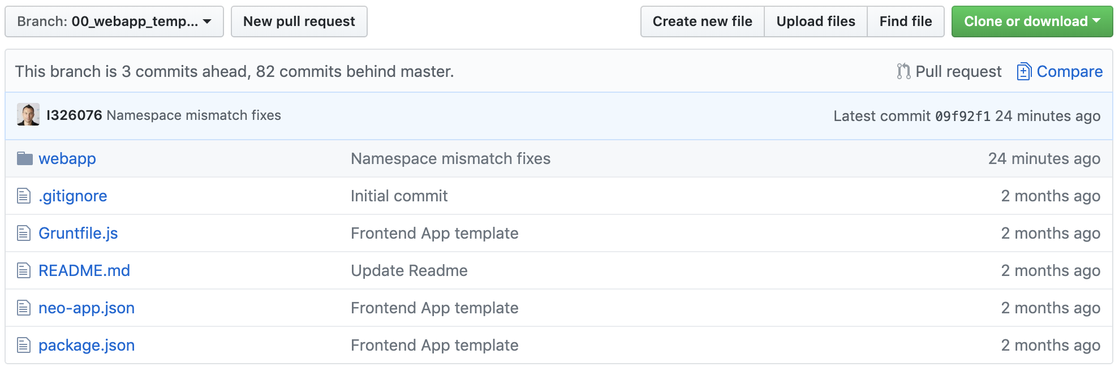
Session Structure

Slide 7
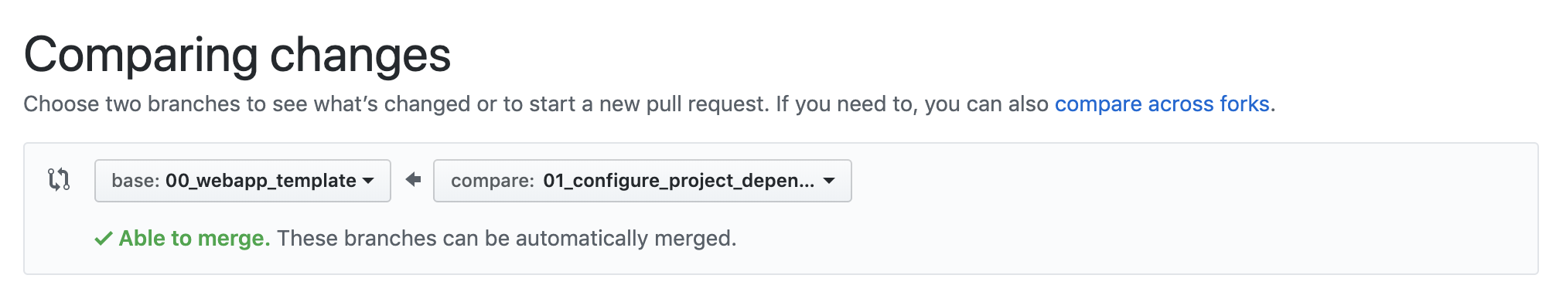
Session Structure

Slide 8
TypeScript

Slide 9
GraphQL

Slide 10
Resources
UI5 Tooling
https://github.com/SAP/ui5-tooling
https://github.com/SAP/ui5-typescript
TypeScript
https://www.typescriptlang.org/
https://palantir.github.io/tslint/
PWA
https://developers.google.com/web/progressive-web-apps/
Express
https://expressjs.com/
MongoDB
https://www.mongodb.com/
GraphQL
https://graphql.org/
https://www.apollographql.com/
https://medium.freecodecamp.org/how-to-set-up-a-graphql-server-using-node-js-express-mongodb-52421b73f474

Slide 11


Thank you.
Contact information:
Yavor Ivanov
yavor.Ivanov@sap.com
@d3xter666 d3xter666
Petya Markova-Bogdanova
petya.markova-bogdanova@sap.com

