Slide 1

“MEAN Stack” .replace(“A”, “OpenUI5”)
Yavor Ivanov, SAP Labs Bulgaria
Petya Markova-Bogdanova, SAP Labs Bulgaria
June 28, 2019

Slide 2
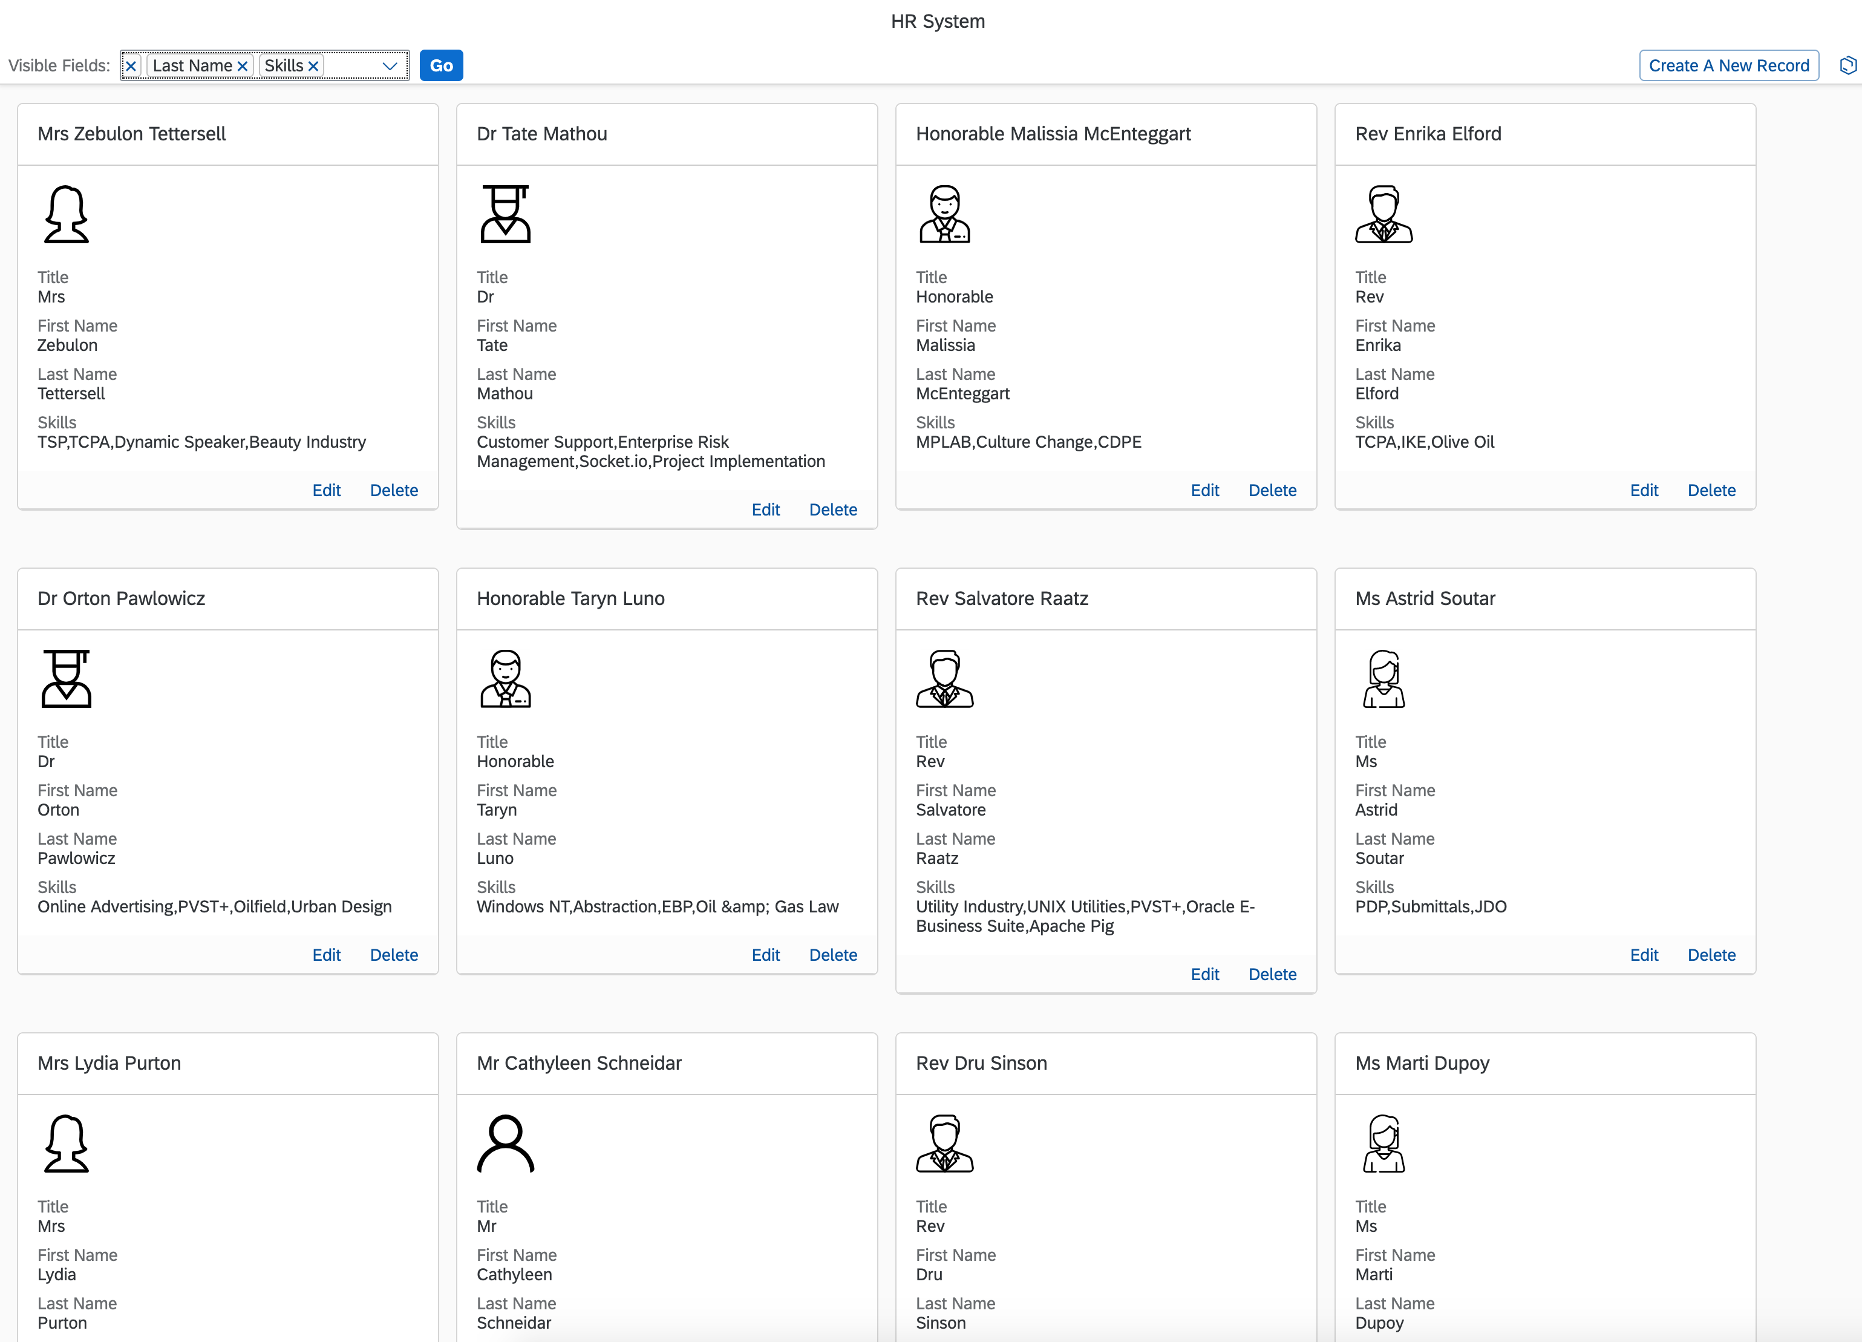
Our App

Slide 3
Agenda
Frontend
UI5
TypeScript
GraphQL Client
PWA
Backend
Node
Express
MongoDB
GraphQL Server
Steps
Bootstrap- initial project with dependencies.
Build a simple static server.
Frontend codding
Backend + GraphQL
Build a self-containing UI5 app
UI5 as Progressive Web App
* Bonus

Slide 4
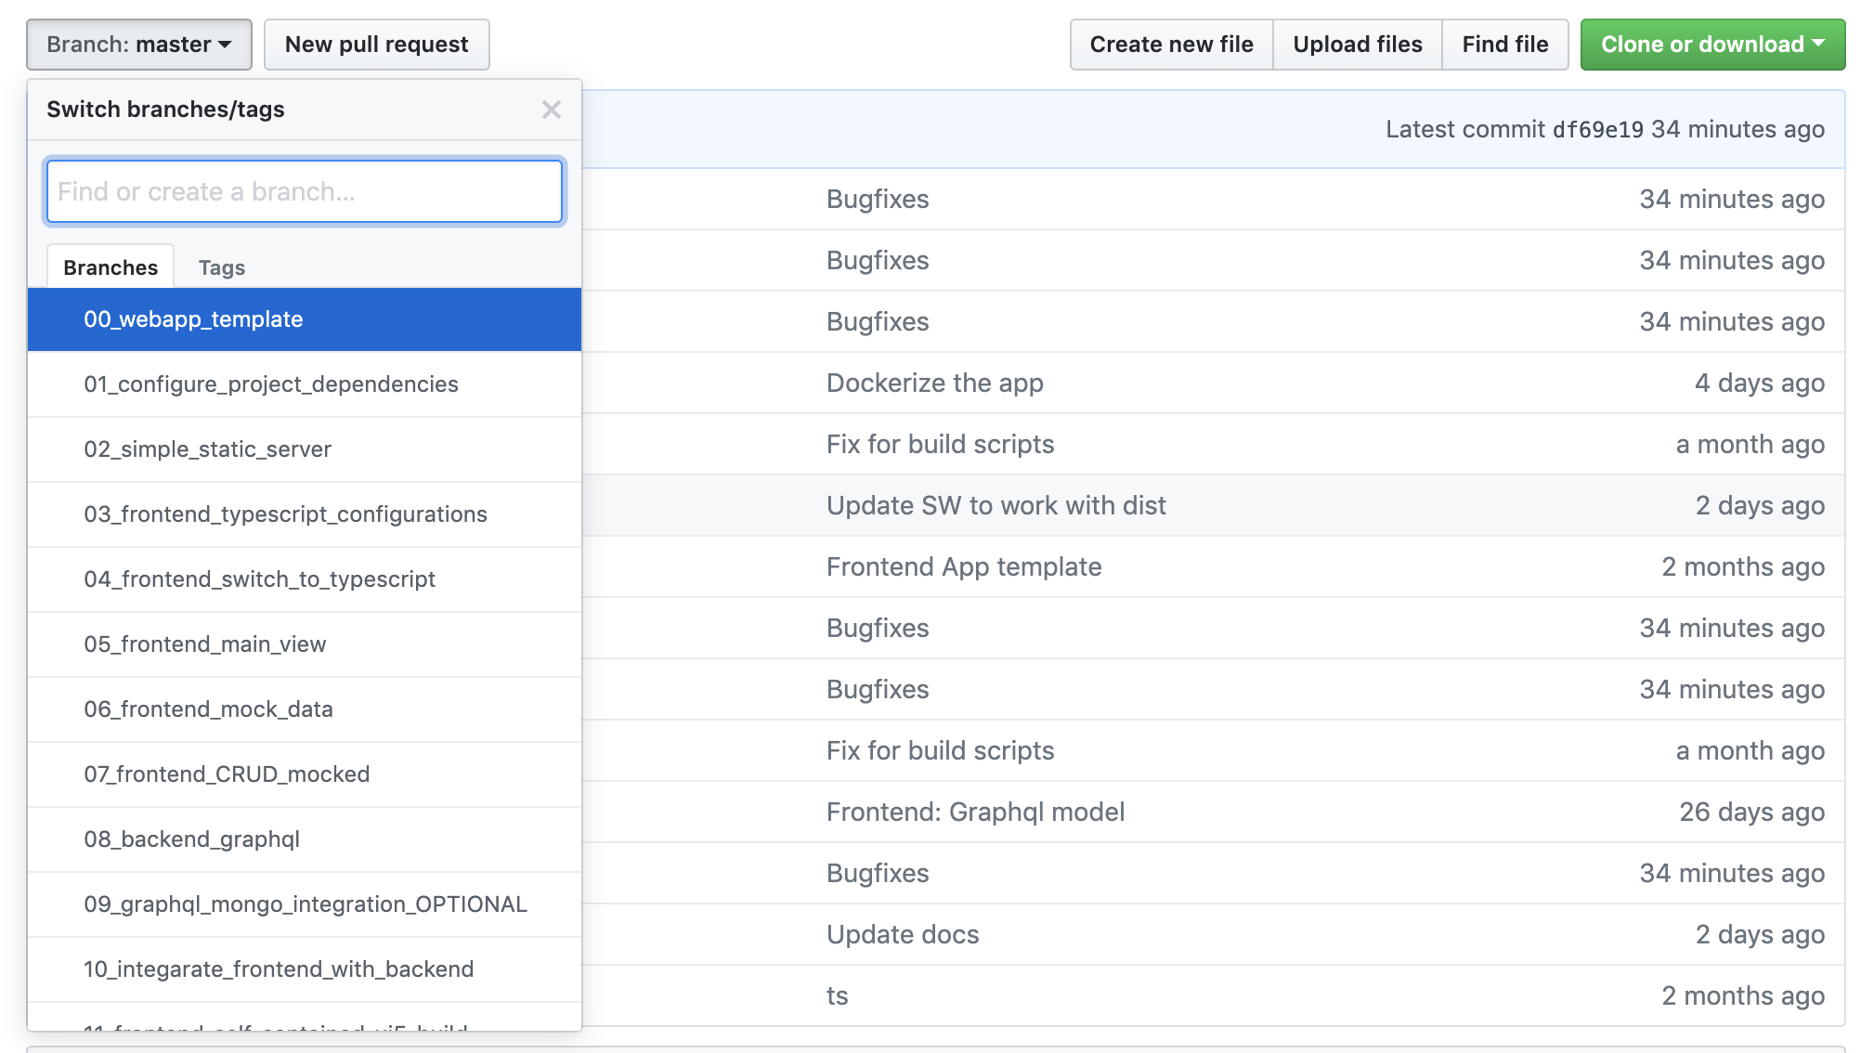
Session Structure

Slide 5
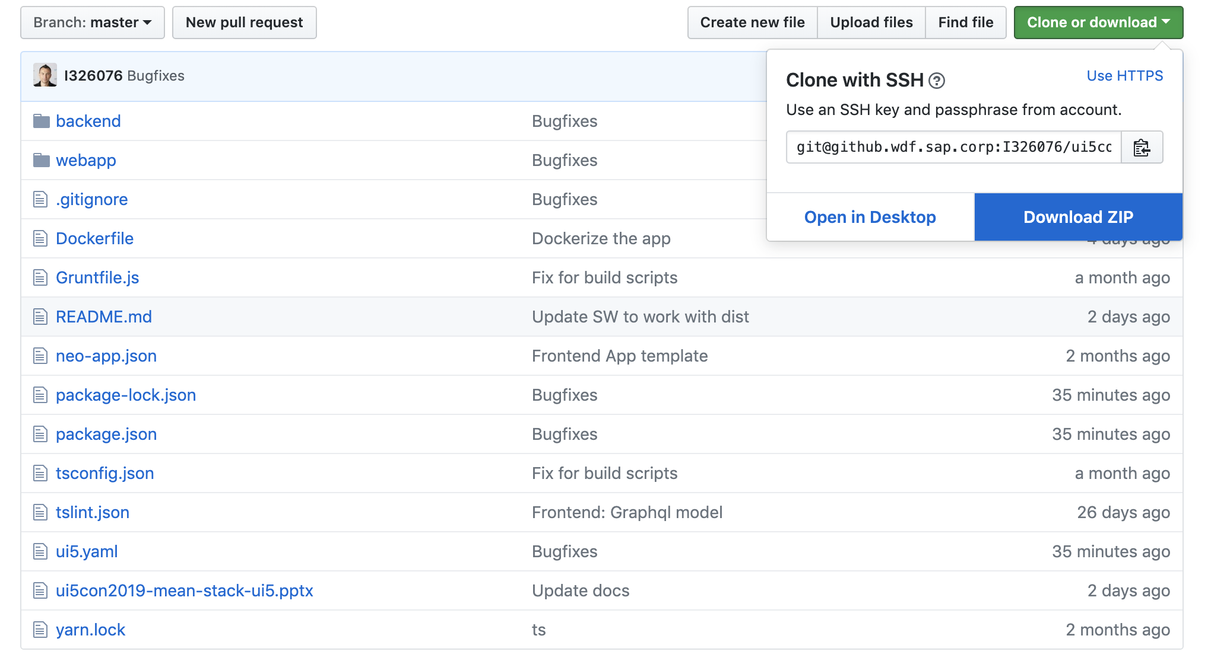
Session Structure

Slide 6
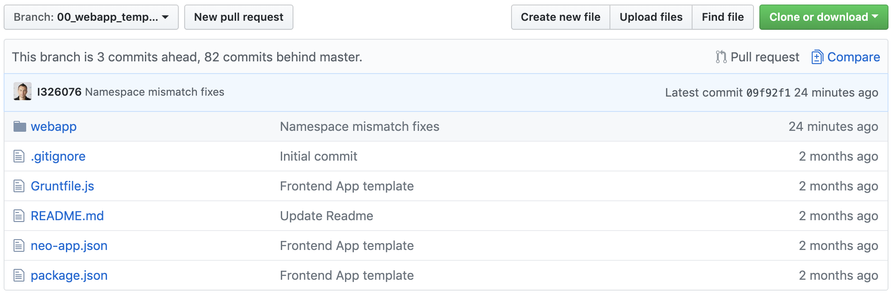
Session Structure

Slide 7
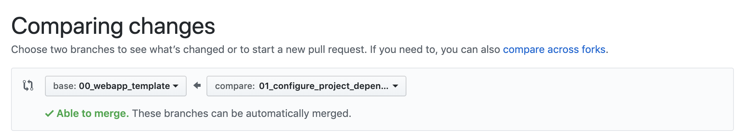
Session Structure

Slide 8
Let’s Code

Slide 9

TypeScript

Slide 10

GraphQL
A query language for your API
GraphQL is a query language for APIs and a runtime for fulfilling those queries with your existing data. GraphQL provides a complete and understandable description of the data in your API, gives clients the power to ask for exactly what they need and nothing more, makes it easier to evolve APIs over time, and enables powerful developer tools.

Slide 11
PWA
Progressive Web Apps are user experiences that have the reach of the web, and are:
Reliable - Load instantly and never show the downasaur, even in uncertain network conditions.
Fast - Respond quickly to user interactions with silky smooth animations and no janky scrolling.
Engaging - Feel like a natural app on the device, with an immersive user experience.
This new level of quality allows Progressive Web Apps to earn a place on the user's home screen.

Slide 12
Resources
UI5 Tooling
https://github.com/SAP/ui5-tooling
https://github.com/SAP/ui5-typescript
TypeScript
https://www.typescriptlang.org/
https://palantir.github.io/tslint/
PWA
https://developers.google.com/web/progressive-web-apps/
Express
https://expressjs.com/
MongoDB
https://www.mongodb.com/
GraphQL
https://graphql.org/
https://www.apollographql.com/
https://medium.freecodecamp.org/how-to-set-up-a-graphql-server-using-node-js-express-mongodb-52421b73f474

Slide 13
Thank you.
Contact information:
Yavor Ivanov
yavor.Ivanov@sap.com
@d3xter666 d3xter666
Petya Markova-Bogdanova
petya.markova-bogdanova@sap.com

