Slide 1
EPAM DevOps Summer Program 2021
Oleg Shmyrin
Final Project: https://github.com/OlegShmyrin/spring-petclinic

Slide 2
In this project I want to emulate deployment steps for Java SpringBoot application PetClinic from github CVS to “stage” environment in AWS cloud.
I managed to implement such steps:
Run maven tests of application in docker container on local Jenkins node launched in VirtualBox
Initialise AWS instance (AppServer) with Terraform from Jenkins node launched on AWS EC2
Prepare AppServer required for application with Ansible
Build application JAR artifact on AWS Jenkins node
Deliver application artifact to AppServer
Run application on AWS AppServer

Slide 3
Application deployment steps
local PC
Application code on github repository
VirtualBox
Jenkins AWS node
AppServer in AWS
Docker

Slide 4
Build Environment
local PC
Java
Maven
Terraform
Ansible
AWS Jenkins node
Java
PetClinic APP
AWS AppServer
Jenkins master
Local Jenkins node with Docker
VirtualBox VM1
VirtualBox VM2
Application code on github repository

Slide 5
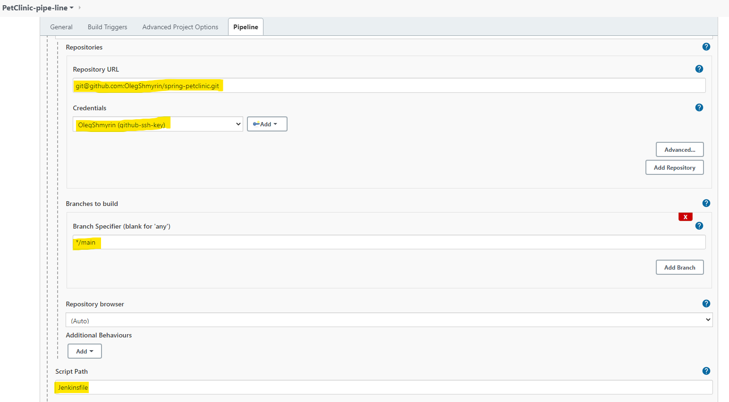
Jenkins Pipeline configuration

Slide 6
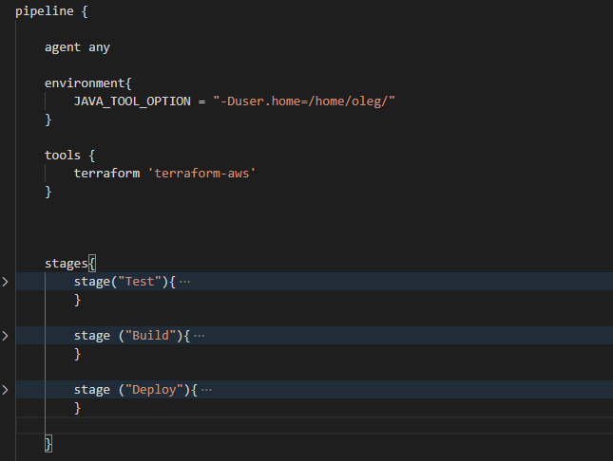
Jenkins Pipeline configuration
Jenkinsfile contains only 3 stages:
Test
Build
Deploy

Slide 7
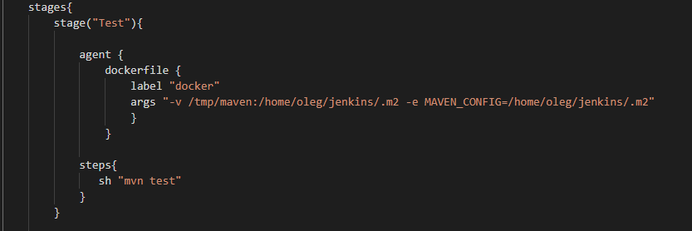
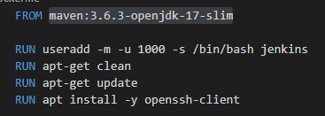
Test Stage
I decide run tests that contains PetClininic application in docker maven image maven:3.6.3-openjdk-17-slim
Test will run on local Jenkins node labeled with “docker”. To make this I call docker module in pipeline:
This module read Dockerfile from root directory of repository:

Slide 8
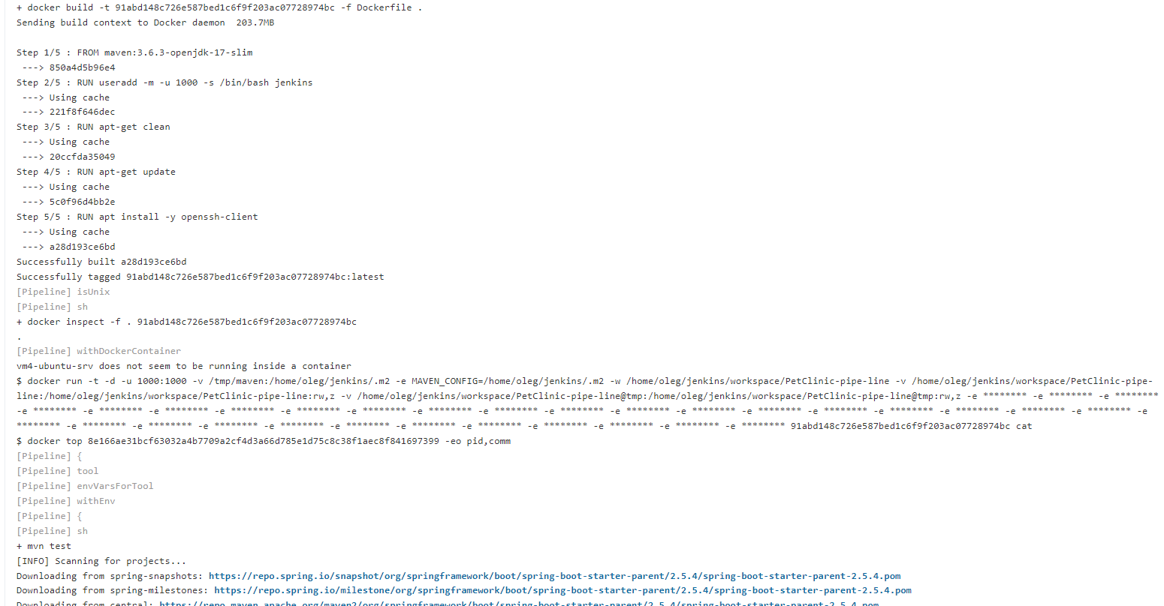
Test Stage
And runs docker with args that listed on screenshot.
-v -- mount local directory inside docker image, to store maven dependencies
-e -- says where to store maven config

Slide 9
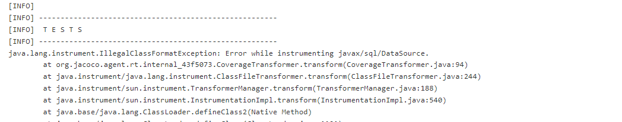
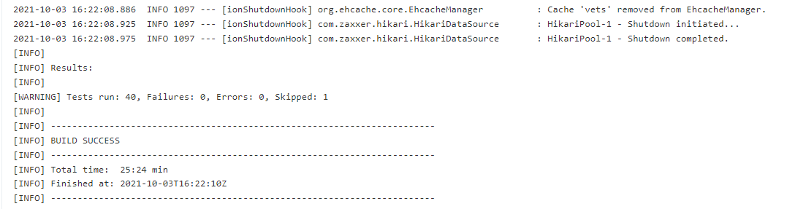
Test stage
mvn test -- start compile project and runs all test from /src/test

Slide 10
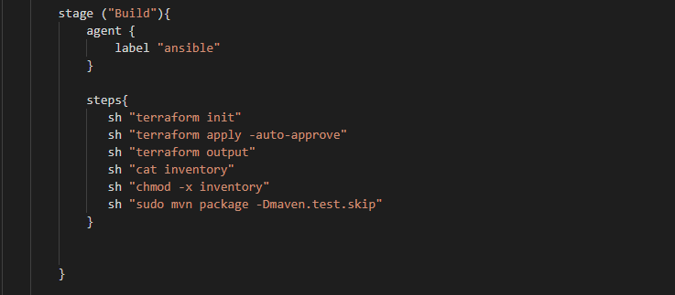
Build Stage
Build stage runs on AWS Jenkins node labeled as “ansible”

Slide 11
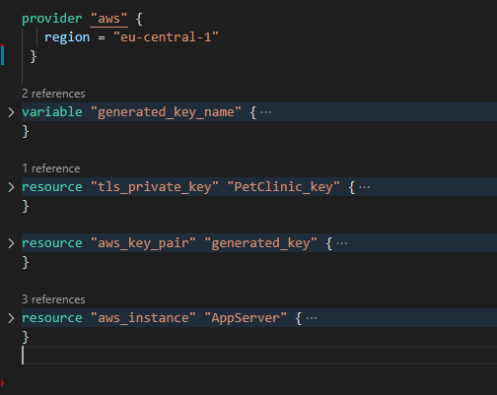
Build Stage
sh "terraform init"
sh "terraform apply -auto-approve"
This commands runs Terraform. Terraform read main.tf file and initiate and runs required server with ssh key generation.

Slide 12
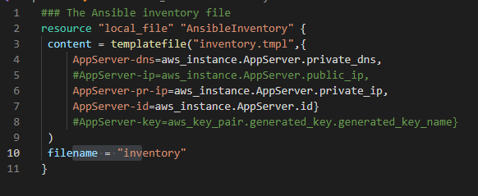
Build stage
sh "terraform output"
This command generate desired outputs variables, based on outputs.tf file
And makes inventory file for Ansible, based on inventory.tmpl file

Slide 13
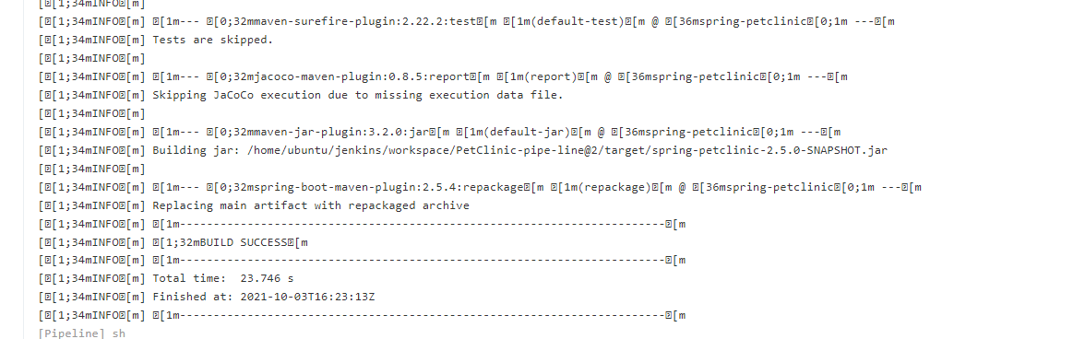
Build stage
sh "sudo mvn package -Dmaven.test.skip"
In this step we build jar artifact on AWS jenkins node.

Slide 14
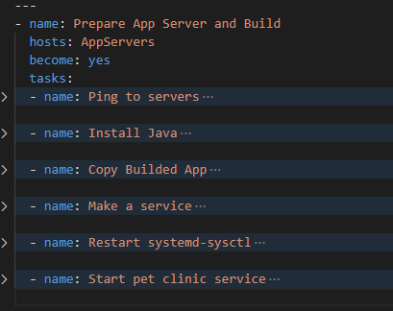
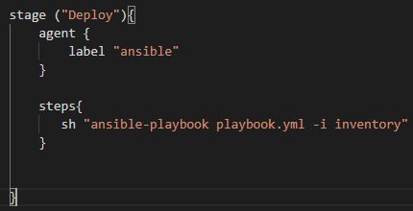
Deploy stage
Deploy stage runs with command
sh "ansible-playbook playbook.yml -i inventory"
on AWS Jenkins node and configure AppServer with Ansible from playbook.yml file.

Slide 15
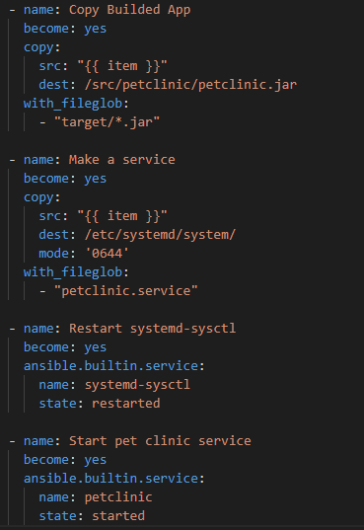
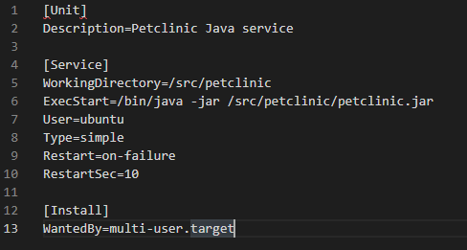
Deploy stage

Slide 16
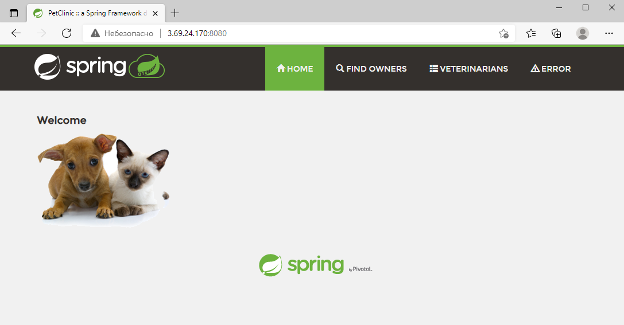

Results
We receive running application on AWS cloud server.

Slide 17
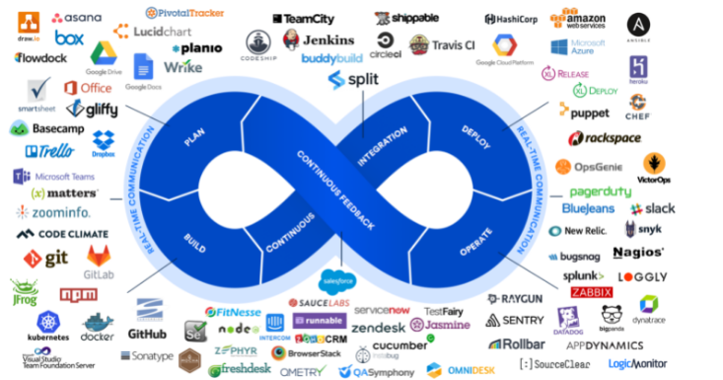
TODO steps
Use mysql database instead H2
Add nginx proxy before app
Make one more AppServer in another availability zone and use balancer
…

Slide 18
Thank You for lessons!

