Slide 1
FIRST DEMO: IF-056 Java
 | Team members: Yuriy Tymchiy Rostislav Vinner Yuriy Baklitskyy Yuriy Chikch Oleg Svyryd Volodymyr Yevdoshenko
Copyright © 2015 SoftServe, Inc.

Slide 2
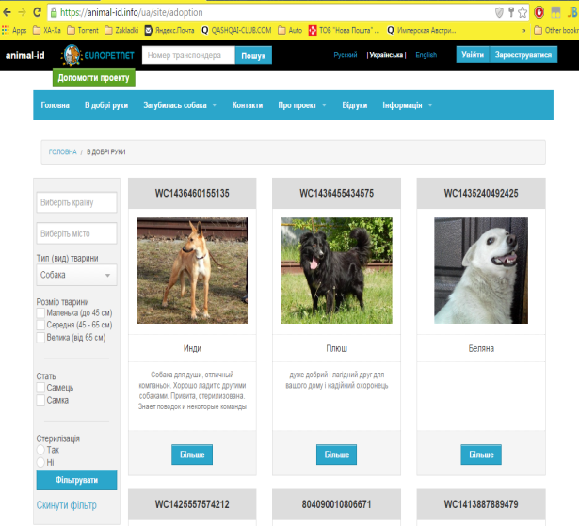
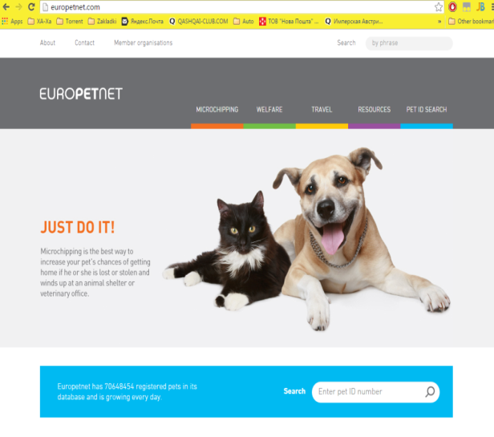
Technical requirements
Need to implement а system with following functions:
Clients: Simple users, Vets, Dog training associations, Housing offices, Customer
Possibilities: Finding lost pets service, Own pets registration, Adoption service, Homeless animals registration, Personal page for users, etc.
Customer opportunities: Managing all animals, Managing users, Receipt of charitable contributions

Slide 3
Stack of technologies
Java 7
Idea with CheckStyle plugin
Maven3
Log4j
Junit
Jersey
MySQL throw MyBatis v.3
OAuth2
Jenkins, Github
AngularJS with Bootstrap v.3.

Slide 4
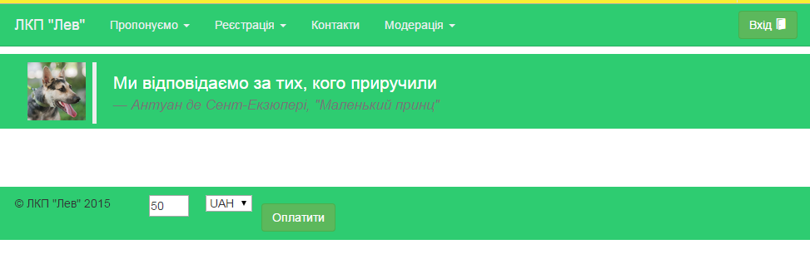
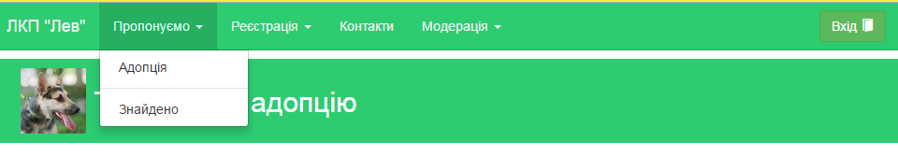
UI design

Slide 5
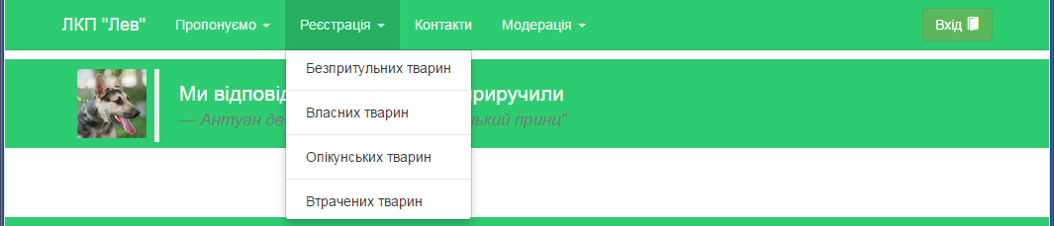
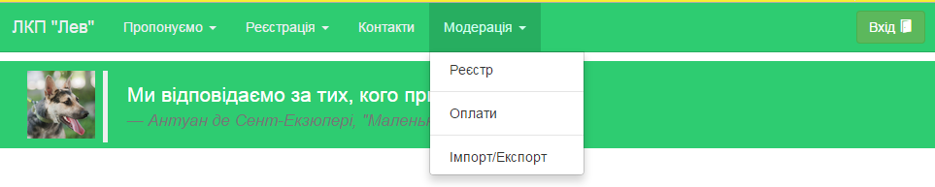
UI design

Slide 6
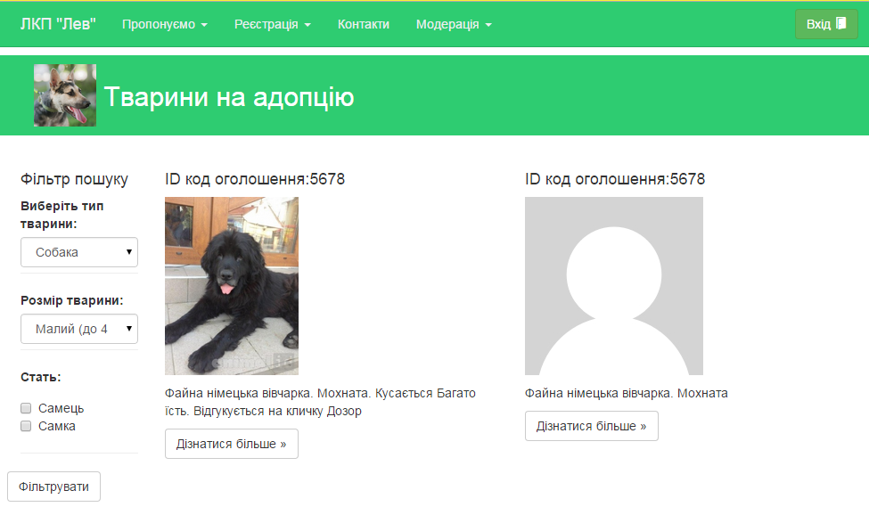
UI design

Slide 7
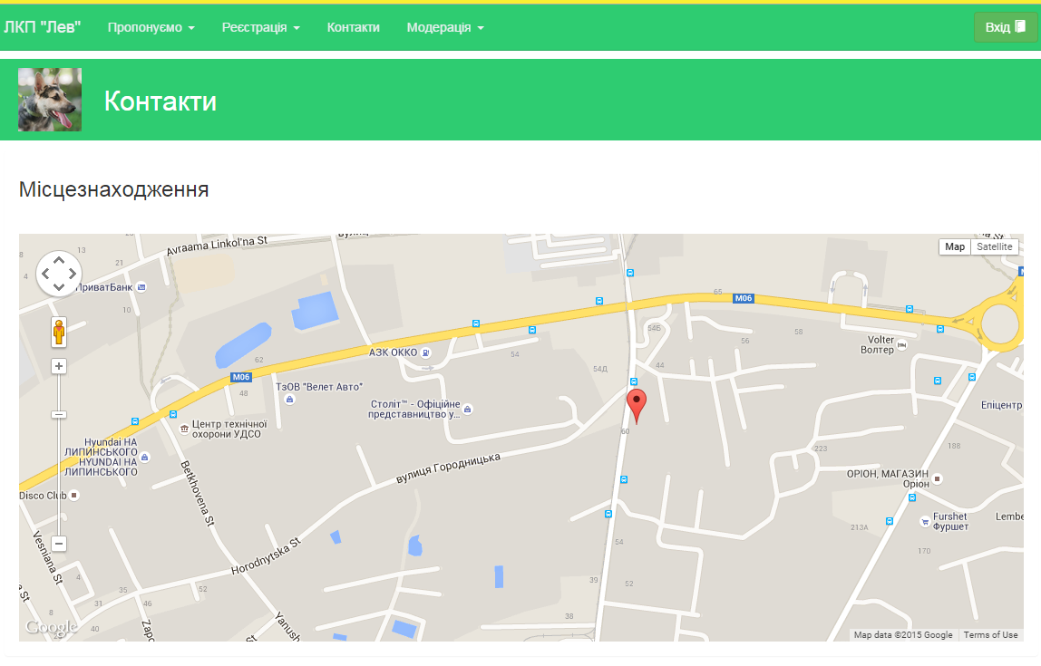
UI design

Slide 8
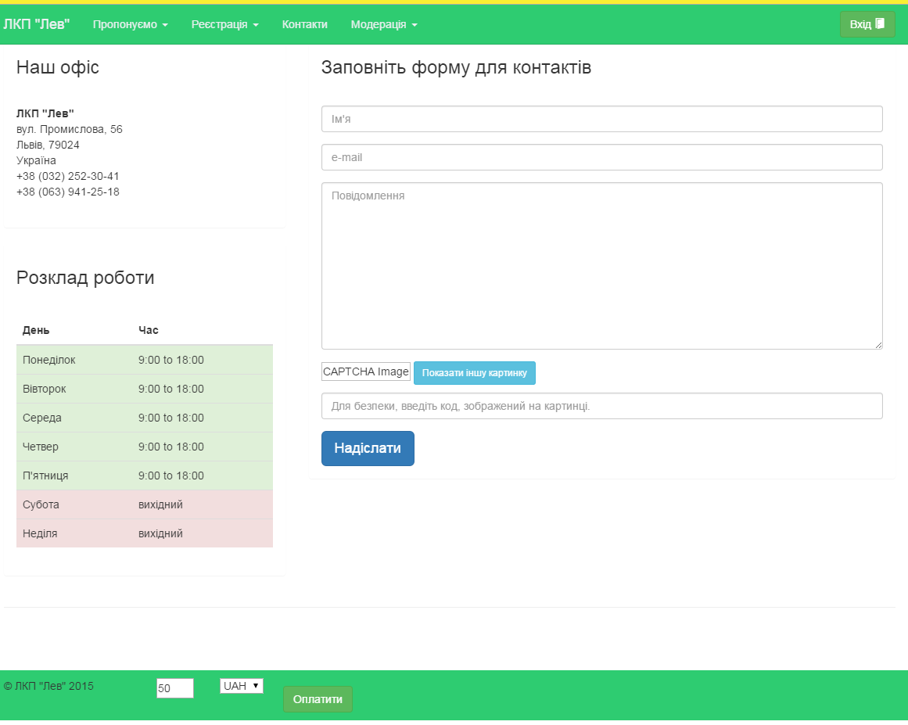
UI design

Slide 9
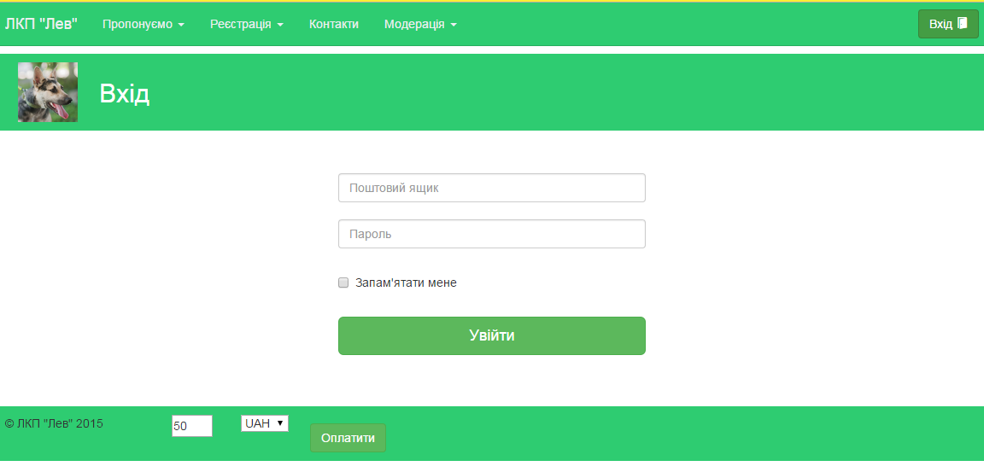
UI design

Slide 10
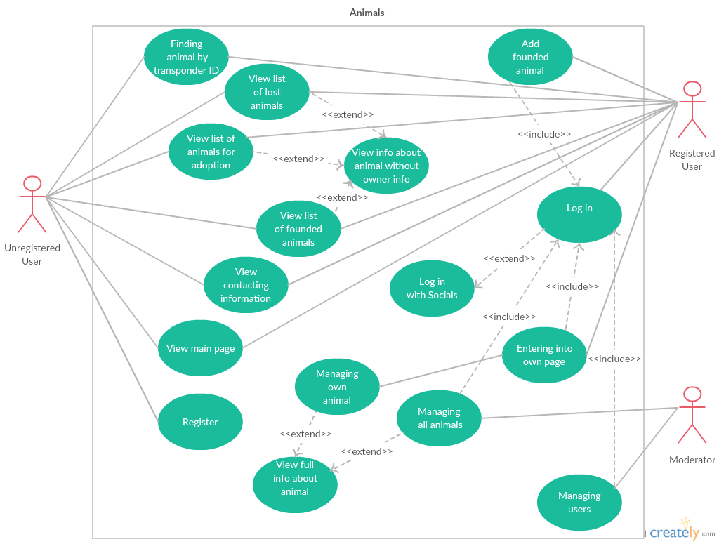
Project
Use Case Diagram

Slide 11
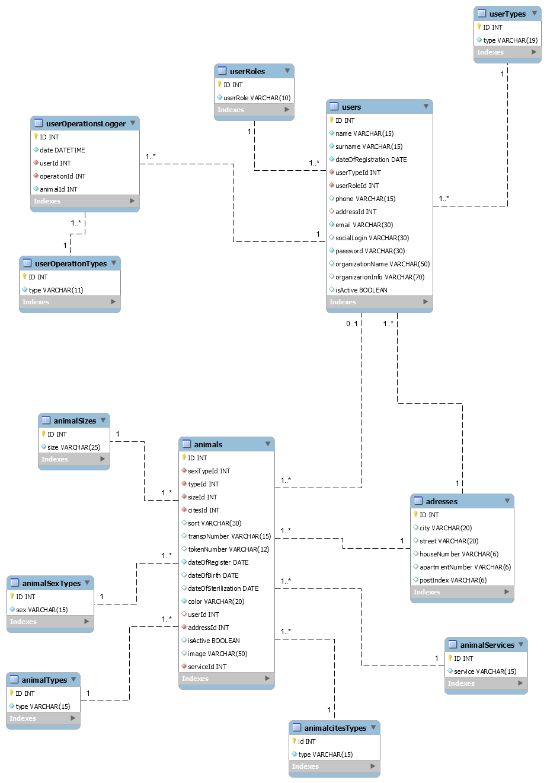
Project
Database structure

Slide 12
Project: CI
Jenkins

Slide 13
Project: code
Domains with MyBatis

Slide 14
Project code
REST

Slide 15
Project code
Tests

Slide 16
Project: code
AngularJS

Slide 17



